Slide 1
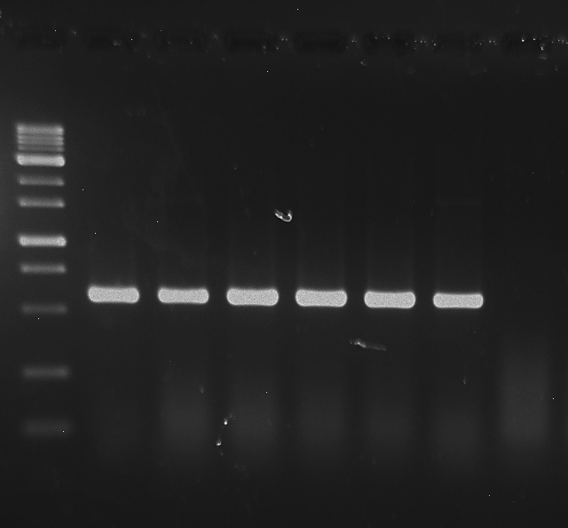
M
1
2
3
4
5
PC
NC
bp
1000
500
585 bp
250
100
Fig. S1. Representative photograph of PCR with DNA isolated from suspected E. coli colonies targeting E. coli specific malB gene. Lanes: 1-5, suspected E. coli colonies; PC, E. coli strain ATCC25922 (positive control); NC, S. enteritidis strain ATCC 13076; M, 1 kb DNA ladder, Promega. Electrophoresis was performed with 1.5% LE agarose (Promega) at 100 volt for 25 minutes in 1X TAE buffer.

Slide 2
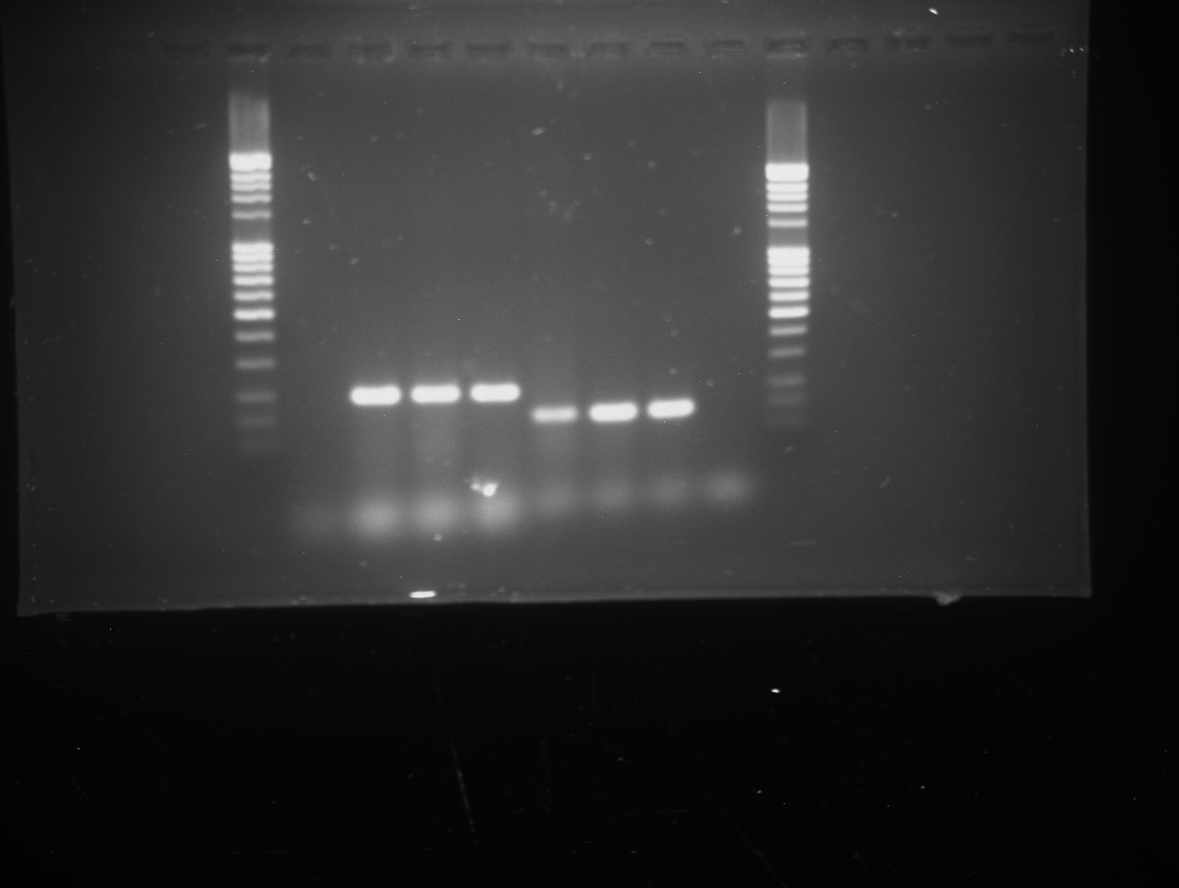
M
1
2
3
4
5
6
7
8
M
bp
1000
500
400
300
200
yjaA
150
TspE4c.2
100
Fig. S2. Representative photograph of phylogenetic grouping of E. coli isolates by PCR targeting the chuA, yjaA and DNA fragment TspE4.c2. Lanes: 1-7, E. coli isolated in this study; 8, E. coli strain ATCC25922 (control); M, 100 bp DNA ladder, Cleaver Scientific. Electrophoresis was performed with 1.5% LE agarose (Promega) at 100 volt for 25 minutes in 1X TAE buffer.

Slide 3
% of isolates resistant
Name of antibiotics
Fig. S3. Antimicrobial resistance pattern of the E. coli isolated in this study. Fourteen (14) different antimicrobials comprising 8 antimicrobial classes were used in this study. Antimicrobial discs were purchased from commercial sources (Oxoid, UK) and sensitivity pattern was determined by disc diffusion method. The experiment was performed at least three times and E. coli strain ATCC25922 was used as the control.

Slide 4
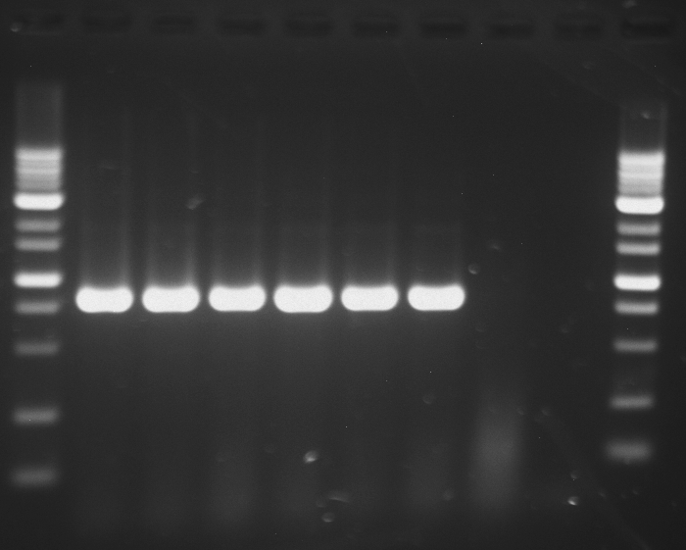
M
1
2
3
4
5
6
7
8
M
bp
1000
tetA
500
250
100
Fig. S4. Representative photograph of tetA gene amplification in the tetracycline resistant E. coli isolated in this study. Lanes: 1-7, E. coli isolated in this study; 8, E. coli strain ATCC25922 (control); M, 1 kb DNA ladder, Promega. Electrophoresis was performed with 1.5% LE agarose (Promega) at 100 volt for 25 minutes in 1X TAE buffer.

Slide 5
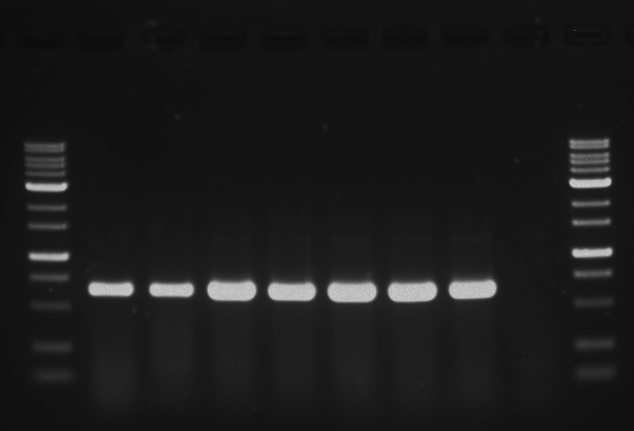
bp
M
1
2
3
4
5
6
7
8
M
1000
bla_{TEM-1}
500
250
100
Fig. S5. Representative photograph of bla_{TEM-1} gene amplification in the β-lactam resistant E. coli isolated in this study. Lanes: 1-7, E. coli isolated in this study; 8, E. coli strain ATCC25922 (control); M, 1 kb DNA ladder, Promega. Electrophoresis was performed with 1.5% LE agarose (Promega) at 100 volt for 25 minutes in 1X TAE buffer.

