Slide 1
Supplemental Table 1. Primers used in this study

Slide 2

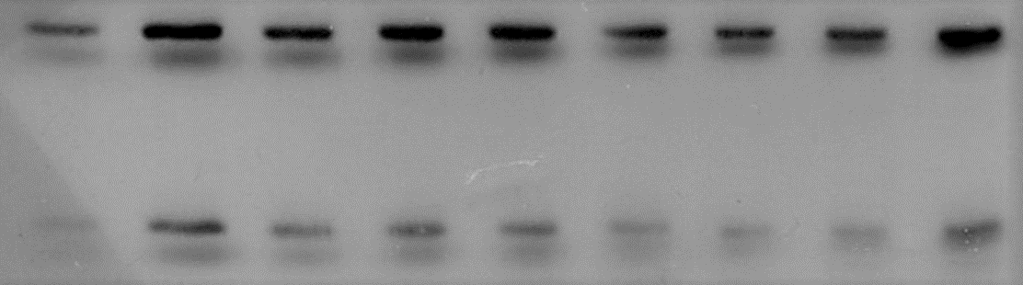

A
B
Recovery
Control Heat 5 min 30 min 1 h 3 h 6 h 24 h 72 h
HSP70
HSP101
APX1
Coomassie Blue staining
HSP70
HSP101
APX1
Relative protein level
Relative protein level
Relative protein level
1 h
3 h
6 h
24 h
72 h
1 h
3 h
6 h
24 h
72 h
1 h
3 h
6 h
24 h
Control
72 h
Heat
5 min
30 min
Control
Heat
5 min
30 min
Control
Heat
5 min
30 min
Recovery
Recovery
Recovery
Supplemental Figure 1. Accumulation of stress response proteins during recovery phase following the application of heat stress for 45 min. Plants were exposed to 45 min heat stress followed by recovery for 5 min to 72 h. (A) Accumulation of proteins determined by Western blotting. (B) Quantification of protein accumulation in A by Image J, version 6. Bars indicate standard error (n=3). Shaded color on the graphs indicate heat stress treatment.

Slide 3
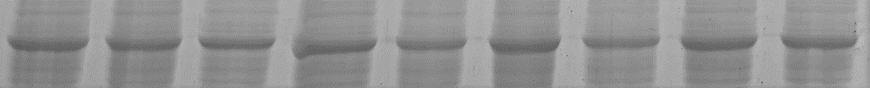
A
B
Recovery
Control Heat 5 min 30 min 1 h 3 h 6 h 24 h 72 h
HSP70
HSP101
APX1
Coomassie Blue staining
HSP70
HSP101
APX1
Relative protein level
**
Relative protein level
Relative protein level
**
**
**
**
**
**
**
1 h
3 h
6 h
24 h
72 h
1 h
3 h
6 h
24 h
72 h
1 h
3 h
6 h
24 h
Control
72 h
Heat
5 min
30 min
Control
Heat
5 min
30 min
Control
Heat
5 min
30 min
Recovery
Recovery
Recovery
Supplemental Figure 2. Accumulation of stress response proteins during recovery phase following the application of heat stress for 5 min. Plants were exposed to 5 min heat stress followed by recovery for 5 min to 72 h. (A) Accumulation of proteins determined by Western blotting. (B) Quantification of protein accumulation in A by Image J, version 6. **; Student’s t-test significant at p<0.01 compared to control. Bars indicate standard error (n=3). Shaded color on the graphs indicate heat stress treatment.

Slide 4
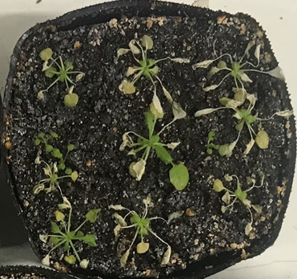
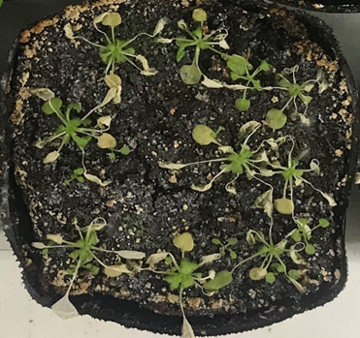
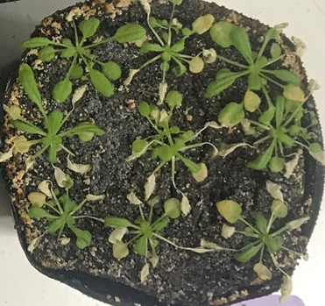
No Acc
1 h recovery
3 h recovery
Supplemental Figure 3. Pictures of plants acclimated by 5 min heat stress followed by different durations of recovery. Bar indicate 5 cm.

