Slide 1
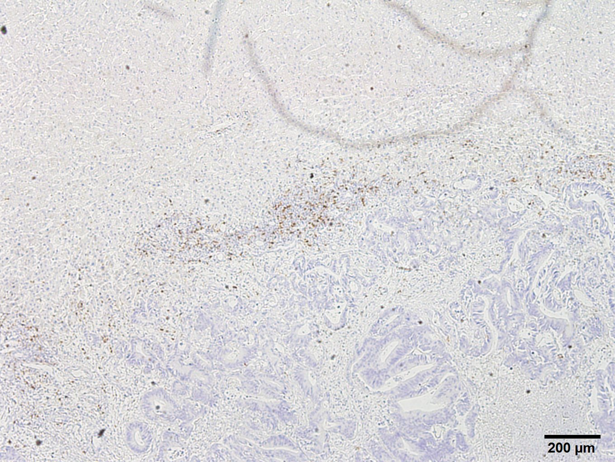
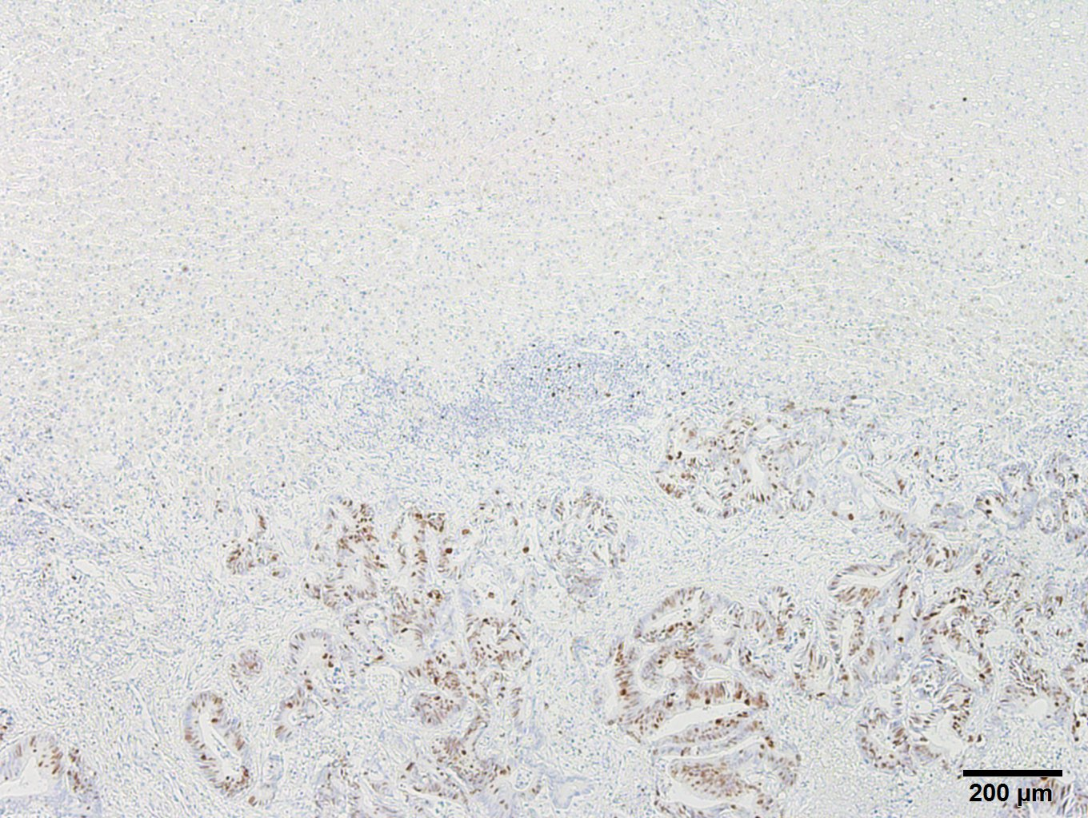
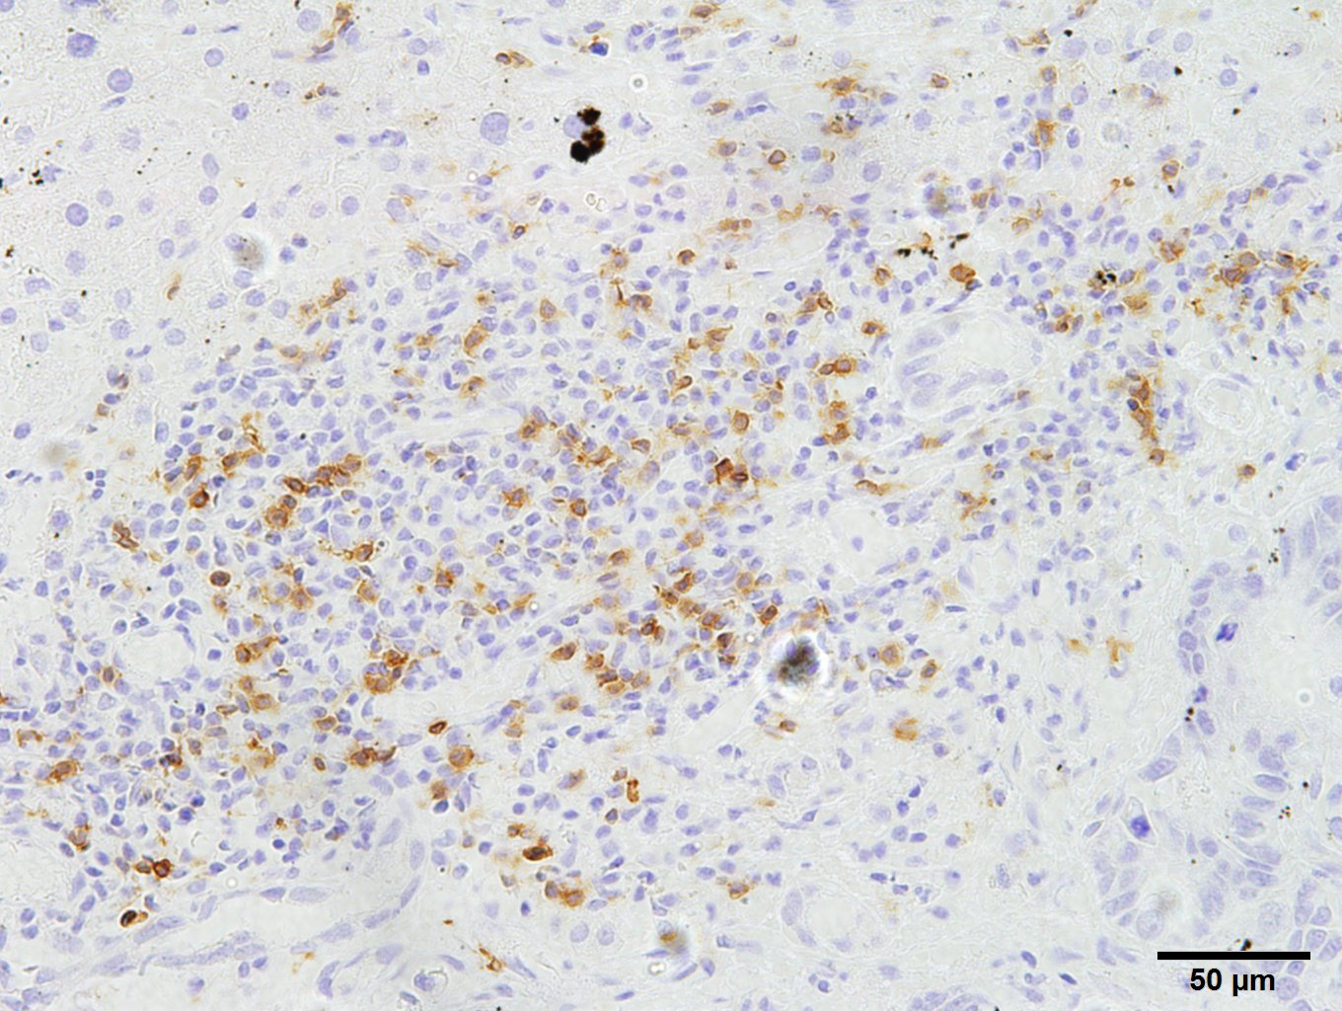
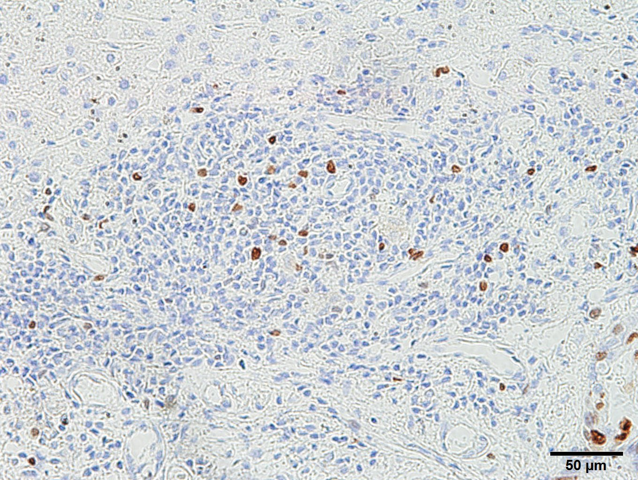
Supplementary Figure 3
A
B
CD8
Ki-67
Survival probability
1.0
0.8
0.6
0.4
High
Middle
Low
0.2
Log-rank test for trend
P = 0.69
0.0
0
1
2
3
4
5
Overall survival (years)
Survival probability
1.0
High
Middle
Low
0.8
0.6
0.4
0.2
Log-rank test for trend
P = 0.94
0.0
0
1
2
3
4
5
Relapse-free survival (years)
Supplementary Figure. 3. Expression of Ki-67 on CD8⁺ T cells.
(A) Immunohistochemical staining of Ki-67. (B) Overall survival and relapse-free survival after curative resection of colorectal cancer liver metastases, grouping number of Ki-67⁺/CD8⁺ T-cell numbers into tertiles.

