Slide 1
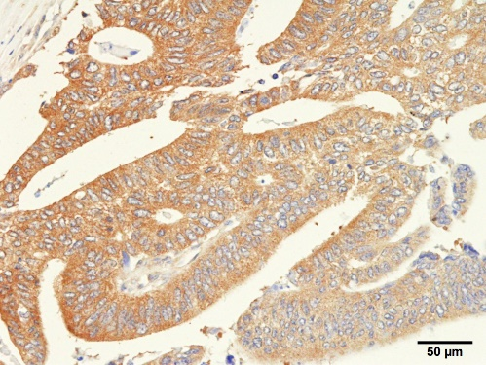
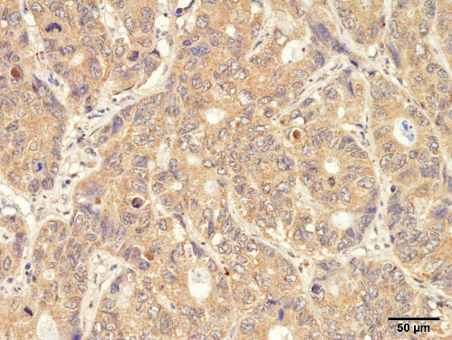
Supplementary Figure 6
A
B
9
9
8
P = 0.11
8
P = 0.41
7
7
6
6
5
5
IL-6 score
TNFα score
4
4
3
3
2
2
1
1
0
F. nucleatum
Negative (n = 173)
F. nucleatum
Positive (n = 8)
0
F. nucleatum
Negative (n = 173)
F. nucleatum
Positive (n = 8)
Supplementary Figure. 6. Relationship between F. nucleatum and inflammatory cytokines in colorectal cancer liver metastasis.
(A) Expression of interleukin-6 according to the F. nucleatum DNA status. (B) Expression of tumour necrosis factor-alpha according to the F. nucleatum DNA status.

