Slide 1
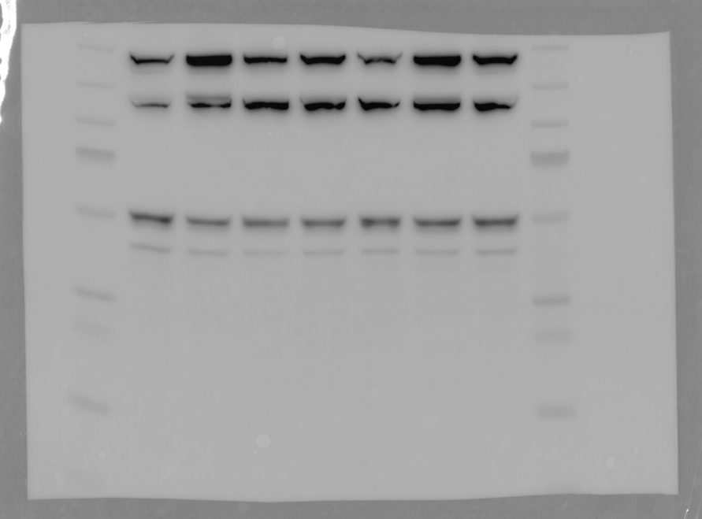
Fig 1B Caspase1_Niclosamide
- 10 20 40 60 120 180 min
190
115
80
70
50
30
25
15

Slide 2
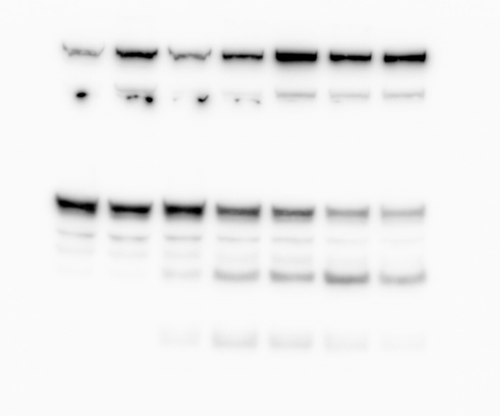
Fig 1B Caspase1_GasderminD_Nigericin
- 10 20 40 60 120 180 min
50
30
25
15

Slide 3
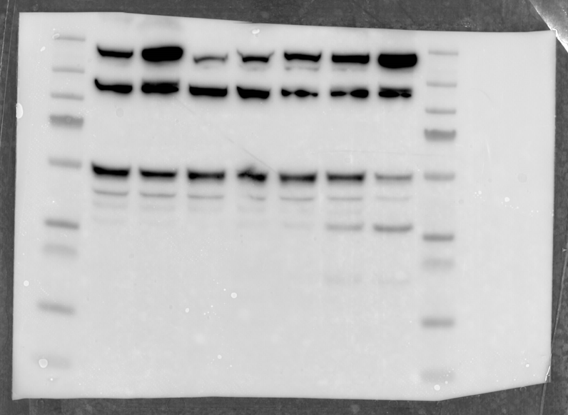
Fig 1B Caspase1_GasderminD_Gramicidin
- 10 20 40 60 120 180 min
50
30
25
15

Slide 4
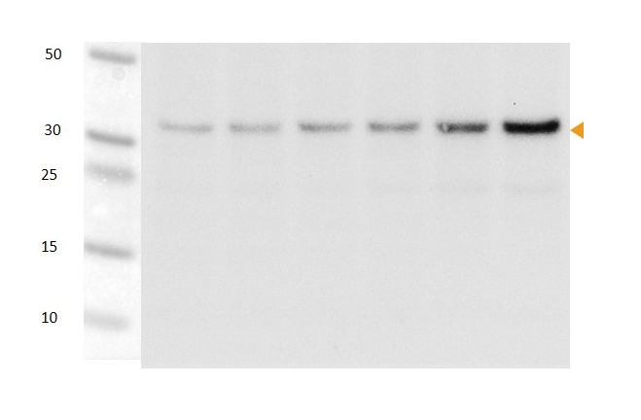
Fig 1B GasderminD_Niclosamide (long time course)
- 60 120 180 240 300 min

Slide 5
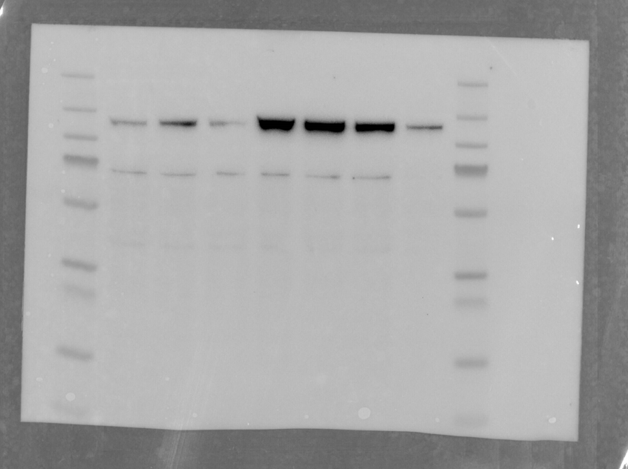
Fig 1B PhosphoPKD_Gramicidin
- 10 20 40 60 120 180 min
190
115
80
70
50
30
25
15

Slide 6
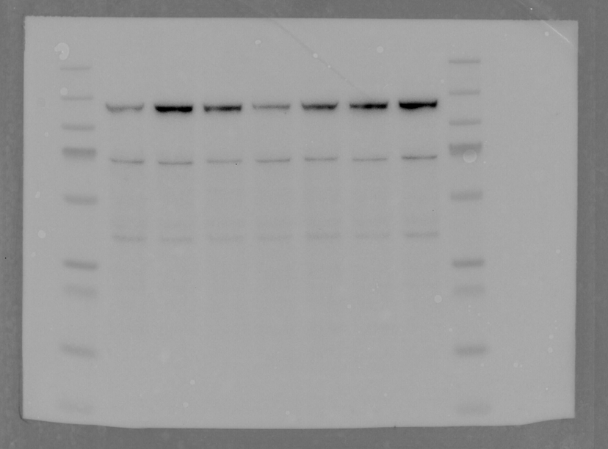
Fig 1B PhosphoPKD_Niclosamide
- 10 20 40 60 120 180 min
190
115
80
70
50
30
25
15

Slide 7
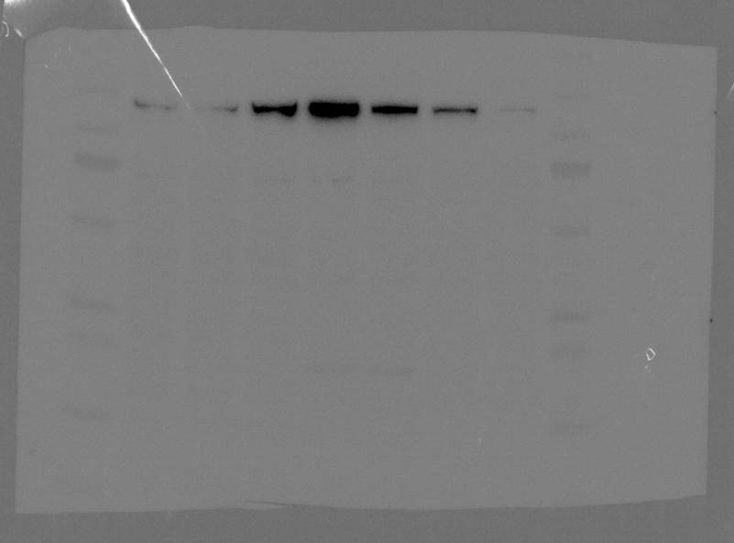
Fig 1B PhosphoPKD_Nigericin
- 10 20 40 60 120 180 min
115
80
70
50
30
25
15

Slide 8
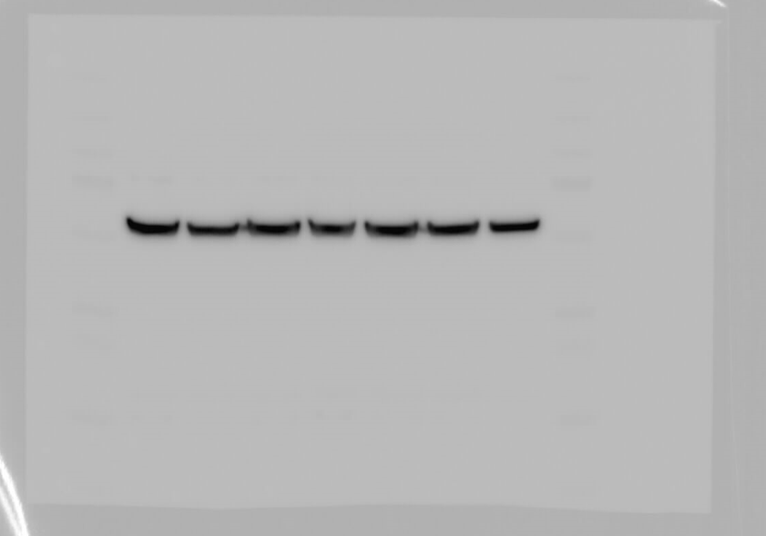
Fig 1B Tubulin_Gramicicin
- 10 20 40 60 120 180 min
190
115
80
70
50
30
25
15

Slide 9
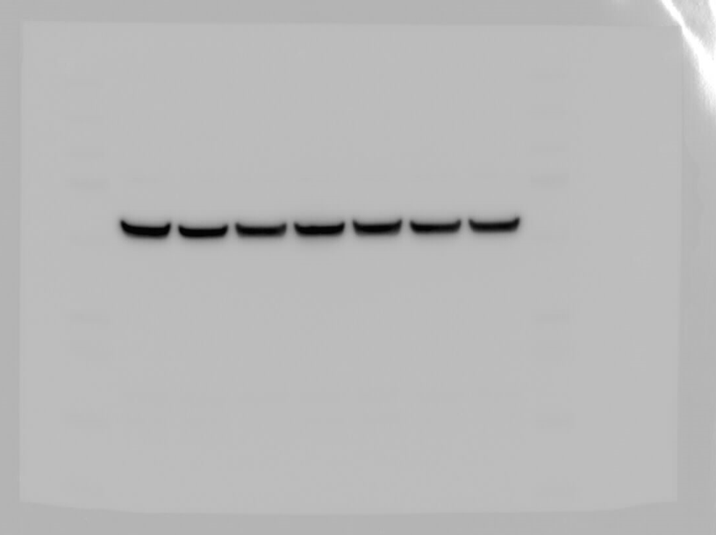
Fig 1B Tubulin_Niclosamide
- 10 20 40 60 120 180 min
70
50
30

Slide 10
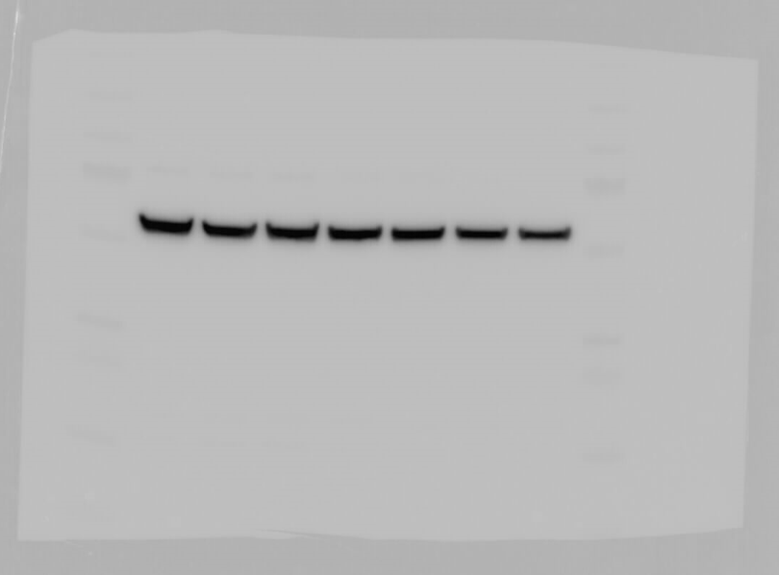
Fig 1B Tubulin_Nigericin
- 10 20 40 60 120 180 min
70
50
30

Slide 11
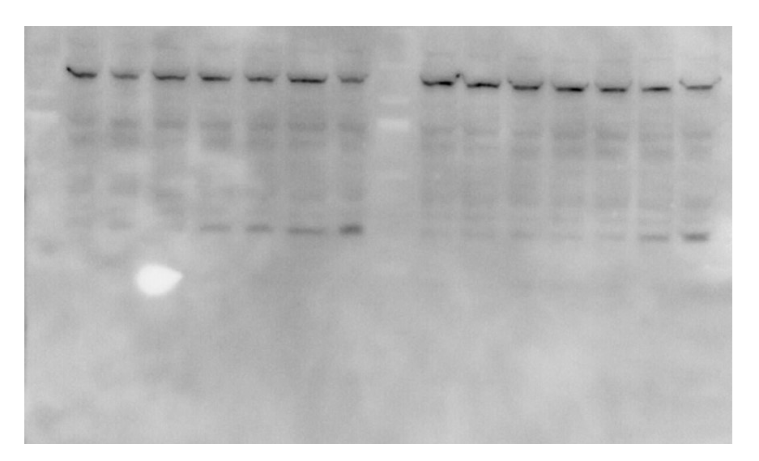
Fig 1C GasderminD
Time [min]
- 15 30 60 120 180 240
X X X X X X X
30

Slide 12
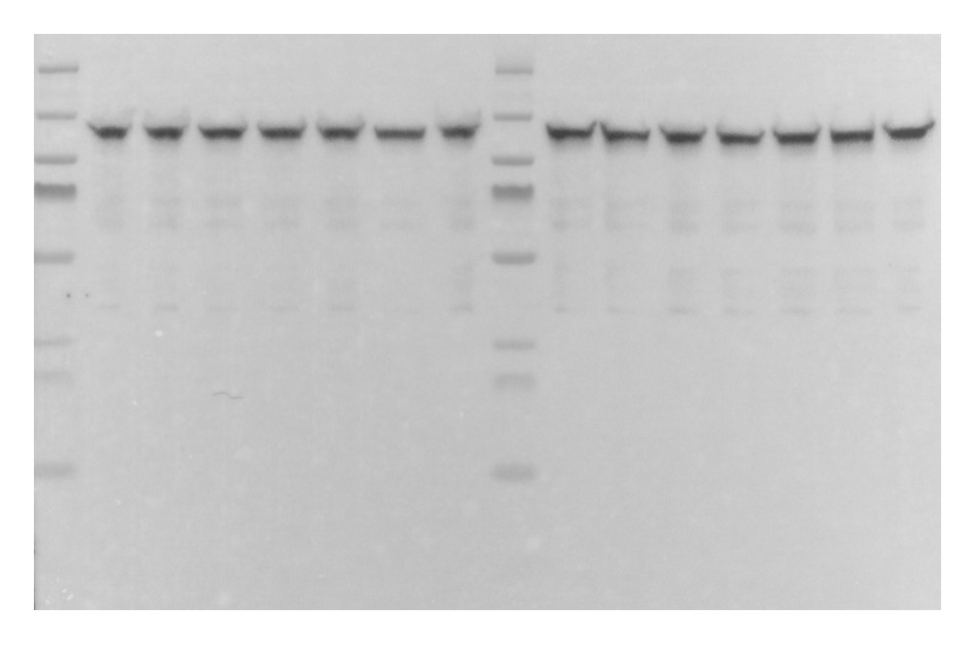
Fig 1C_PKD3
Time [min]
- 15 30 60 120 180 240
X X X X X X X
115
80
70

Slide 13
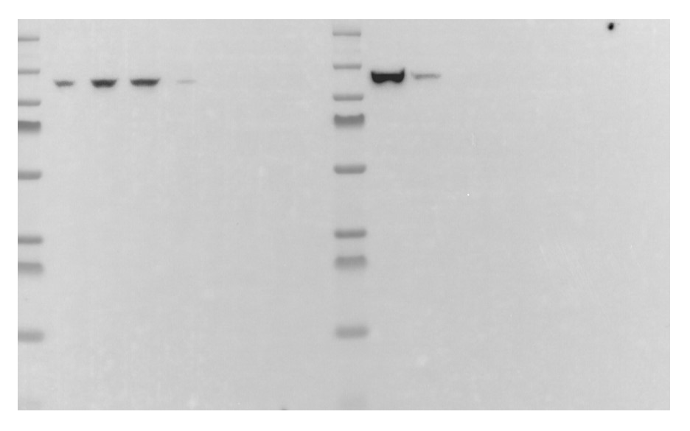
Fig 1C_PhosphoPKD
Time [min]
- 15 30 60 120 180 240
X X X X X X X
115
80
70

Slide 14
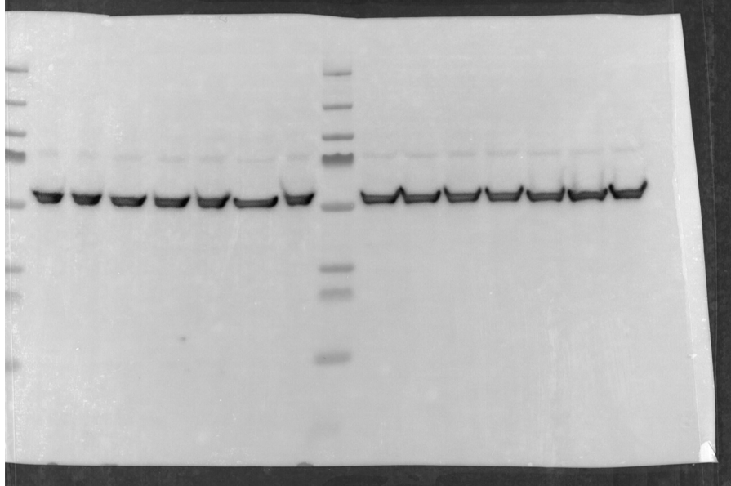
Fig 1C_Tubulin
Time [min]
X X X X X X X
- 15 30 60 120 180 240
70
50

Slide 15
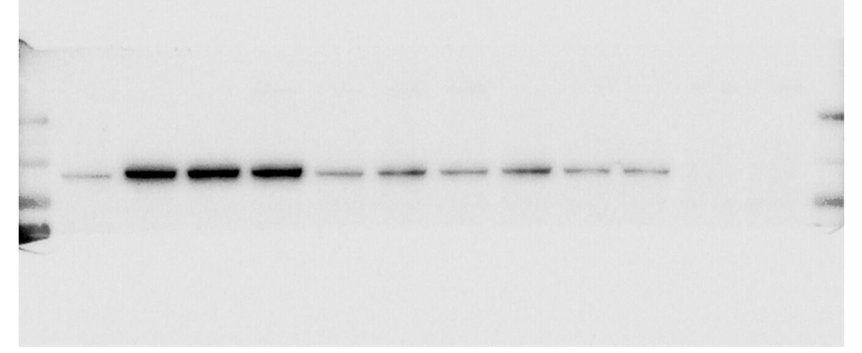
Fig 2A_PhosphoPKD
-
DMSO
X X X X X X X
CRT0066101
130
100

Slide 16
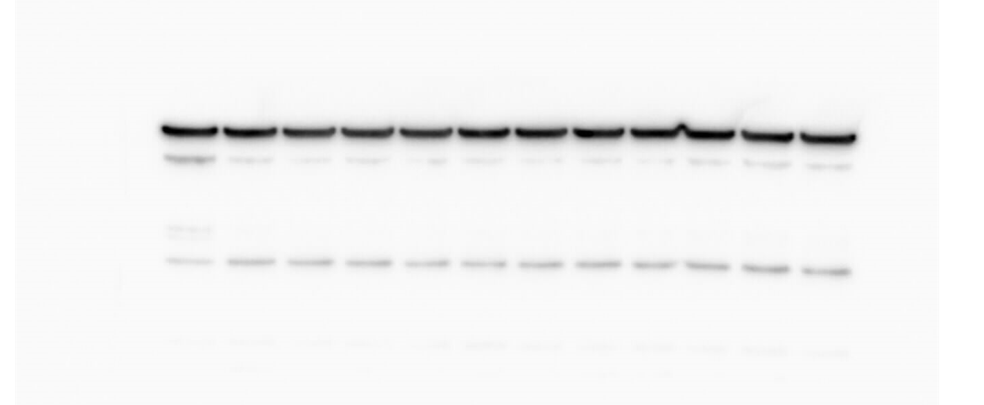
Fig 2A_Tubulin
-
DMSO
X X X X X X X
CRT0066101
55-

Slide 17
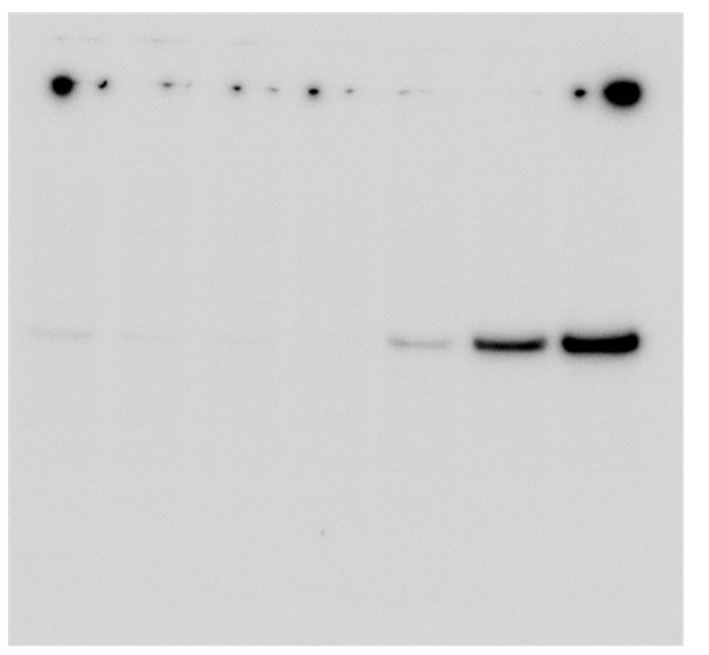
Fig 2C_Gasdermin D_5uM Nigericin
- 10 20 40 60 120 180

Slide 18
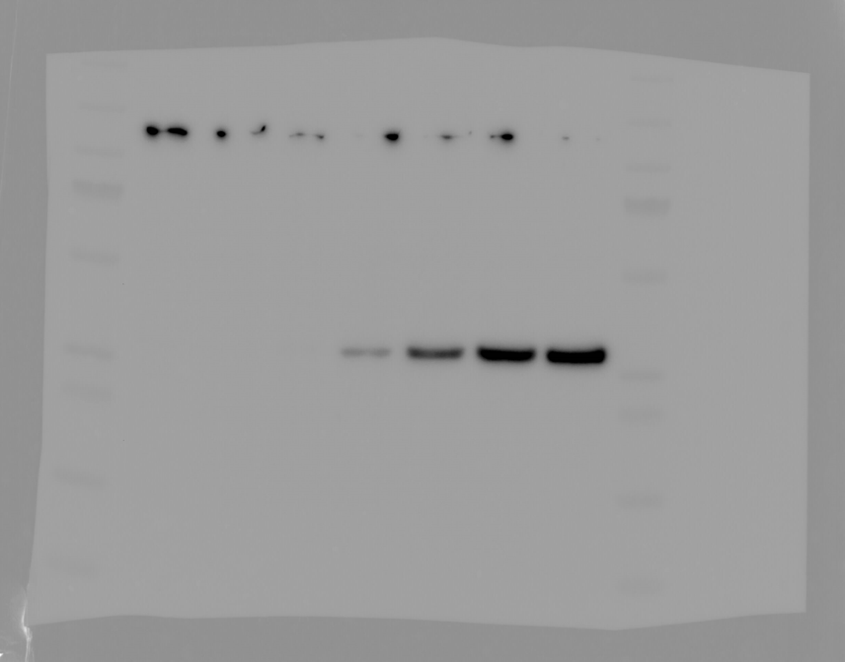
Fig 2C_Gasdermin D_15uM Nigericin
30
25
- 10 20 40 60 120 180

Slide 19
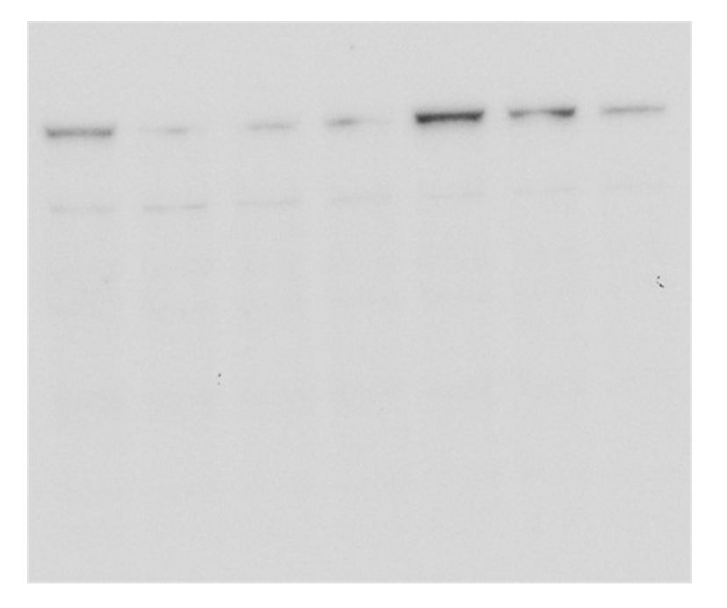
Fig 2C_phosphoPKD_5uM Nigericin
X 10 20 40 60 120 180

Slide 20
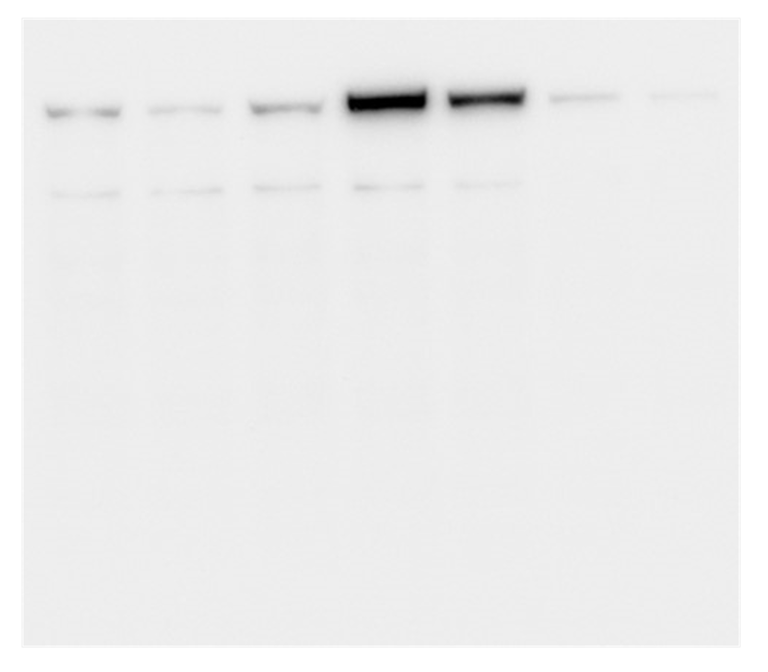
Fig 2C_phosphoPKD_15uM Nigericin
- 10 20 40 60 120 180

Slide 21

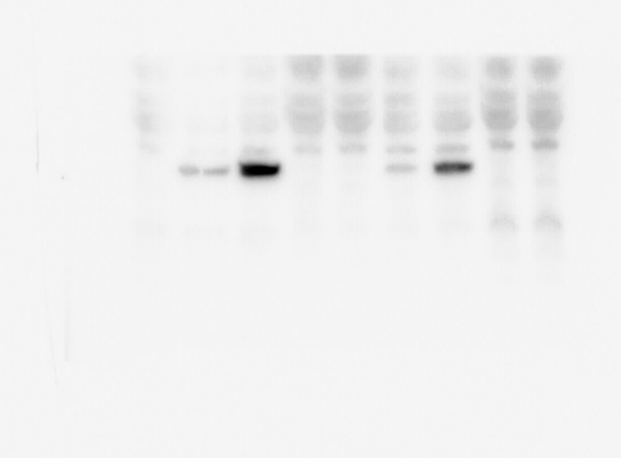
Fig 3A_Gasdermin D
30-

Slide 22
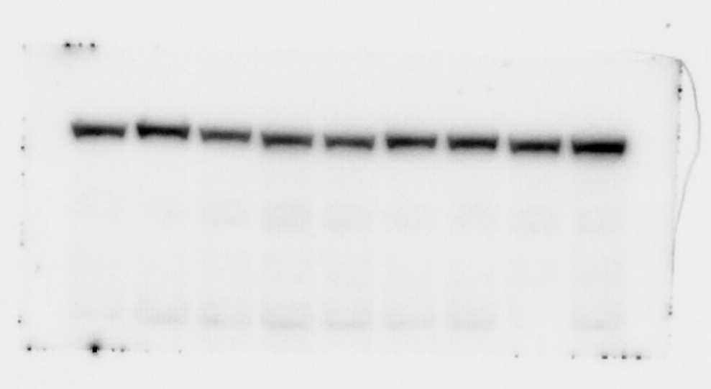
Fig 3A_PKD3
115-
80-

Slide 23
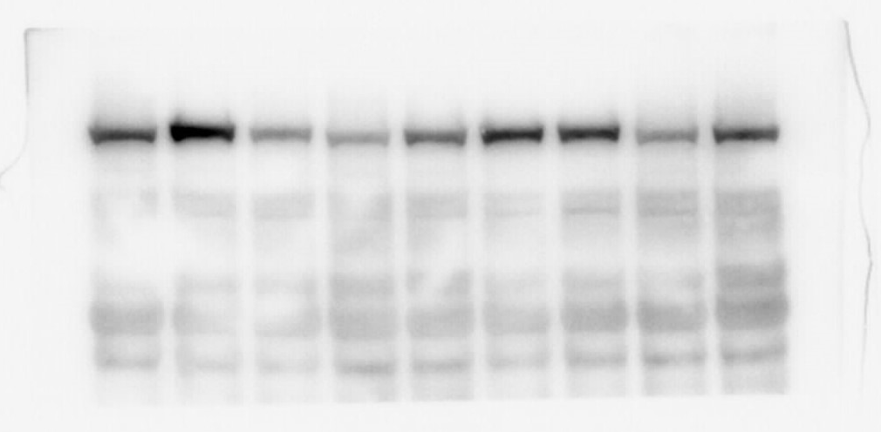
Fig 3A_phosphoPKD
115-
80-

Slide 24
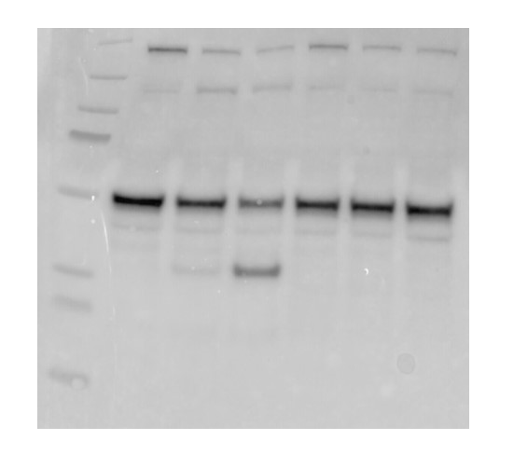
Fig 3B_Gasdermin D
NLRP3 WT
NLRP3 KO
nigericin
- 20’ 40’ - 20’ 40’
50
30

Slide 25
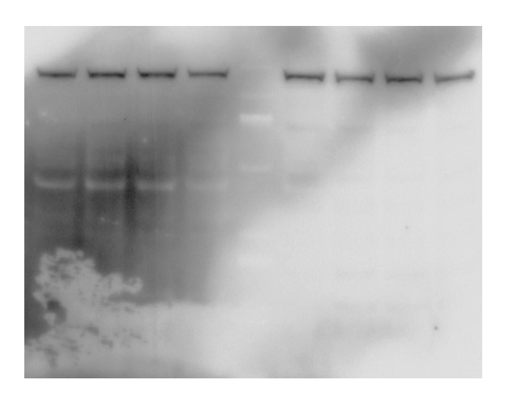
Fig 3B_PKD3
NLRP3 WT
NLRP3 KO
- 20’ 40’ X X - 20’ 40’ X
nigericin
115
80
70

Slide 26
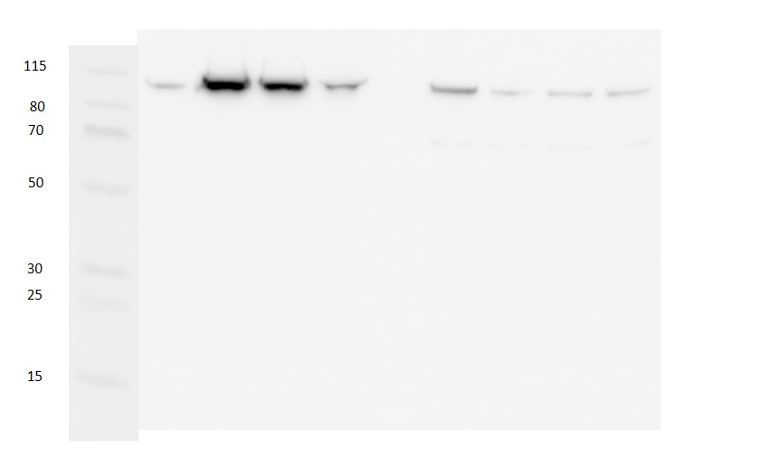
Fig 3B_phosphoPKD
NLRP3 WT
NLRP3 KO
- 20’ 40’ X X - 20’ 40’ X
nigericin

Slide 27

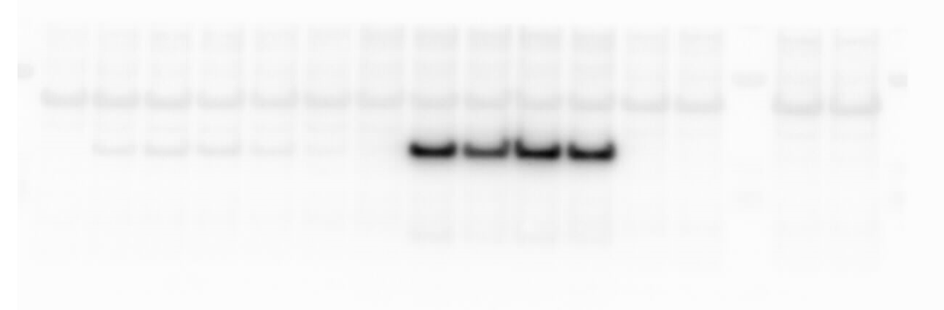
Fig 4A_Gasdermin D
Prgl
X X X X X X
30-

Slide 28
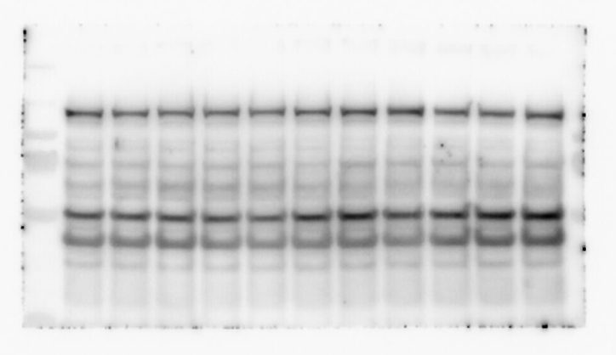
Fig 4A_PKD3
Prgl
115
80

Slide 29
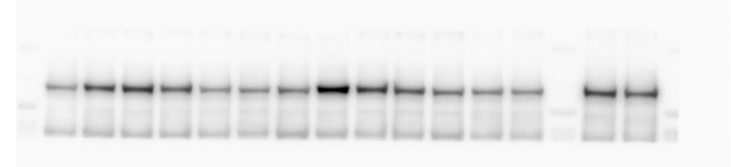
Fig 4A_phosphoPKD
Prgl
X X X X X X
190
80

Slide 30

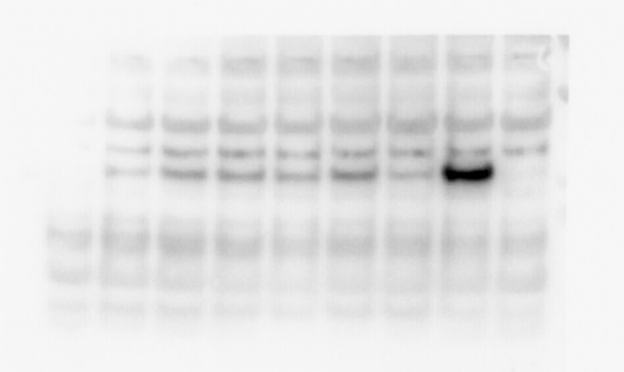
Fig 4B_Gasdermin D
-30

Slide 31
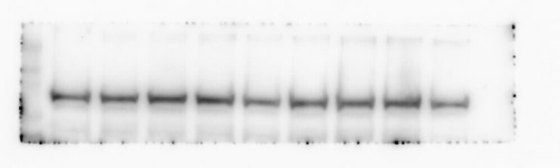
Fig 4B_PKD3
115
80

Slide 32
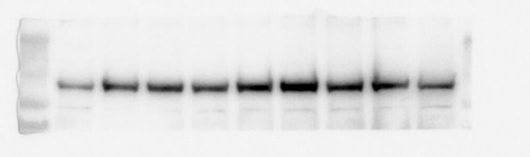
Fig 4B_Phospho-PKD
115
80

Slide 33
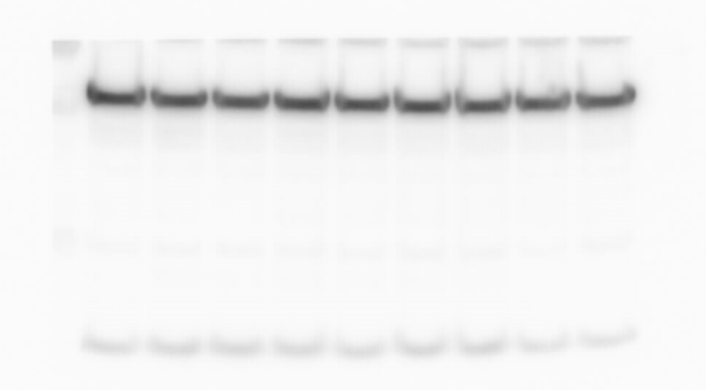
Fig 4B_Tubulin
50-

Slide 34

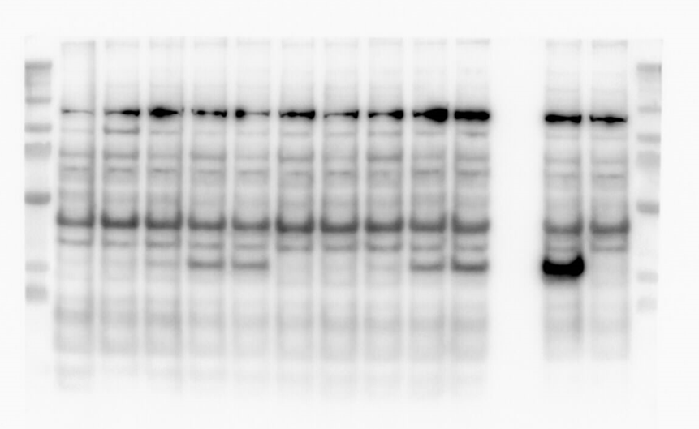
Fig 4C_Gasdermin D
X
X
30
30
25
25

Slide 35
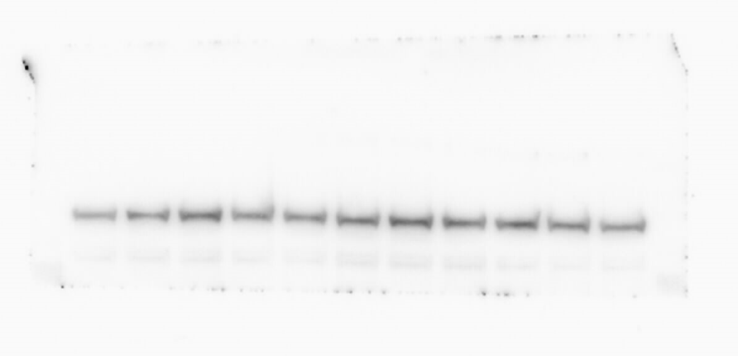
Fig 4C_PKD3

Slide 36
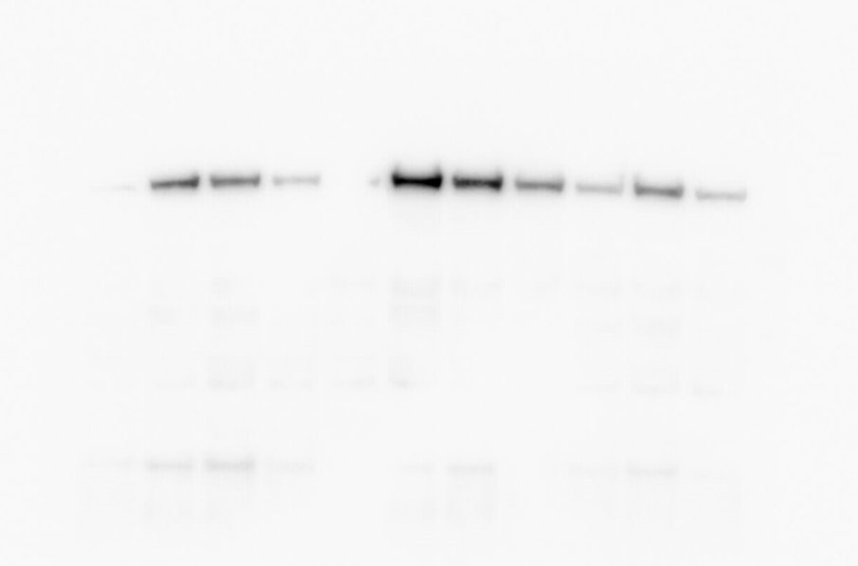
Fig 4C_PhosphoPKD

Slide 37
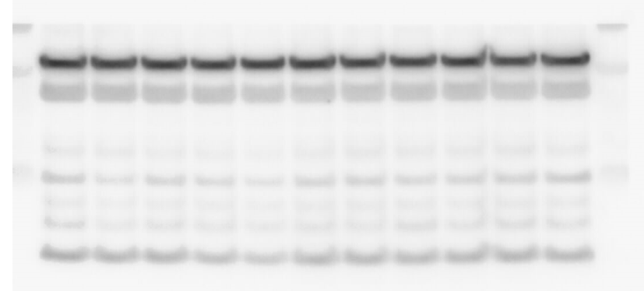
Fig 4C_Tubulin
50-

Slide 38

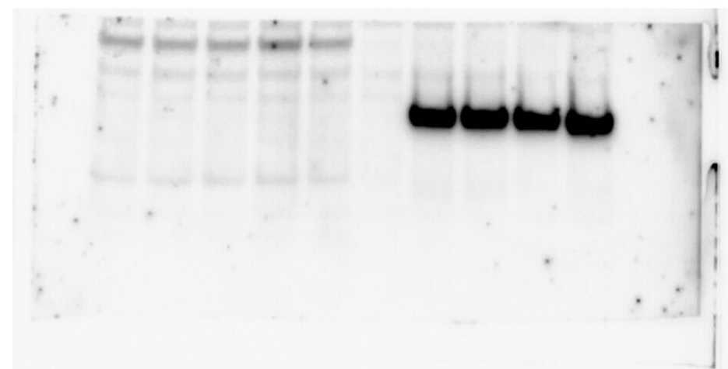
Fig 4D_Gasdermin D

Slide 39
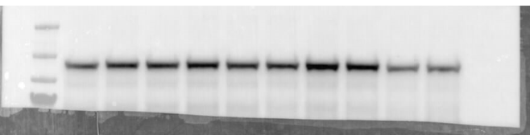
Fig 4D_PKD2
115
80

Slide 40
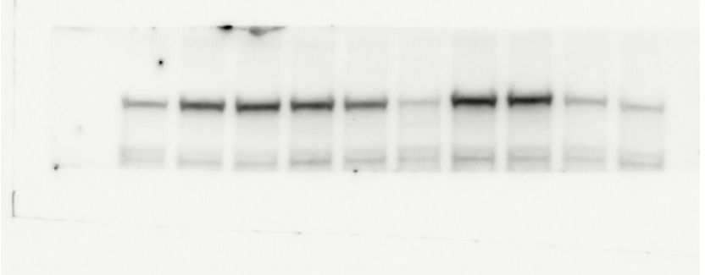
Fig 4D_PhosphoPKD

Slide 41
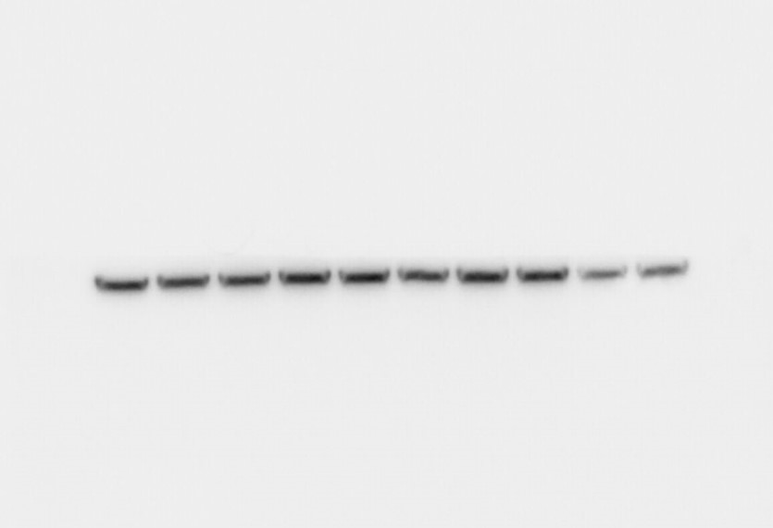
Fig 4D_Tubulin

