Slide 1
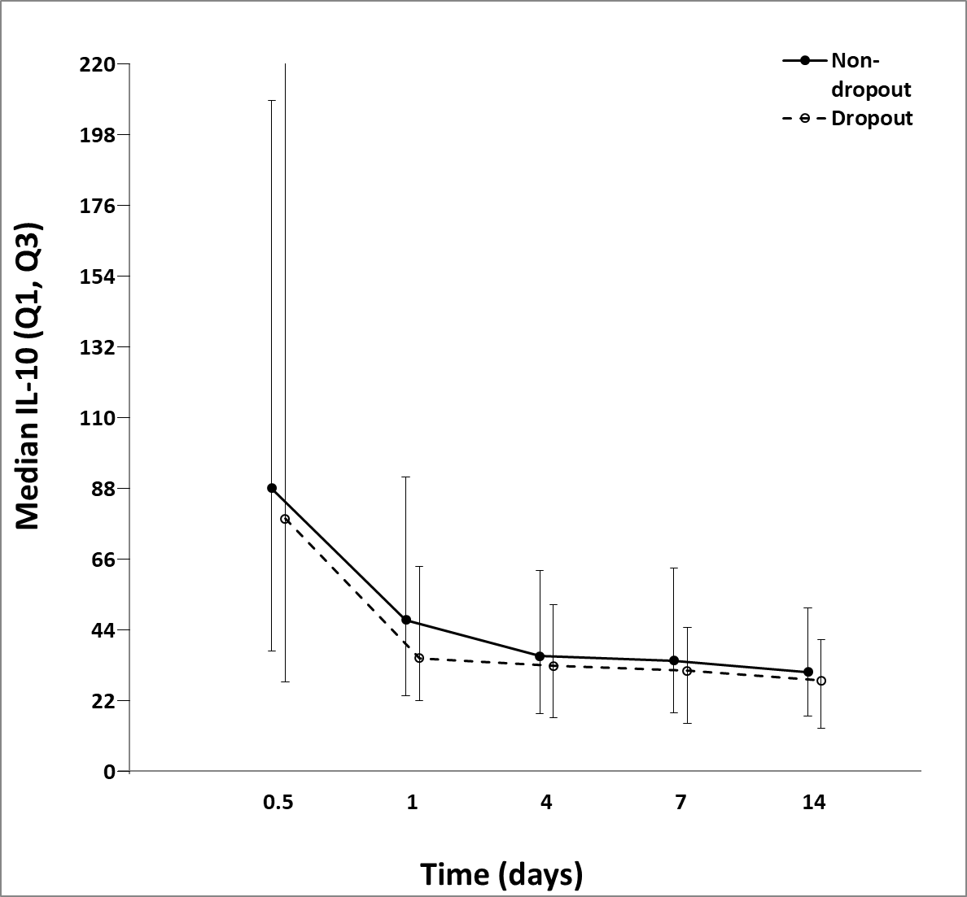
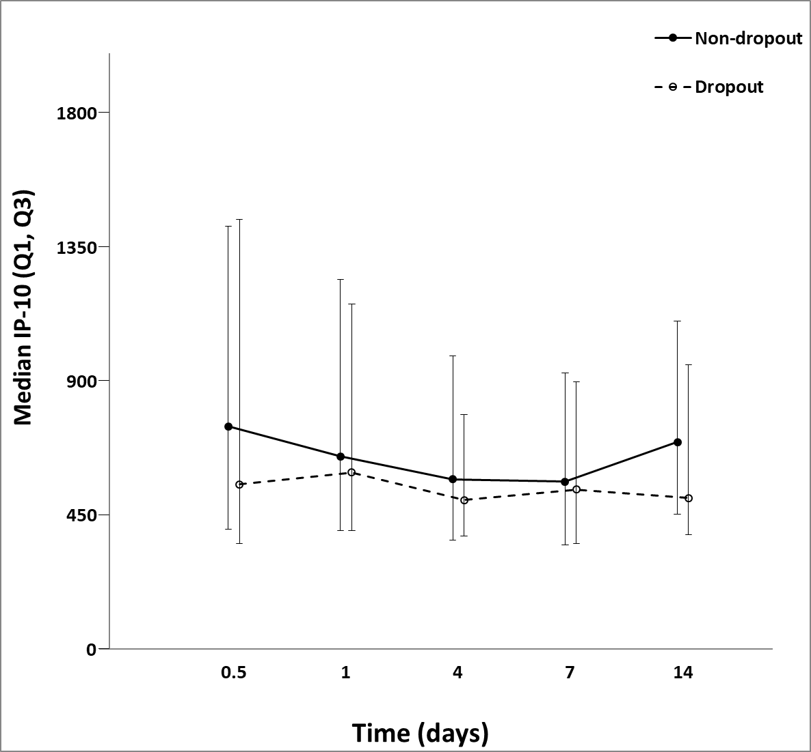
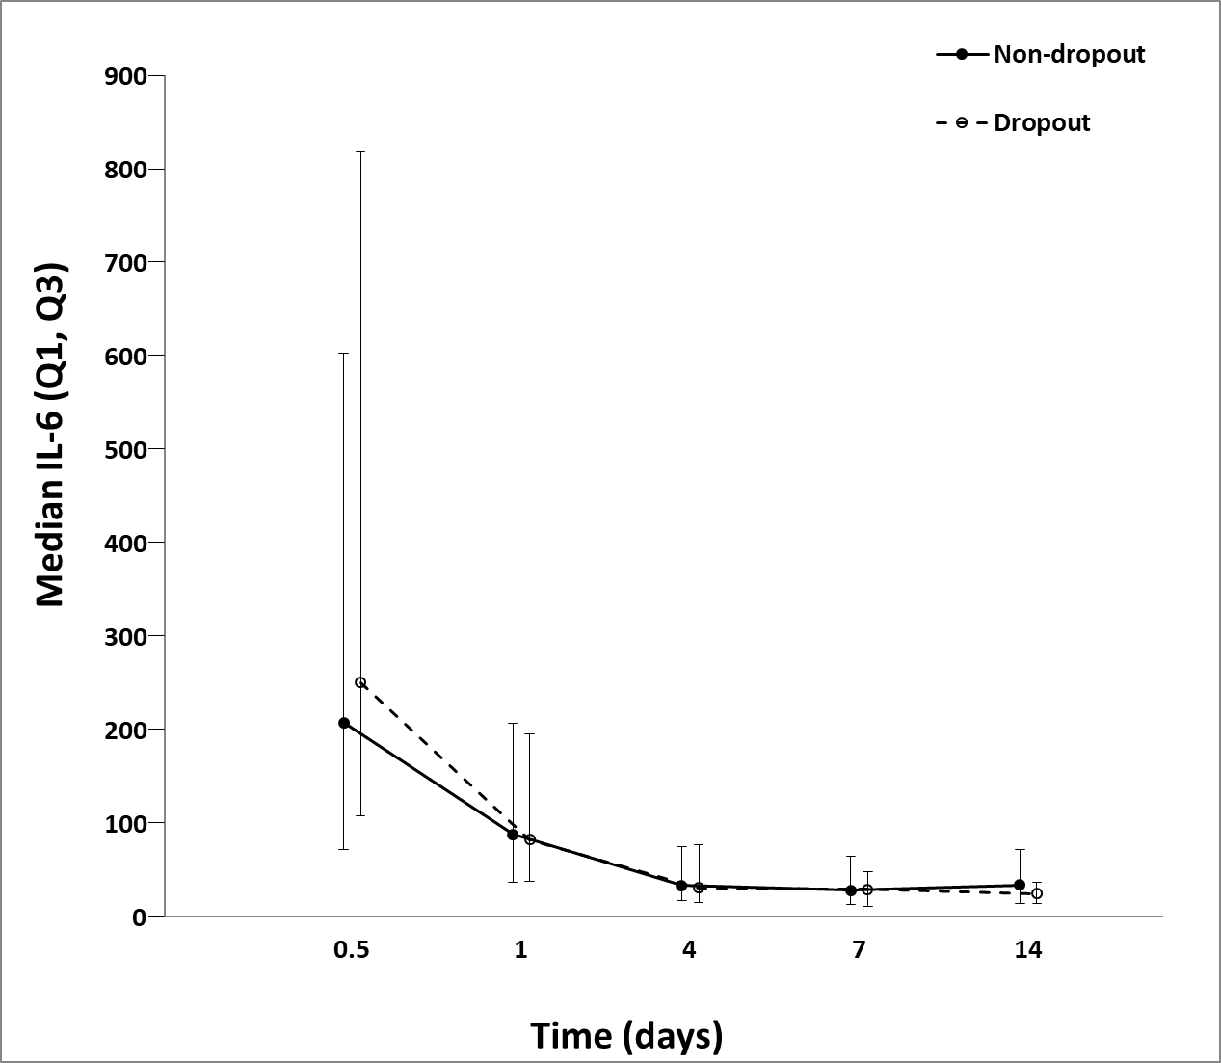
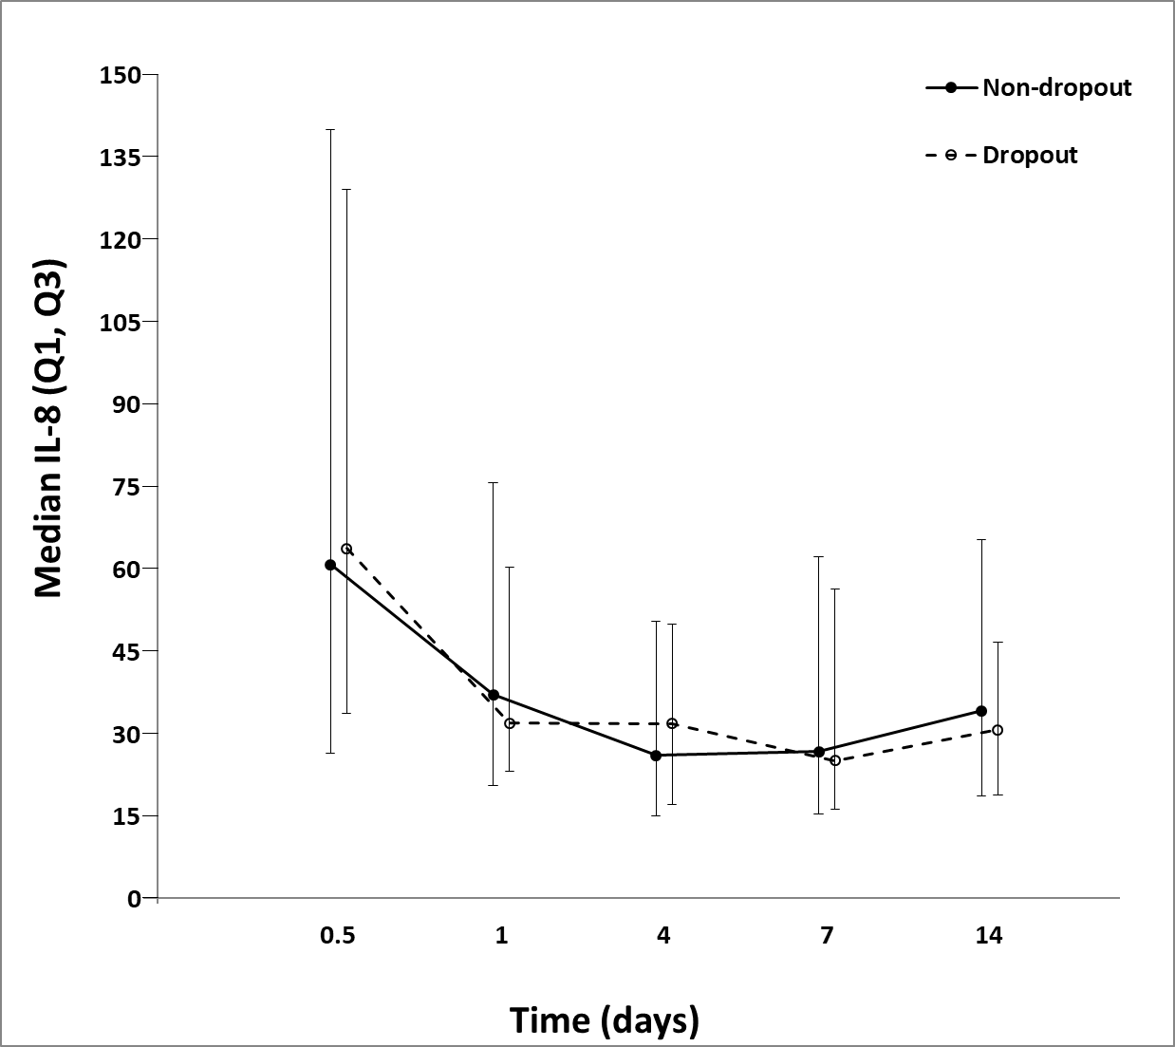
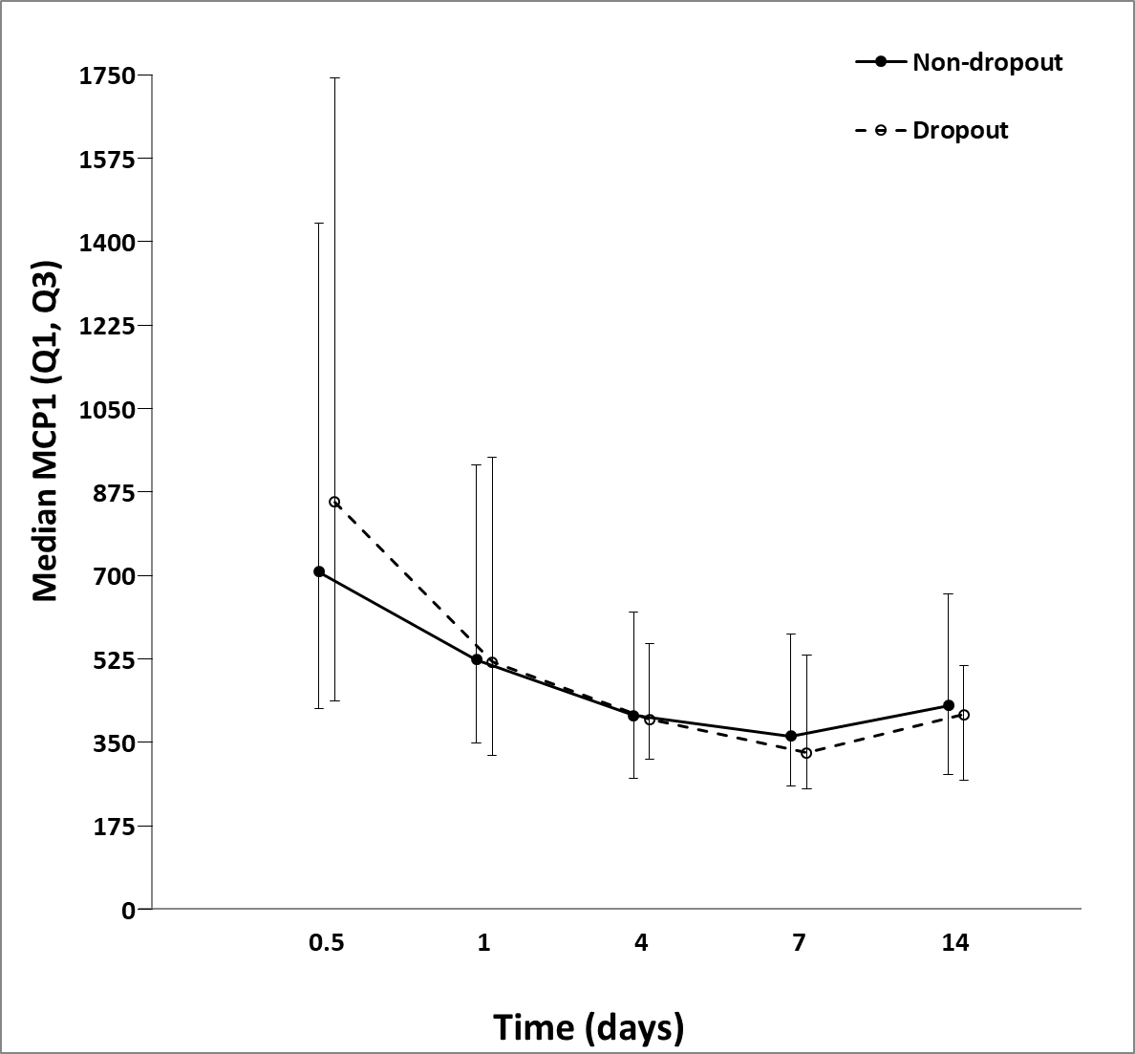
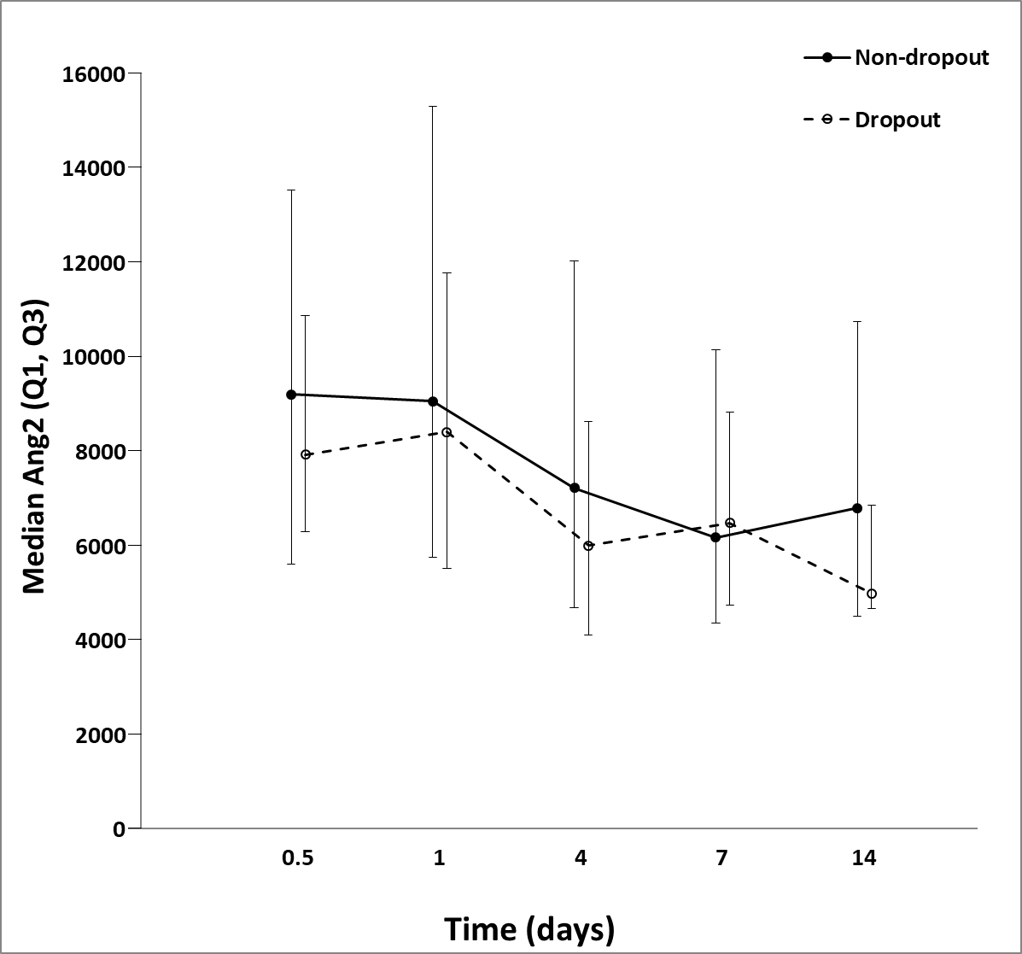
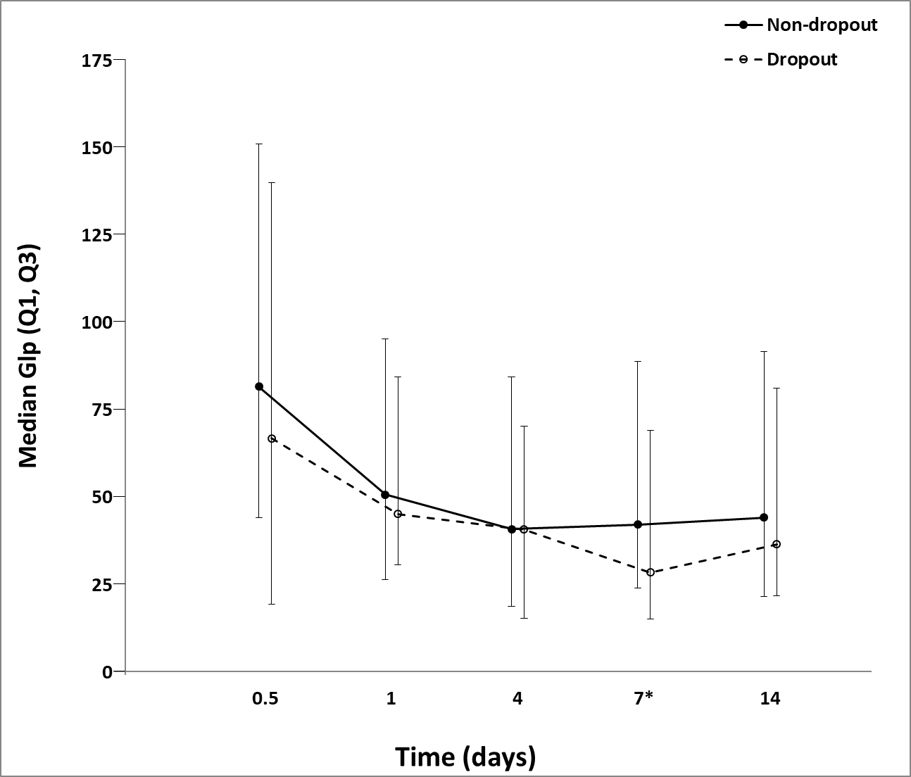
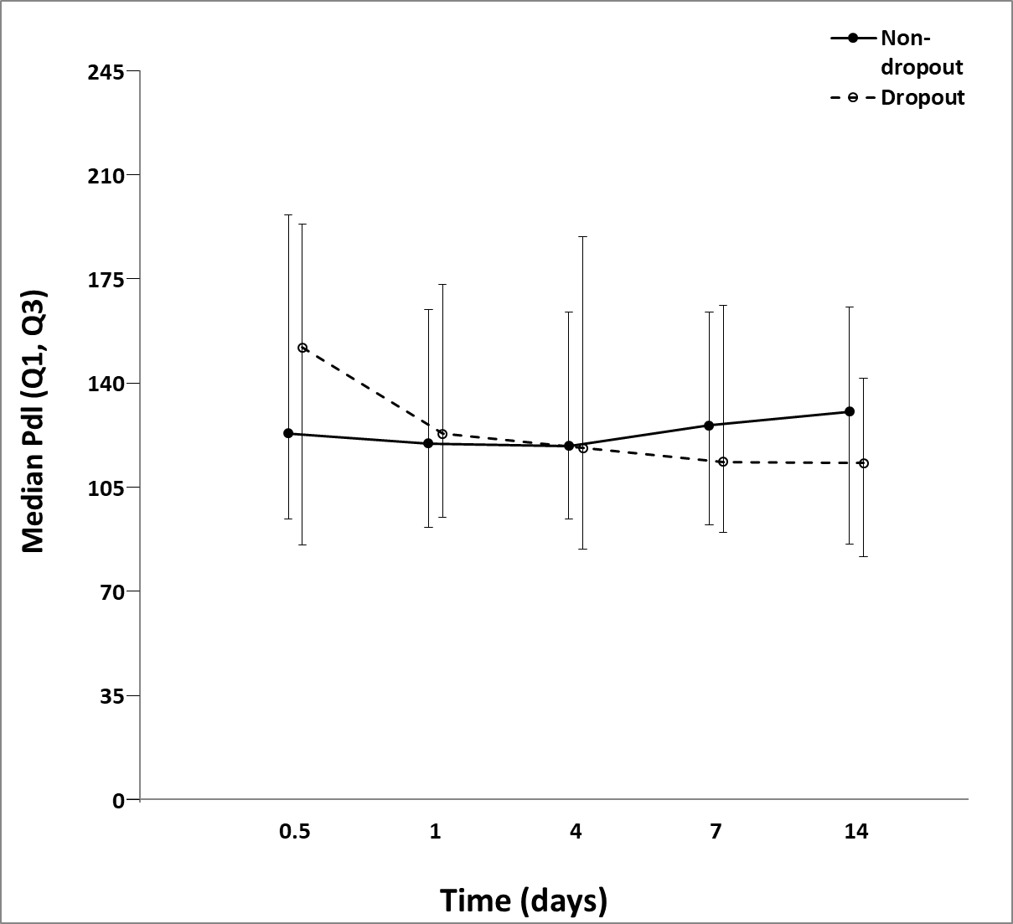
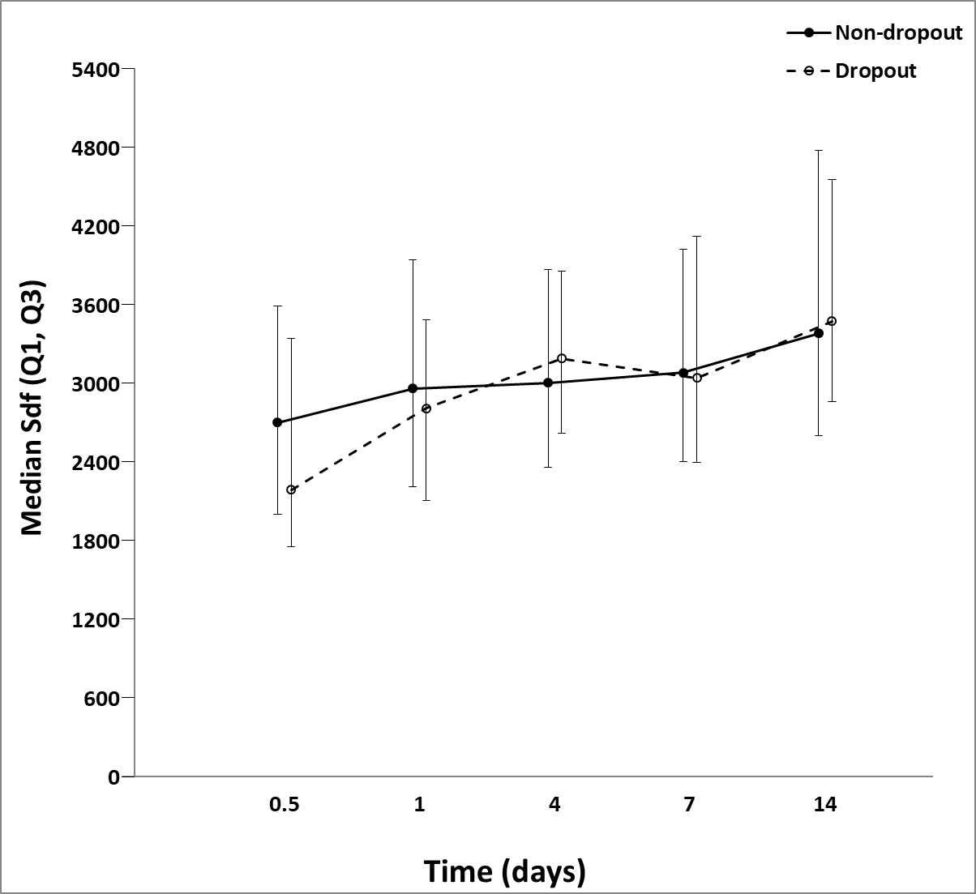
A
B
C
D
E
F
G
H
I
Notes:
SCD Figure 1. Comparison of select biomarkers for 59 patient dropouts and final 304 patients that completed 1-year follow-up.
(A) interleukin-10 (IL-10), (B) interferon gamma-induced protein 10 (IP-10), (C) interleukin-6 (IL-6), (D) interleukin-8 (IL-8), (E) monocyte chemoattractant protein 1 (MCP-1), (F) angiopoietin 2 (Ang2), (G) glucagon- like peptide-1 (GLP-1), (H) soluble programmed death ligand 1 (sPDL-1), and (I) stromal-derived-factor-1/ C-X-C motif chemokine 12 (SDF-1).
Prediction models for 1 year Zubrod 4/5 with GLP-1 had an AUC was 0.8813 (0.8257, 0.9368) and without GLP-1 the AUC was 0.8811 (0.8254, 0.9367).
Data presented as median (25%, 75%) with * denoting statistical significance set at p<0.05. Dotted black line represents median of biomarker levels in matched control subjects.

