Slide 1
A LysR-Type Transcriptional Regulator Controls Multiple Phenotypes in Acinetobacter baumannii
Supplemental Figures

Slide 2
Supplemental Table 1
RNA Sequencing Data for VIR-O Δ1132
Uploaded as a separate worksheet: Supplementary Table 1 RNA Seq Data.xslx

Slide 3
Supplemental Table 2
Primer Name | Sequence | Description/Use
1132 Up 1 | GATACCCTCATCAGCAAAAA | Amplifies the 2kb region upstream of 1132
1132 Up 2 | AAAAAATGCTTATTGTTGTAATGAAAG
1132 Down 1 | ATGCAGATTGTTCGTTAACTTT | Amplifies the 2kb region downstream of 1132
1132 Down 2 | ATCAGGTTCAAGAACTGACT
1132 For | GTTTCCTCGTATAATACAAT | Verification of 1132 deletion
1132 Rev | CTACGCTAAAGCAAAAATAA
manB qPCR 1 | AGCGCTTAACGTACCTGTTGA | qRT-PCR of manB
manB qPCR 2 | AAACAGCGGTCAAAATCGCC
galE qPCR 1 | CAGTGGGTGAAAGCCAGGAA | qRT-PCR of galE
galE qPCR 2 | GGCATACCCGTTGGCATTTC
3818 qPCR 1 | TCGGGCATGTTAGCTACTCG | qRT-PCR of ABUW_3818
3818 qPCR 2 | CACCGCCAAATCCTACACCT
3820 qPCR 1 | AGCATTACCTTCAGTAGGCCG | qRT-PCR of ABUW_3820
3820 qPCR 2 | AGGGTCACGTCCCAGTAAGT
3821 qPCR 1 | TGGTCATATTGCGGCATGGT | qRT-PCR of ABUW_3821
3821 qPCR 2 | AAACCTGGTGGGTGCTGTTT
3830 qPCR 1 | CAGGAACTCACAAGGCACCA | qRT-PCR of ABUW_3830
3830 qPCR 2 | CGCCAACTAAACCTGGACGA
wza qPCR 1 | GTTTCCTCTAGTGGGACGCT | qRT-PCR of wza
wza qPCR 2 | CGCTGCCTTGAACGGAAAAG
wzb qPCR 1 | CTGCCGGTATTTCAGGGCTT | qRT-PCR of wzb
wzb qPCR 2 | GCAAAGGGCCAAGTCTGTTC
wzc qPCR 1 | AGATACGGCCGTTGAACCAG | qRT-PCR of wzc
wzc qPCR 2 | GCGTGGCACAGTTGCATAAA
16S qPCR 1 | GATCTTCGGACCTTGCGCTA | qRT-PCR of 16S
16S qPCR 2 | GTGTCTCAGTCCCAGTGTGG
abaI qPCR 1 | TGCCAGACTACTACCCACCA | qRT-PCR of abaI
abaI qPCR 2 | ACTAGCAGAGGAAGGCGGAT
att-Tn7 site 1 | TTGCTGATGAAAATAGTGGTGTAG | Amplification of the att-Tn7 insertion site downstream of glmS
att-Tn7 site 2 | CACATCTAGAATTGCCTTCCAT

Slide 4
Supplemental Figure 1
Deletion of 1132 does not affect abaI expression. qRT-PCR experiments comparing wild-type VIR-O and VIR-O Δ1132 indicate no significant difference in the expression of abaI, using 16S as an internal control (two-tailed Mann-Whitney test, ns = not significant). Results are the average of three biological replicates.

Slide 5
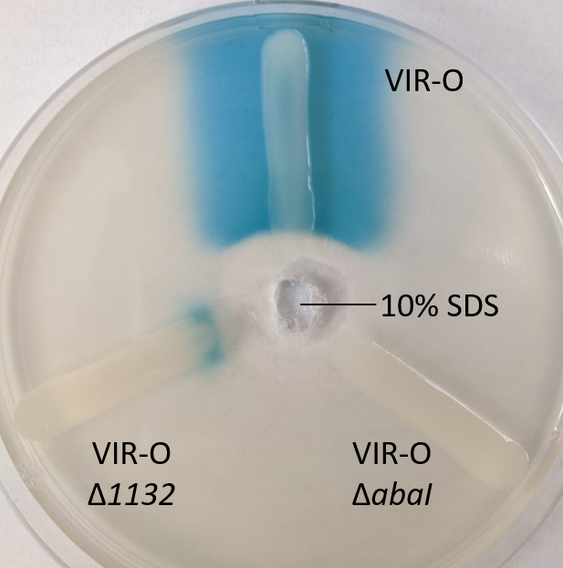
Supplemental Figure 2
VIR-O Δ1132 cells contain quorum sensing signal (AHL), but do not secrete it. Cultures of wild-type VIR-O, VIR-O Δ1132, and VIR-O ΔabaI were grown to the same OD₆₀₀ and plated as a line onto a soft-agar lawn containing Agrobacterium tumefaciens (traG::lacZ) and X-Gal. 10% SDS was added to a well at the center of the plate, lysing the cells.

Slide 6
Supplemental Figure 3
AV-T Δ1132 switches to the VIR-O variant at the same frequency as wild-type AV-T. Bars represent averages of six colonies assayed for switching frequency at 18 hours of growth. Error bars indicate standard deviation of the mean, and there is no statistical significance as assessed by Welch’s ANOVA.

Slide 7
Supplementary Figure 4
K locus genes for capsule polysaccharide synthesis and export are not transcriptionally regulated by 1132. Bars for AV-T Δ1132 and AV-T Δ1132/Tn7-1132 represent averages of three biological replicates. Error bars indicate standard deviation of the mean, and there is no statistical significance in expression across strains as assessed by multiple Mann-Whitney tests.

Slide 8
A
B
Supplementary Figure 5
(A) Growth curves for VIR-O, AV-T, VIR-O Δ1132, and AV-T Δ1132 in LB media. Data represents two biological replicates, and error bars indicate standard deviation of the mean. (B) Galleria mellonella infected with VIR-O Δ1132 show no significant difference in mortality compared with wild-type VIR-O (n=30 per strain) as assessed by a log-rank (Mantel-Cox) test. (C) Mice were infected intranasally with either VIR-O or VIR-O Δ1132. At 24 hours post-inoculation, bacteria were recovered from the lungs, spleen, and liver tissues and CFU/g quantified. There is no significant difference between the two strains in all tissues as assessed by a Mann-Whitney test. ns, not significant.
C

