Slide 1
JAMA Ophthalmology Journal Club Slides:
Nicotinamide and Pyruvate for Neuroenhancement in Open-Angle Glaucoma
De Moraes CG, John SWM, Williams PA, Blumberg DM, Cioffi GA, Liebmann JM. Nicotinamide and pyruvate for neuroenhancement in open-angle glaucoma: a phase 2 randomized clinical trial. JAMA Ophthalmol. Published online November 18, 2021. doi:10.1001/jamaophthalmol.2021.4576

Slide 2
Introduction
Importance:
  Open-angle glaucoma (OAG) may continue to progress despite significant lowering of intraocular pressure.
  Preclinical research has suggested that enhancing mitochondrial function and energy production may enhance retinal ganglion cell (RCG) in animal models of glaucoma.
  Nicotinamide and pyruvate have been shown to be neuroprotective in mice models of glaucoma; however, there is scant data on its effectiveness in patients.
Objective:
  To test the hypothesis that a combination of nicotinamide and pyruvate can improve RGC function in human glaucoma as measured with standard automated perimetry.

Slide 3
Methods
Study Design, Setting, and Participants:
  Phase 2, randomized, double-blind, placebo-controlled clinical trial at a single academic institution.
  Patients with treated OAG and moderate visual field loss in at least 1 eye were included.
  Clustered visual field testing at baseline (4 tests) and last visit (4 tests).
Main Outcomes and Measures:
  Primary: number of visual field test locations improving beyond normal variability in the study eye.
  Secondary: rates of change of visual field global indices (mean deviation, pattern standard deviation, and visual field index).
Limitations:
  Short duration of the trial (median, 2.2 months).

Slide 4
Results
A total of 32 participants (21 randomized to treatment and 11 to placebo) completed the study procedures.
  Mean (SD) age, 64.6 (9.8) years
  21 Female participants (66%)
No serious adverse events were reported during the study.
  The most commonly reported adverse event was mild gastrointestinal discomfort reported in 10 of 32 participants (31%) (7 of 21 in the treatment group [33%] vs 3 of 11 [27%] in the placebo group; P > .99)
The number of improving test locations was significantly higher in the treatment vs the placebo group (median [IQR], 15 [6-25] vs 7 [6-11]; P = .005).
There was no difference between treatment and placebo groups (median [IQR], 12 [6-21] vs 11 [5-20]; P = .66).
There was no effect of randomization on rates of change of optical coherence tomography global retinal nerve fiber layer thickness (difference, 0.18; 95% CI, −0.06 to 0.43; P = .13).
No differences in Montréal Cognitive Assessment scores were noted between groups (difference, 0.06 units; 95% CI, −0.08 to 0.20; P = .42).

Slide 5
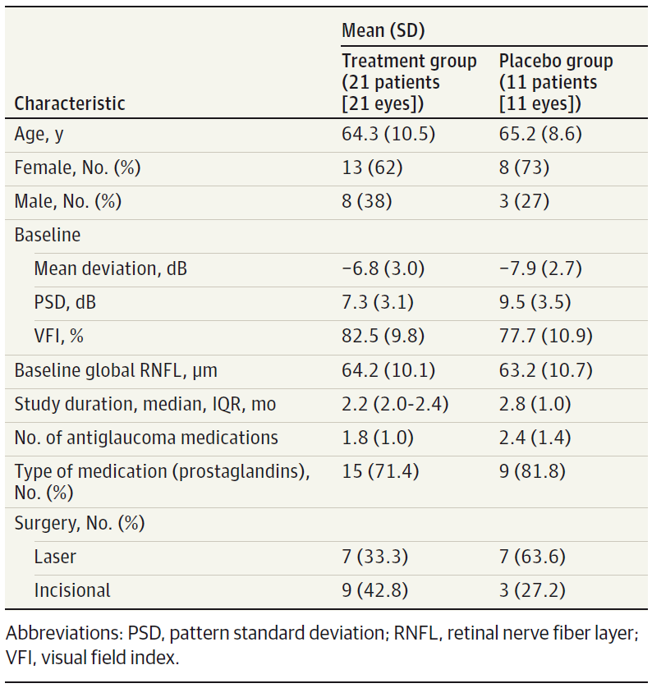
Results
Clinical Characteristics of the Study Sample by Randomization Group

Slide 6
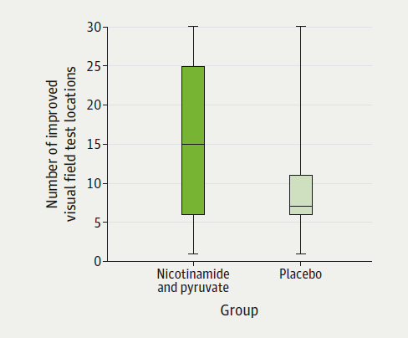
Results
Visual function significantly improved in the nicotinamide and pyruvate group compared with placebo.
Odds ratio for visual function improvement, nicotinamide and pyruvate vs placebo: 3.20 (95% CI, 1.25-8.16); P = .01.

Slide 7
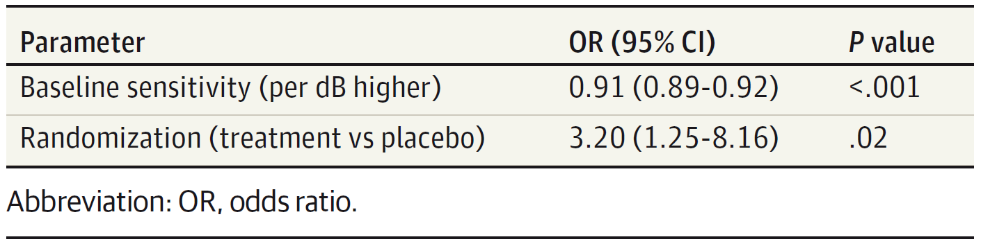
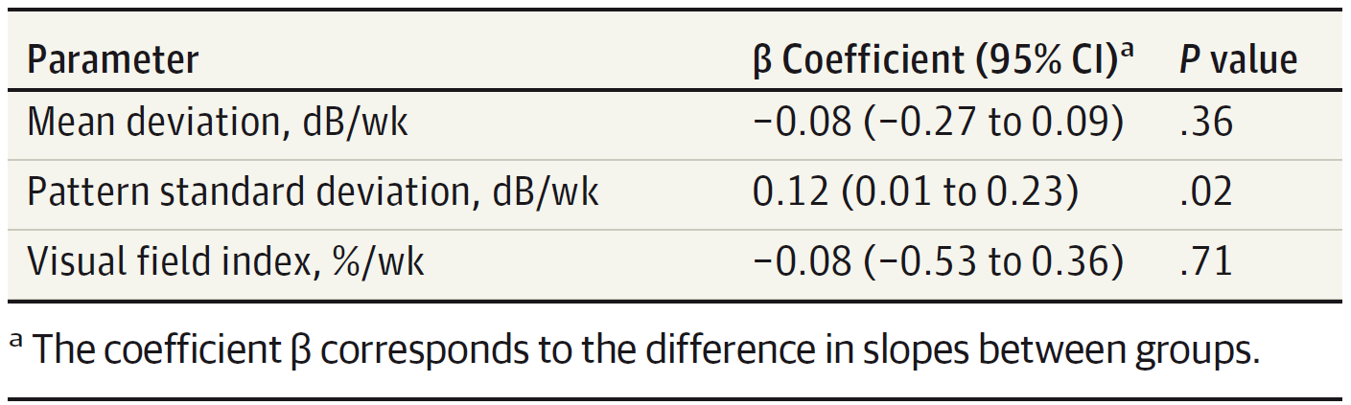
Results
Bivariate Logistic Mixed-Effects Regression Testing the Association Between Randomization, Baseline Severity, and Pointwise Improvement
Univariable Linear Mixed-Effects Models Testing Differences in Rates of Change of Visual Field Global Indices Between Treatment Groups

Slide 8
Comment
In this randomized, double-blind, placebo-controlled clinical trial, patients with manifest OAG treated with a combination of nutritional supplements (nicotinamide and pyruvate) experienced a statistically significant improvement in visual function compared to the placebo group.
One hypothesis is that, in addition to dead and healthy RGCs in patents with glaucoma, some cells may still be functioning at variable firing rates.
The combination of nicotinamide and pyruvate may help improve their function.
Nicotinamide and pyruvate supplementation and their effects on the mitochondria and energetic status of these cells may rescue these cells to a state with better function, which is translated into improved perimetric and electroretinographic measures.

Slide 9
Comment
Although optical coherence tomography changes were not significant in the current study, this imaging modality was performed only twice (at baseline and end of study) for safety assessment and was therefore underpowered.
This study used a novel design aimed at improving the statistical power to detect visual field changes using clusters of tests, which is called the wait-and-see approach.
Clinical trials in glaucoma to date have required large sample sizes and long follow-up to be able to detect statistically significant changes between groups.
This study has important implications for clinical trial design, suggesting that this approach is feasible and may indeed be able to reduce costs of future trials in glaucoma.

Slide 10
Contact Information
If you have questions, please contact the corresponding author:
  Carlos Gustavo De Moraes, MD, MPH, PhD, Columbia University Irving Medical Center, 635 W 165th St, Box 69, New York, NY 10032 (cvd2109@cumc.columbia.edu).
  Funding/Support
This work was supported by the Shirlee and Bernard Brown Glaucoma Genetics Initiative at the Department of Ophthalmology, Columbia University Irving Medical Center and by Research to Prevent Blindness. Dr John was an investigator of Howard Hughes Medical Institute and supported by funds from the Precision Medicine Initiative at Columbia University. Dr Williams is supported by Karolinska Institutet in the form of a board of research faculty–funded career position and by philanthropic donations from the St Erik Eye Hospital (Vetenskapsrådet 2018-02124).

Slide 11
Conflict of Interest Disclosures
Dr De Moraes reports support from Allergan, Belite, Carl Zeiss Meditec, Galimedix, Genentech, Novartis, Ora, Thea, and Reichert outside the submitted work and from Heidelberg Engineering, the National Institutes of Health, the US Centers for Disease Control and Prevention, and Topcon during the conduct of the study. Drs John and Williams are inventors on a patent application filed by the Jackson Laboratory that covers nicotinamide- and pyruvate-based therapies in glaucoma. Dr John was employed by Howard Hughes Medical Institute during the conduct of the study. Dr Liebmann reports support from Allergan, Carl Zeiss Meditec, Genentech, and Thea outside the submitted work. No other disclosures were reported.

