Slide 1
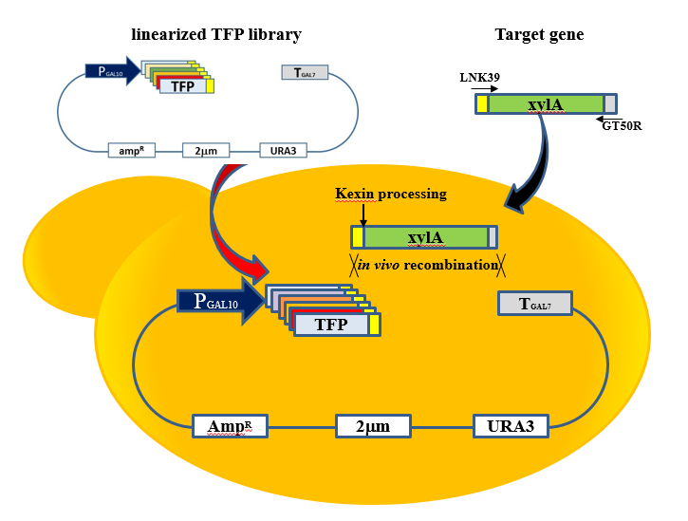
Fig. S1
Figure S1. Scheme for the direct construction of recombinant xylA expression vectors by in vivo recombination with translational fusion partners (TFPs).

Slide 2
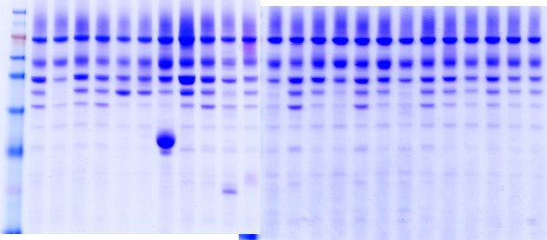
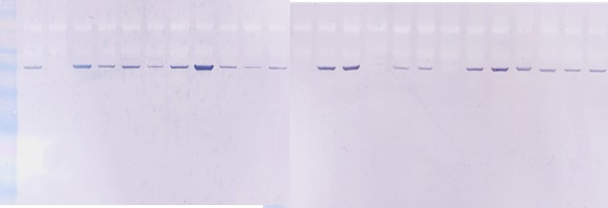
Fig. S2
a
(kDa) M 1 2 3 4 5 6 7 8 9 10 11 12 13 14 15 16 17 18 19 20 21 22 23 24
98
62
49
38
b
(kDa) M 1 2 3 4 5 6 7 8 9 10 11 12 13 14 15 16 17 18 19 20 21 22 23 24
98
62
49
38
Figure S2. Optimal TFP screening for secretory expression of xylA. (a) SDS-PAGE analysis of culture broth of recombinant yeasts expressing xylA and Coomassie Blue staining. The xylA protein band was verified by western blotting analysis (b). 1-24; TFP number, M: protein size marker.

Slide 3
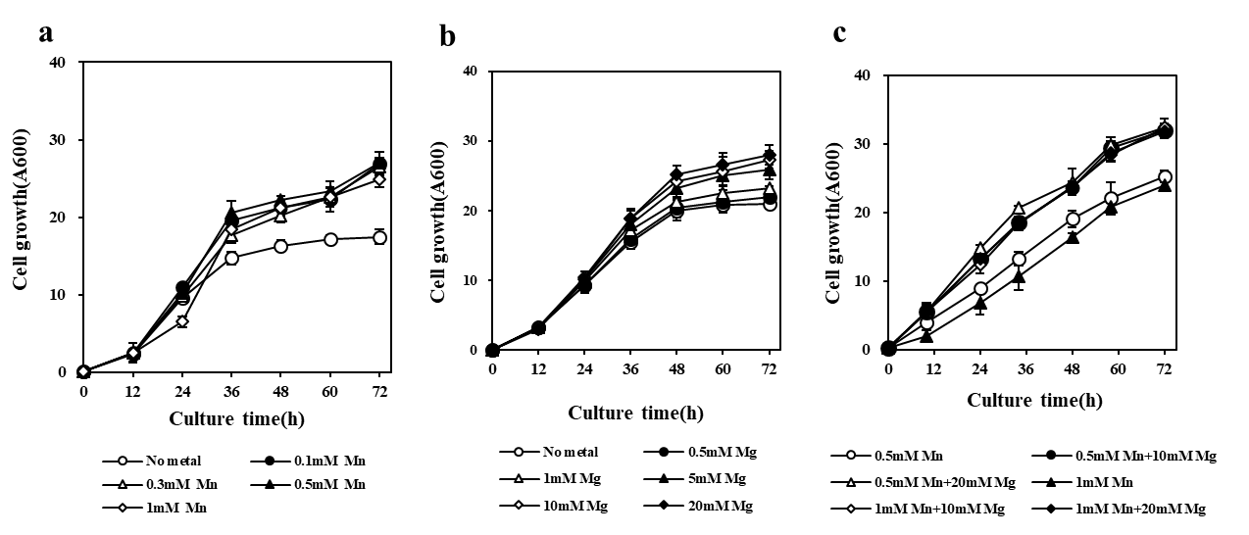
Fig. S3
*
*
*
*
Figure 3. Determination of optimal concentration of metal ions for growth in YPX medium containing 2% xylose as a sole carbon source. Various concentration of MnCl₂ (a), MgCl₂ (b) were analyzed separately and simultaneously (c). All experiment were triplicated. *p < 0.03.

Slide 4
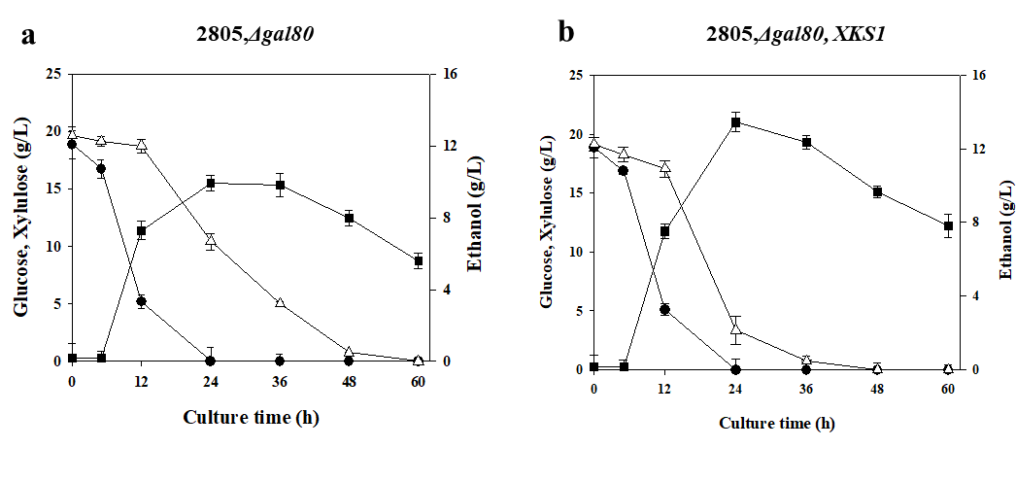
Fig. S4
Figure S4. Co-fermentation of glucose and xylulose using wild type (a) and xylulokinase overproduced strain (b). All experiment were triplicated. Symbols: Glucose (●), Xylulose (△), Ethanol (■)

Slide 5
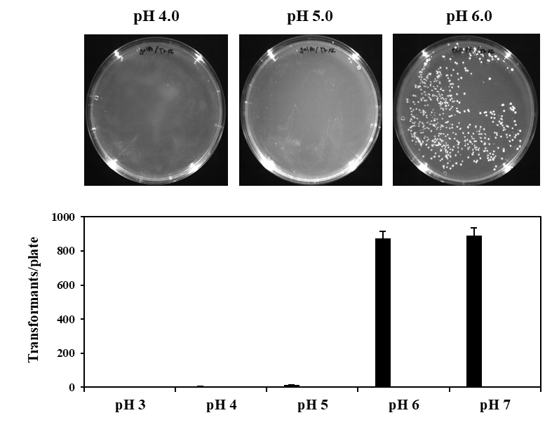
Fig. S5
Figure S5. Comparison of growing cells on different pH media after transformation of TFP3-XI vector. UDX solid media containing 0.1% glucose and 2% xylose with different pH from 3 to 7 were used.

Slide 6
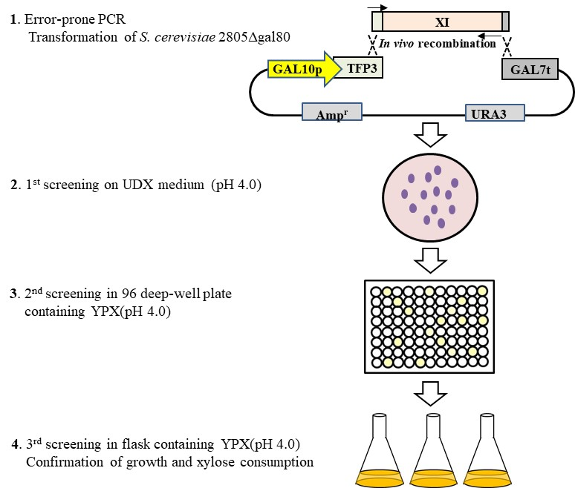
Fig. S6
Figure S6. Summary of directed evolution of XI for the development of low pH optimized XI

