Slide 1
Supplementary Figure S1
Supplementary Figure S1: AKT2 expression correlates with poor overall and eventfree survival of NB patients. Kaplan-Meier analysis in response to AKT2 gene expression showing overall and eventfree survival probability of NB patients. (A and D) Kocak dataset of 649 patients. (B and E) SEQC dataset of 498 patients. (C and F) Versteeg dataset of 88 patients.

Slide 2
Supplementary Figure S2
A.
BX-795 (µM)
Control 5 10 15 20 25
Calcein AM
EthD-III
Merged
B.
C.
BX-795 (µM)
BX-795 (µM)
Supplementary Figure S2: (A) Fluorescence images of 3D spheroid tumors at day 7 treated with different concentrations of BX-795 as shown is Figure 5C. Calcein AM (Green; live cells), Ethidium bromide homodimer III (Red; dead cells), composite merged images of both fluorescence dyes. (B) Quantitative representation of the percentage of cells stained with calcein AM. (C) Quantitative representation of the percentage of cells stained with EthD-III. * p<0.05; ** p<0.01.

Slide 3
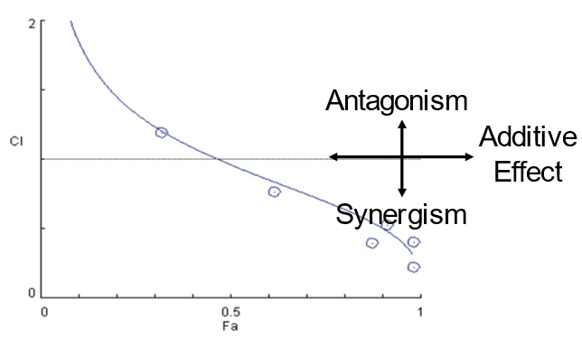
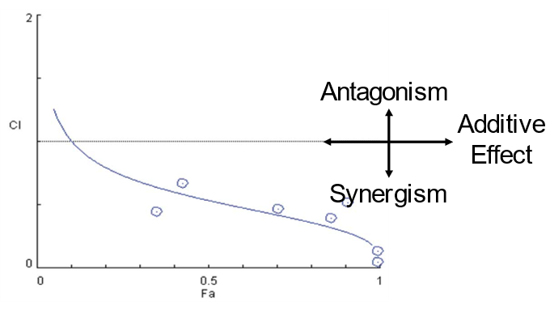
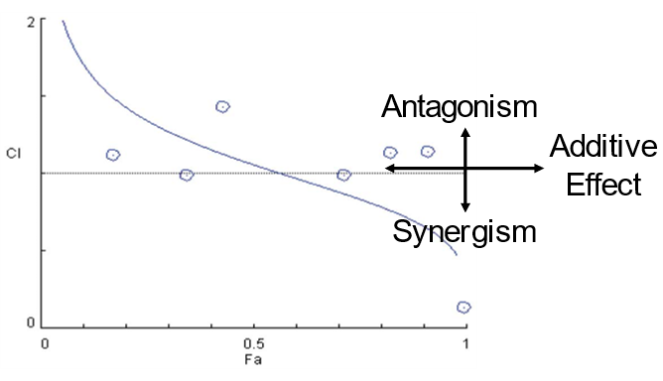
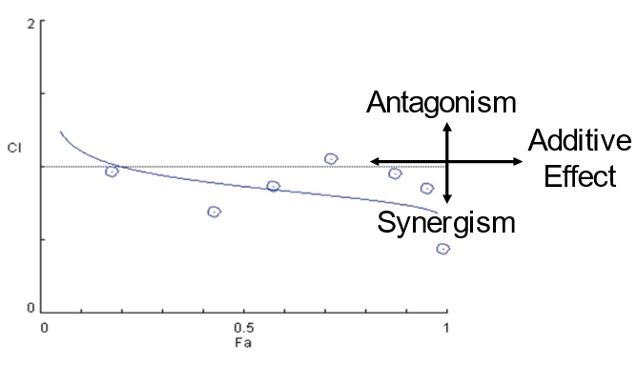
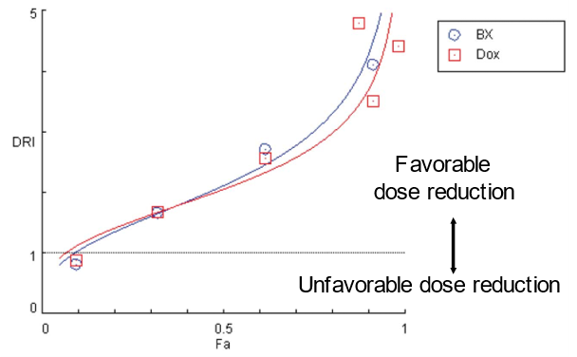
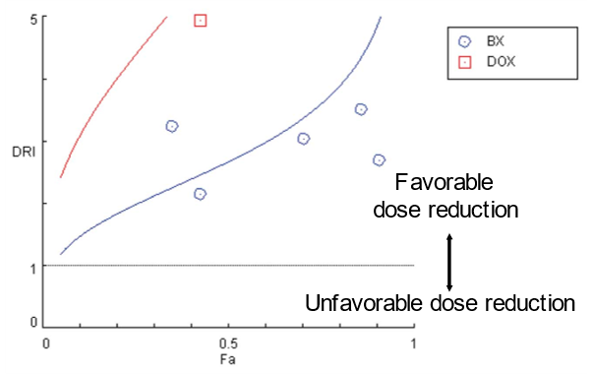
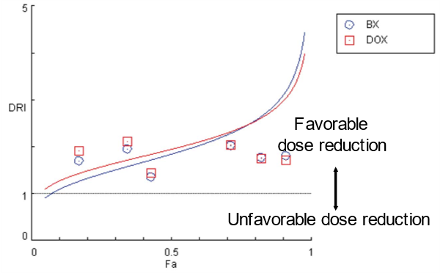
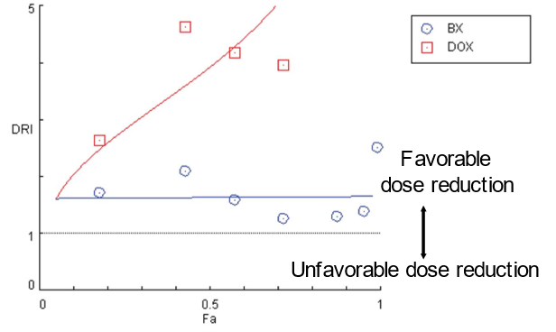
Supplementary Figure S3
A.
SH-SY5Y
SK-N-AS
NGP
LAN-5
Combination Index Plot
Combination Index Plot
Combination Index Plot
Combination Index Plot
B.
SH-SY5Y
SK-N-AS
NGP
LAN-5
Dose Reduction Index Plot
Dose Reduction Index Plot
Dose Reduction Index Plot
Dose Reduction Index Plot
Supplementary Figure S3: BX-795 synergizes NB to chemotherapy doxorubicin. (A) CI plots for different NB cell lines. (B) Dose-reduction index (DRI) plots for different NB cell lines. DRI > 1 indicates a favorable dose reduction, while a DRI < 1 indicates an unfavorable dose reduction. CI and DRI values were calculated by the Chou-Talalay method for drug interactions using Compusyn software for different fractions affected

Slide 4
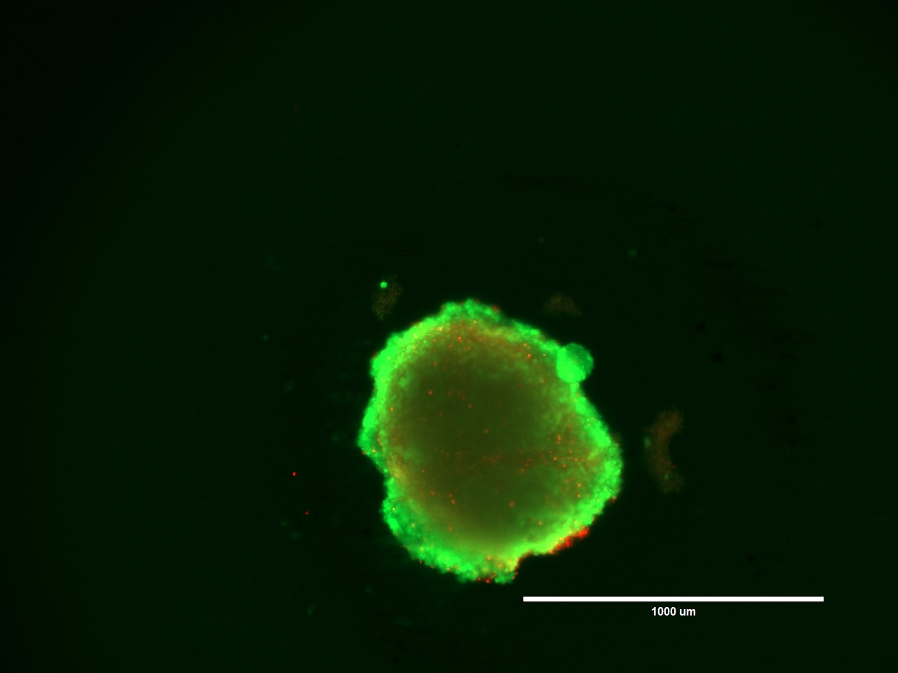
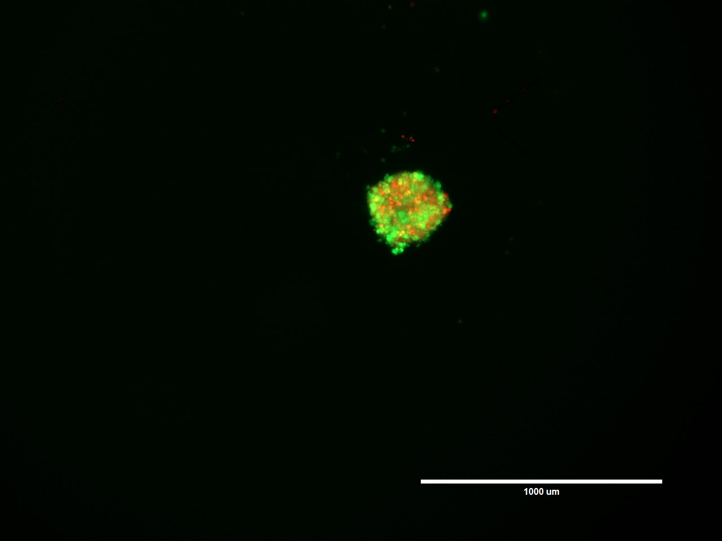
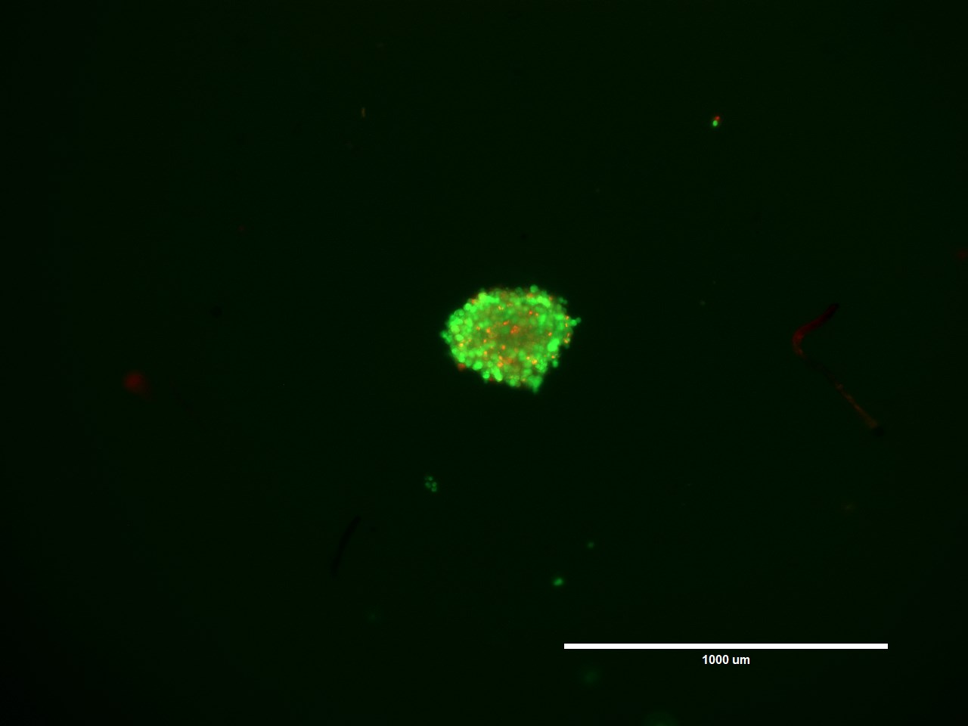
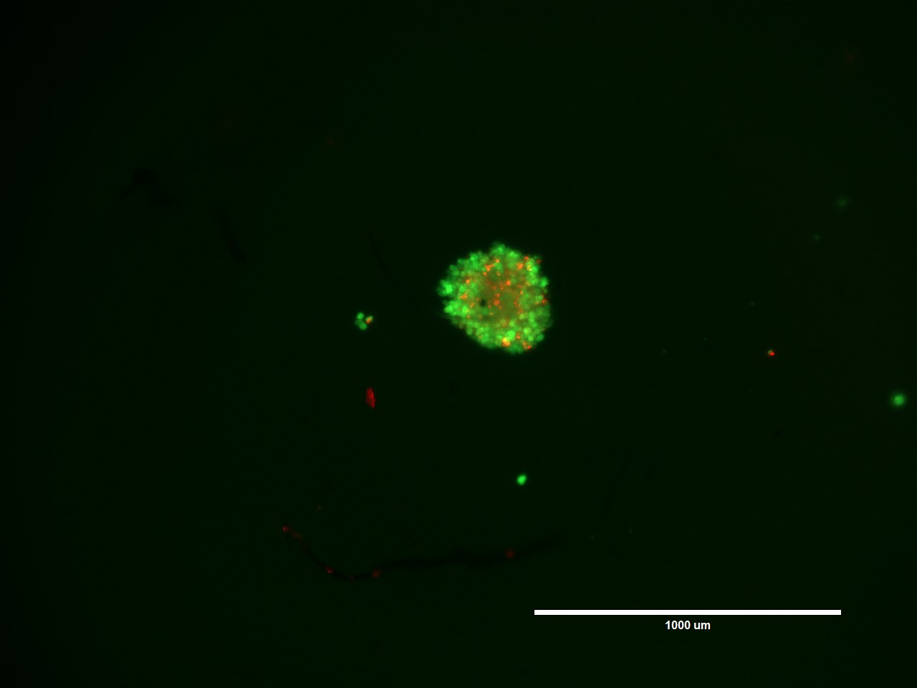
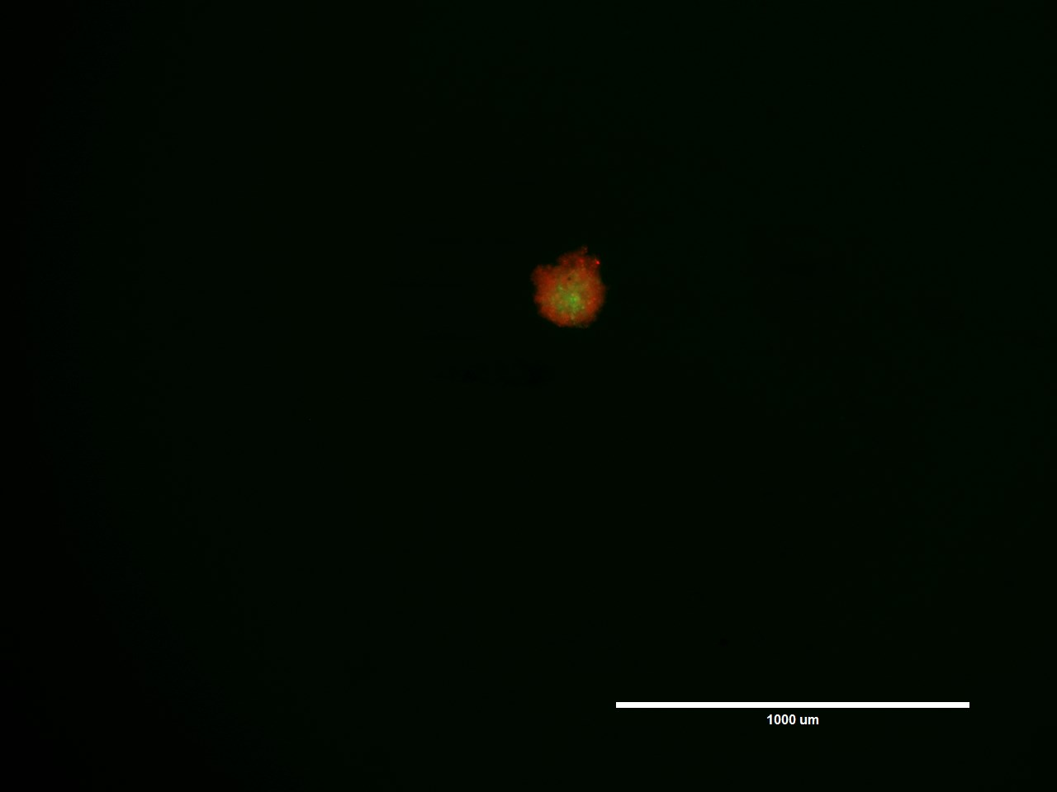
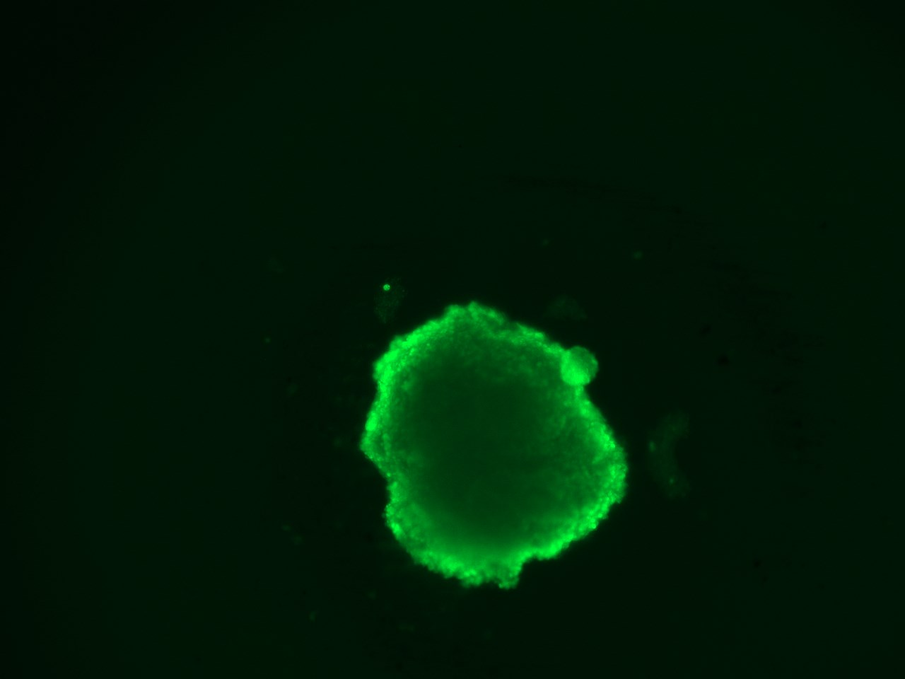
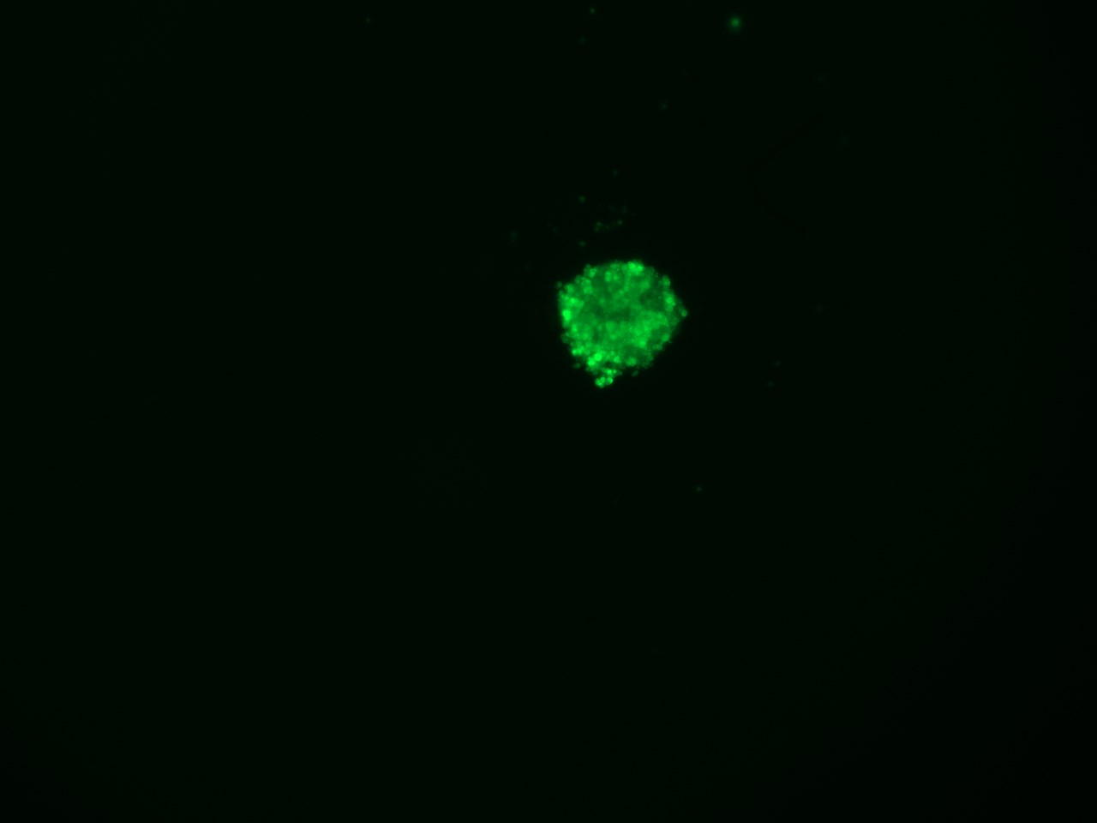
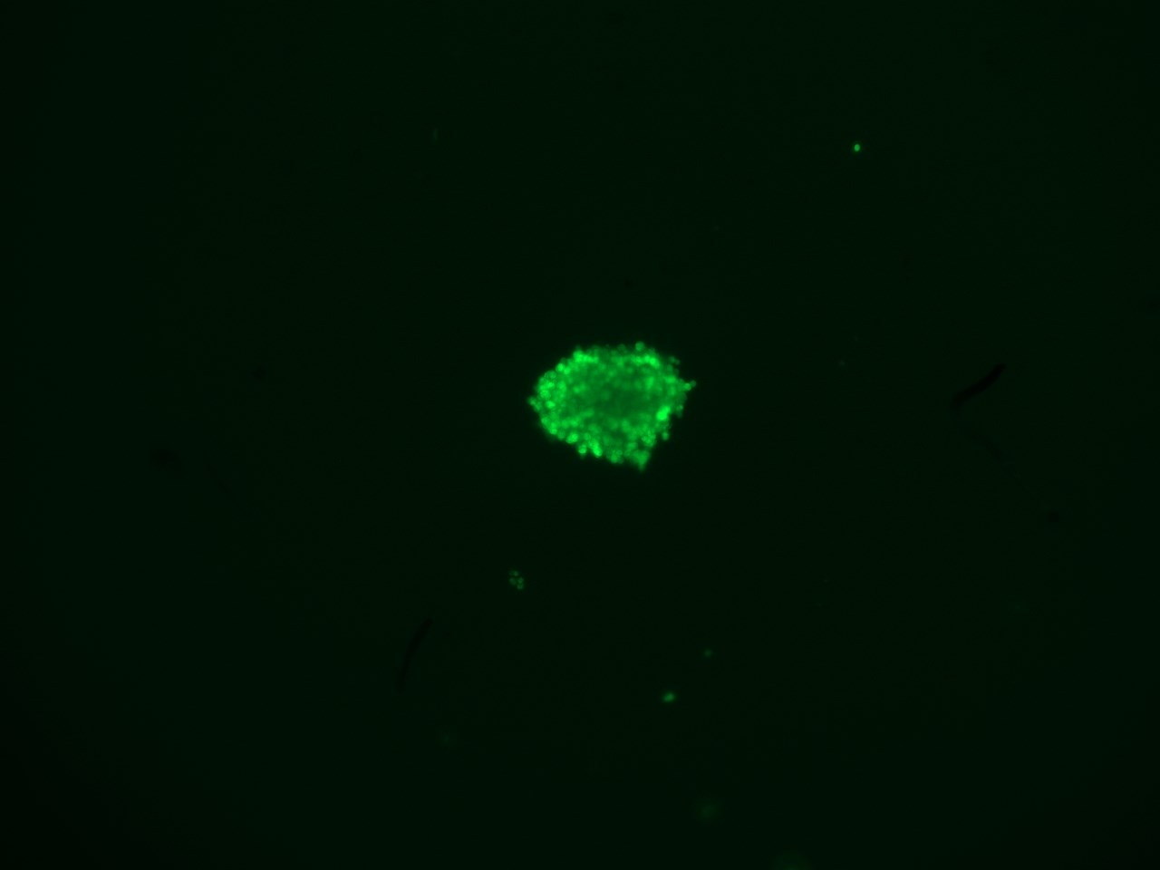
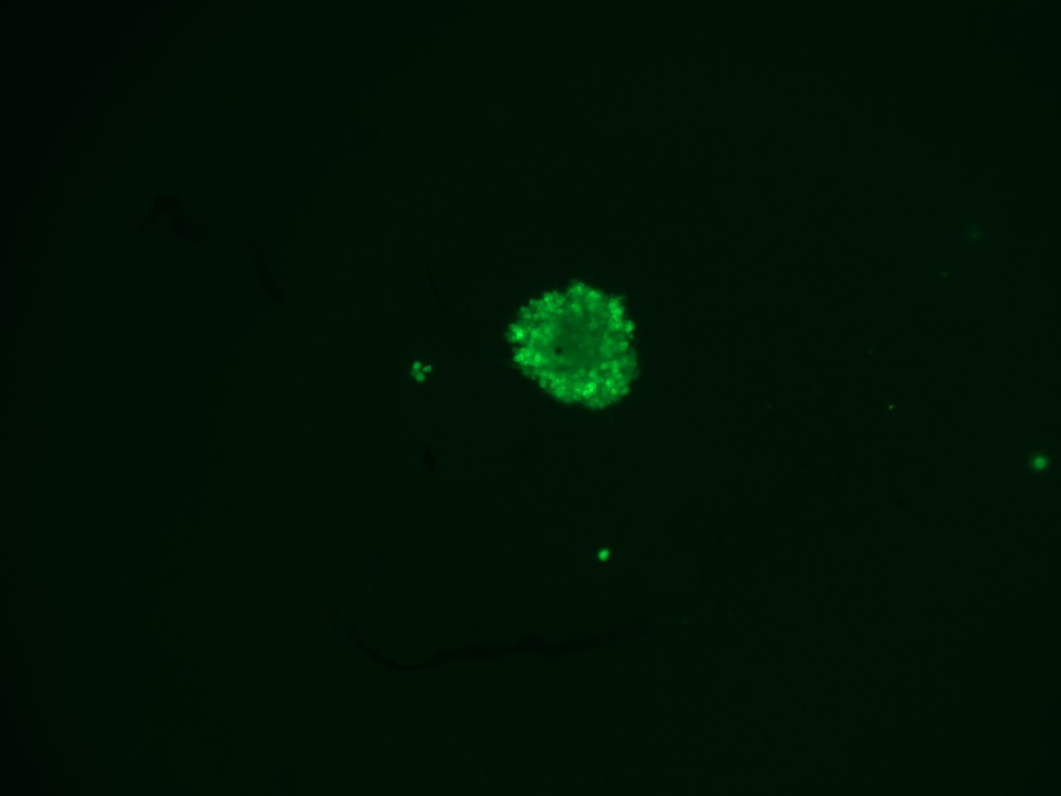
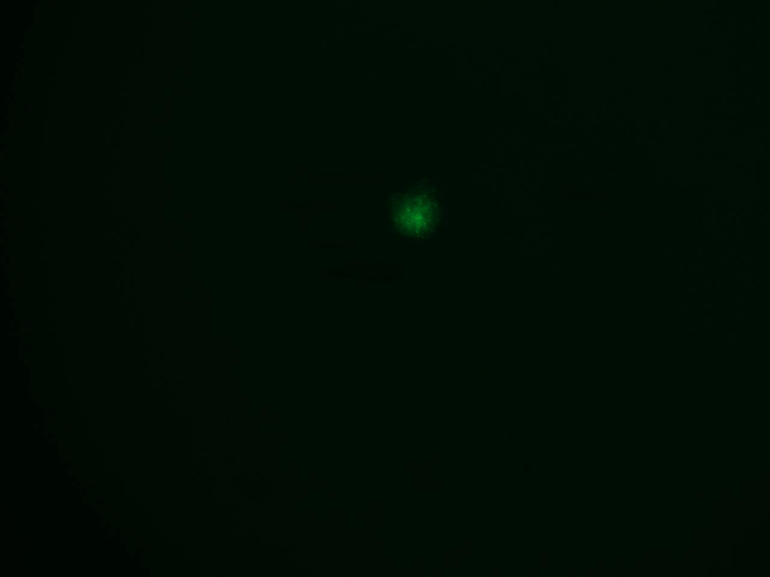
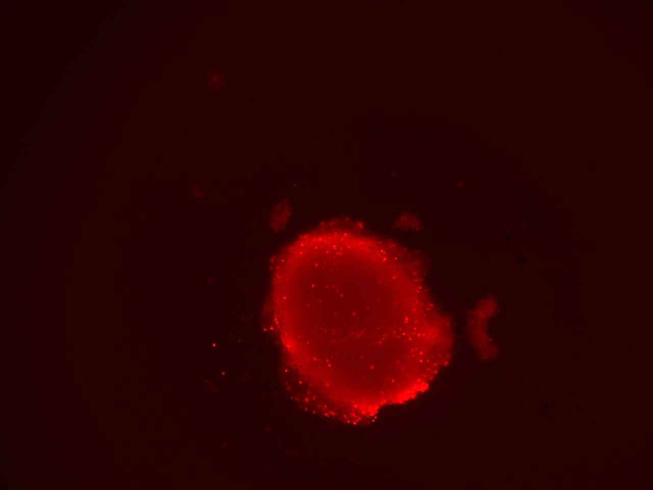
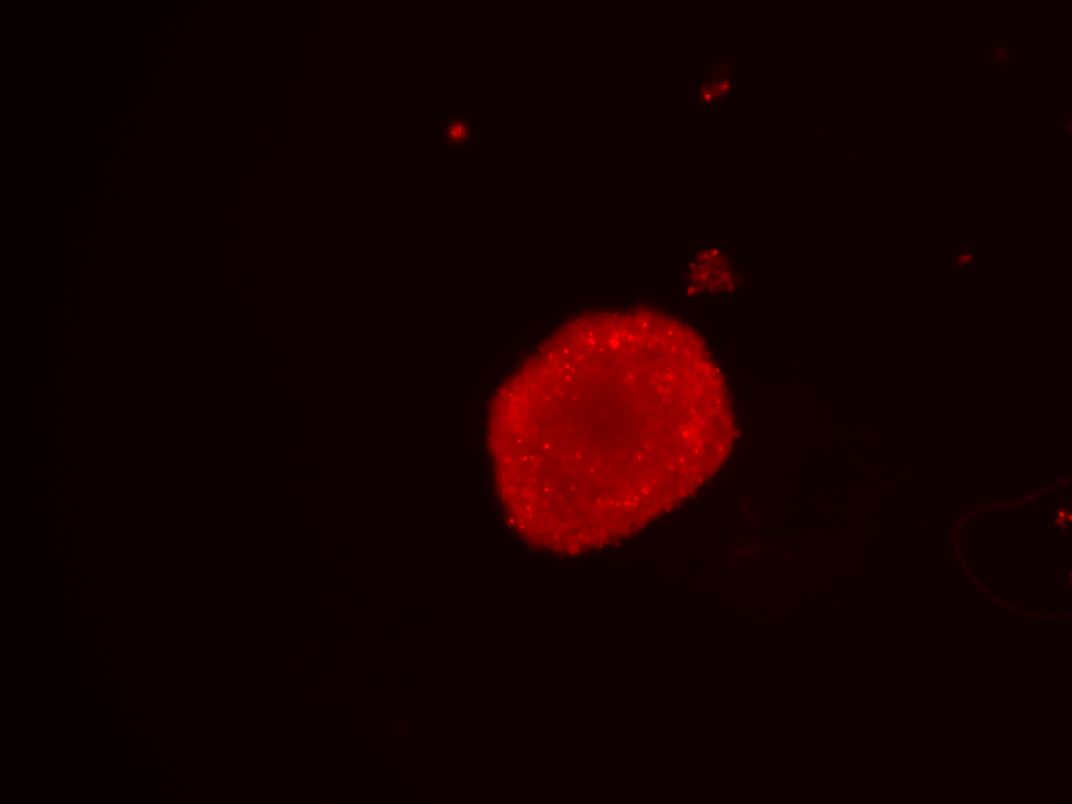
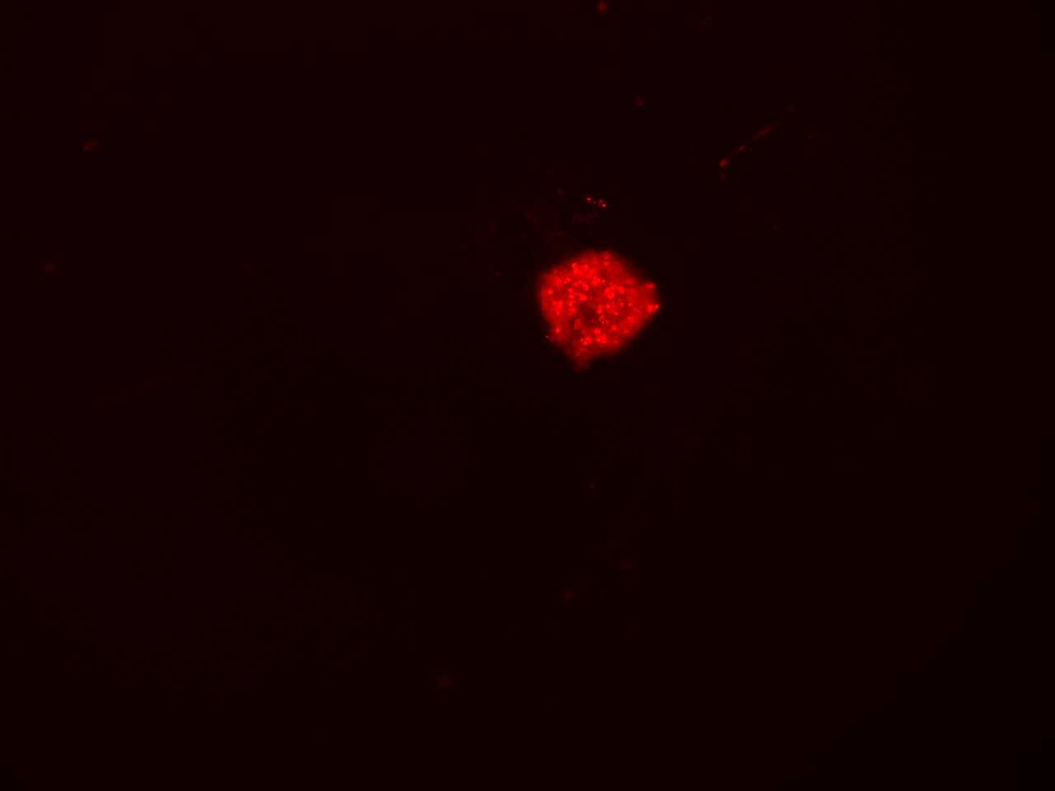
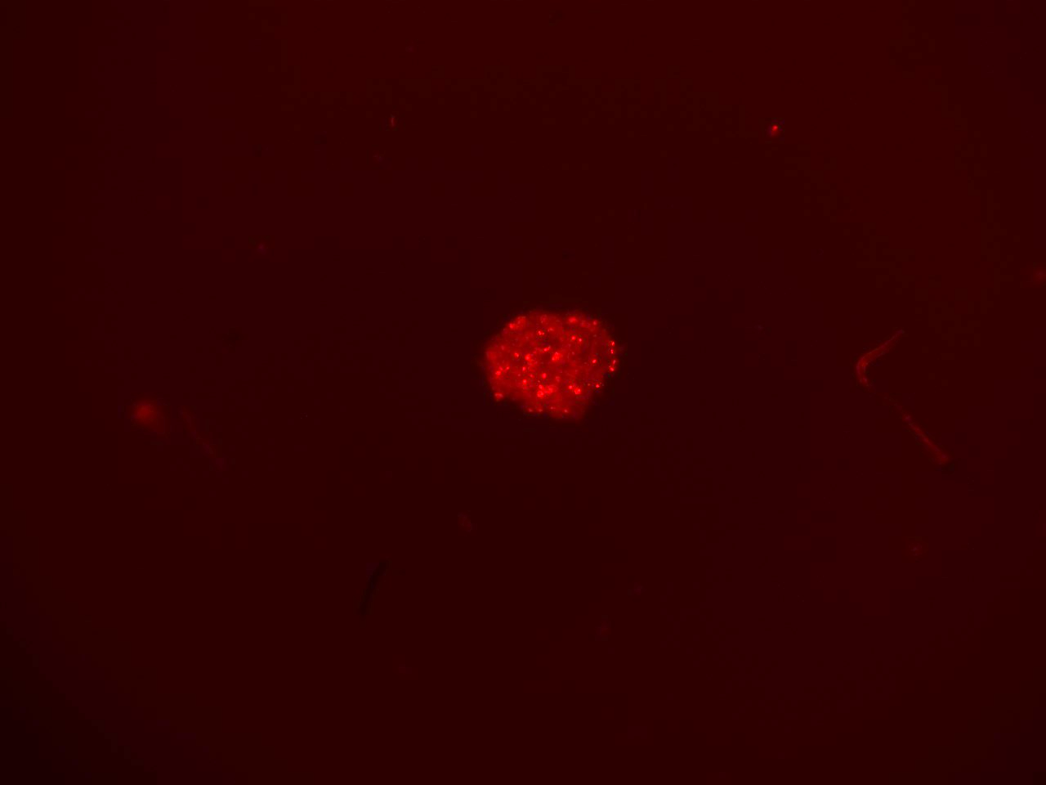
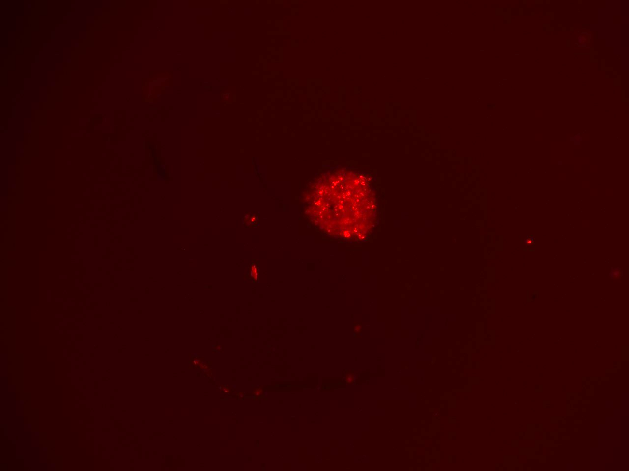
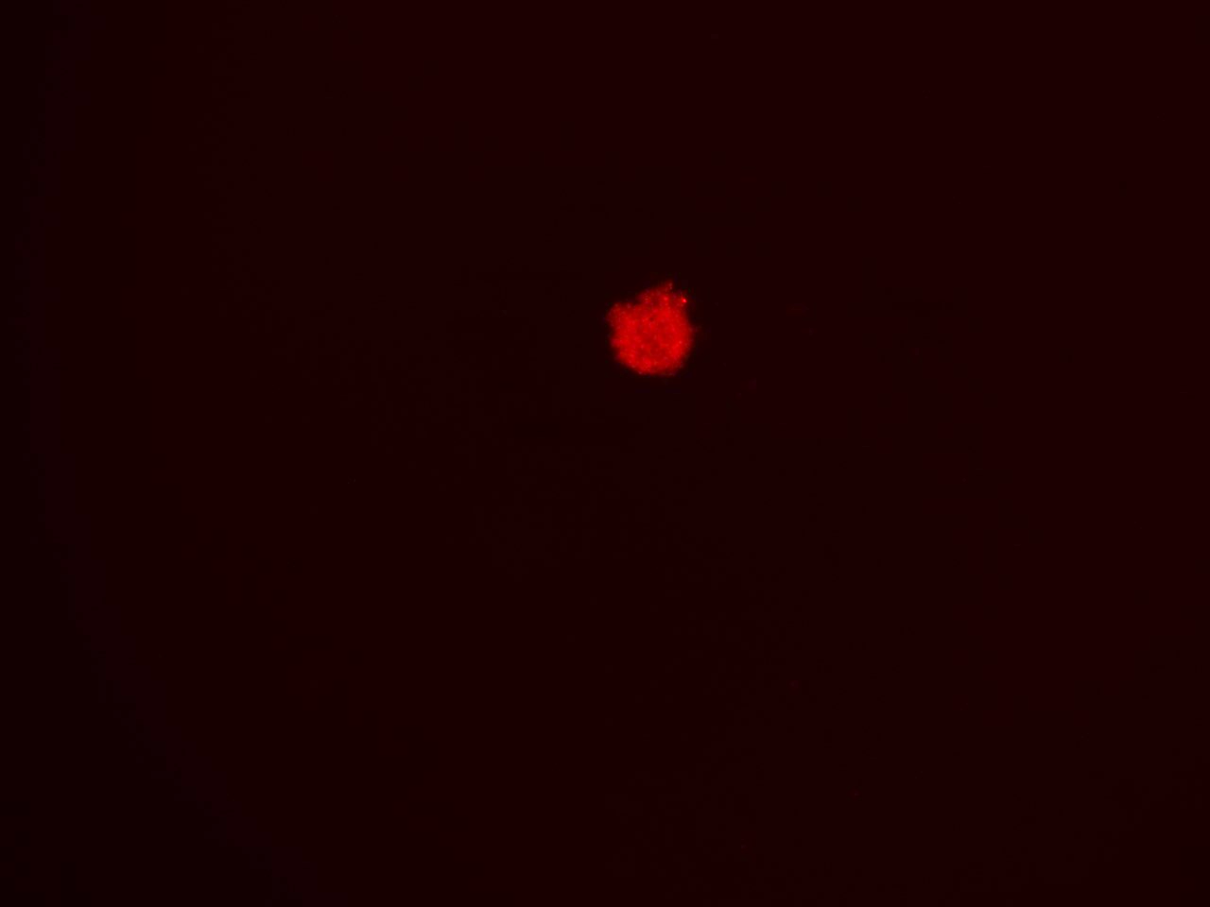
Supplementary Figure S4
A.
Control Dox C1 C2 C3 C4
BX-795 (μM)
0 0 1 2 4 8
Doxorubicin (nM)
0 150 8 16 32 64
Calcein AM
EthD-III
Merged
B.
C.
Control Dox C1 C2 C3 C4
Control Dox C1 C2 C3 C4
Supplementary Figure S4: (A) Fluorescence images of 3D spheroid tumors at day 7 treated with different drug combinations of BX-795 and doxorubicin as shown in Figure 8C. Calcein AM (Green; live cells), Ethidium bromide homodimer III (Red; dead cells), composite merged images of both fluorescence dyes. (B) Quantitative representation of the percentage of cells stained with calcein AM. (C) Quantitative representation of the percentage of cells stained with EthD-III. * p<0.05; ** p<0.01.

