Slide 1
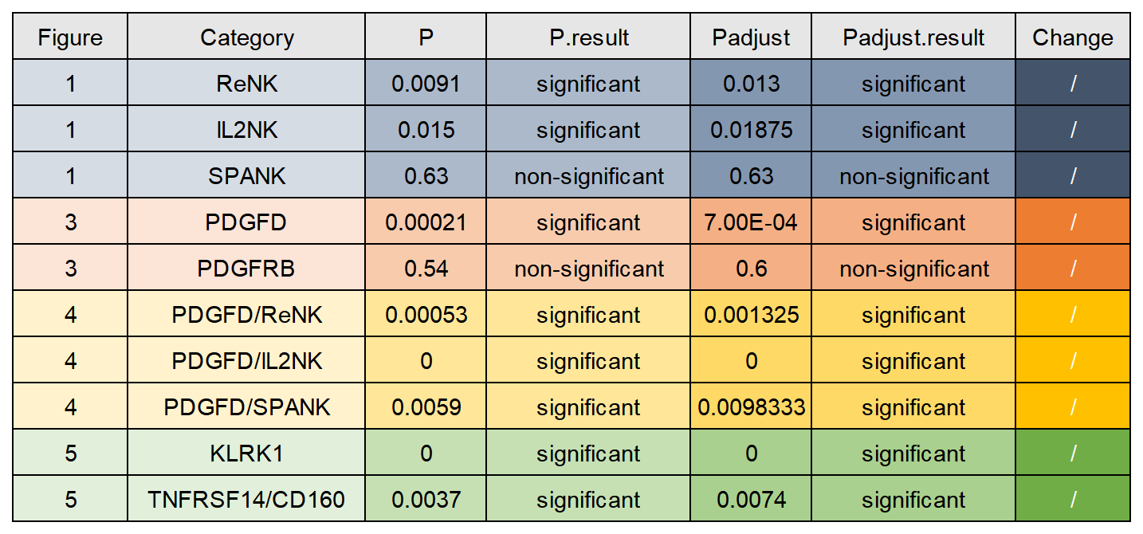
Supplementary Table 1. Log rank p values and Benjamini-Hochberg corrected p values. Log rank P values of Kaplan-Meier curves were all corrected by BH procedure (/ = unchanged).

