Slide 1
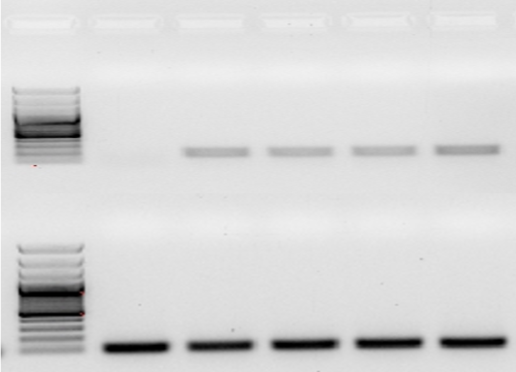
A B
WT 5007 5012 5016 5031
PtLecRLK1
Pavir-eEF-1a
Figure S1 Verification of ZmUbipro-PtLecRLK expression in the switchgrass transgenic plants. A) RT-PCR analysis of PtLecRLK1 expression in switchgrass wild type (WT) and transgenic lines (5007, 5012, 5016, and 5031). Amplification of Pavir-eEF-1a transcript was used as a control. B) Expression of PtLecRLK (from RNAseq data) in switchgrass with and without L. bicolor inoculation.

Slide 2
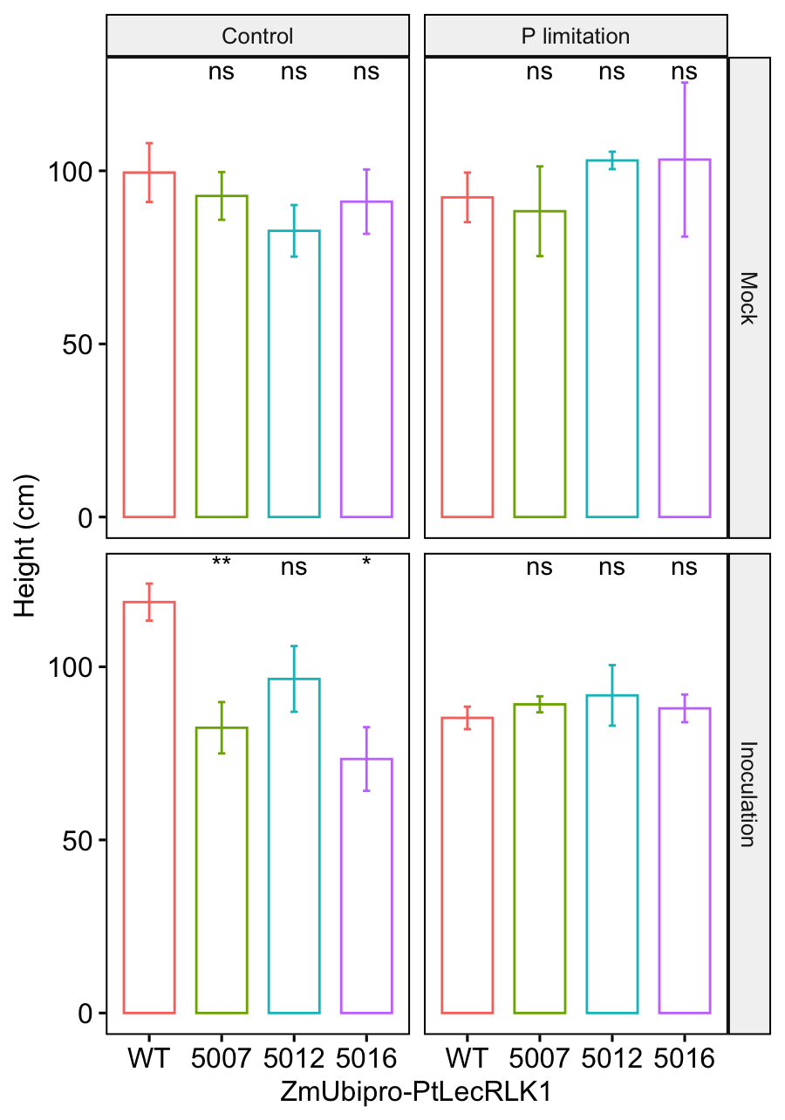
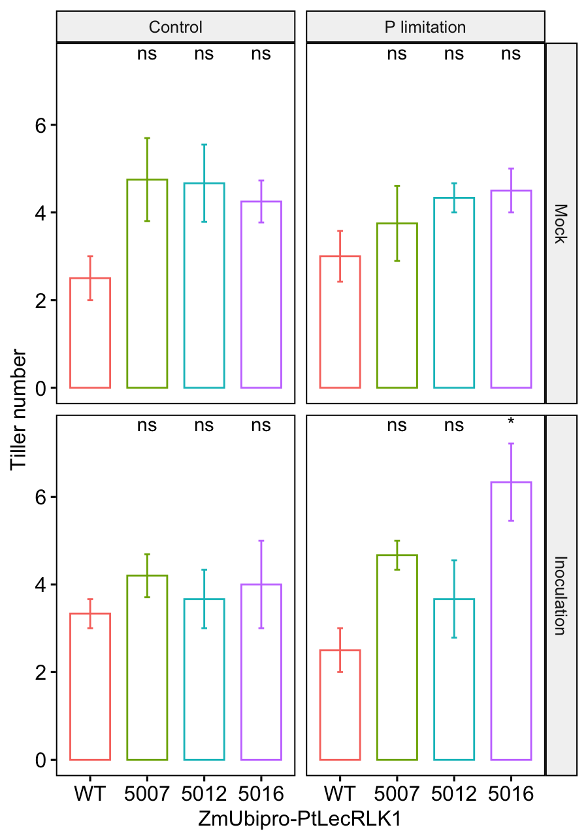
A B
ZmUbipro-PtLecRLK1
ZmUbipro-PtLecRLK1
ZmUbipro-PtLecRLK1
ZmUbipro-PtLecRLK1
Figure S2 Phenotypic parameters of switchgrass in different growth conditions. WT switchgrass (Panicum virgatum L., genotype ‘NFCX01’ ) and ZmUbipro-PtLecRLK1 transgenic switchgrass (lines 5007, 5012 and 5016) inoculated with/without L. bicolor growing under control or phosphorus (P) limitation condition. A) Plant height of WT and transgenic plants in response L. bicolor inoculation and P limitation treatment. B) Plant tiller number of WT and transgenic plants in response L. bicolor inoculation and P limitation treatment. Plots shown are the average values of two to five individual replicates ± standard error. Three-way ANOVA was performed for overall influence of L. bicolor, P limitation, transgene and interactions among them on the switchgrass growth (Table S1). Student’s t-test was performed between transgenic plants and WT plants to examine the significant difference in growth parameters. ns: non-significance, p > 0.05; *: p ≤ 0.05; **: p < 0.01.

Slide 3
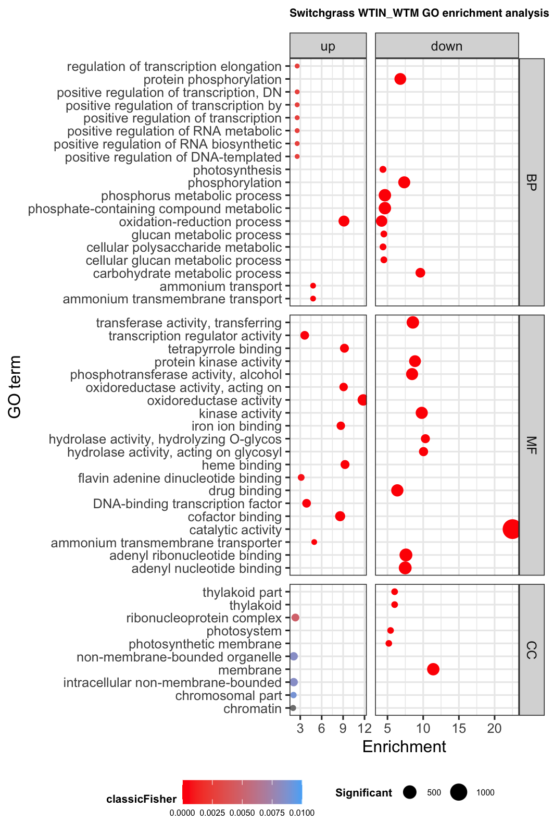
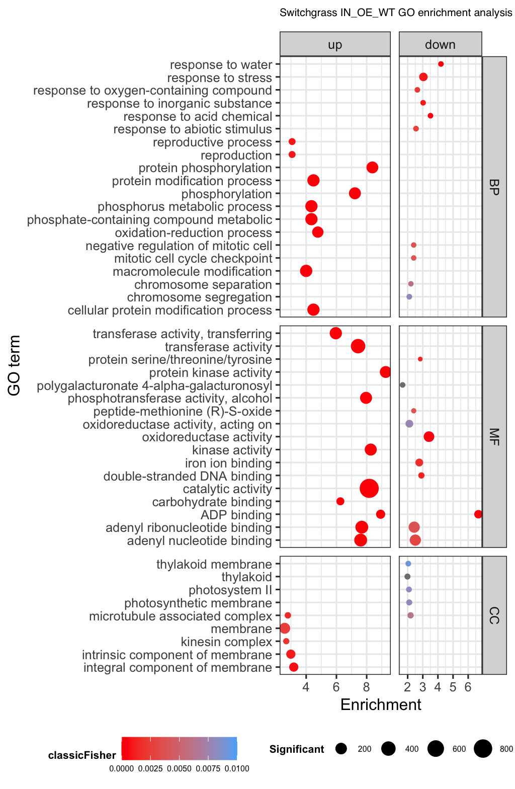
A B
Figure S3 Gene Ontology (GO) enrichment analysis of differential expressed genes. (A) GO enrichment analysis of differential expressed genes between inoculated-WT and mock-WT. (B) GO enrichment analysis of differential expressed genes between inoculated-transgenic and inoculated-WT. BP: biological process; MF: molecular function; CC: cellular component. The dot size reflects the number of genes included in the category.

Slide 4
Figure S4 Genes related to nutrient assimilation. Green bars show genes that are regulated in response to L. bicolor inoculation only. Red bars show genes that are regulated by L. bicolor inoculation plus the PtLecRLK1 transgene.

Slide 5
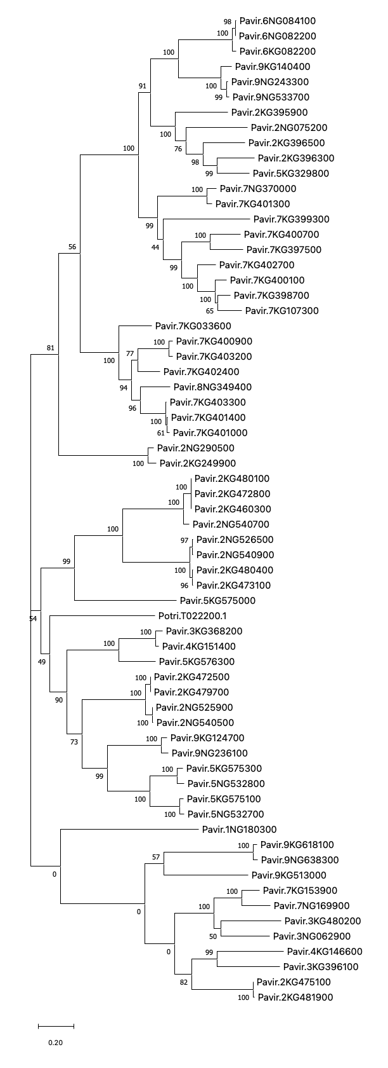
Figure S5
A B
Inoc-WT vs Mock-WT | Inoc-trans vs Mock-trans | Mock-trans vs Mock-WT | Inoc-trans vs Inoc-WT
 | 2.177 |  | 3.246
2.774 | 2.642
-3.535 | -2.601
-6.045 |  |  | 4.811
 |  |  | -2.425
 |  | 7.704 | 10.802
2.723
-3.502 | -5.035
 | -3.230
 | 2.418
 |  |  | 2.025
6.607 | 4.281
6.226 | 4.486
 | -4.257
-2.983 | -2.320
4.626 |  |  | -5.105
2.864 | -4.870 |  | -6.942

Slide 6
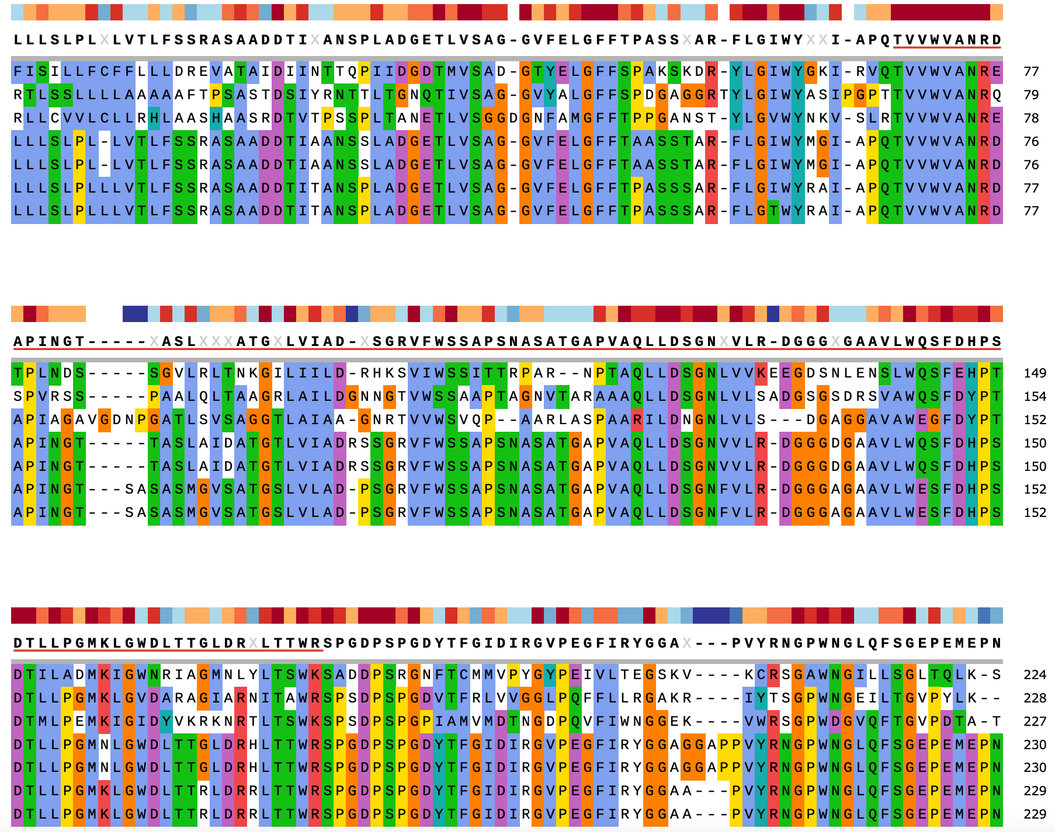
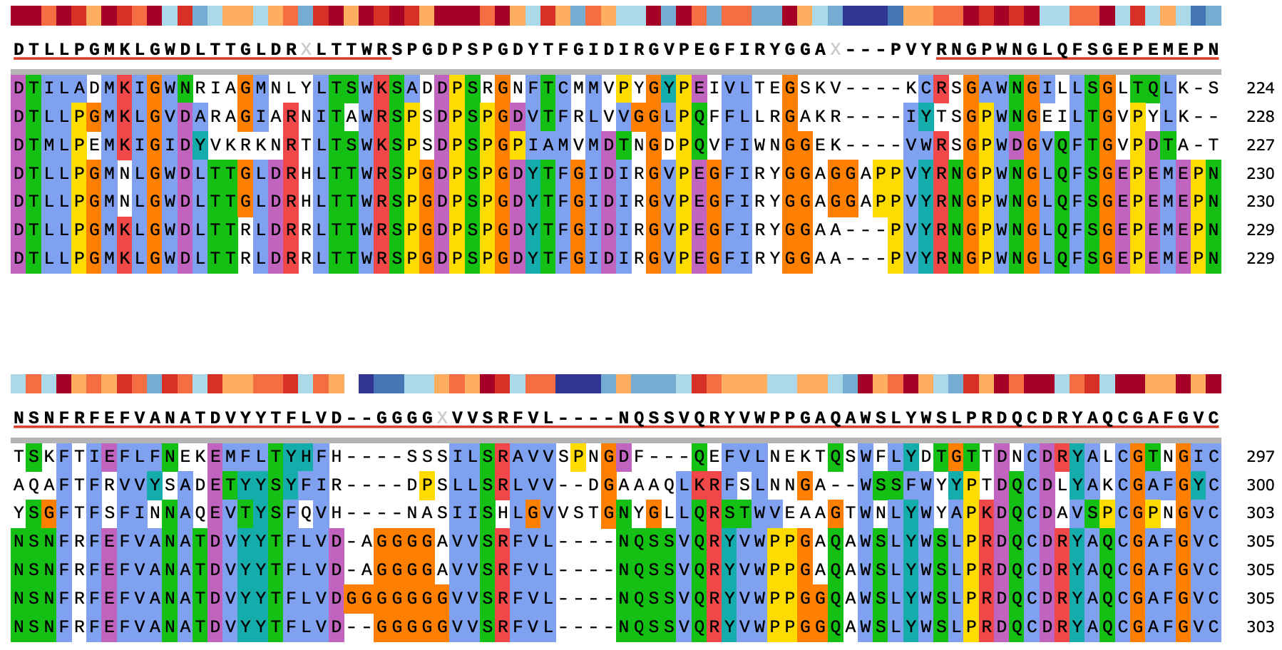
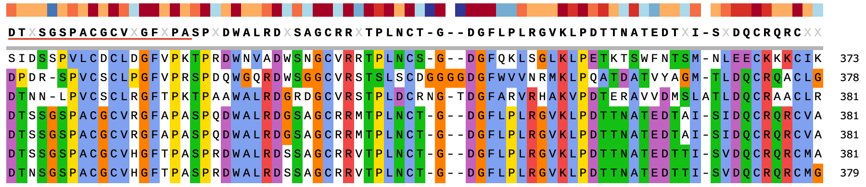
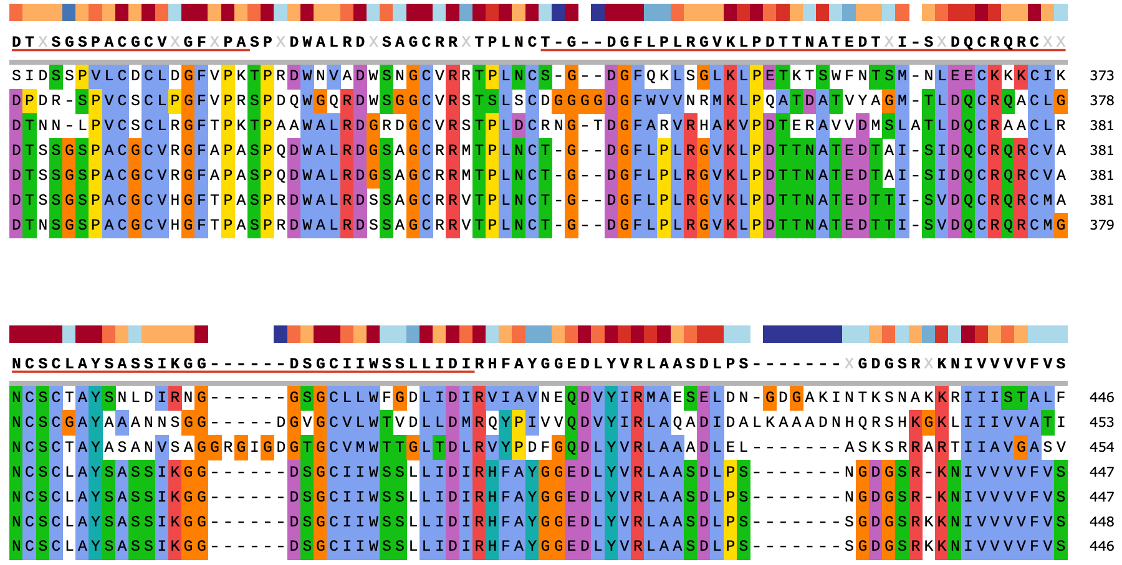
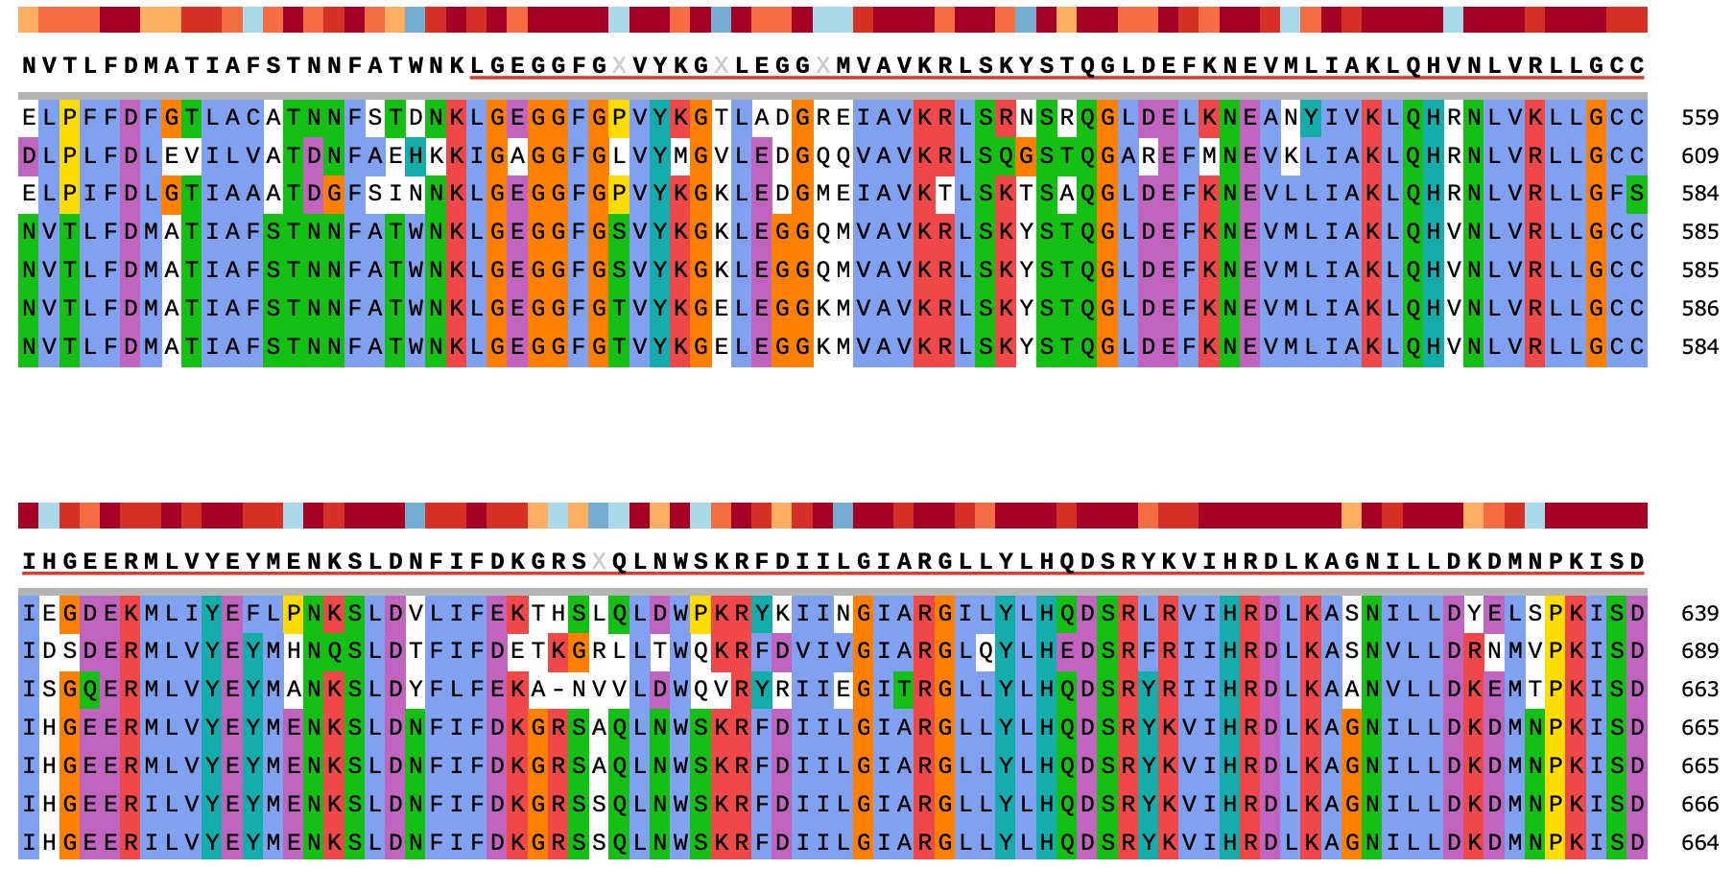
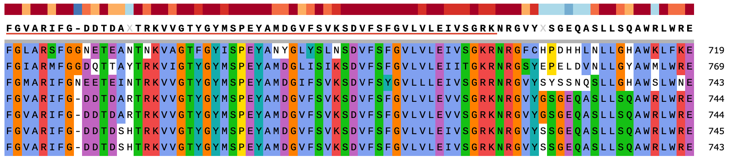
Figure S5-continue
C. D-mannose binding lectin domain
D. S-locus glycoprotein domain
E. PAN-like domain
F. Protein kinase domain
Consensus
Potri.T022200
Pavir.5KG575100
Pavir.5KG576300
Pavir.2KG472500
Pavir.2KG479700
Pavir.2NG525900
Pavir.2NG540500
Consensus
Potri.T022200
Pavir.5KG575100
Pavir.5KG576300
Pavir.2KG472500
Pavir.2KG479700
Pavir.2NG525900
Pavir.2NG540500
Consensus
Potri.T022200
Pavir.5KG575100
Pavir.5KG576300
Pavir.2KG472500
Pavir.2KG479700
Pavir.2NG525900
Pavir.2NG540500
Consensus
Potri.T022200
Pavir.5KG575100
Pavir.5KG576300
Pavir.2KG472500
Pavir.2KG479700
Pavir.2NG525900
Pavir.2NG540500
Figure S5 PtLecRLK1 sequence homology in switchgrass. A) Molecular phylogenetic analysis by maximum likelihood based on the JTT matrix-based model. The tree with the highest log likelihood (-57305.66) is shown. The percentage of trees in which the associated taxa clustered together is shown next to the branches. Initial tree for the heuristic search were obtained by applying the Neighbor-Joining method to a matrix of pairwise distances estimated using a JTT model. The tree is drawn to scale, with branch lengths measured in the number of substitutions per site. The analysis involved 65 amino acid sequences. There were a total of 1,238 positions in the final dataset. Evolutionary analyses were conducted in MEGA X. B) Fold change of differential expressed genes in different conditions. IN-trans, M-trans, IN-WT, and M-WT are abbreviations for inoculated-transgenic, mock-transgenic, inoculated-WT and mock-WT. Red and blue colors indicate the up- and down- regulated genes, respectively; Red and blue arrows point to the PtLecRLK1 and its 6 closest switchgrass sequence homologous LecRLKs. C) –F) Conserved domains (D-mannose binding lectin domain, S-locus glycoprotein domain, PAN-like domain and Protein kinase domain) in PtLecRLK1 and 6 closest switchgrass sequence homologues LecRLKs. Color blocks on top of the alignments indicate the degree of sequence conservation. Blue to red block color indicates low to high degree of conservation.

Slide 7
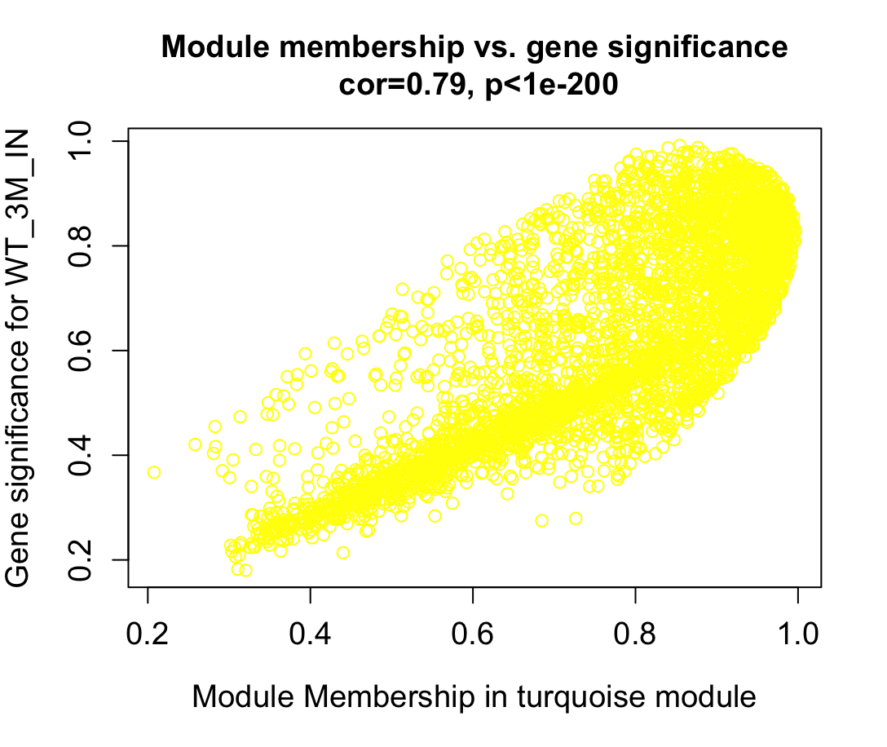
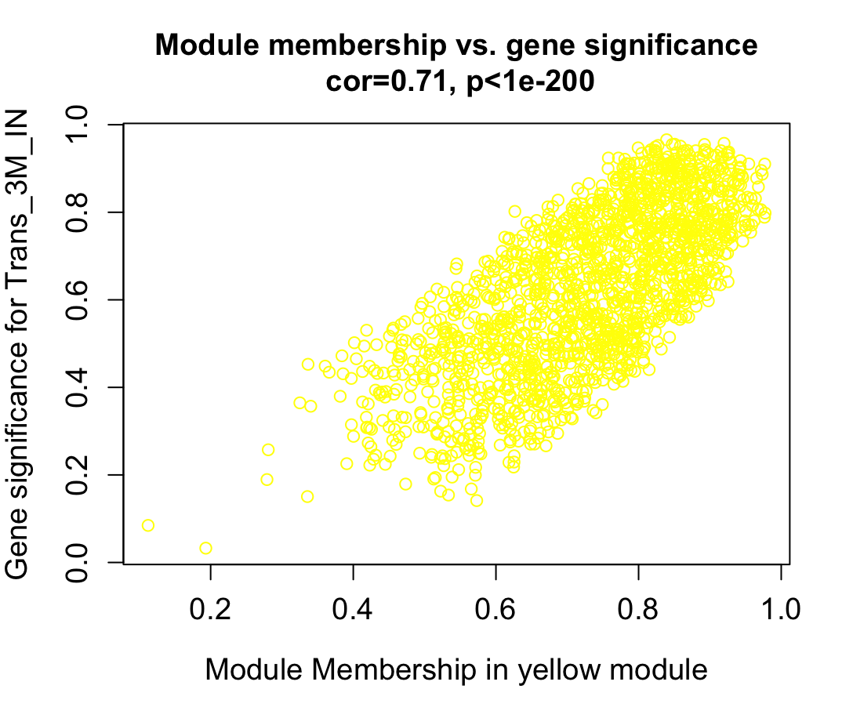
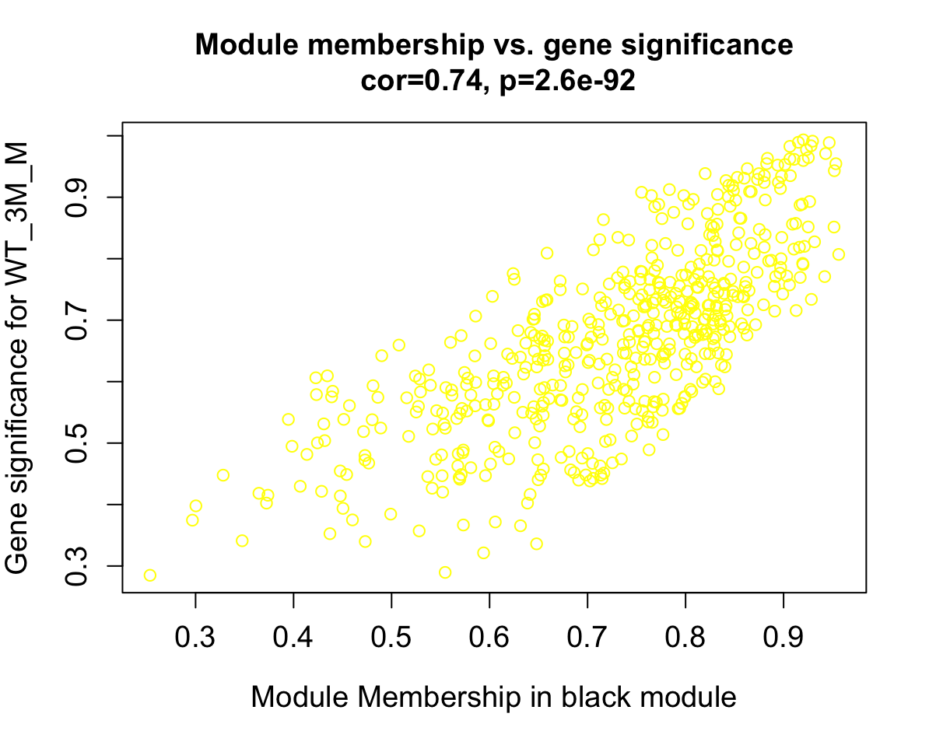
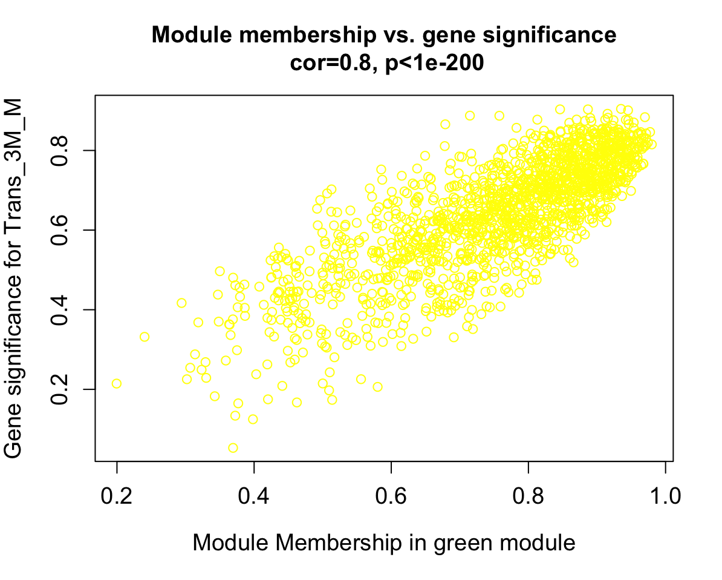
A B
C D
Gene significance for inoculated-WT
Gene significance for inoculated-transgenic
Gene significance for mock-WT
Gene significance for mock-transgenic
Figure S6 Scatterplots of Gene Significance (GS) for weight vs. Module Membership (MM) in the turquoise, yellow, black and green modules. There is a highly significant correlation between GS and MM in this module.

Slide 8
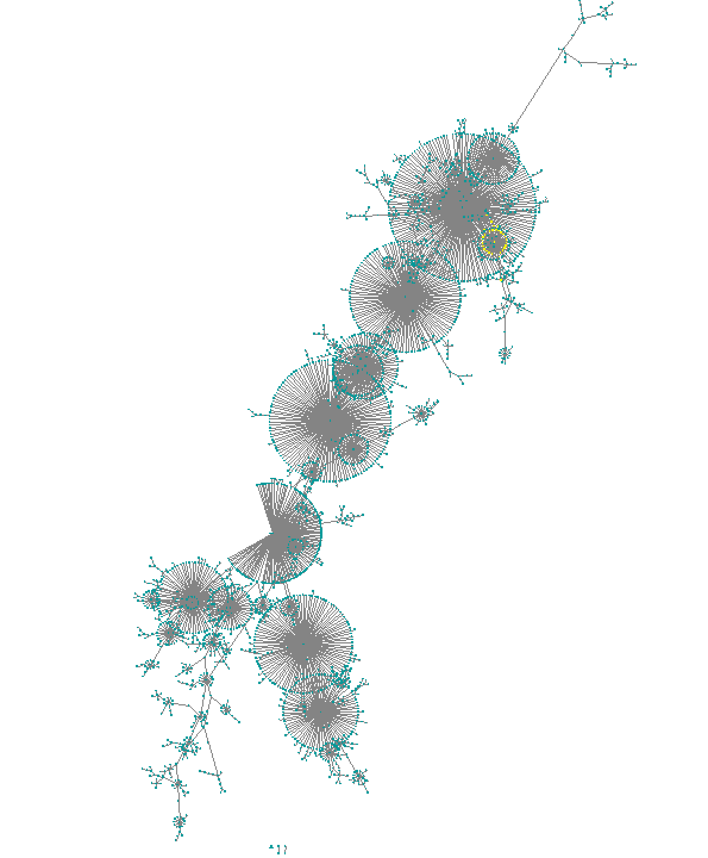
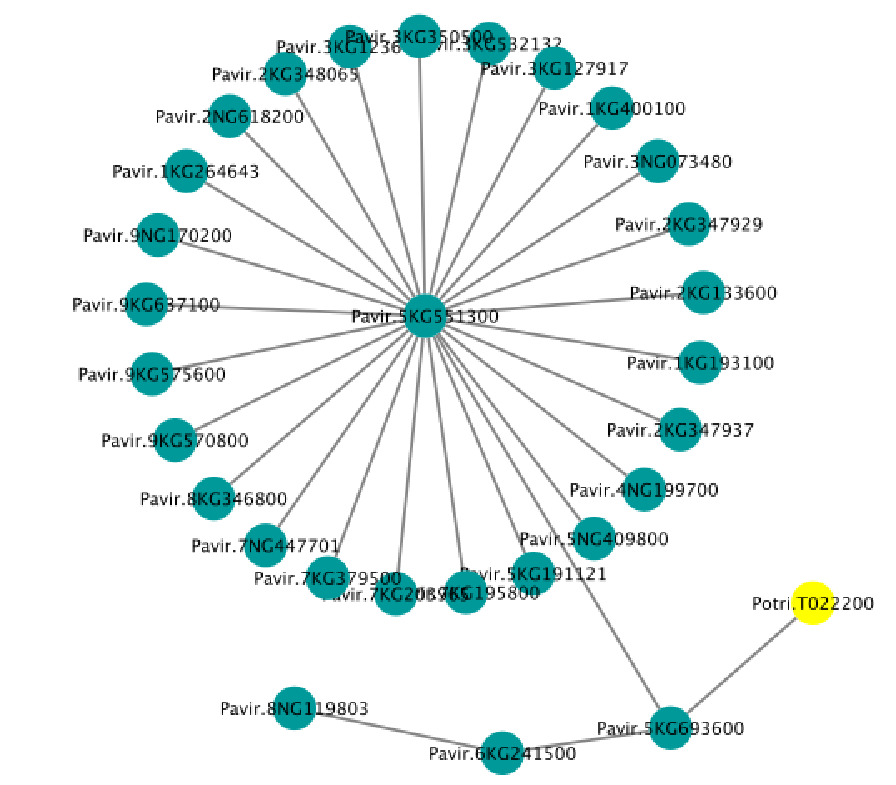
Figure S7 A co-expression network in the inoculated-transgenic module. The average gene expression values of all the replicates from the respective condition were used to build the network. Yellow color in the zoom-in indicates the PtLecRLK1.

