Slide 1
A case report of immune checkpoint inhibitor-related steroid-refractory myocarditis and myasthenia gravis-like myositis treated with abatacept and mycophenolate mofetil
Submitted: May 2021
EHJ-CR-D-21-00189

Slide 2
Introduction
      Immune checkpoint inhibitor (ICI)-related myocarditis is an uncommon but potentially fatal adverse event with mortality rates up to 50%¹
      Myocarditis caused by ICI occurs frequently concurrent with myositis (25%) and myasthenia gravis-like conditions (10%)¹
      Glucocorticoid is the essential treatment of ICI-related myocarditis. Steroid-resistant cases are an important clinical challenge²

Slide 3
Case Presentation
History and Examination Findings
      57-years old male with metastatic renal cell carcinoma (RCC) received first dose combination ICI nivolumab (anti-PD-1) and ipilimumab (anti-CTLA-4). No cardiovascular risk factors.
      12 days after ICI he was admitted to the hospital due to headache, myalgia, and palpitations. No chest pain or dyspnoea.
      In the following days the patient developed weakness in his proximal and distal muscles.

Slide 4
Case Presentation
Investigations at admission
      Clinical findings at admission: normal physical examination with vital parameters SpO₂ 96%, respiratory rate 20 breaths per minute, blood pressure 109/75 mmHg, pulse 119 beats per minute and normal temperature. ECG with new onset first-degree AV-block and RBBB. ECG subsequently with complete heart block and ventricular tachycardia (VT)
      Elevation of troponin I: 5760 ng/L (normal values < 7 ng/L), increasing to 16400 ng/L
      Elevation of creatine phosphokinase (CPK): 3510 U/L (normal range 40-280 U/L)
      Apical hypokinesia and ejection fraction 50% on transthoracic echocardiography (TTE)

Slide 5
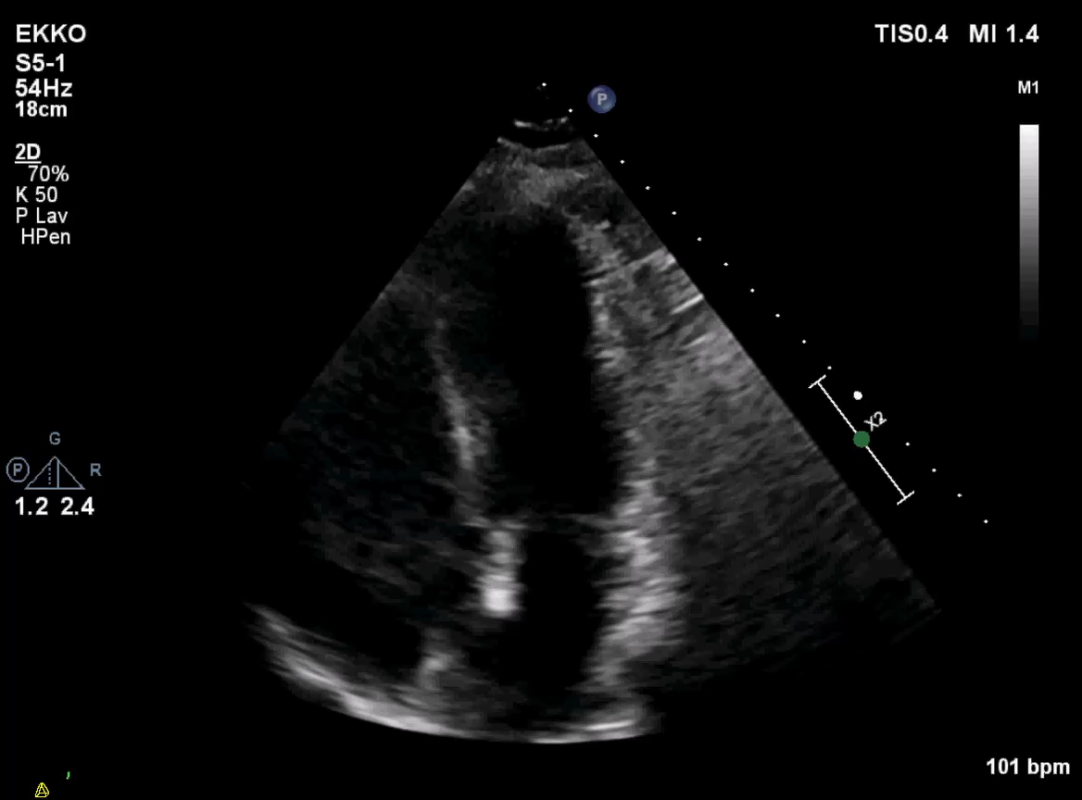
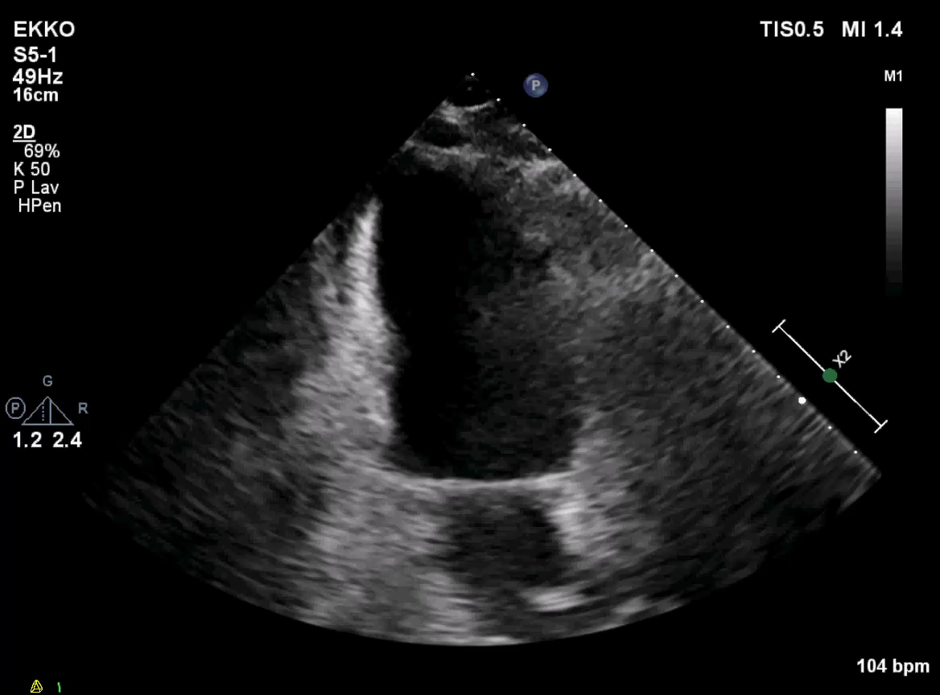
TTE with apical hypokinesia and ejection fraction 50%
Case Presentation
Investigations at admission
      ECG with first-degree AV-block and RBBB

Slide 6
Case Presentation
Investigations
      Cardiac MRI failed due to arrhythmia
      Endomyocardial biopsy was not performed due to the invasive character
      However, there was a strong clinical suspicion of ICI-related myocarditis and myasthenia gravis-like myocarditis.

Slide 7
Case Presentation
Management
Myocarditis
Discontinuation of ICI
      Day 12 (at admission): Intravenous methylprednisolone 2 mg/kg/day
      Day 14: Intravenous methylprednisolone 1000 mg/day for 3 days
      Day 18: Intravenous abatacept (CTLA-4-agonist) (500 mg/2 weeks, a total for 5 doses) and mycophenolate mofetil (1 g x 2/ day for 3 months)

Slide 8
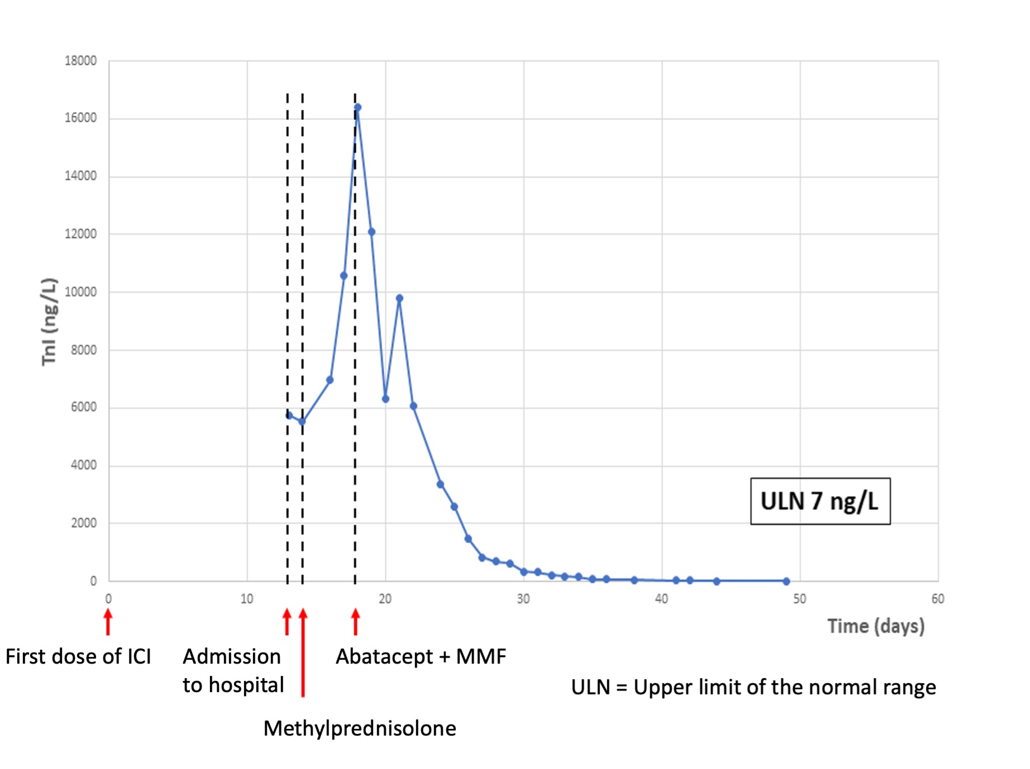
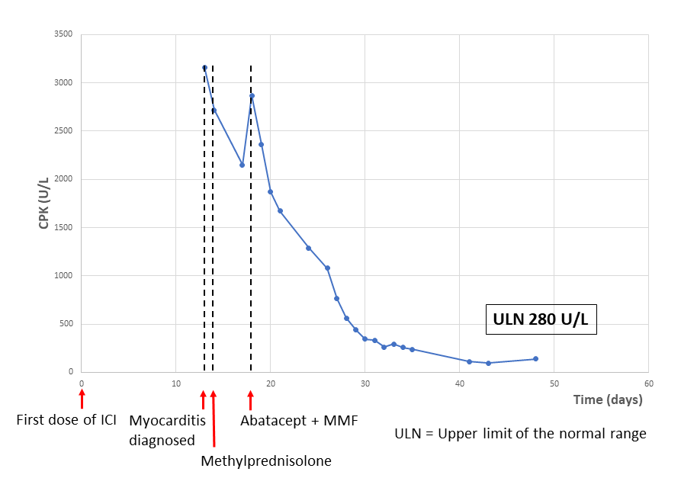
Case Presentation
Management
TnI and CPK

Slide 9
Case presentation
Follow-up
3 weeks after ICI Cardiac arrest (ventricular tachycardia).
Resuscitated after external defibrillation, ICD inserted.
6 weeks after ICI TnI normalized, VT decreased, tapering of steroid. Discharged from hospital.
12 weeks after ICI PET with progression.
48 weeks after ICI Patient passed away (cancer-related).

Slide 10
Discussion of diagnosis
The diagnosis of ICI-related myocarditis was based on:
    Palpitations, no chest pain or dyspnoea
    Concurrent symptoms of myasthenia gravis-like myositis
    Highly elevated TnI and CPK
    Relevant changes in ECG and TTE
    No other cardiovascular risk factors³

Slide 11
Discussion of treatment
Treatment of ICI-related myocarditis
      Glucocorticoid
Steroid-refractory ICI-related myocarditis
      Other immune suppressive treatments, e.g. MMF, anti-thymocyte globulin, intravenous immunoglobulin, infliximab, plasmapheresis or abatacept

Slide 12
Learning Points
1) ICI-related myocarditis is an infrequent adverse event with mortality rate up to 50%. It often presents with a simultaneous myositis.
2) ICI-related myocarditis can be challenging to identify. Characteristic cardiac symptoms can be absent.
3) Central treatment of ICI-related myocarditis is glucocorticoid. In steroid-refractory cases abatacept and MMF can be used. Clinical trials are needed to determine the optimal treatment of steroid-refractory myocarditis.

Slide 13
References
      1: Salem JE, Manouchehri A, Moey M, Lebrun-Vignes B, Bastarache L, Pariente A, et al. Spectrum of cardiovascular toxicities of immune checkpoint inhibitors: A pharmacovigilance study. Lancet Oncol. 2018 Dec; 19(12): 1579–1589.
      2: Brahmer JR, Lacchetti C, Schneider BJ, Atkins MB, Brassil KJ, Caterino JM. Management of Immune-Related Adverse Events in Patients Treated With Immune Checkpoint Inhibitor Therapy. American Society of Clinical Oncology Clinical Practical Guideline. J Clin Oncol 2018; 36:1714-68.
      3: Mir H, Alhussein M, Alrashidi S, Alzayer H, Alshatti A, Valetteas N, et al. Cardiac Complications Associated With Checkpoint Inhibition: A Systematic Review of the Literature in an Important Emerging Area. Canadian Journal of Cardiology, 2018 Jan; 34(8):1059-1068.

