Slide 1
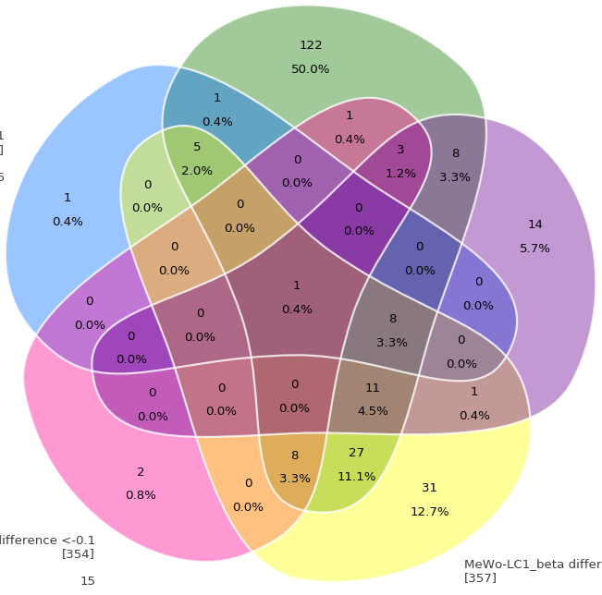
HepG2
GO pathway
Difference of β <-0.1
122
50.0%
HepG2
GO pathway
Difference of β >0.1
1
0.4%
1
0.4%
5
2.0%
0
0.0%
3
1.2%
0
0.0%
8
3.3%
1
0.4%
0
0.0%
0
0.0%
14
5.7%
U251
GO pathway
Difference of β <-0.1
0
0.0%
0
0.0%
0
0.0%
1
0.4%
0
0.0%
0
0.0%
8
3.3%
0
0.0%
0
0.0%
0
0.0%
0
0.0%
0
0.0%
11
4.5%
1
0.4%
8
3.3%
27
11.1%
2
0.8%
0
0.0%
MeWo-LC1
GO pathway
Difference of β <-0.1
31
12.7%
MeWo-LC1
GO pathway
Difference of β >0.1

