Slide 1
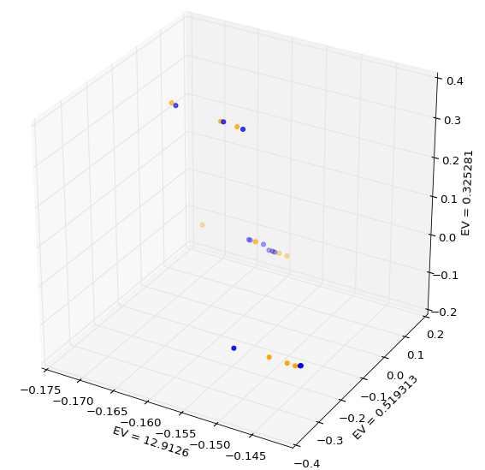
End_No irradiation
Baseline

