Slide 1
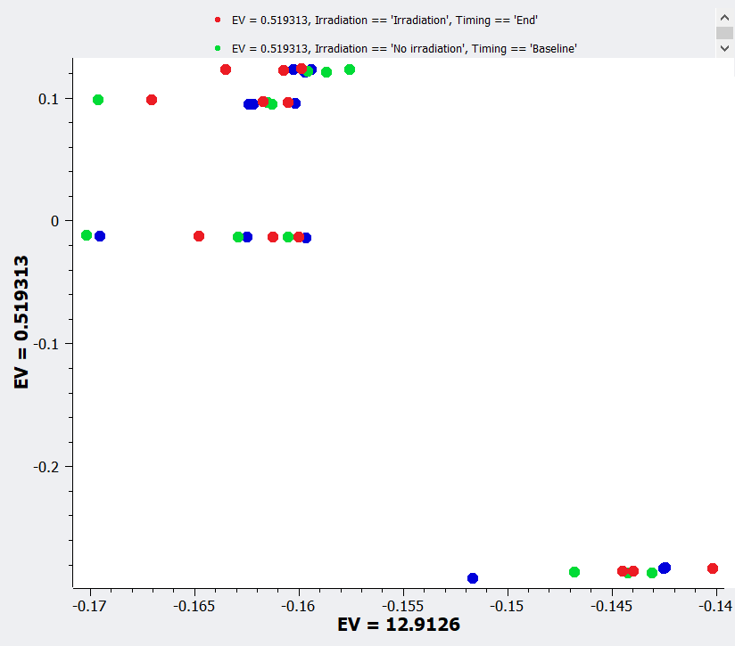
MeWo
‘Baseline’ condition
‘End_No irradiation’ condition
MeWo-LC1
‘End_Irradiation’ condition
U251
HepG2

