Slide 1
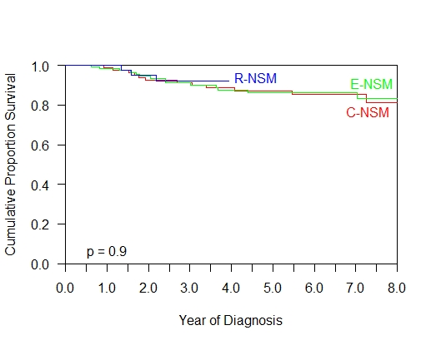
Supplementary Fig 2a. Disease Free survival of various nipple sparing mastectomy with immediate breast reconstruction

Slide 2
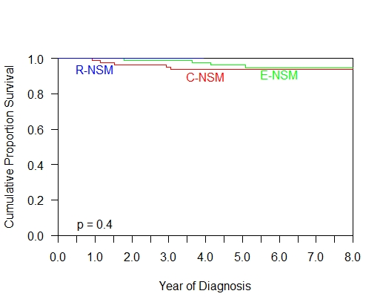
Supplementary Fig 2b. Overall survival of various nipple sparing mastectomy with immediate breast reconstruction

