Slide 1
Supplemental Fig S1
Spectra of short complex glycans identified on N331.
a.
b.

Slide 2
Supplemental Fig S2
T523 was identified as O-glycosite from recombinant RBD protein
a.
b.

Slide 3
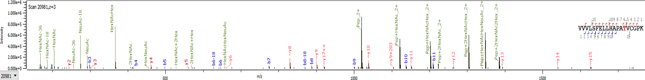
Supplemental Fig S2 continued
c.
d.

Slide 4
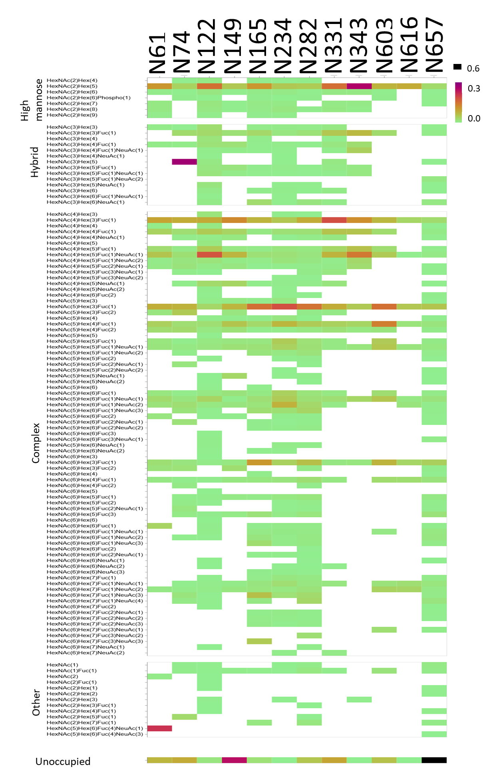
Supplemental Fig S3

Slide 5
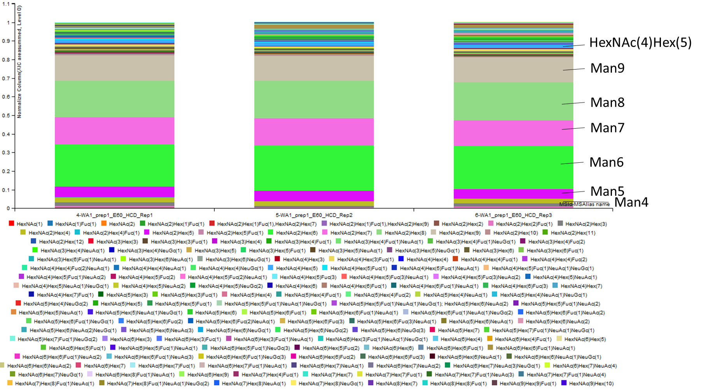
Supplemental Fig S4 A

Slide 6
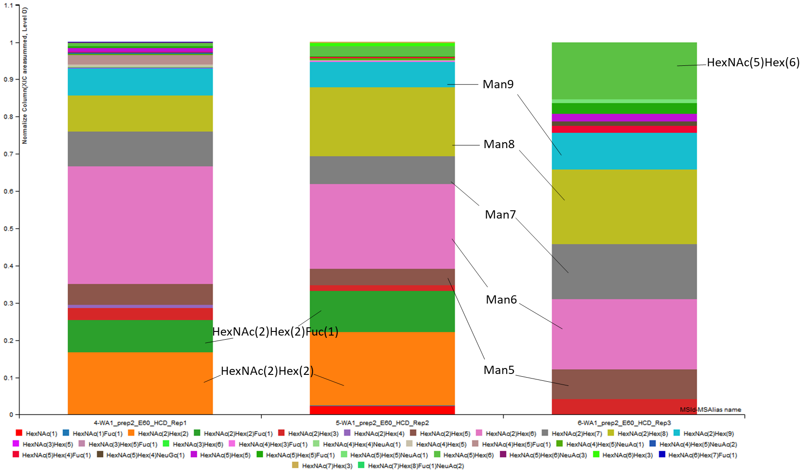
Supplemental Fig S4 B

