Slide 1
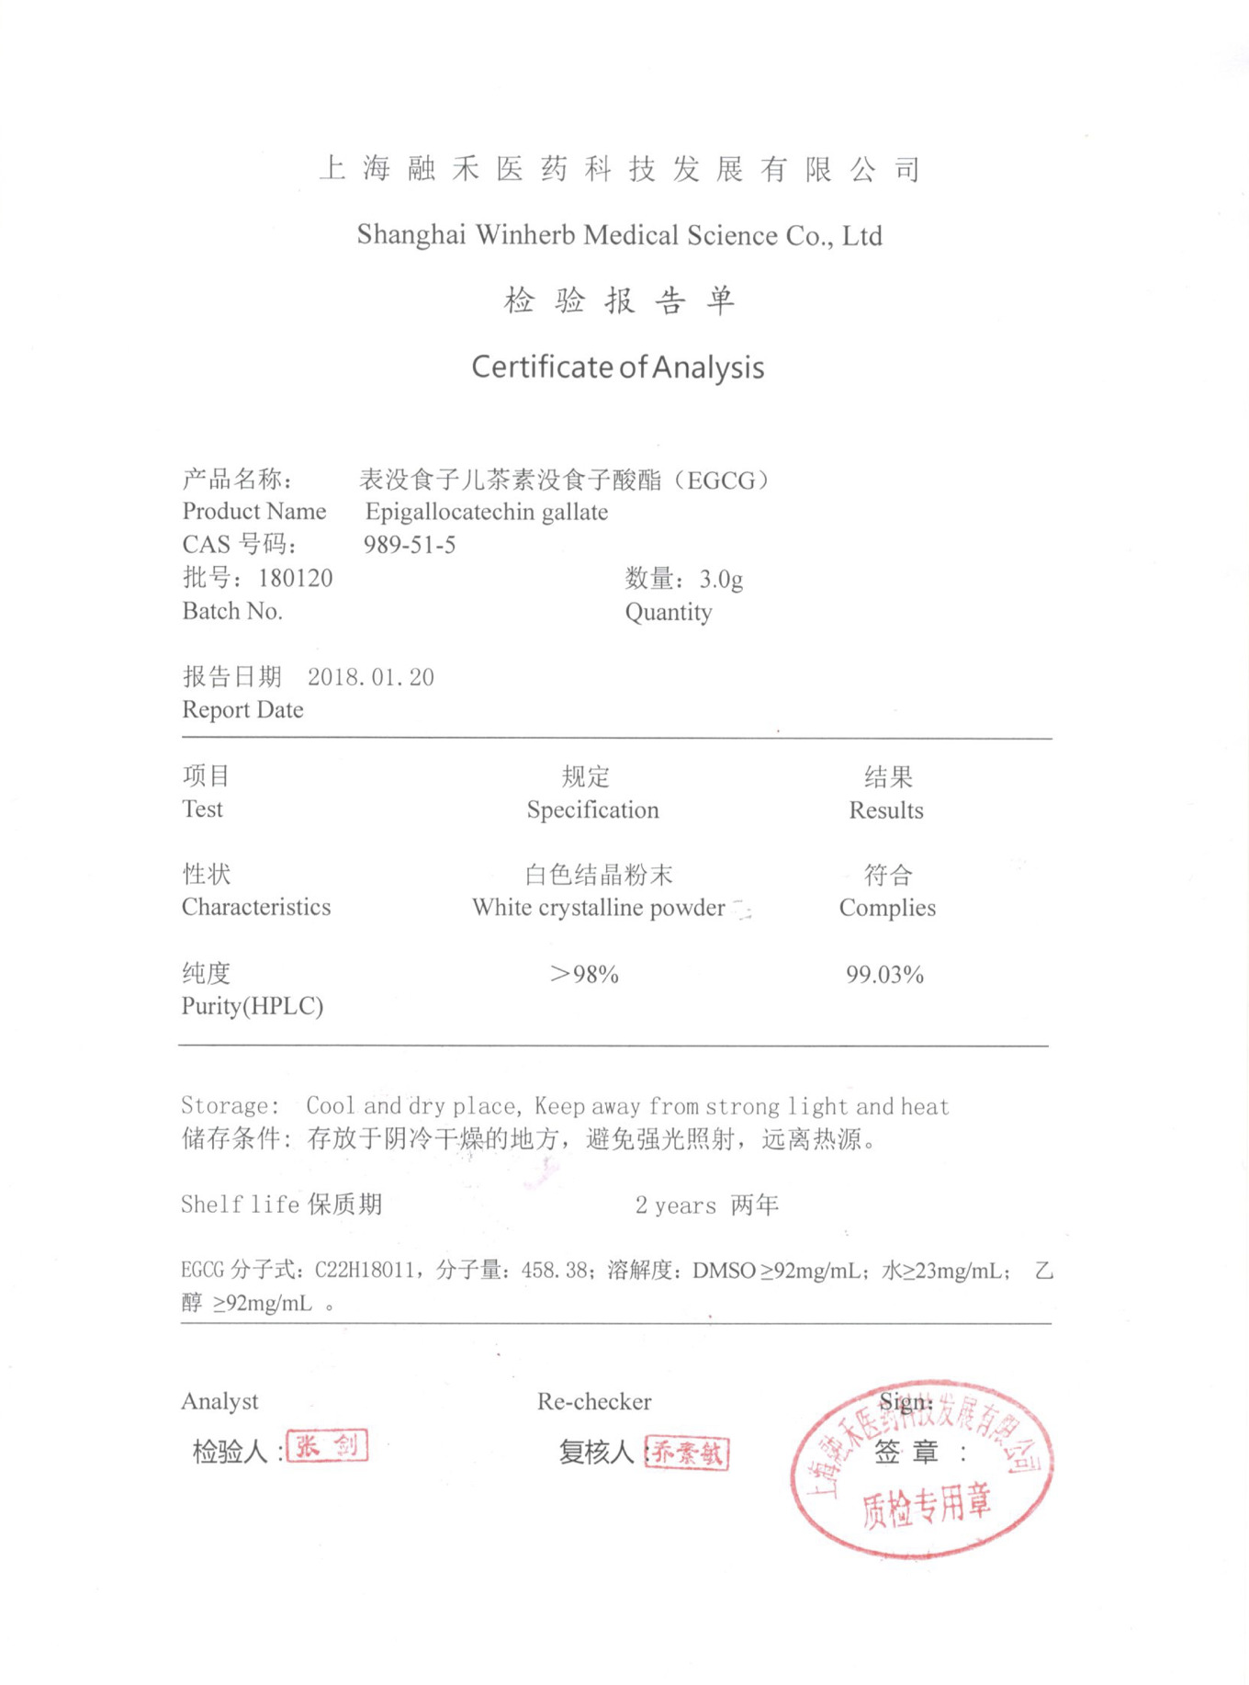
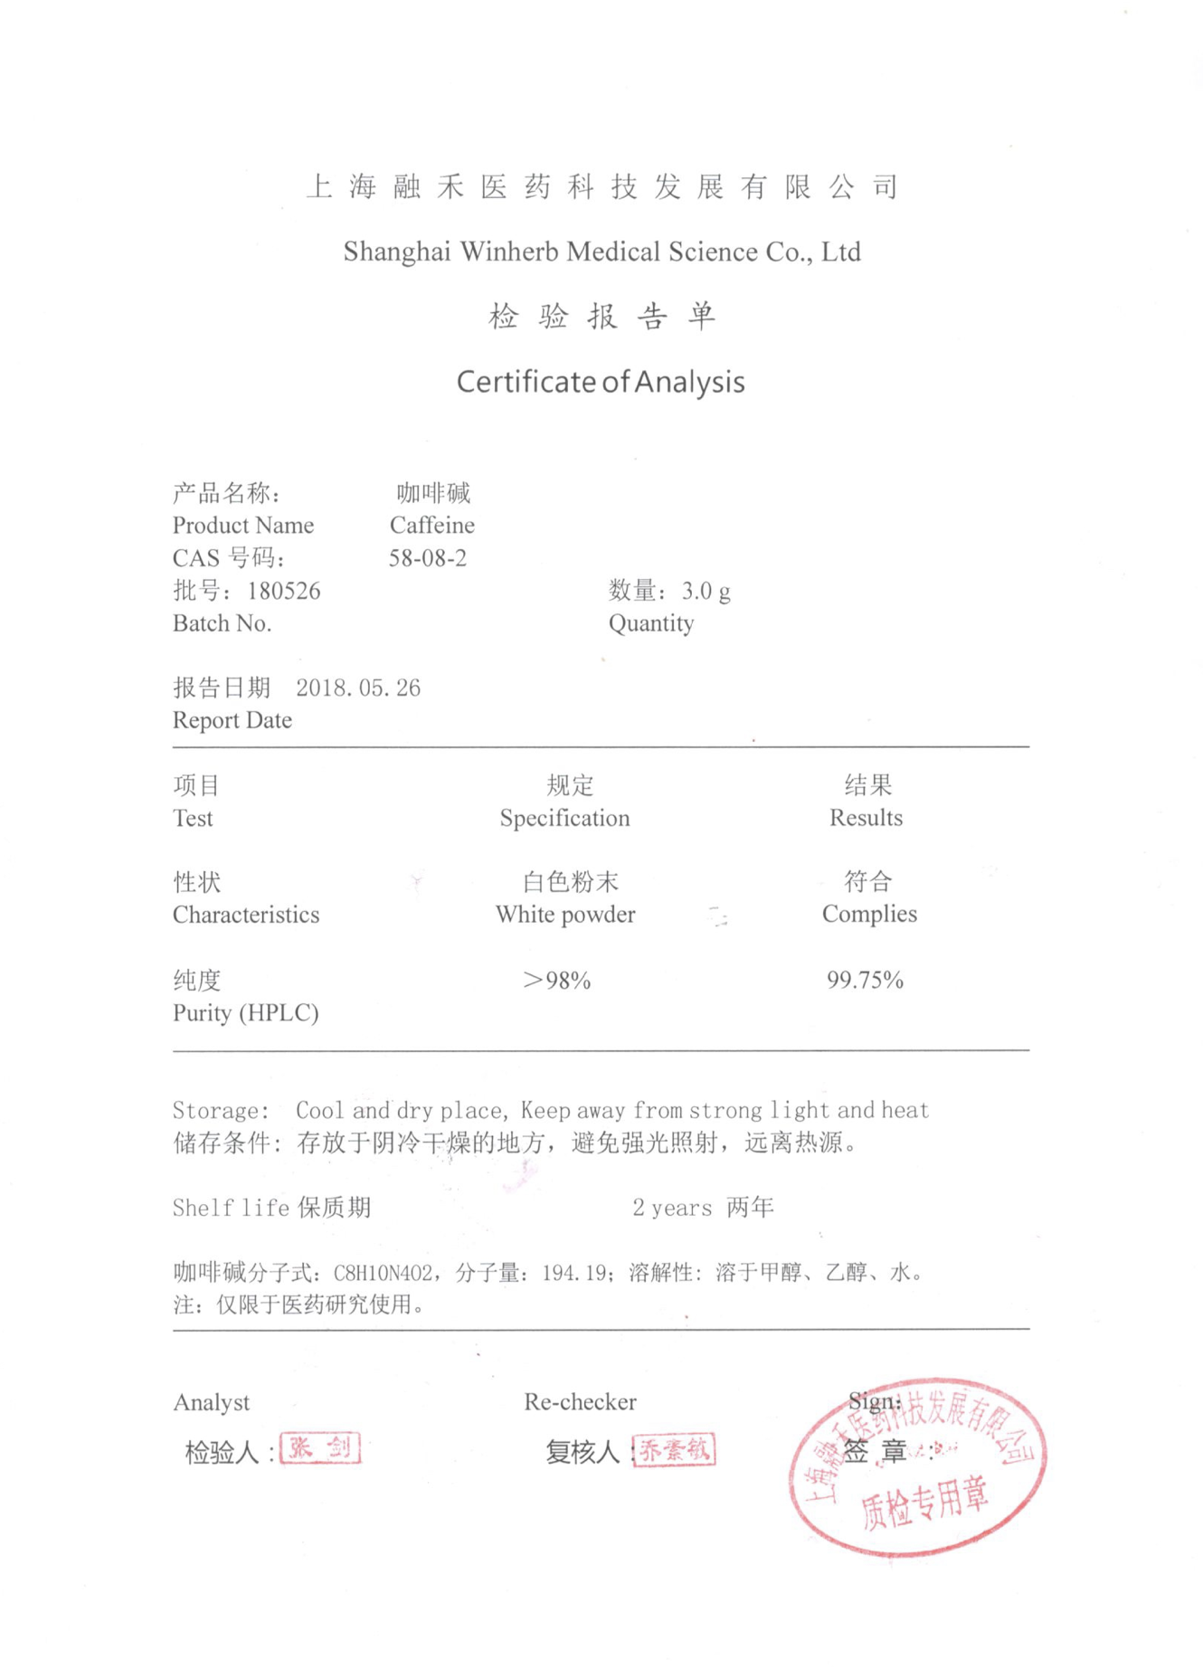
Supplemental Figure1

Slide 2
Supplemental Table1
Primary antibody name | Catalog Number | Company | Dilution range
α-SMA | ab5694 | abcam | 1:1000
Col-1 | ab34710 | abcam | 1:1000
GAPDH | 2118 | CST | 1:1000

