Slide 1
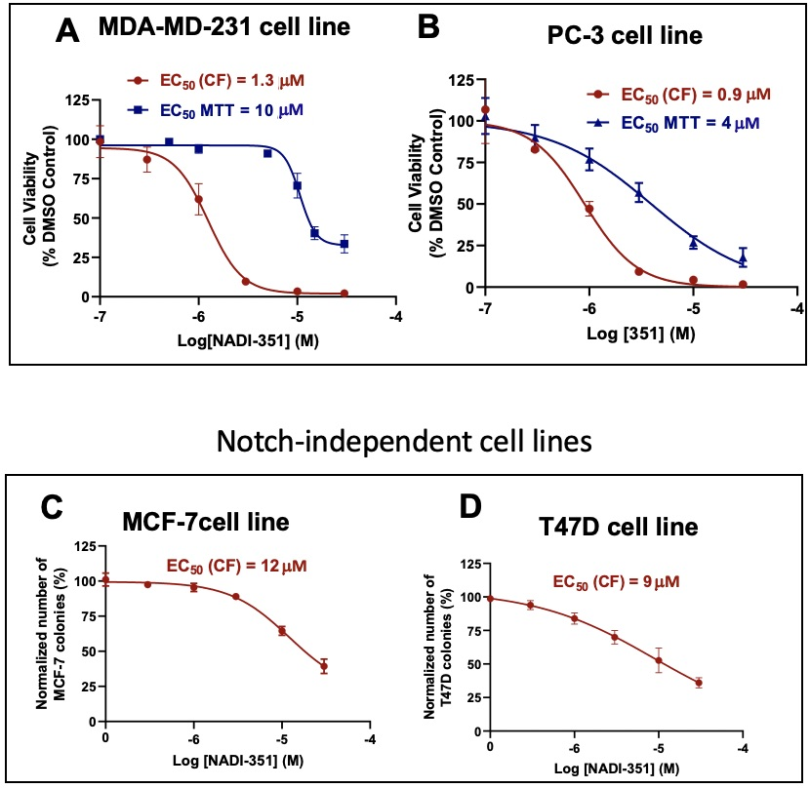
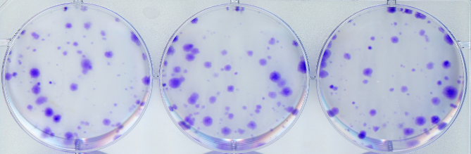
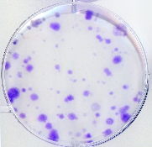
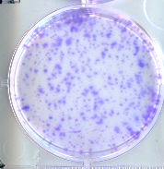
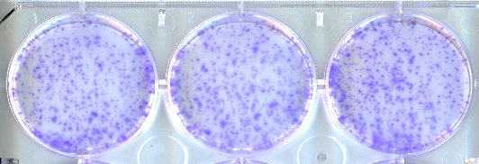
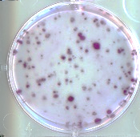
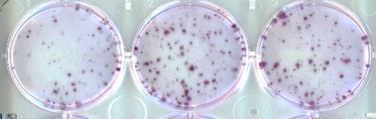
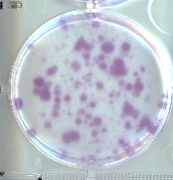
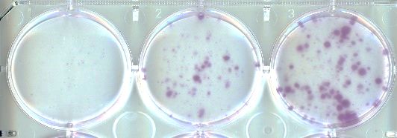
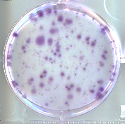
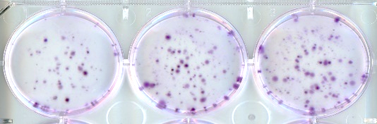
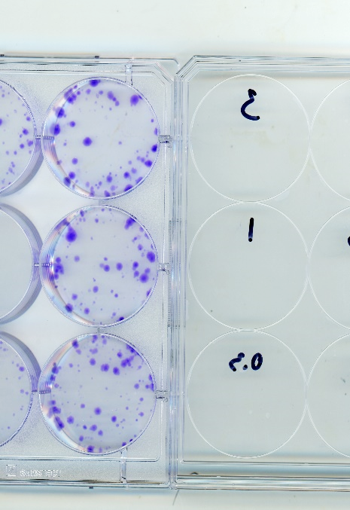
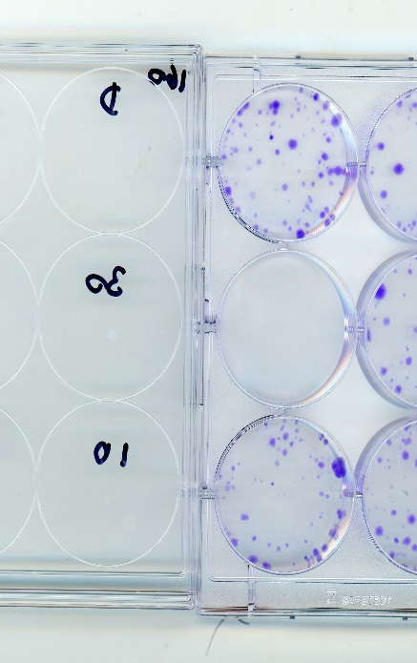
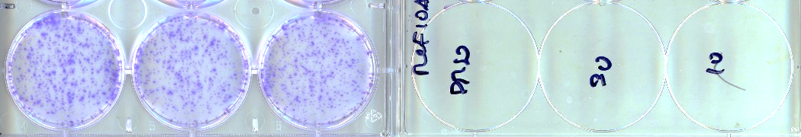
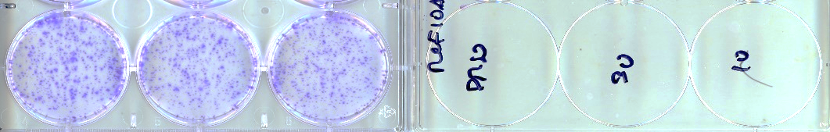
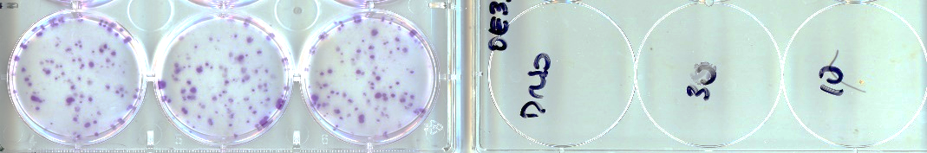
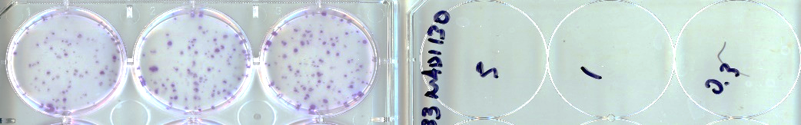
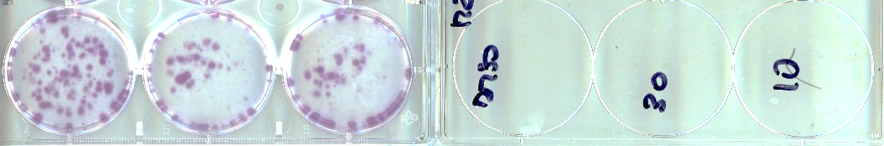
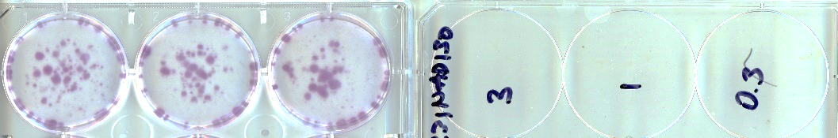
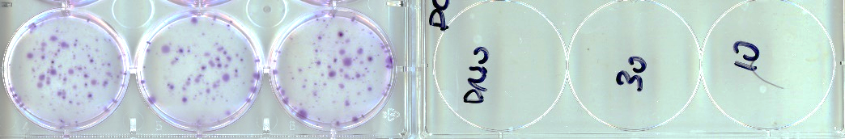
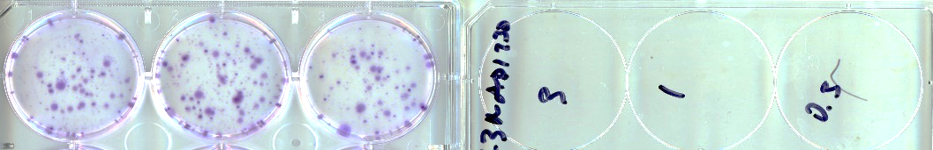
Notch-dependent cell lines
E
NADI-351
DMSO
3 µM
1 µM
0.3 µM
Het1A
MCF10A
Notch-independent cell lines
OE33
MDA-MB-231
PC-3
F
NADI-130
Supplemental Figure 2. (A-B) NADI-351 dose-response effect on cell viability (MTT assay) or clonogenic growth (CellTiter-Glo) in Notch-dependent cell lines MDA-MB-231 and PC-3. (C-D) NADI-351 dose-response effect on cell viability (MTT assay) in Notch-independent cell lines MCF-7 and T47D (ER+ Luminal breast cancer). Colony formation assays for NADI-351 (E) and NADI-130 (F) were performed in normal cell lines (Het1A and MCF10A) and tumor cell lines (OE33, MDA-MB-231 and PC-3) (n=3).
DMSO
3 µM
1 µM
0.3 µM
Het1A
MCF10A
OE33
MDA-MB-231
PC-3

