Slide 1
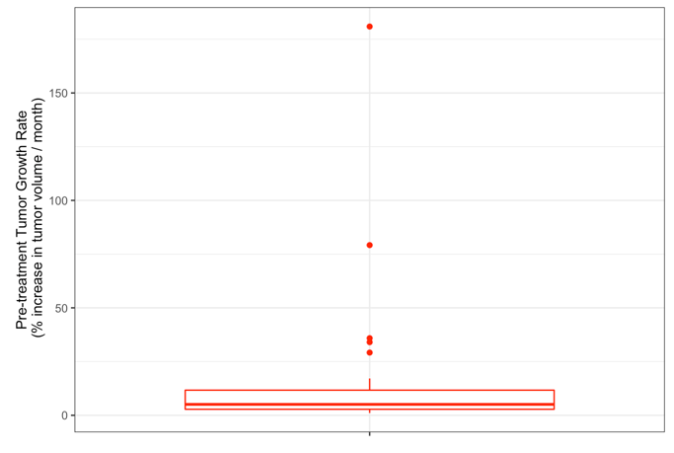
Suppl. Fig. 3: Distribution of the pre-treatment tumor growth rates over all the lesions (the median was 5%)

