Slide 1
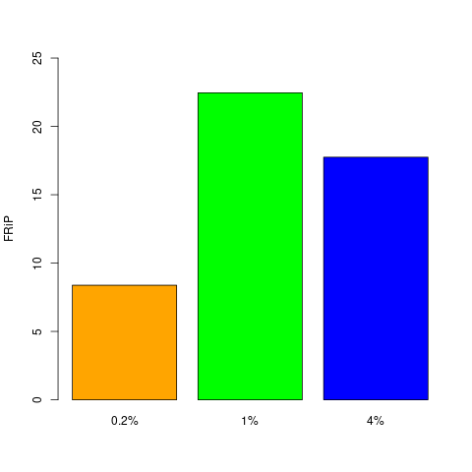
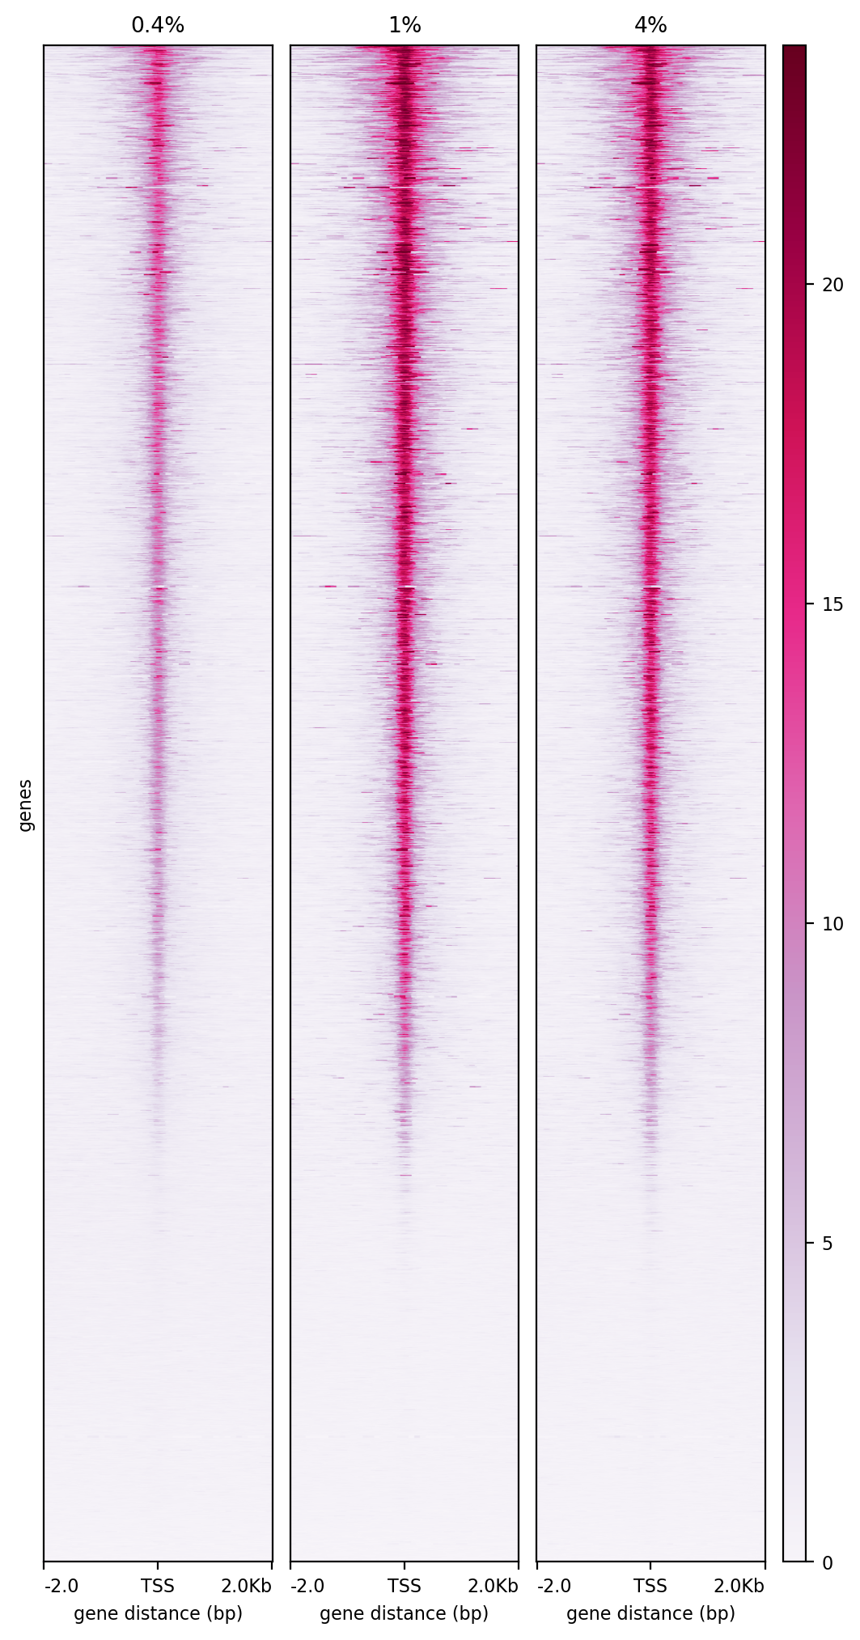
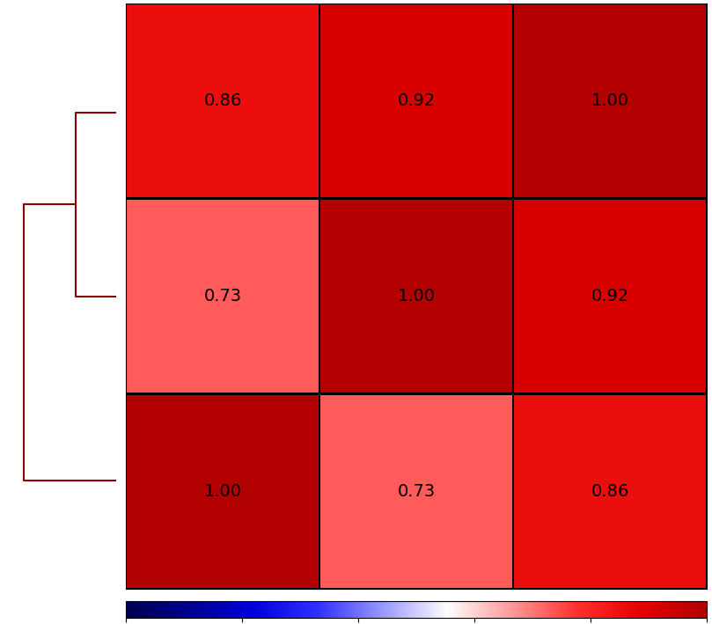
A
0.25
0.20
0.15
C
1%
FRiP
0.2%
4%
0.10
0.05
20
0
0.2
1
4
Formaldehyde %
15
B
Genes
1%
0.2%
4%
10
4%
5
0.2%
-2Kb
TSS
2Kb
TSS
2Kb
TSS
2Kb
0
-2Kb
-2Kb
1%
0
0.2
0.4
0.6
0.8
1
D
chr12:6,218,118-7,318,828 bp
0.2
0-40
1
0-40
Formaldehyde (%)
0-40
4
Genes
Figure S1

Slide 2
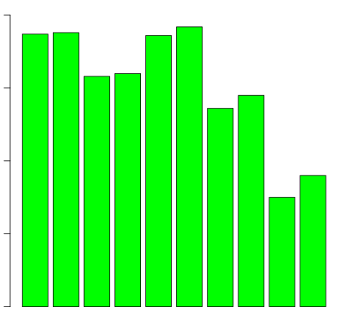
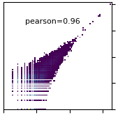
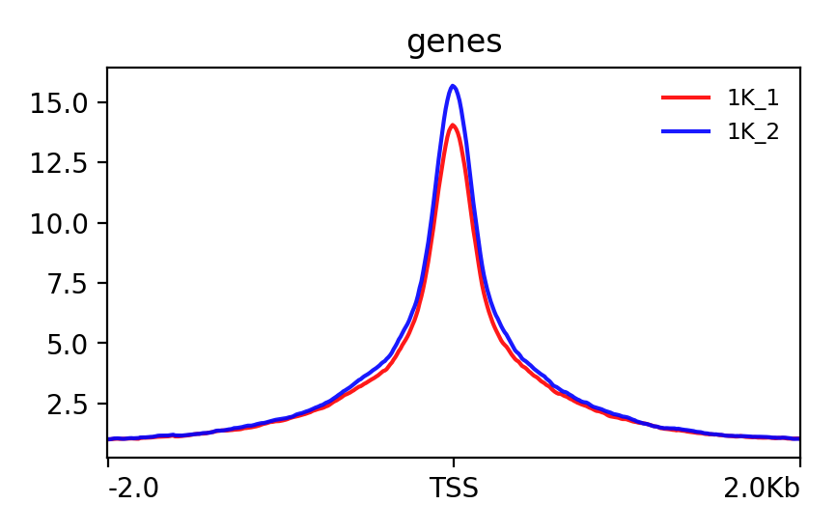
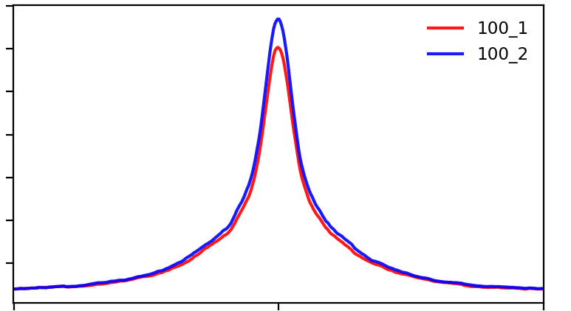
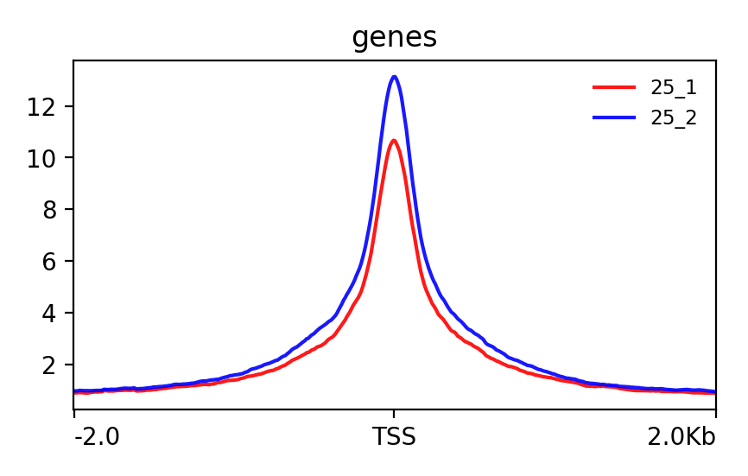
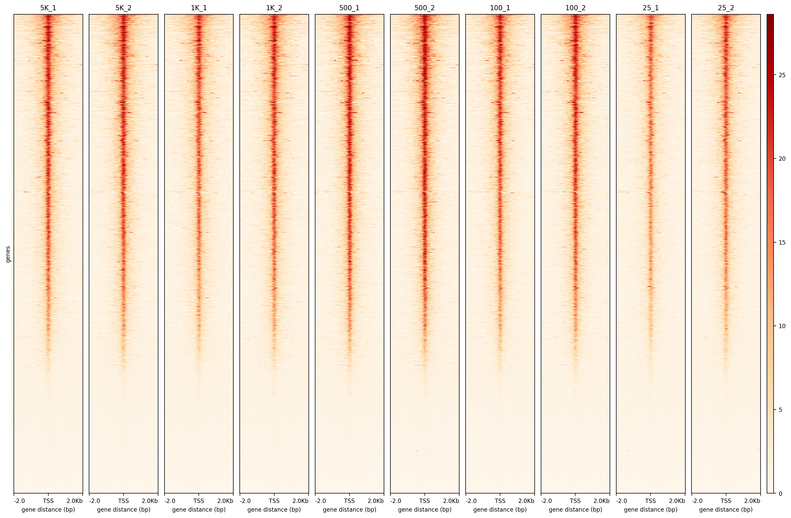
A
B
C
0.20
Pearson=0.96
8
Pearson=0.96
8
0.15
6
6
FRiP
5000_rep1
1000_rep1
4
0.10
4
0.05
2
2
0
2.5
5
7.5
0
0
2.5
5
7.5
0
0
5000_rep2
1000_rep2
500_rep1
25_rep1
100_rep1
25_rep2
1000_rep1
500_rep2
100_rep2
5000_rep2
1000_rep2
5000_rep1
F
D
E
8
Pearson=0.95
6
Pearson=0.94
6
Pearson=0.96
6
500_rep1
4
100_rep1
4
25_rep1
4
2
2
2
0
6
0
0
2
4
6
0
0
2.5
5
7.5
0
2
4
100_rep2
25_rep2
500_rep2
G
5000
5000_rep1
15
1000
1000_rep1
20
500
500_rep1
17.5
100
100_rep1
12
25
25_rep1
15
5000_rep2
12.5
1000_rep2
15
500_rep2
15
100_rep2
10
25_rep2
10
12.5
10
7.5
10
10
8
5
7.5
6
5
2.5
5
5
4
2Kb
-2Kb
TSS
-2Kb
TSS
2.5
2
-2Kb
TSS
2Kb
2Kb
-2Kb
TSS
2Kb
-2Kb
TSS
2Kb
25
20
genes
15
10
5
TSS
2Kb
TSS
2Kb
TSS
2Kb
TSS
2Kb
TSS
2Kb
TSS
2Kb
TSS
2Kb
TSS
2Kb
TSS
2Kb
TSS
2Kb
0
-2Kb
-2Kb
-2Kb
-2Kb
-2Kb
-2Kb
-2Kb
-2Kb
-2Kb
-2Kb
Figure S2

Slide 3
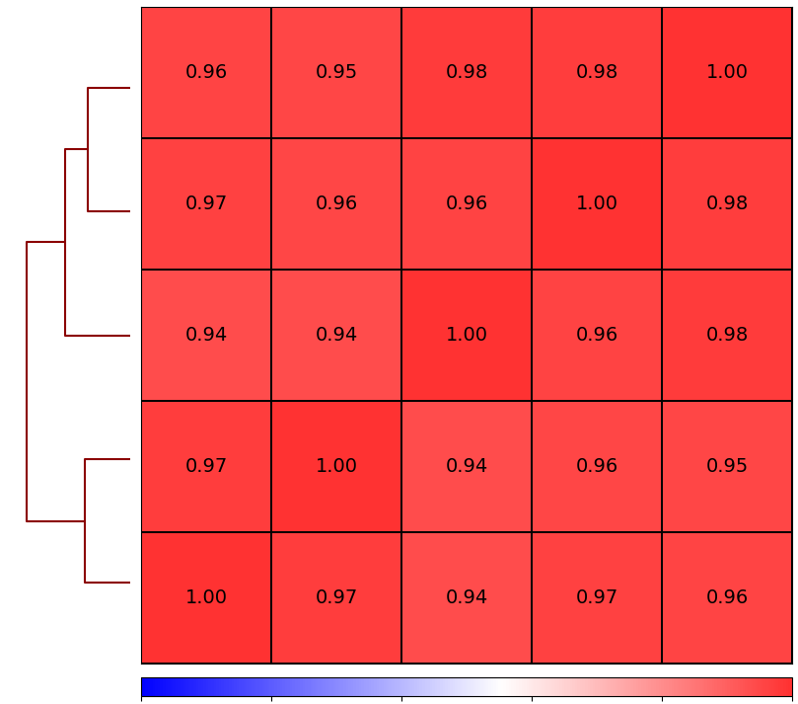
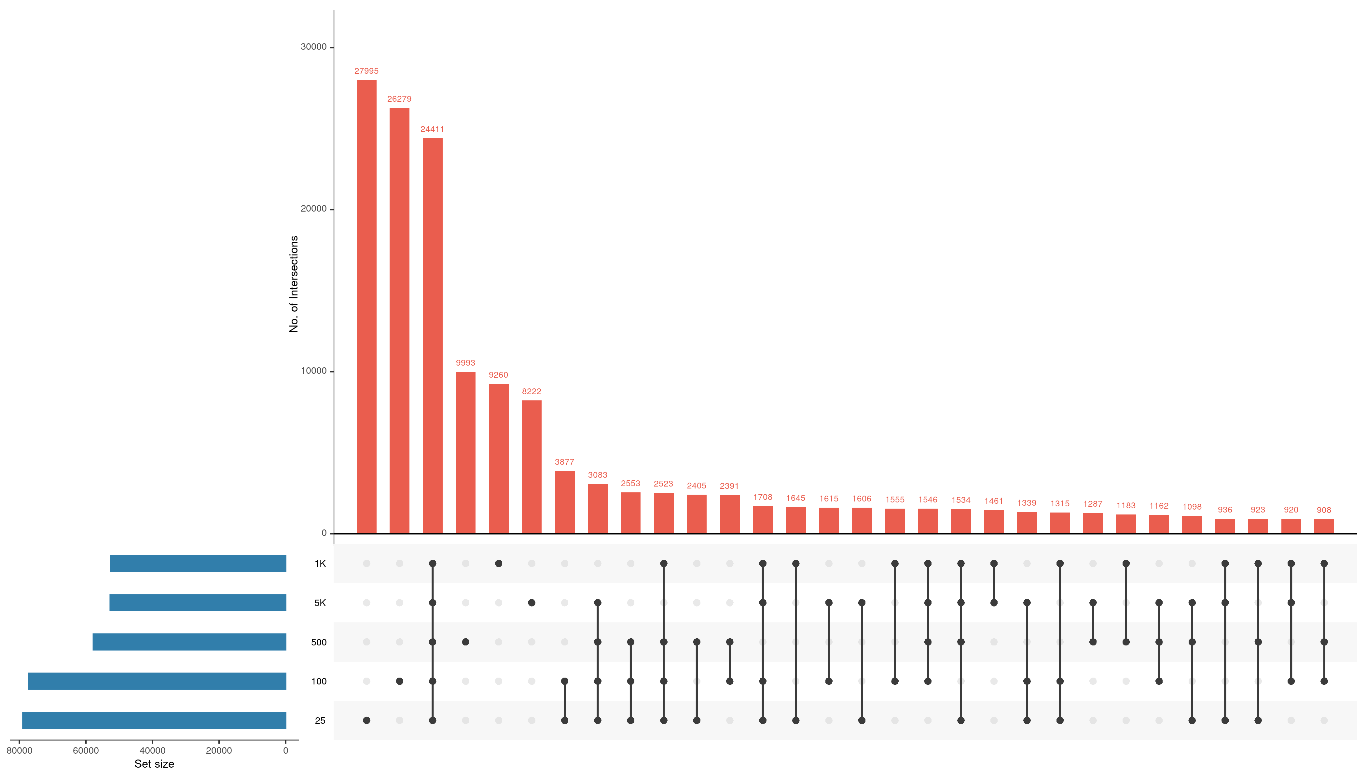
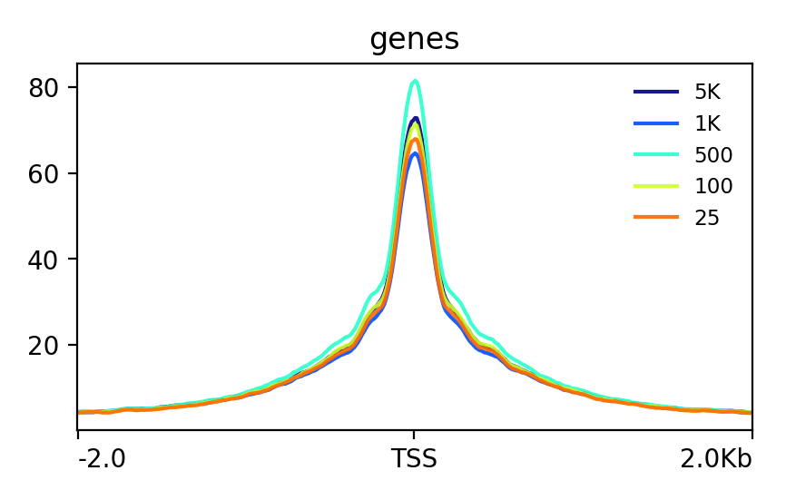
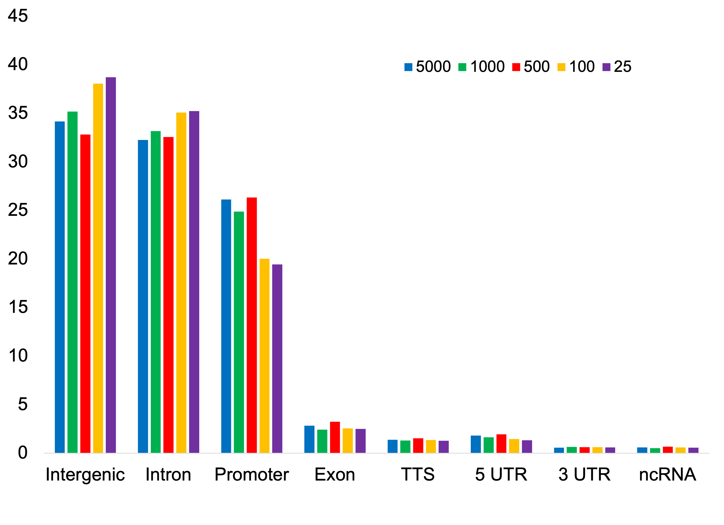
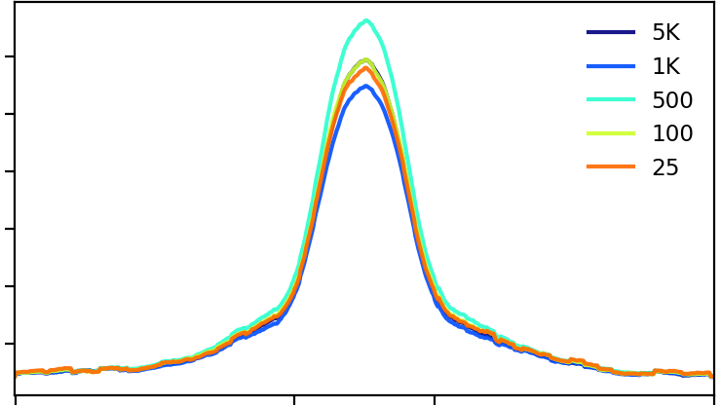
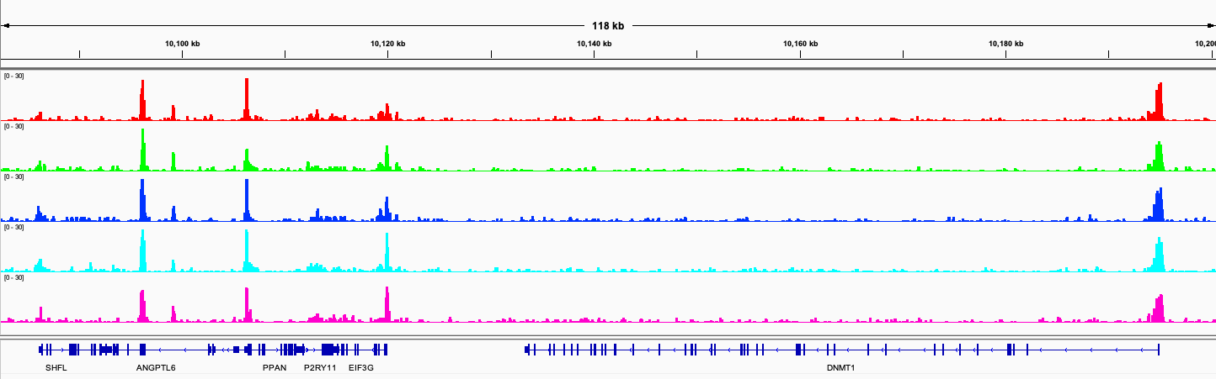
A
5000
1000
25
500
100
B
100
30000
500
20000
No. of intersections
25
10000
1000
0
1000
5000
5000
500
100
80000
60000
40000
20000
0
25
C
0
0.2
0.4
0.6
0.8
1
80
5000
D
60
1000
500
100
40
25
20
Percentage
-2Kb
TSS
2Kb
15
5000
12.5
1000
500
10
100
7.5
25
5
2.5
-2Kb
ES
EE
2Kb
E
chr19:10,079,614-10,204,206 bp
5000
0-30
1000
0-30
Cell numbers
0-30
500
0-30
100
0-30
25
Genes
SHFL
ANGPTL6
PPAN
EIF3G
DNMT1
Figure S3

Slide 4
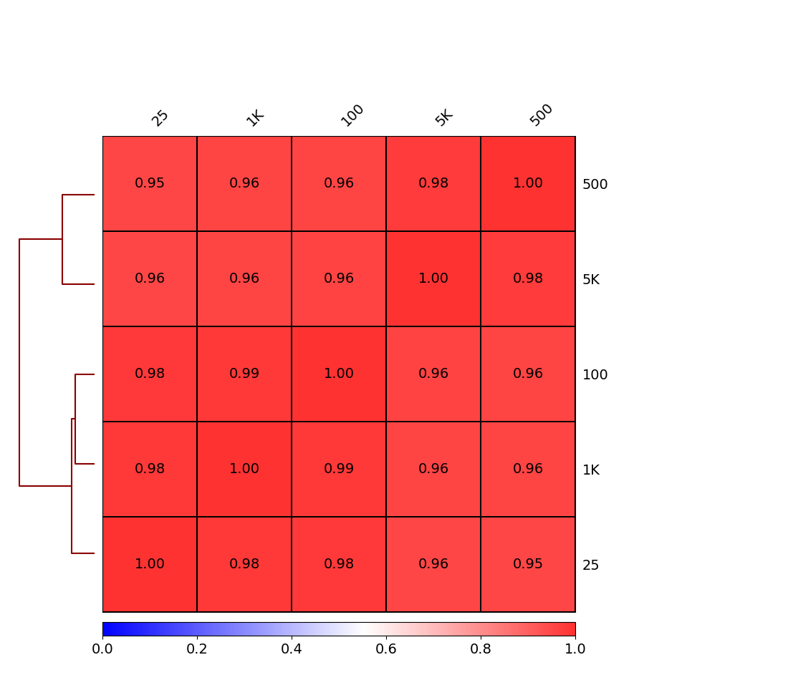
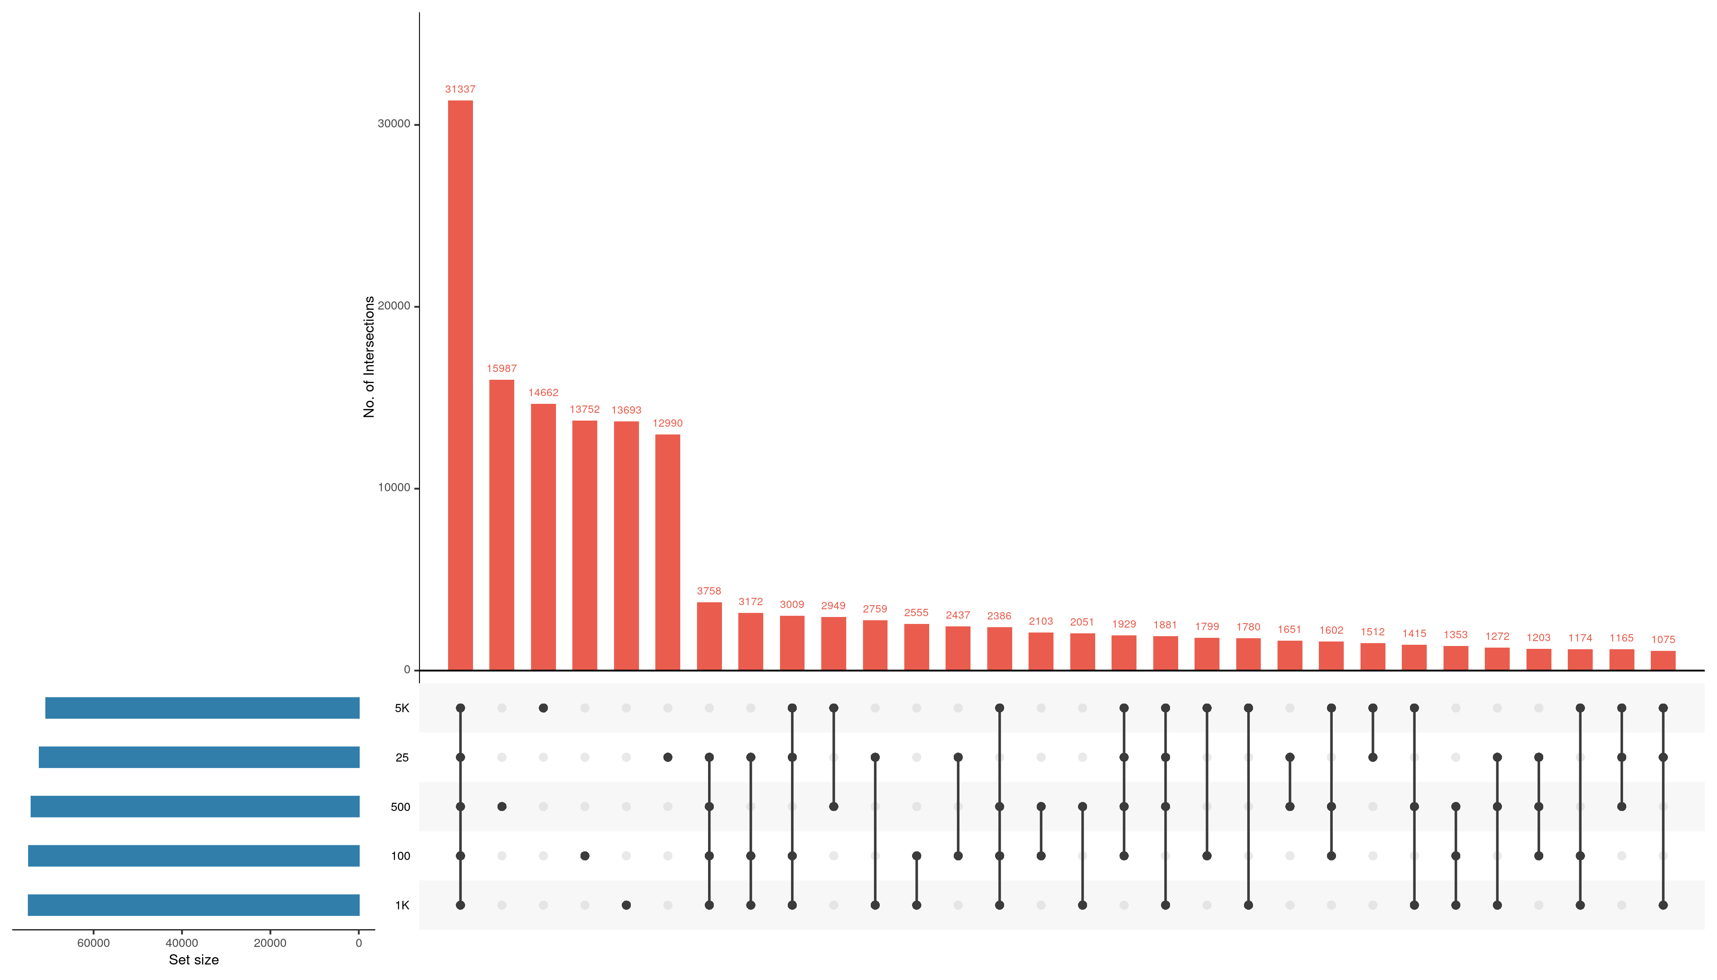
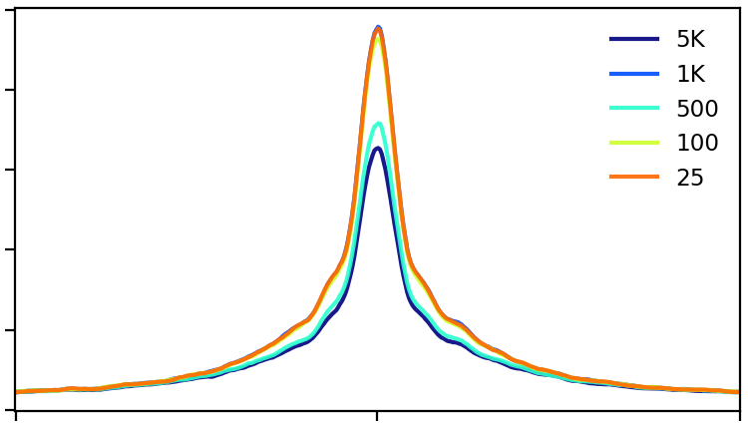
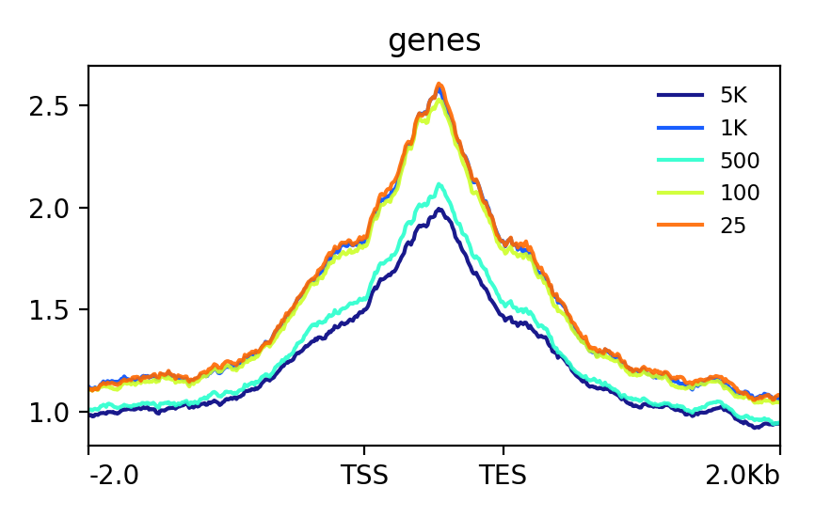
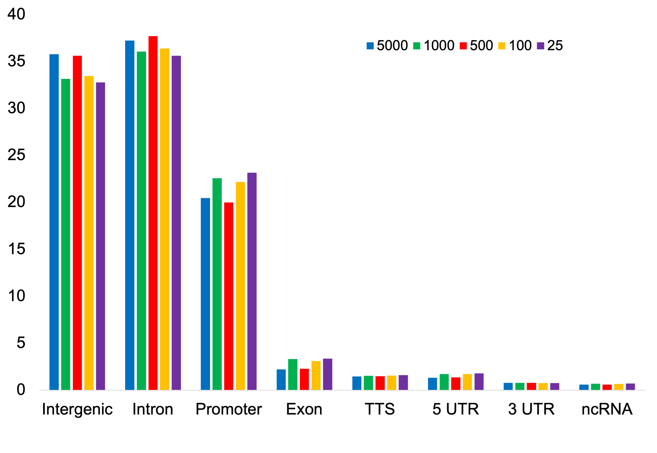
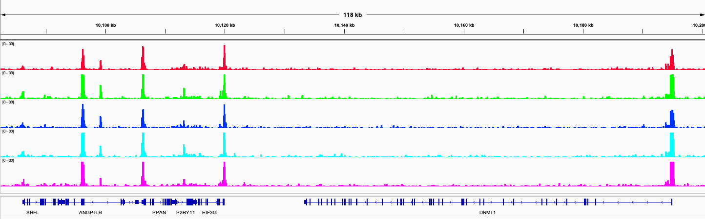
A
25
1000
100
5000
500
B
500
30000
5000
20000
No. of intersections
100
10000
1000
0
5000
25
25
500
100
1000
40000
0
60000
20000
0
0.2
0.4
0.6
0.8
1
C
D
100
5000
80
1000
500
60
100
40
25
20
Percentage
0
TSS
2Kb
-2Kb
2.5
5000
1000
2
500
100
1.5
25
1
E
-2Kb
ES
EE
2Kb
chr19:10,079,614-10,204,206 bp
5000
0-30
1000
0-30
Cell numbers
0-30
500
100
0-30
25
0-30
Genes
SHFL
ANGPTL6
PPAN
EIF3G
DNMT1
Figure S4

Slide 5
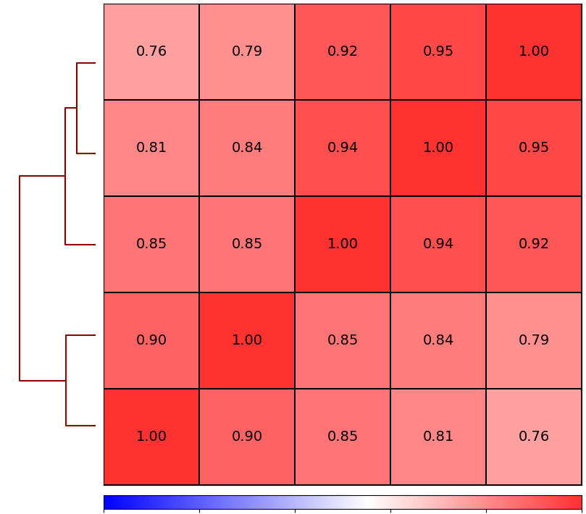
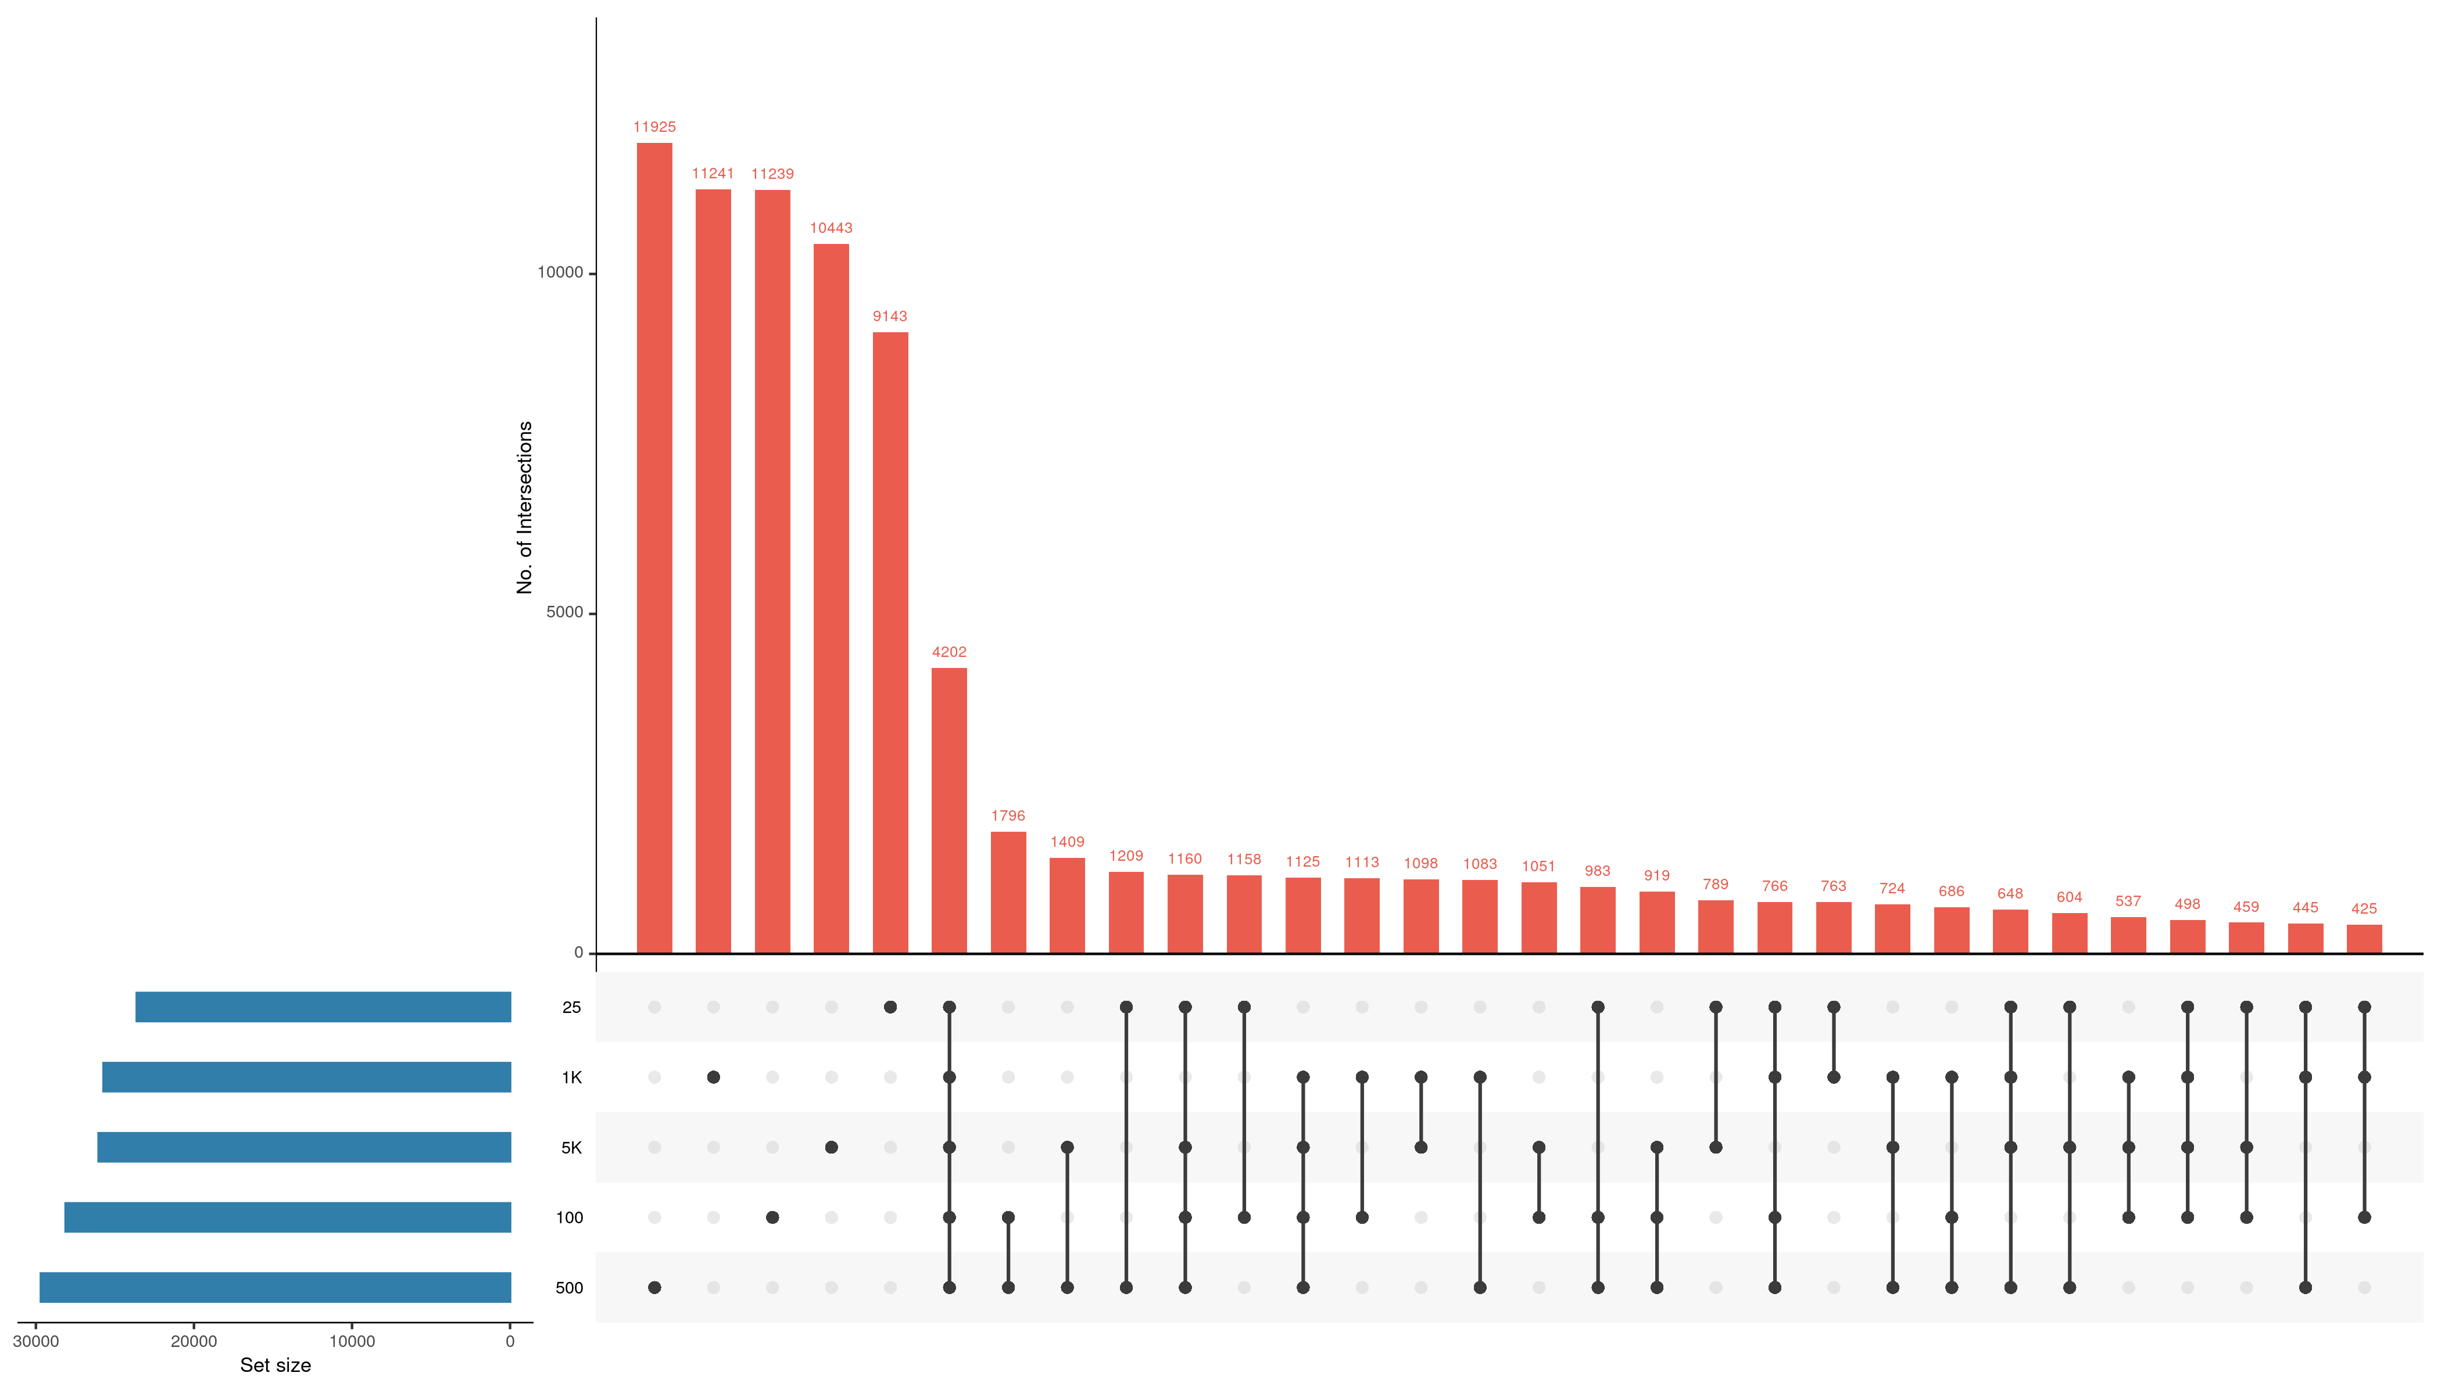
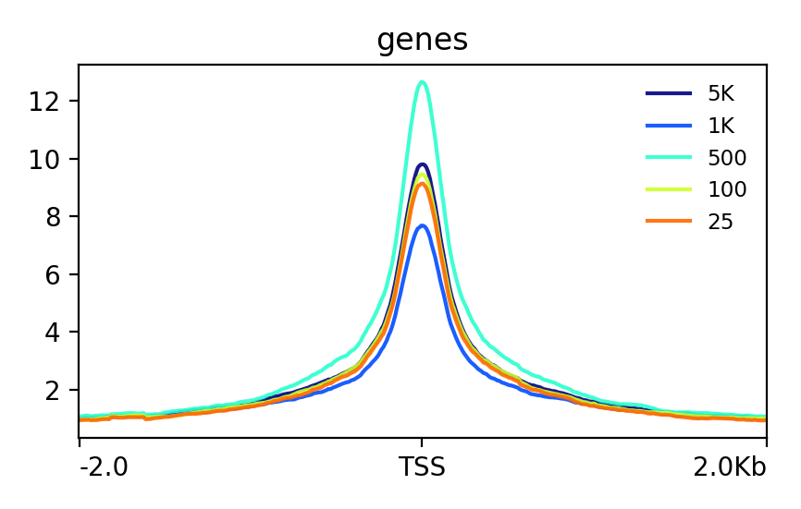
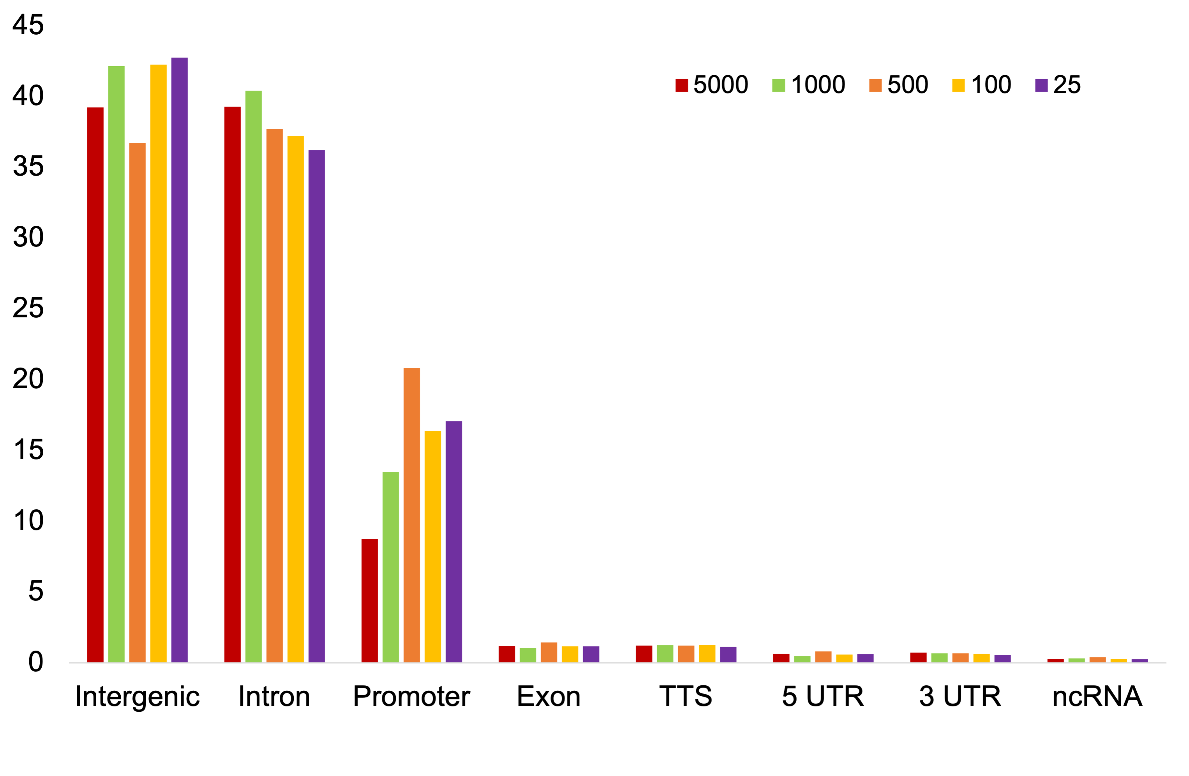
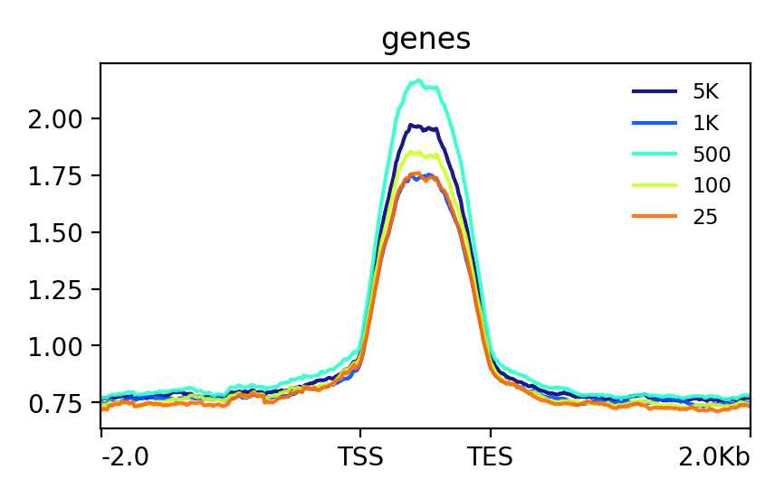
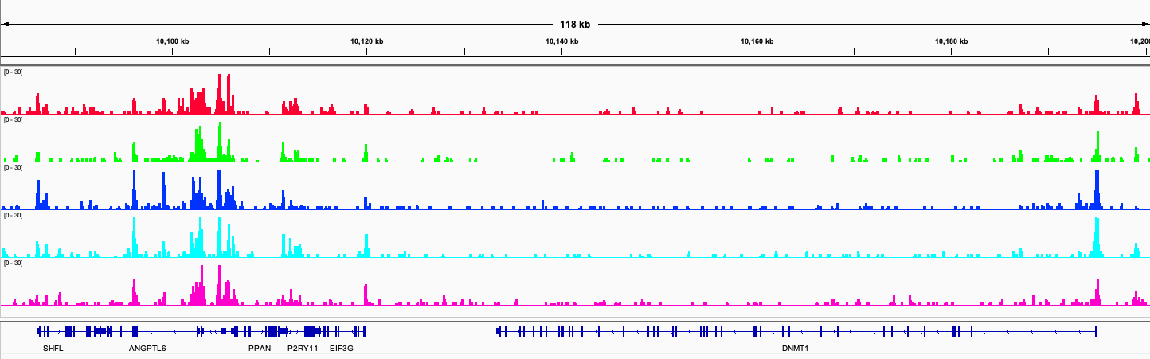
A
5000
1000
500
100
25
B
25
10000
100
No. of intersections
500
5000
0
1000
25
1000
5000
100
5000
30000
20000
10000
500
Set size
0
C
0
0.2
0.4
0.6
0.8
1
12
5000
D
10
1000
8
500
100
6
25
4
2
-2Kb
TSS
2Kb
2
5000
Percentage
1.75
1000
500
1.50
100
1.25
25
1
0.75
EE
2Kb
-2Kb
ES
E
chr19:10,079,614-10,204,206 bp
5000
0-30
1000
0-30
500
0-30
Cell numbers
0-30
100
25
0-30
Genes
SHFL
ANGPTL6
PPAN
EIF3G
DNMT1
Figure S5

Slide 6
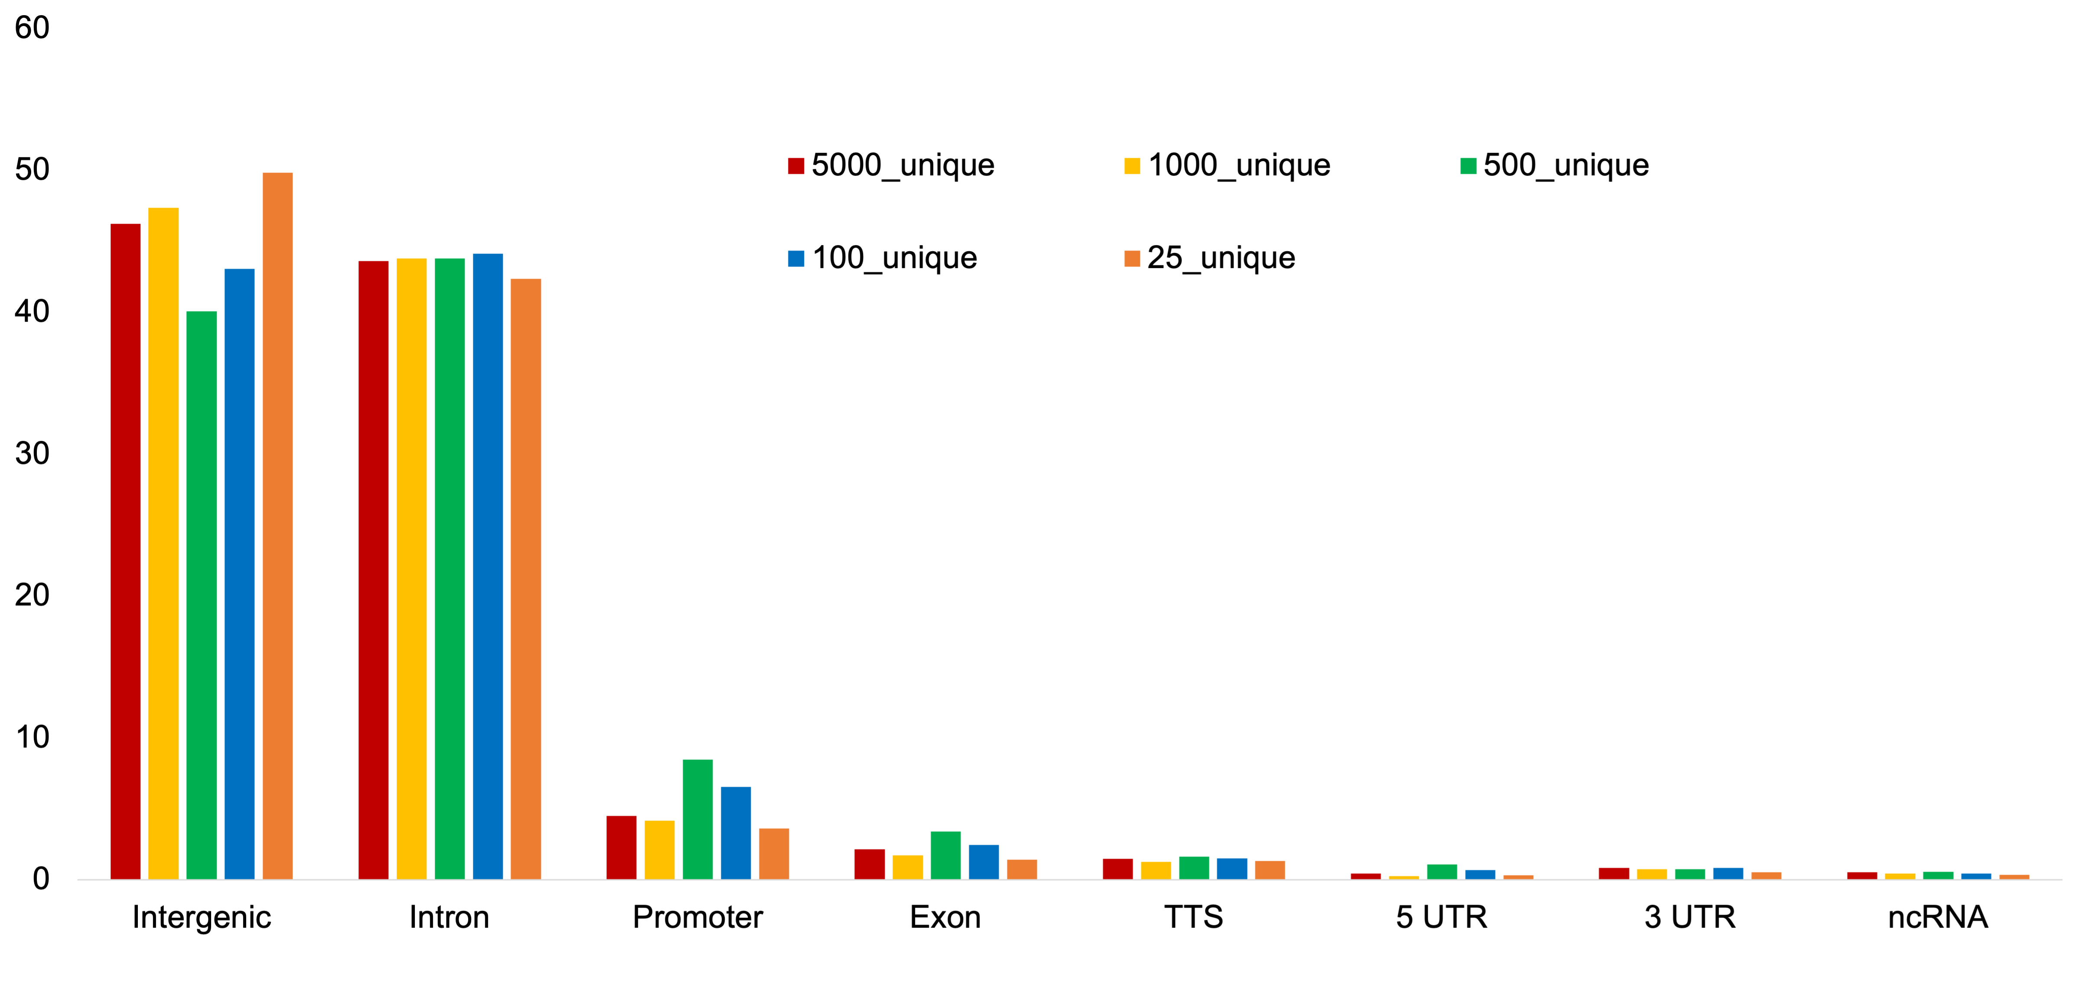
Percentage
Figure S6

Slide 7
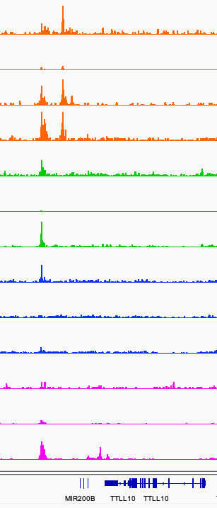
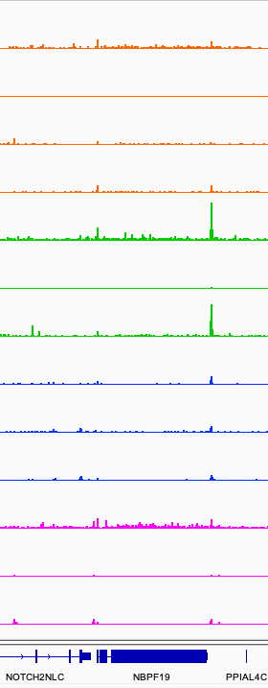
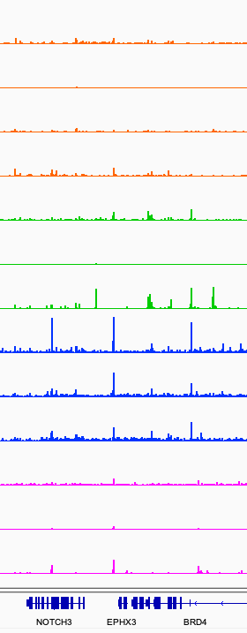
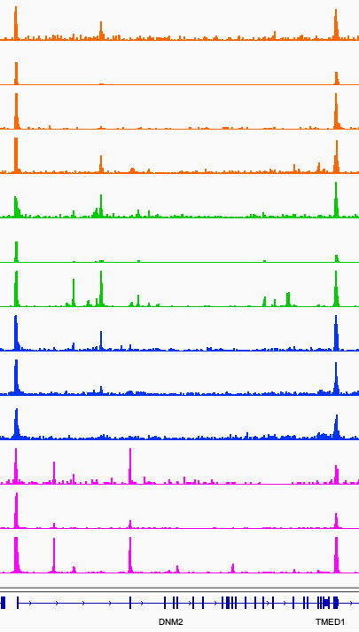
HCT116 One-pot
UniNicE-seq
HEK293 One-pot
UniNicE-seq
GM12878 One-pot
UniNicE-seq
HCT116
Omni ATAC-seq
HEK293
Omni ATAC-seq
GM12878
Omni ATAC-seq
HCT116
DNaseq
HCT116
ATAC-seq
HeLa One-pot
UniNicE-seq
HeLa
ATAC-seq
HEK293
ATAC-seq
GM12878
ATAC-seq
HeLa
DNaseq
TTLL10
MIR200B
NBPF19
NOTCH2NLC
BRD4
EPHX3
NOTCH3
TMED1
DNM2
Figure S7

Slide 8
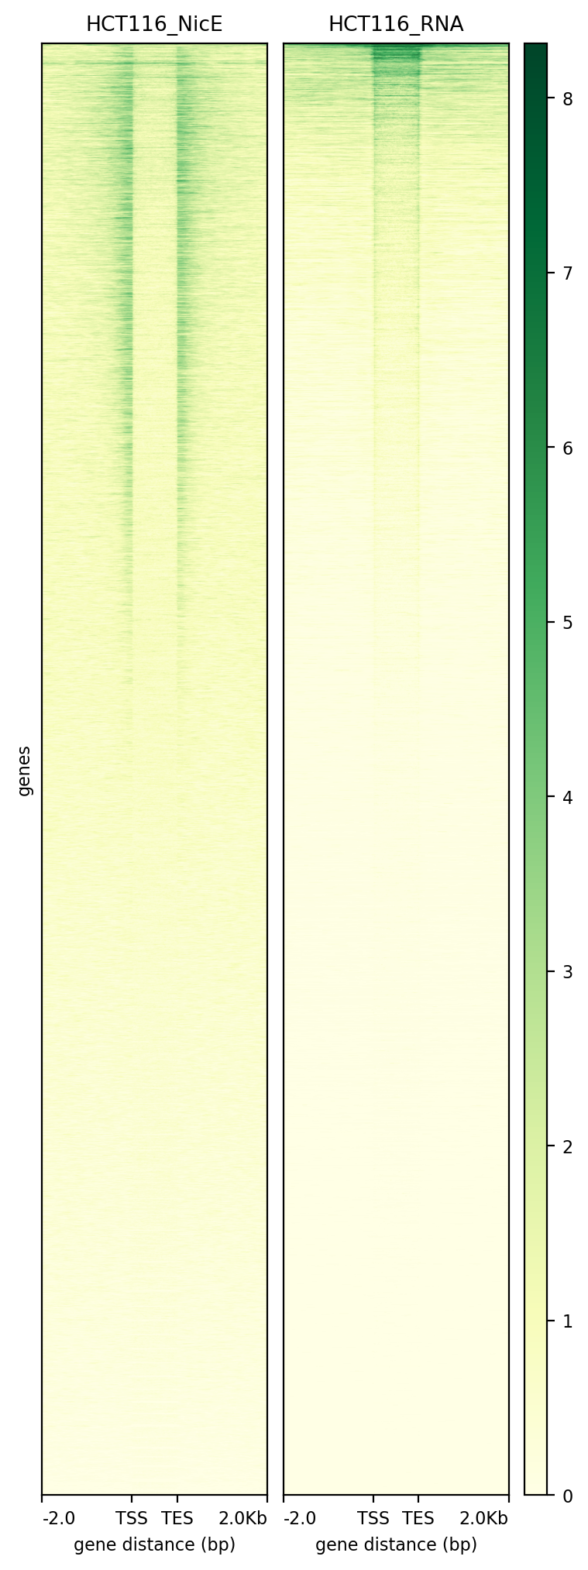
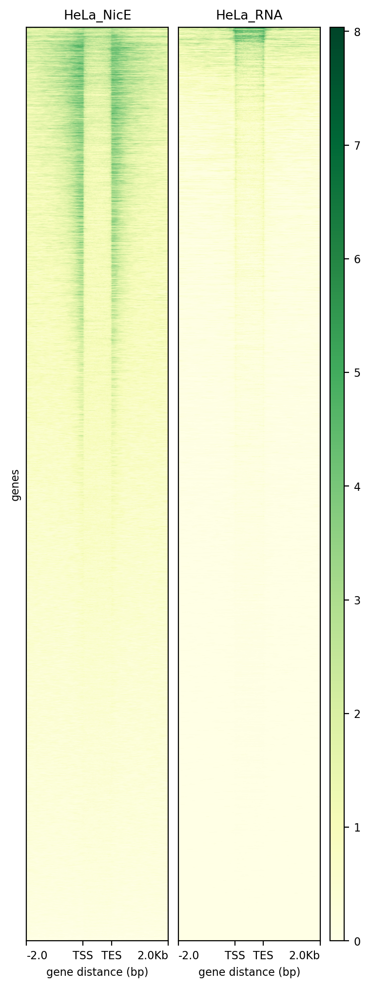
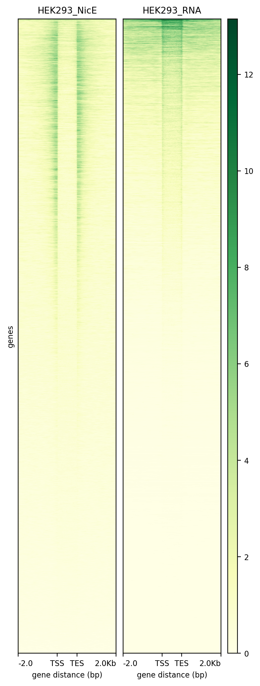
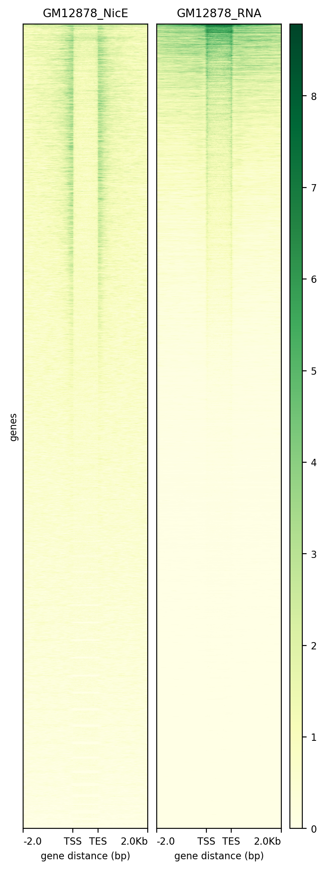
Figure S8

Slide 9
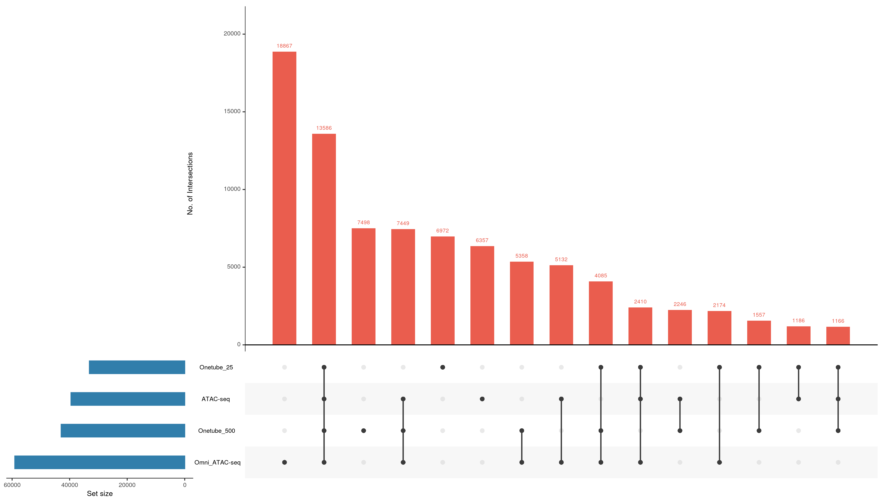
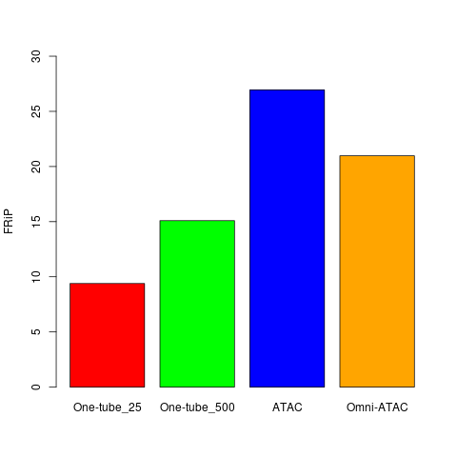
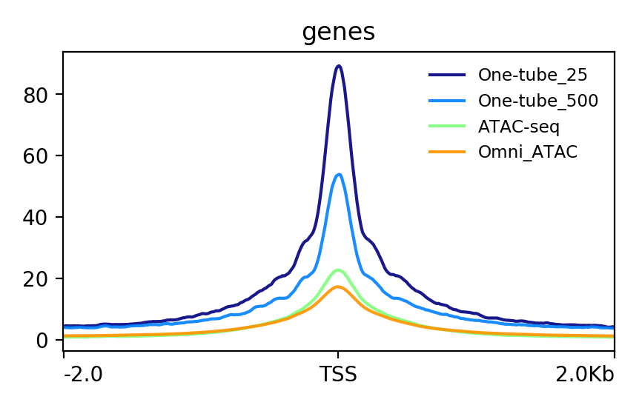
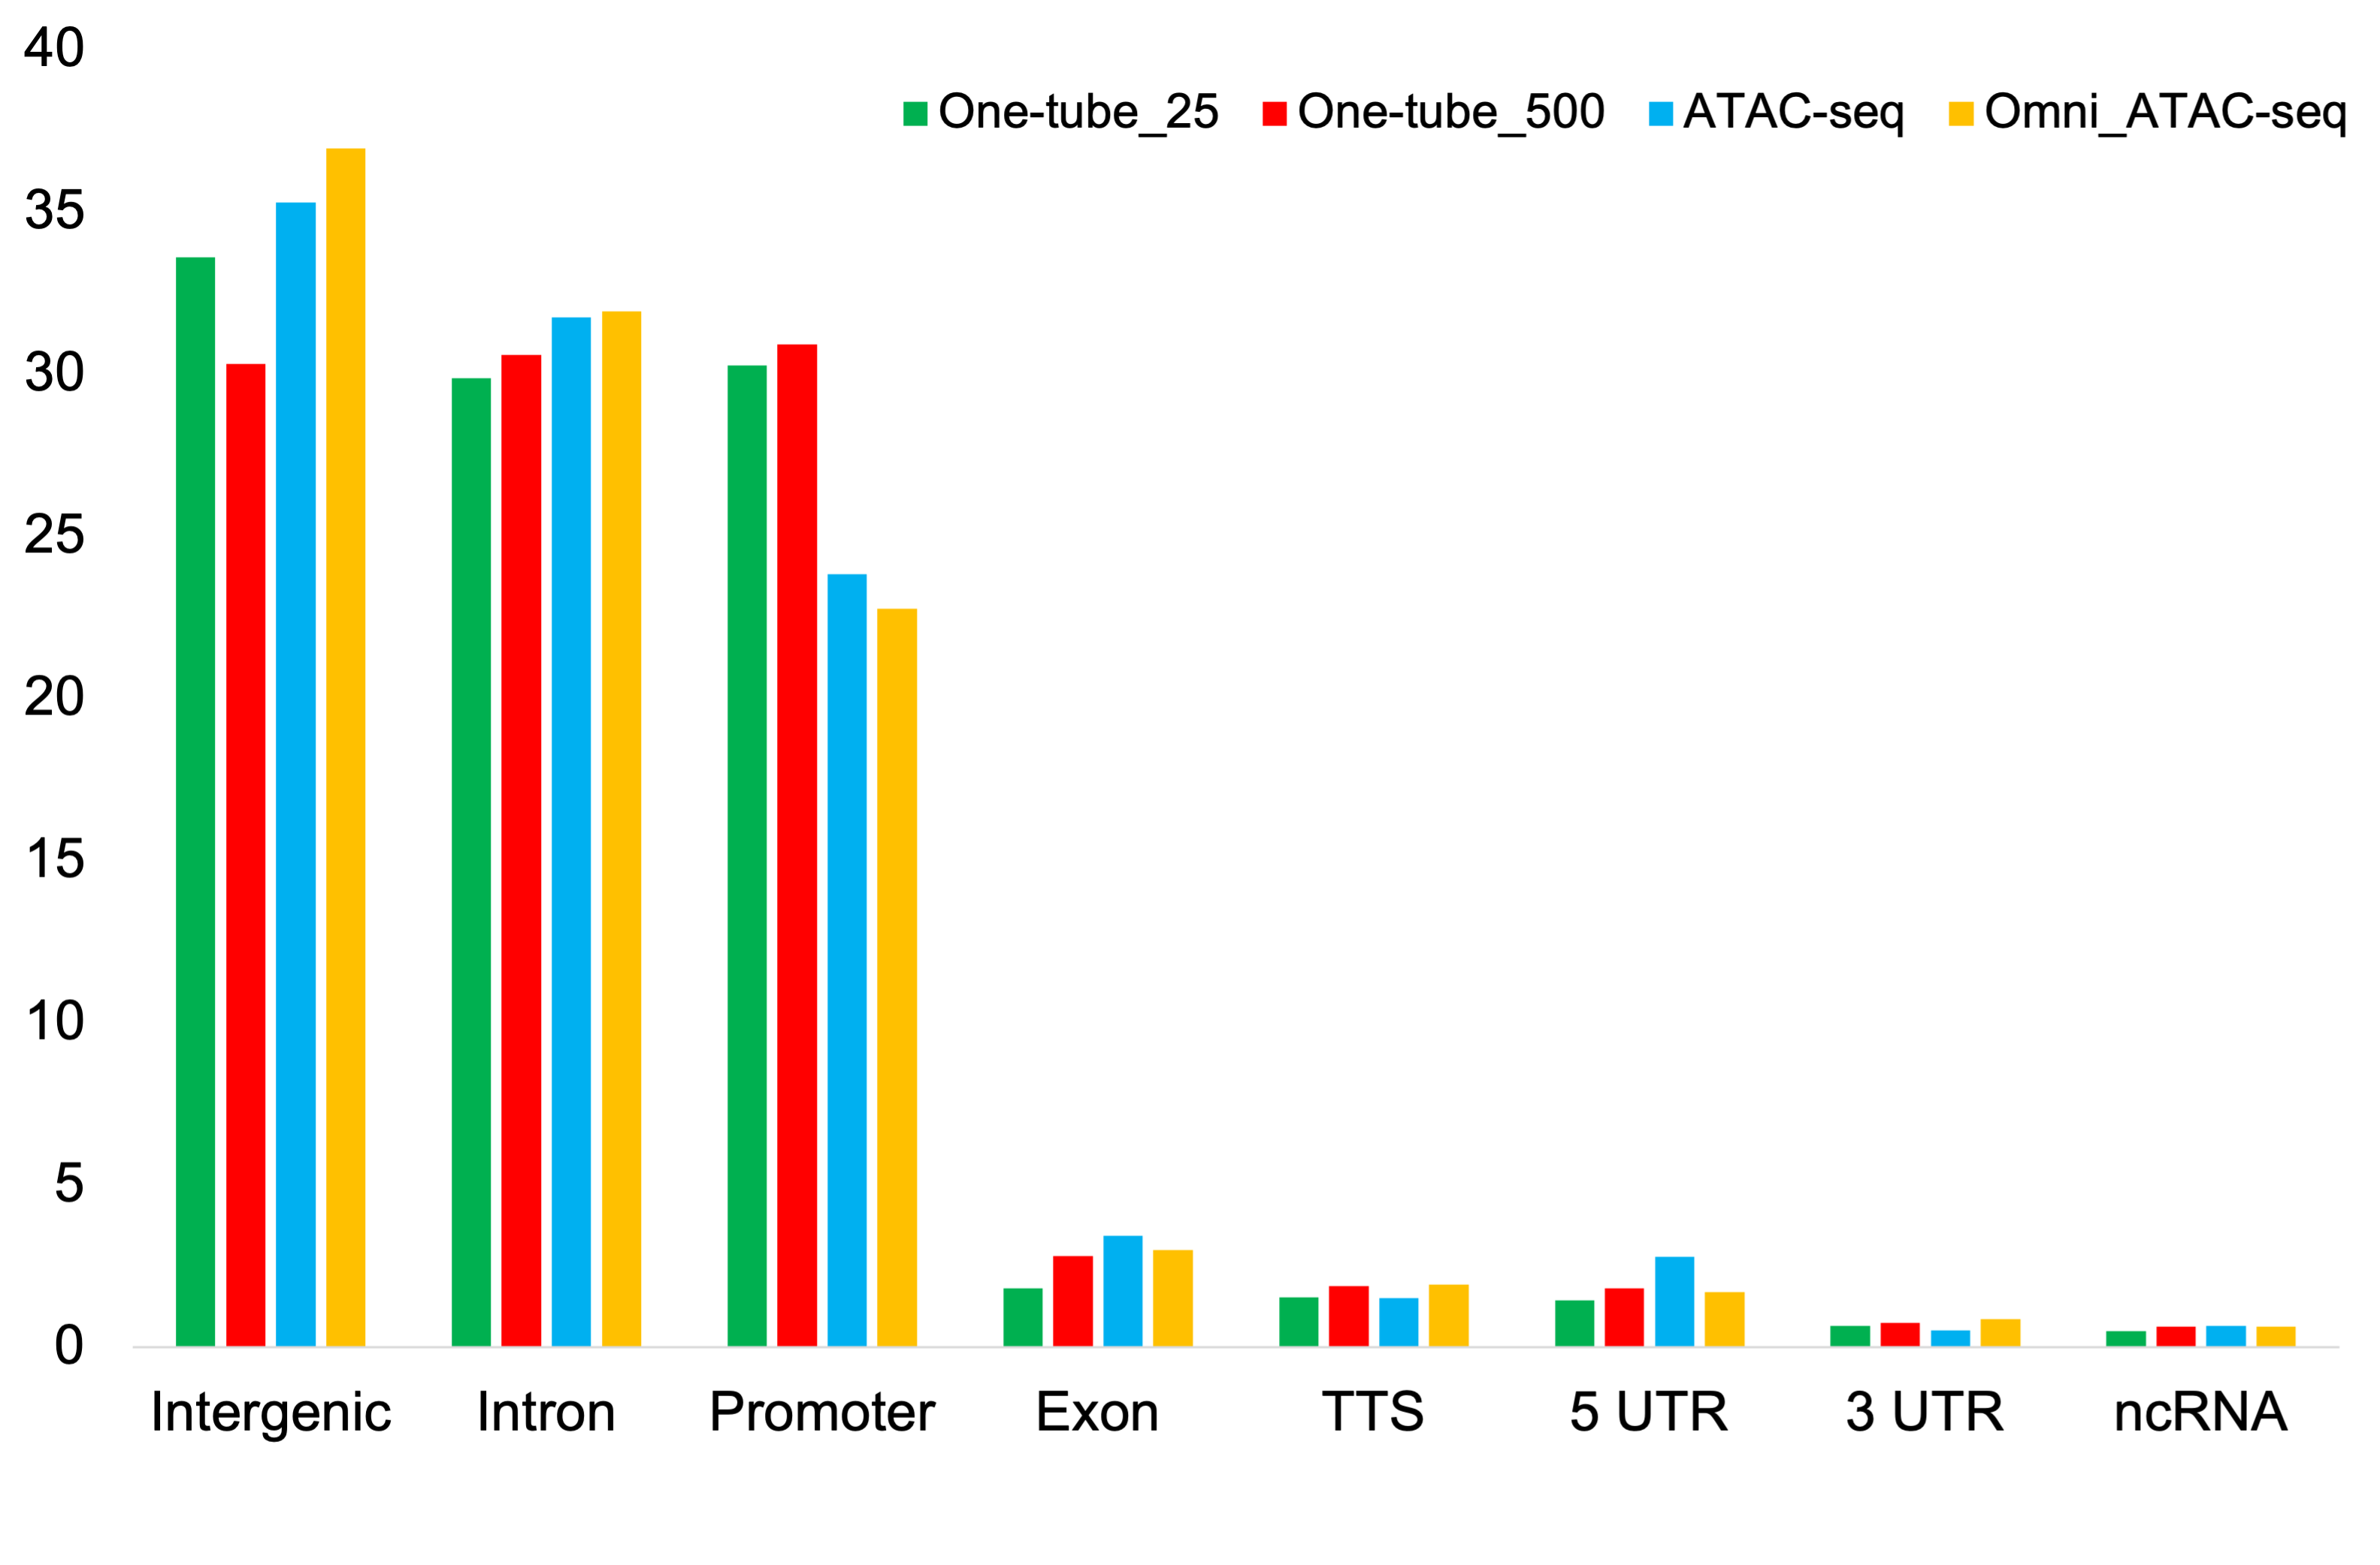
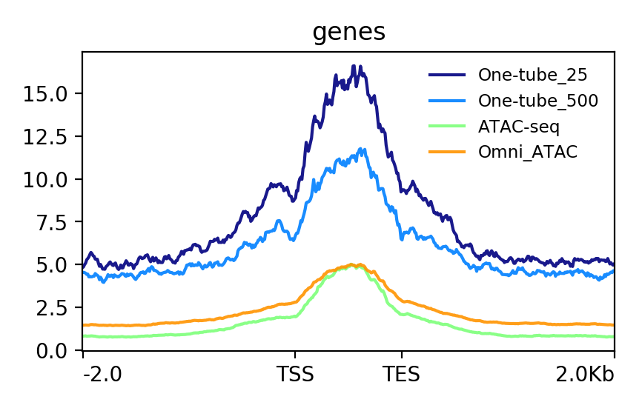
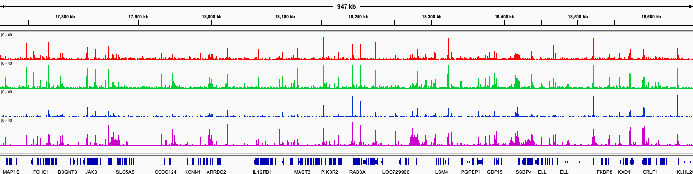
A
20000
B
15000
30
25
No. of Intersections
20
10000
FRiP
5000
15
0
10
One-Pot
UniNicE-seq_25
5
ATAC-seq
One-Pot
UniNicE-seq
500
0
One-pot
UniNicE-seq
25 cells
One-pot
UniNicE-seq
500 cells
ATAC-seq
Omni ATAC-seq
Omni ATAC-seq
60000
40000
20000
0
C
80
One-pot UniNicE-seq
25 cells
60
One-pot UniNicE-seq
500 cells
D
ATAC-seq
40
Omni ATAC-seq
One-pot UniNicE-seq 25 cells
20
One-pot UniNicE-seq 500 cells
ATAC-seq
0
Omni ATAC-seq
-2Kb
TSS
2Kb
Percentage
15
One-pot UniNicE-seq
25 cells
12.5
One-pot UniNicE-seq
500 cells
10
ATAC-seq
Omni ATAC-seq
7.5
5
2.5
0
ES
EE
2Kb
-2Kb
E
chr19:17,703,243-18,671,479 bp
One-pot
UniNicE-seq
25 cells
0-40
One-pot
UniNicE-seq
500 cells
0-40
ATAC-seq
0-40
Omni ATAC-seq
0-40
FCHO1
JAK3
SLC5A5
CCDC124
ARRDC2
MAST3
PIK3R2
LOC729966
LSM4
SSBP4
ELL
FKBP8
KXD1
Figure S9

Slide 10
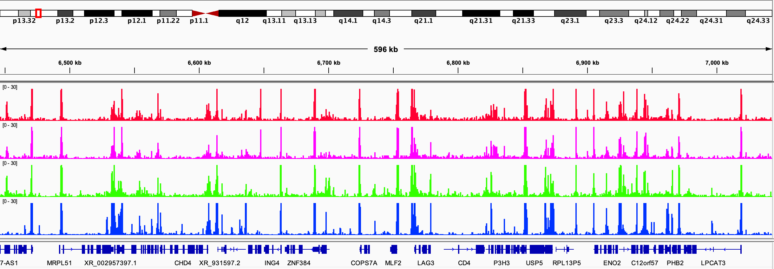
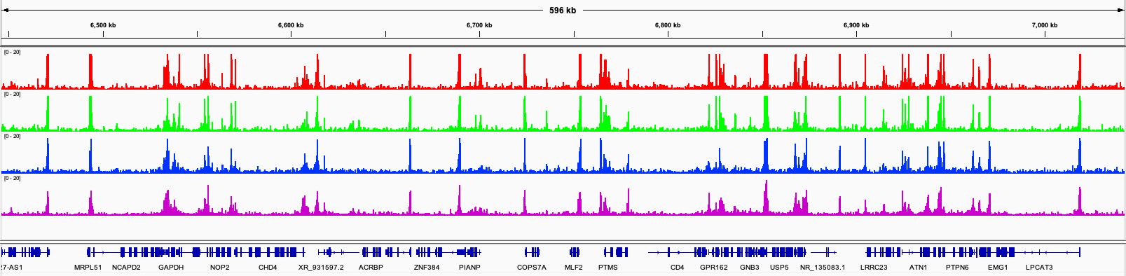
A
HeLa
One-pot
UniNicE-seq
500 cells
chr12:6,444,967-7,031,764 bp
0-30
One-pot
UniNicE-seq
25 cells
0-30
NicE-viewseq
0-30
ATAC-seq
0-30
Genes
B
HEK293
chr12:6,444,967-7,031,764 bp
0-20
One-pot
UniNicE-seq
25 cells
0-20
One-pot
UniNicE-seq
500 cells
0-20
ATAC-seq
0-20
Omni ATAC-seq
Genes
Figure S10

Slide 11
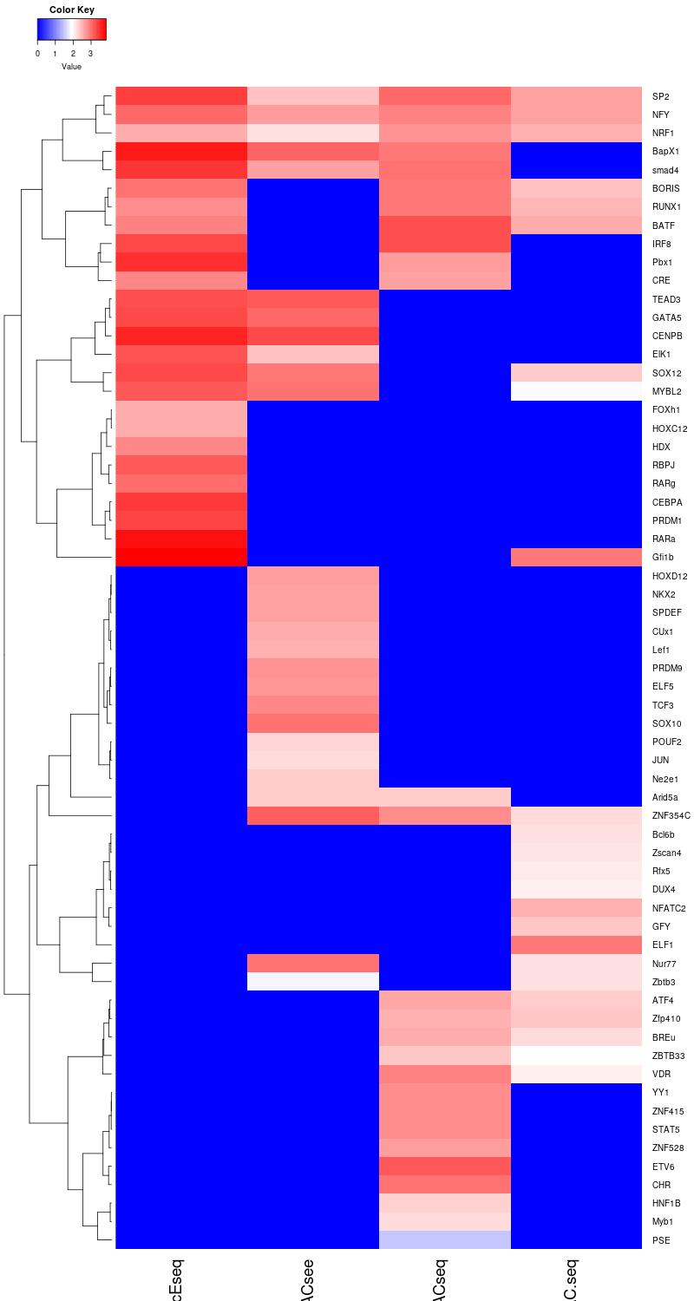
One-pot
UniNicE-seq
ATAC-see
scATAC-seq
ATAC-seq
Figure S11

