Slide 1


Inflammation and JNK role in Niacin-GPR109A Diminished Flushed Effect in Schizophrenia
By Sabrina Ansarey
Brian Morris (Supervisor)
2504243

Slide 2






Introduction
Schizophrenia is a neuropsychiatric illness which has a prevalence of 1% of the world population
POSITIVE SYMPTOMS
Hallucination, delusion
NEGATIVE SYMPTOMS
Depression, social withdrawal, anhedonia and apathy
1%
Heterogeneous syndrome
COGNITIVE SYMPTOMS
DSM-IV
Inattention, dysfunctional executive function and impaired working memory

Slide 3










Problem with schizophrenia
Depressed
Bipolar
ADHD

Slide 4
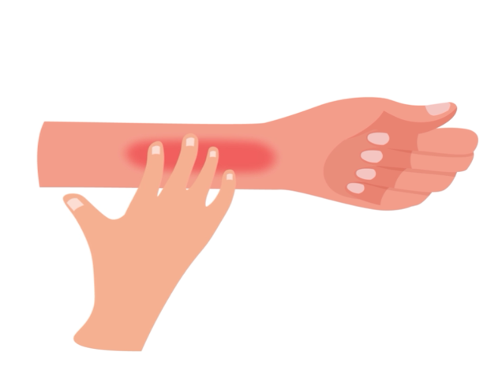

Niacin flush response
Aims
Investigate whether reduced PGD₂
or PGE₂ is the cellular cause behind diminished flush
Link the cell alteration in skin cells
to brain cells - microglia and neuron
Treatment to alleviate cell alteration behind diminished flush
Flushing in general population depressed, bipolar, social phobia patients
Diminished flushing in schizophrenia
Hypothesis: Stimulation of GPR109A by niacin will result in prostaglandin D2 or E2 release from either microglial or neuronal cells, and this will be mediated by JNK.

Slide 5
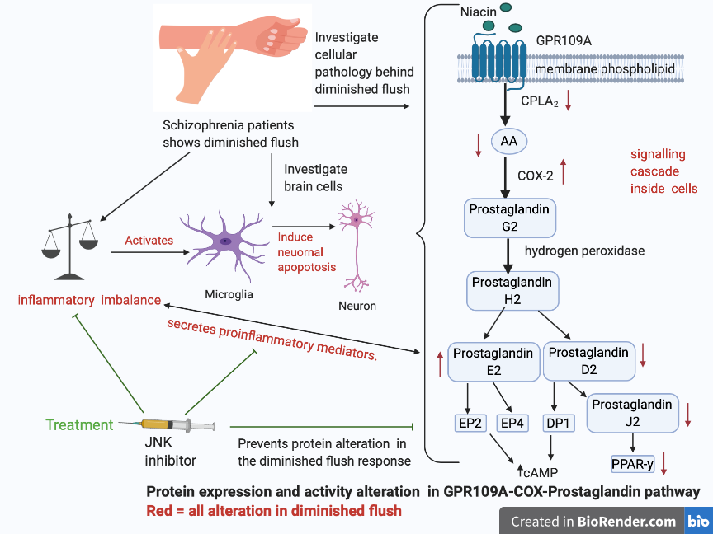
Findings in the Literature Review

Slide 6
GPR109A-COX-prostaglandin pathway gene against 128 GWAS schizophrenia
Gene | Aliases for Gene | (GRCh37/hg19) | 128 GWAS Chr. Position
HCAR2 | Hydroxycarboxylic Acid Receptor 2 (GPR109A) | chr12:123,185,840-123,187,904 | Yes
PLA2G4A | Phospholipase A2 Group IVA (cPLA₂) | chr1:186,798,032-186,958,113 | No
PTGS2 | Prostaglandin-endoperoxide synthase 2 (COX-2) | chr1:186,640,923-186,649,559 | No
PTGDS | Prostaglandin D2 Synthase | chr9:139,871,956-139,879,887 | No
PTGES2 | Prostaglandin E Synthase 2 | chr9:130,882,972-130,890,741 | No
PEGER2 | Prostaglandin E Receptor 2 | chr14:52,781,016-52,795,324 | No
PTGER4 | Prostaglandin E Receptor 4 | chr5:40,679,600-40,693,837 | No
PPARG | Peroxisome Proliferator Activated Receptor Gamma (PPAR-y) | chr3:12,328,867-12,475,855 | No
Expected genetic alteration here.
Research suggests, does not contribute significantly
Maybe, genetic alteration here.

Slide 7
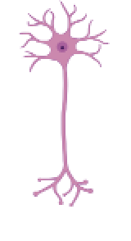


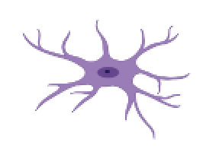









Discussion: limitation and strength of review
Health comorbidities
Use of antipsychotics
Lack of research on neuron and GPR109A-COX-Prostaglandin pathway, compared to strong evidence on microglia with the pathway.
Patient Demographics
Stages of schizophrenia
Stage of illness
Prodromal
Acute
Chronic
Widespread research on all stages of schizophrenia and GPR109A flushing response, but limited research focusing on the prodromal alone.
Ethnicity
Age

Slide 8
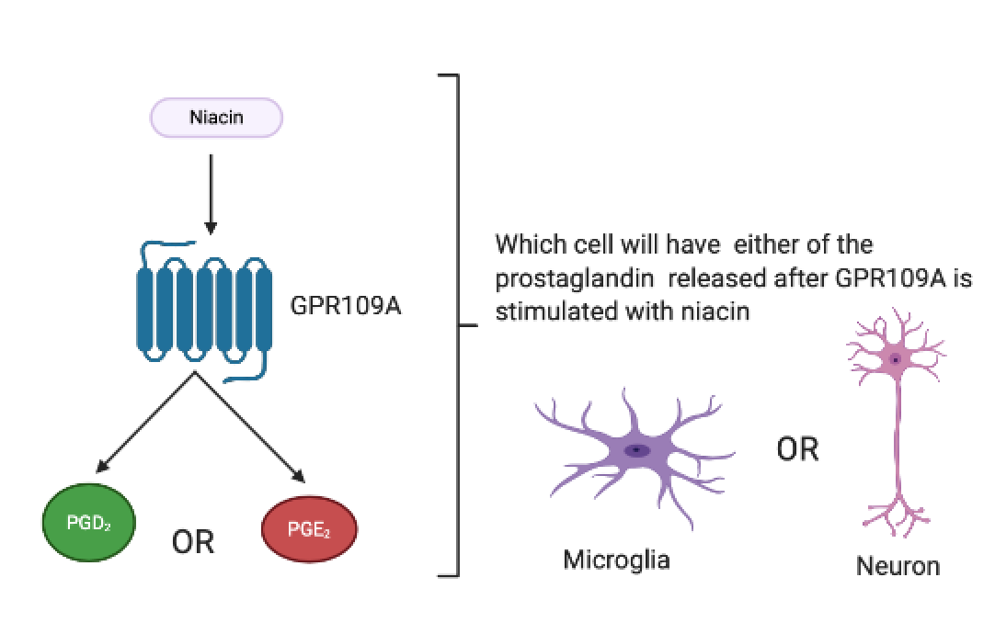
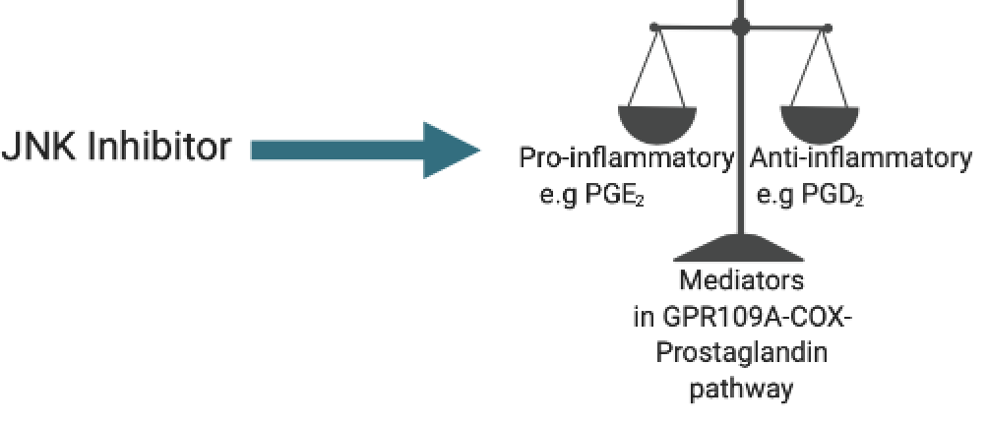
Revision for the current Hypothesis
Early hypothesis
New hypothesis to investigate
Reduced Flush response due to genetic defect in GPR109A receptor, this may reduce PGD₂ release
Link between disrupted GPR109A gene as a result of ROS and reversed by JNK inhibitor
??
Stimulation of GPR109A by niacin will result in prostaglandin D2 or E2 release from either microglial or neuronal cells, and this will be mediated by JNK.
Reduce hyperactive microglia

Slide 9
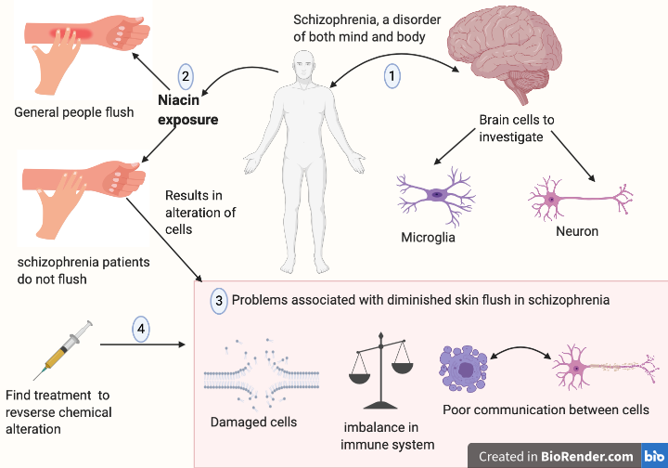
Summary
Schizophrenia patients have diminished flush.
Diminished flush has alteration in the GPR109A-COX-prostaglandin pathway
JNK inhibitor is a potential treatment for diminished flush and even schizophrenia

Slide 10
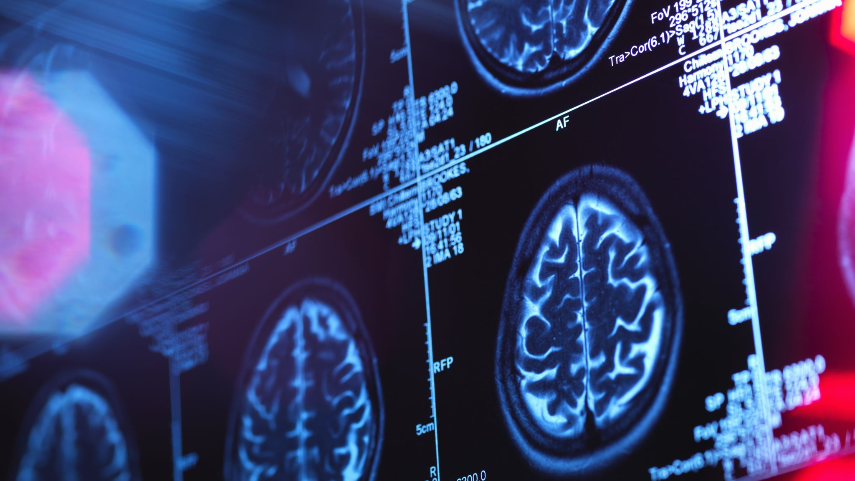
Acknowledgement
Many thanks to Dr. Brian Morris (supervisor),
Dr. Guillaume Rousselet and Dr. Michael Kohl
From University of Glasgow

