Slide 1
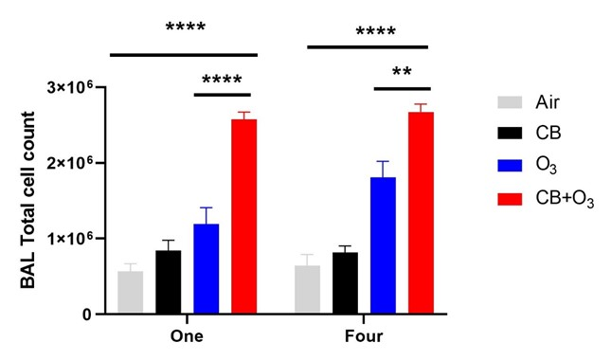
A
B
Figure S1

