Slide 1
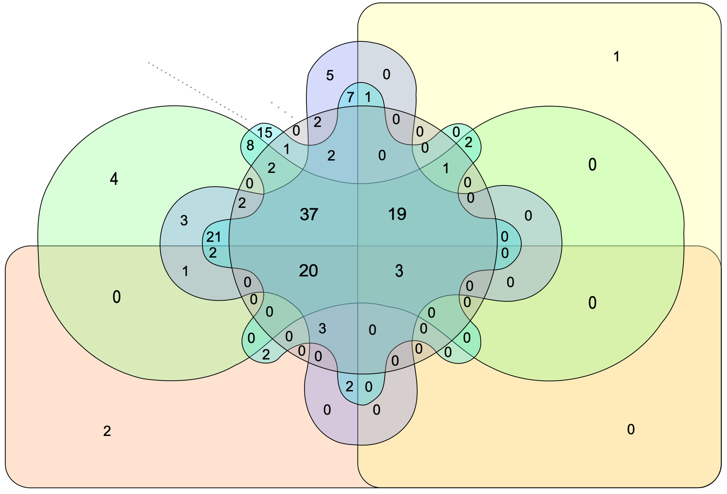
A
CB – 4
CB-O₃ – 1
CB-O₃ – 4
O₃ – 1
B
O₃ – 4
ID | Term Description | Up Regulated | Down Regulated
mmu04110 | Cell cycle | Rb1, Rbl2 | Ccnd3
mmu04213 | Longevity regulating pathway - multiple species | Akt3 Prkaa1
mmu03040 | Spliceosome |  | Snrpb U2af2 Srsf3
*
CB – 1
Figure S5

