Slide 1
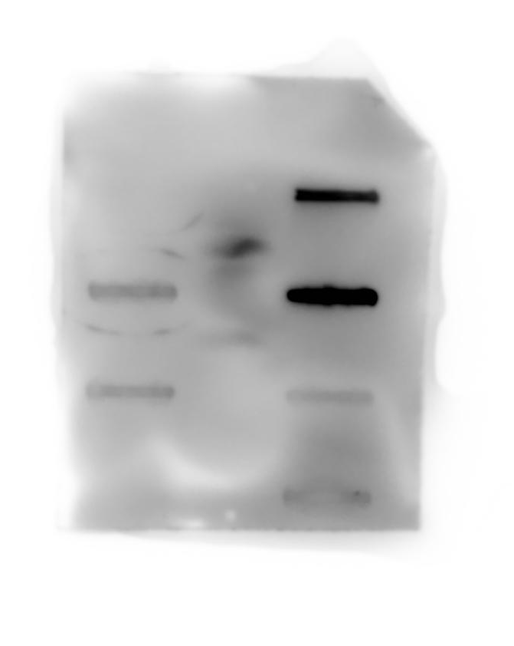
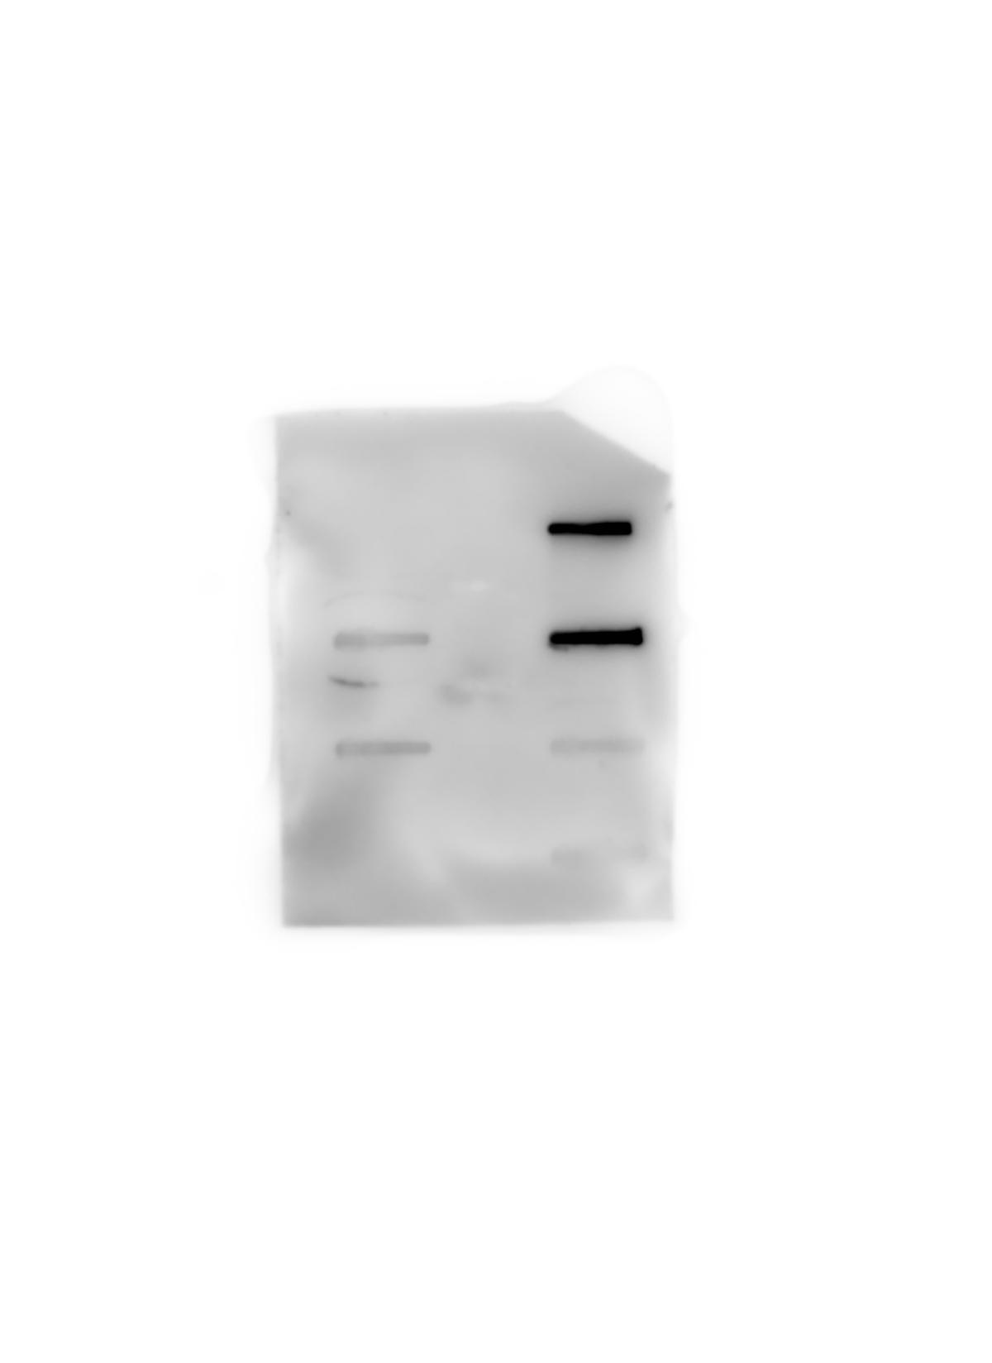
Supplementary information file
NC
PC
CD81
L1CAM
TSG101
ENO2
CANX
MAPT
Future
ischemic
stroke
Control
NC, negative control
CANX, Calnexin
PC, positive control
L1CAM, L1 transmembrane protein
ENO2, Enolase 2
MAPT, Total tau protein

