Slide 1
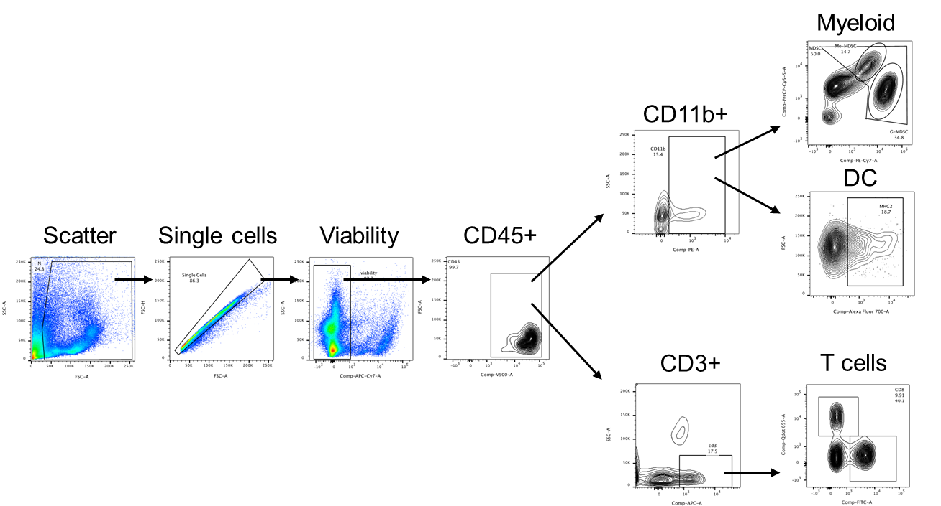
Supplementary Figure 3. Flow cytometry gating strategy for hepatic immune cells. Shown is the complete flow cytometric gating strategy for immunophenotyping and sorting of hepatic MDSC, DC, and T cells.

