Slide 1
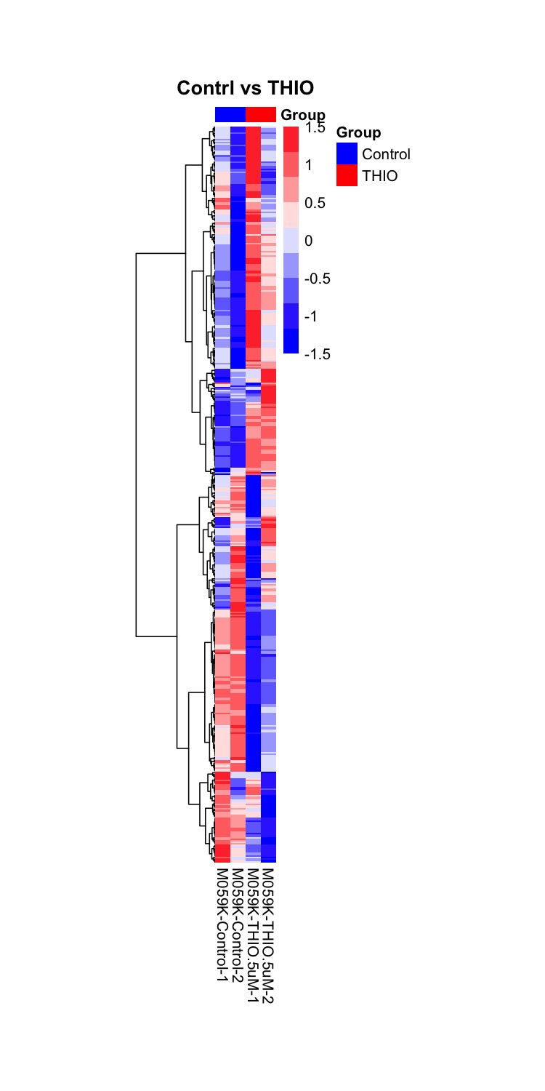
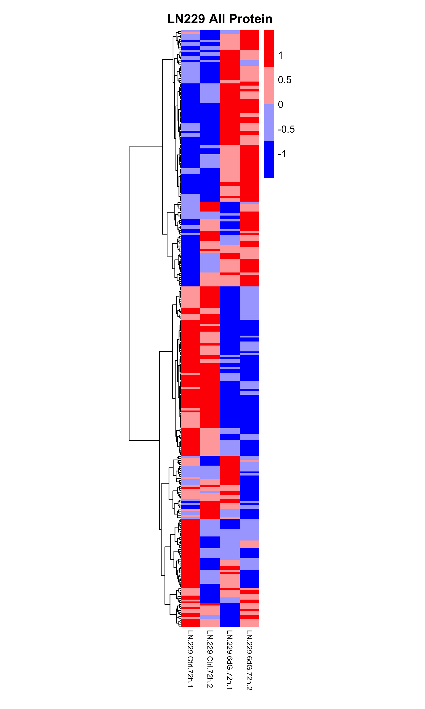
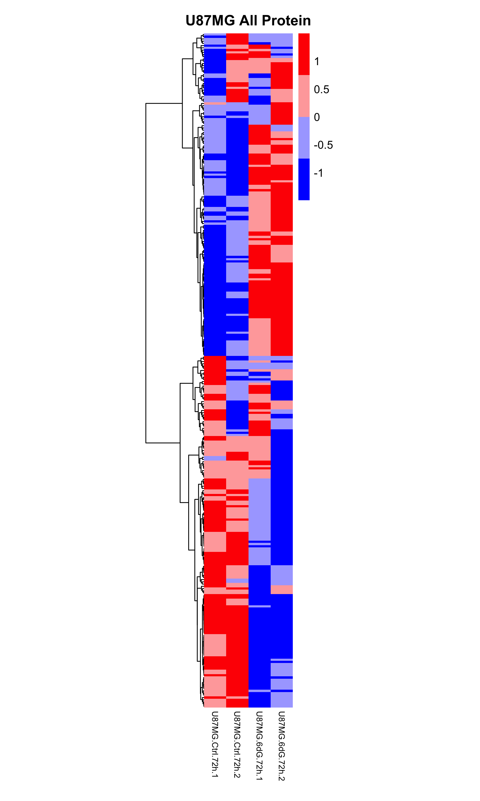
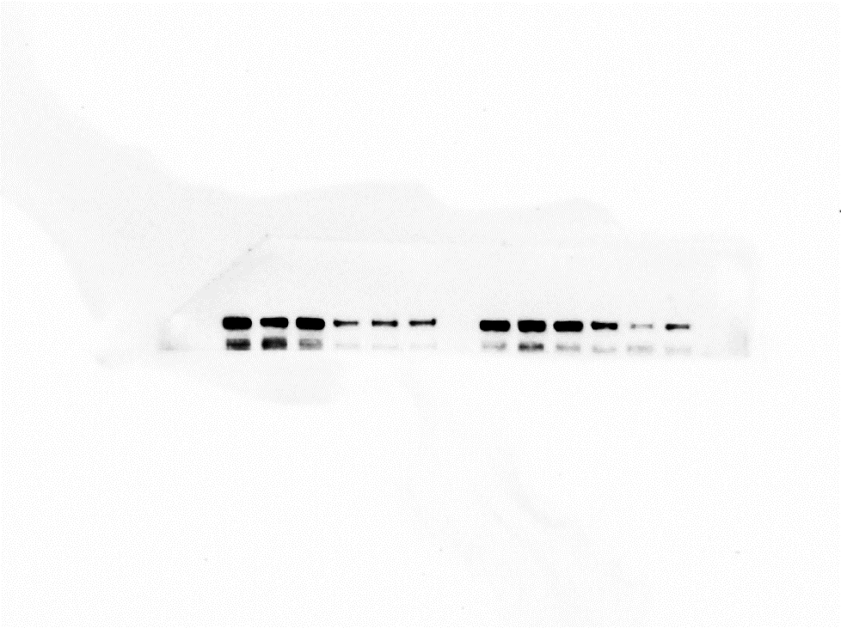
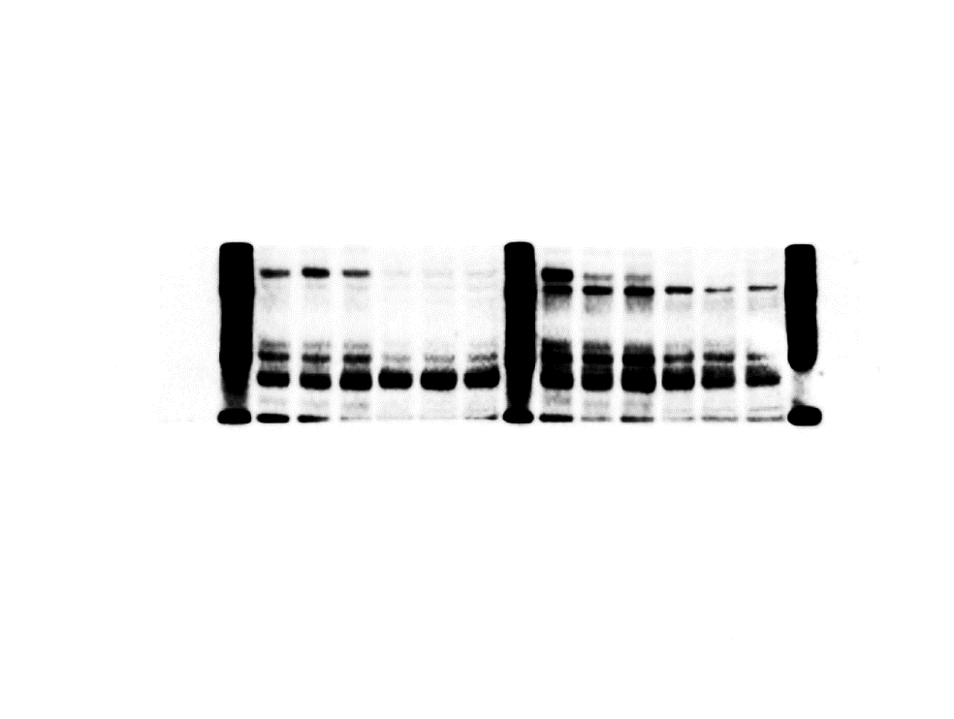
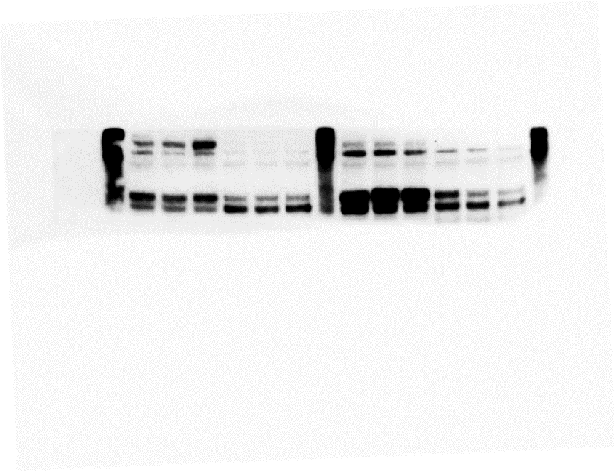

Supplementary Figure 5
A
M059K
B
LN229
C
U87MG
THIO-1
THIO-1
THIO-2
THIO-2
Control-1
Control-1
Control-2
Control-2
THIO-1
Control-1
THIO-2
D
E
F
Control-2
More sensitive to THIO
Less sensitive to THIO
More resistant to THIO
H4
U87MG
U251MG
ATRX
ATRX
ATRX
PDGFRβ
PDGFRβ
PDGFRβ
AXL
AXL
AXL
pRb^{Ser807/811}
pRb^{Ser807/811}
pRb^{Ser807/811}
HSP70
HSP70
HSP70
β-actin
β-actin
β-actin
Control
THIO 1µM
THIO 5µM
Control
THIO 1µM
THIO 5µM
Control
TMZ 250µM
THIO 2.5µM
THIO 10µM
TMZ 250µM
THIO 2.5µM
THIO 10µM
THIO 1µM
THIO 5µM
TMZ 250µM
THIO 2.5µM
THIO 10µM
G
Control
THIO
Control
THIO
Control
THIO
2
Cell_cycle_progression
G0_G1
TSC_mTOR
G1_S
PI3K_Akt
Hormone_receptor
DNA_Damage_Checkpoint
RAS_MAPK
Immune_Checkpoint
BH3_Balance
Hormone_signaling_Breast
RTK
Apoptosis
G2_M
DNA_Damage
Notch
0
-2
M059K
LN229
U87MG

Slide 2
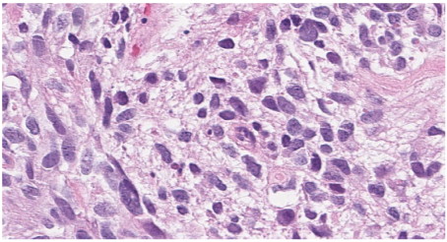
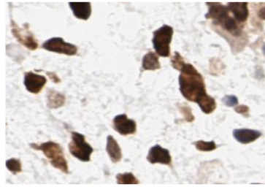
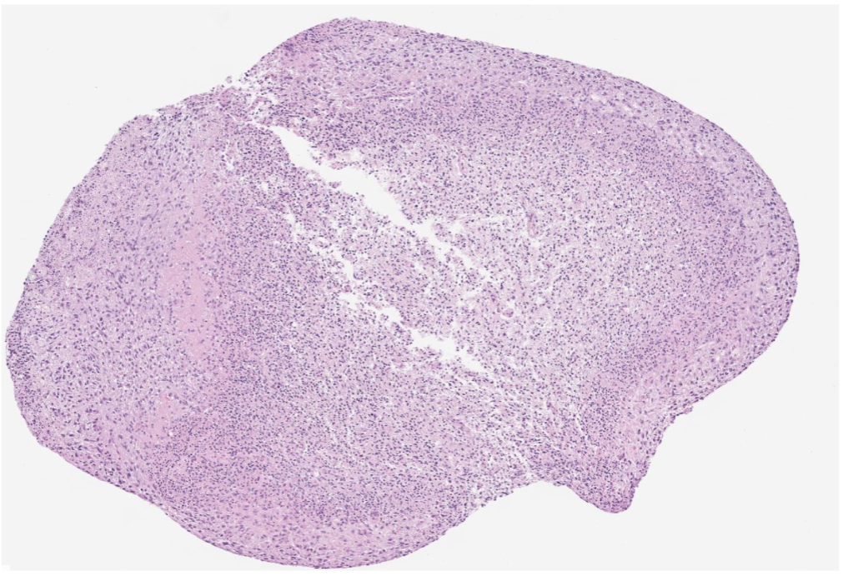
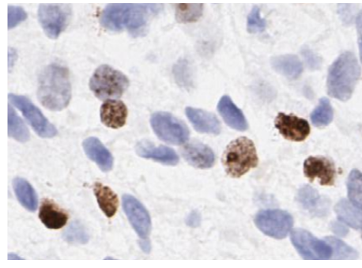
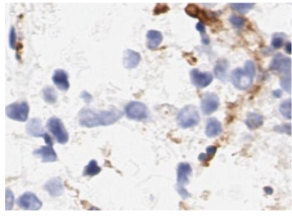
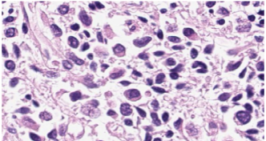
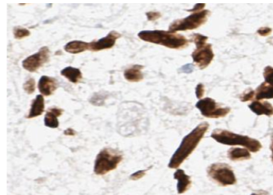
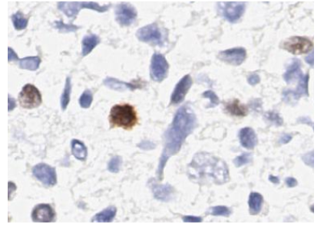
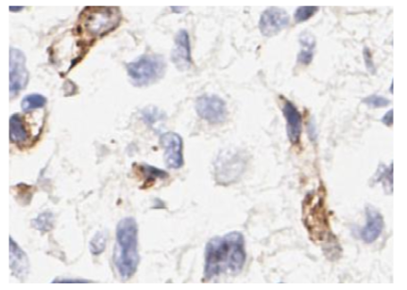
Supplementary Figure 6
A
WHO Grade IV Glioblastoma
Sox2
Ki67
CD31
Sox2
Ki67
CD31
B
C
U87MG
U87MG
*
ns
Control
THIO 3mg/kg
(Days)
D
GBM PDX
E
GBM PDX
ns
(Days)
F
U251MG
ns
(Days)

