Slide 1
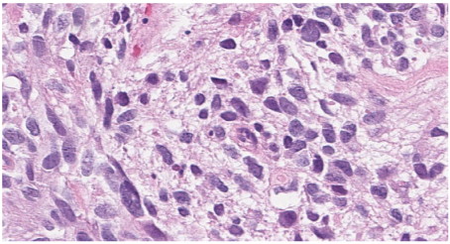
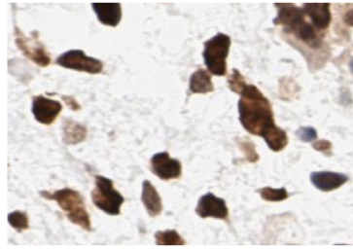
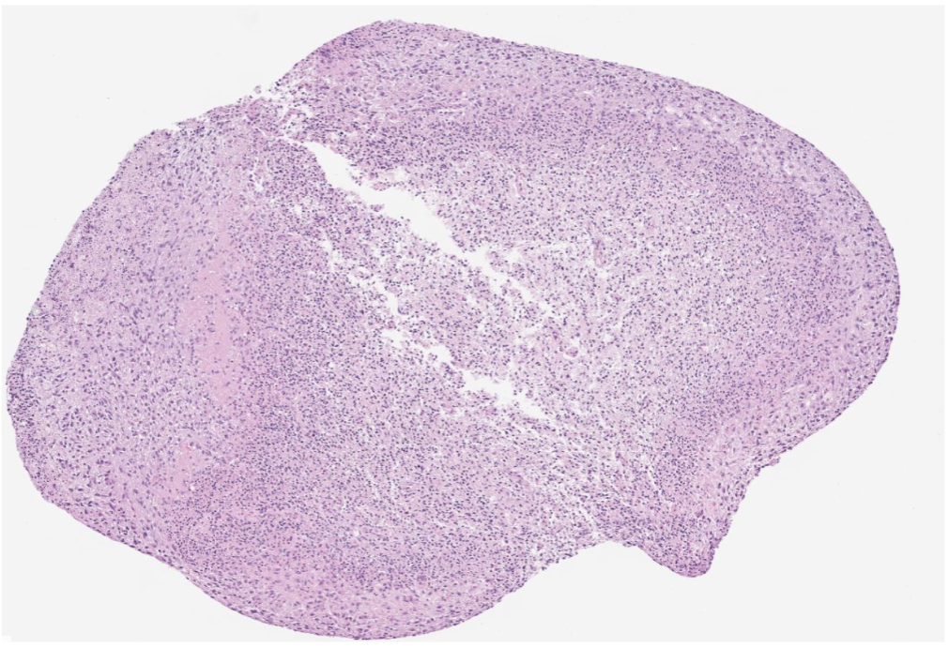
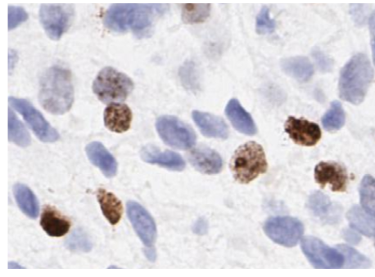
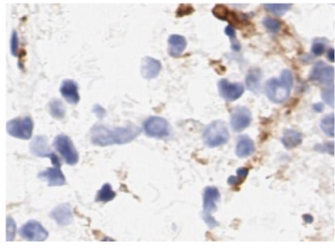
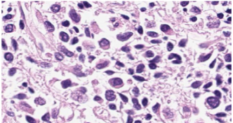
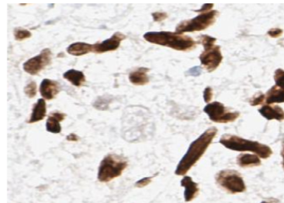
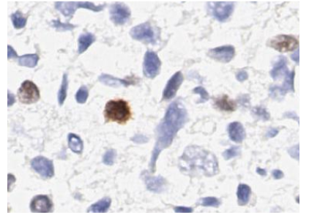
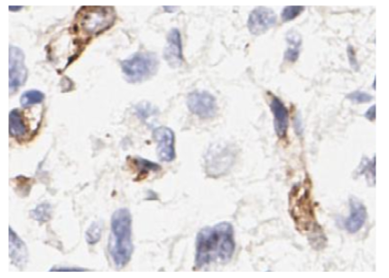
Supplementary Figure 6
A
WHO Grade IV Glioblastoma
Sox2
Ki67
CD31
Sox2
Ki67
CD31
B
C
U87MG
U87MG
*
ns
Control
THIO 3mg/kg
(Days)
D
GBM PDX
E
GBM PDX
ns
(Days)
F
U251MG
ns
(Days)

