Slide 1
Supplementary Figure 1
(1) Select the region where PD complex accumulates.
(2) Take z-stack images (Top - Bottom) excluding PD complex on leaf epidermis.
(3) Select only mesophyll region.
(4) Image J (Z projects and 3D project)
(5) Line along cell shape.
(6) Count the PD complex inside and outside cell
using Image J by manual.
(Plugins > Analyze > Cell Counter)
(7) Calculation of number of PDC by Excel.
 | outside | inside
KH-OEP34-pDNA | 68 | 41
Notes:
Supplementary Figure 1. Calculation of the number of KH-AtOEP34–pDNA complexes.
Representative image of KH-AtOEP34–pDNA labeled with Cy3 (cpPD-Cy3; magenta) and chloroplast (green) in Arabidopsis leaf spongy mesophyll cells. The quantification procedure is shown below the image (1)-(7). To clearly delineate the cell border, the plasma membrane was stained with FM-4-64 (blue). The cpPD-Cy3 complexes outside or inside cells are indicated as yellow or white numbers, respectively.

Slide 2
Supplementary Figure 2
A
Control
WM (50 µM)
BFA (20 µM)
cpPD-Cy3 complex
(Col-0) 12 h
B
100
80
60
Inside / outside (%)
(cpPD-Cy3 complex)
40
20
0
WM
BFA
Control
Notes:
Supplementary Figure 2. Effect of wortmannin and BFA on degradation of the KH-AtOEP34–pDNA complexes in vacuole.
(A) Representative images of KH-AtOEP34–pDNA labeled with Cy3 (cpPD-Cy3; magenta) (cpPD-Cy3 complex) and chloroplast (green) in Arabidopsis leaf spongy mesophyll cells without (control) or with wortmannin (WM) (50 µM) and Brefeldin A (BFA) (20 µM) at 12 h after infiltration of the cpPD-Cy3 complex. White arrows indicate the cpPD-Cy3 complex inside the cells. Bars = 10 µm. (B) Ratio of the number of cpPD-Cy3 complexes inside and outside cells shown in (A), as box plots. The horizontal lines represent the mean and the cross represents the median. Circles represent outliers.

Slide 3
Supplementary Figure 3
A
1h
3h
6h
12h
PD-Cy3 complex
(KH9-BP100)
Enlarged
B
Leaf epidermis (3h)
Leaf mesophyll (3h)
D
100
80
60
PD-Cy3 complex
(KH9-BP100)
Inside / outside (%)
40
20
0
1
3
6
12
Time (h)
C
1h
3h
6h
12h
N_{PD-Cy3 complex} (Inside)
N_{PD-Cy3 complex} (Inside)
N_{PD-Cy3 complex} (Inside)
N_{PD-Cy3 complex} (Inside)
N_{PD-Cy3 complex} (Outside)
N_{PD-Cy3 complex} (Outside)
N_{PD-Cy3 complex} (Outside)
N_{PD-Cy3 complex} (Outside)
Notes:
Supplementary Figure 3. Time-dependent penetration of BP100(KH)₉–pDNA complexes into the cell.
(A) BP100(KH)₉-pDNA complexes labeled with Cy3 (PD-Cy3 complex; magenta) in Arabidopsis leaf mesophyll cells at different time points. The leaf cells membranes were stained with FM4-64 (blue). Chloroplasts (green) are shown as chlorophyll autofluorescence. Bars = 10 µm. Enlarged images are on lower panels. (B) PD-Cy3 complexes accumulate in the extracellular space under stomata and the outer plasma membrane at 3 h after infiltration. (C) Scatterplots of the number of PD-Cy3 complexes at different time points shown in (A). Each circle represents a cell with the number of PD-Cy3 complexes outside (x-axis), N_{PD-Cy3 complex} (Outside), and inside (y-axis), N_{PD-Cy3 complex} (Inside), the cell (n>20). (D) The ratio between the number of PD-Cy3 complexes inside and outside cells, calculated at each time point.

Slide 4
Supplementary Figure 4
A
BP100(KH)9
(Col-0)
cpPD-Cy3 complex
(Col-0)
cpPD-Cy3 complex
(NT-CHUP1)
6 h
B
PD-Cy3 complex
(KH9-BP100)
(Col-0)
cpPD-Cy3 complex
(Col-0)
cpPD-Cy3 complex
(NT-CHUP1)
N_{PD-Cy3 complex} (Inside)
N_{cpPD-Cy3 complex} (Inside)
N_{cpPD-Cy3 complex} (Inside)
N_{PD-Cy3 complex} (Outside)
N_{cpPD-Cy3 complex} (Outside)
N_{cpPD-Cy3 complex} (Outside)
C
6 h
100
80
60
PD-Cy3 complex in cytosol (%)
40
20
0
PD-Cy3 complex
BP100(KH) (Col-0)
cpPD-Cy3 complex
(NT-CHUP1)
cpPD-Cy3 complex (Col-0)
Notes:
Supplementary Figure 4. Comparison of the penetration efficiency into cells of BP100(KH)₉–pDNA and KH-AtOEP34–pDNA complexes.
(A) BP100(KH)₉–pDNA or KH-AtOEP34–pDNA complexes labeled with Cy3 (PD-Cy3 or cpPD-Cy3 complex; magenta) in Arabidopsis leaf mesophyll cells or in leaf mesophyll cells from transgenic plants expressing NT-CHUP1 at different time points. Chloroplasts (green) are shown as chlorophyll autofluorescence. Bars = 10 µm. (B) Scatterplots of the number of PD-Cy3 or cpPD-Cy3 complexes at different time points shown in (A). Each circle represents the number of PD-Cy3 or cpPD-Cy3 complexes outside (x-axis), N_{PD-Cy3 complex} (Outside) or N_{cpPD-Cy3 complex} (Outside), and inside (y-axis), N_{PD-Cy3 complex} (Inside) or N_{cpPD-Cy3 complex} (Inside), the cell (n>20). (D) The ratio of the number of PD-Cy3 or cpPD-Cy3 complexes inside and outside each cell at 6 h after infiltration.

Slide 5
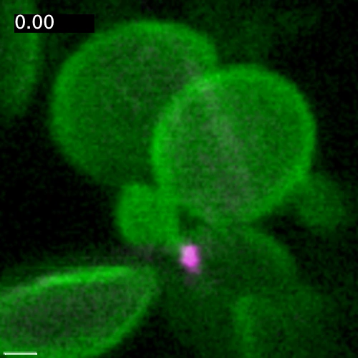
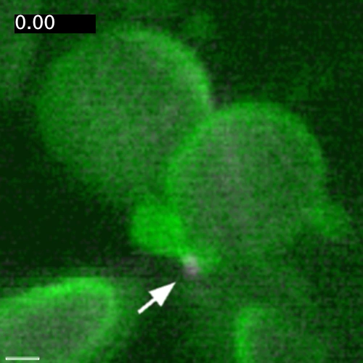
Supplementary Movie 1
A
B
1 µm
Notes:
Supplementary Movie 1. KH-AtOEP34–pDNA is trapped by the chloroplast outer membrane.
(A, B) KH-AtOEP34–pDNA-Cy3 (cpPD-Cy3, magenta) adjacent to a chloroplast (left panel; 0–10 min) (A) is gradually engulfed by the chloroplast outer envelope (green) (right panel; 10–20 min) (B). Time-lapse images were taken every 10 s.

Slide 6
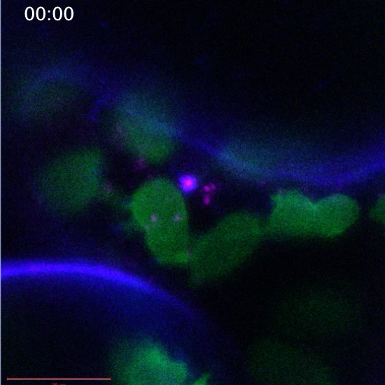
Supplementary Movie 2
10µm
Notes:
Supplementary Movie 2. Complexes-containing vesicles remain in the cytosol.
The region indicated by the white dashed line shows a vesicle containing KH-AtOEP34–pDNA-Cy3 complexes (cpPD-Cy3, magenta). The vesicle is enveloped by the plasma membrane (blue), which was visualized by staining with FM-4-64. Time-lapse images were taken every 2.5 s.

