Slide 1

hvCAS before optical mapping
Notes:
Spontaneous contraction of hvCAS.

Slide 2
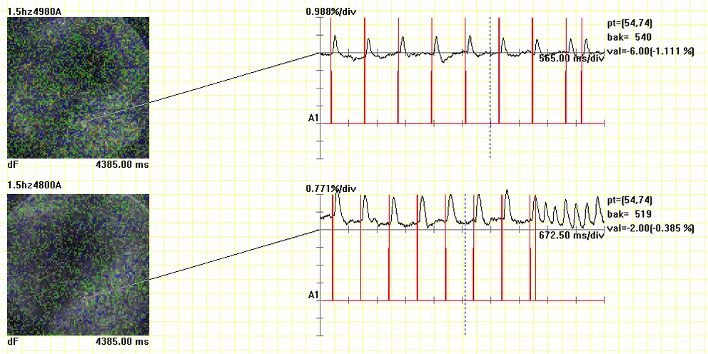
Regular pacing at 1.5 Hz
Programmed Electrical Stimulation
S1S2 pacing
Normokalaemia
S1S2 pacing
inducing spiral
on Hypokalaemia
Notes:
Red vertical lines represent external electrical stimulation and peaks represent action potential. Hypokalaemia shows spiral after PES.

Slide 3
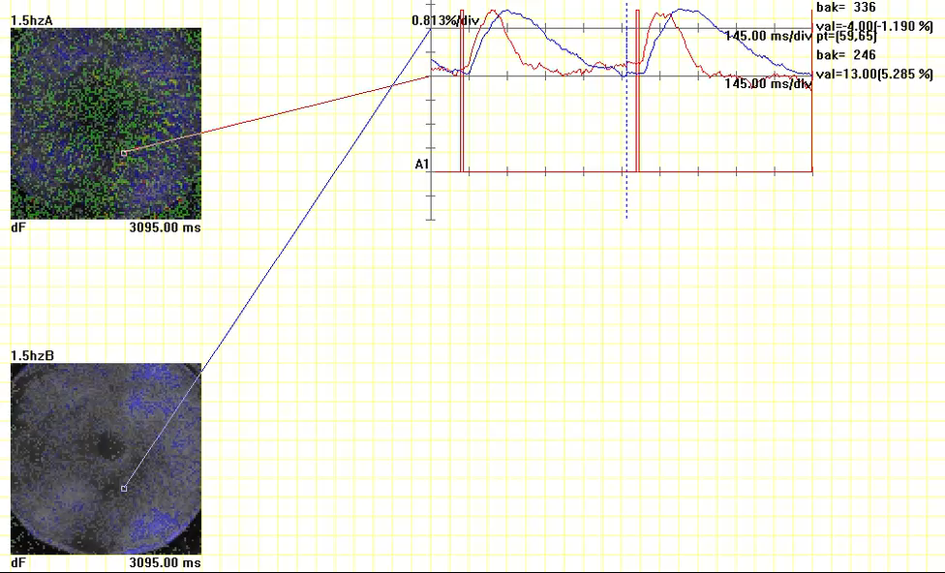
Simultaneous mapping of AP (red line) and CaT (blue line)
AP
CaT
Notes:
Red vertical lines represent external electrical stimulation and peaks represent action potential and calcium transient.

