Slide 1
SUPPLEMENTAL FIGURE 1
A
B
C
D

Slide 2
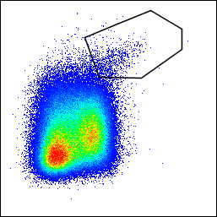
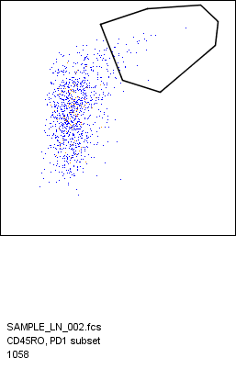
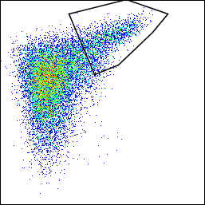
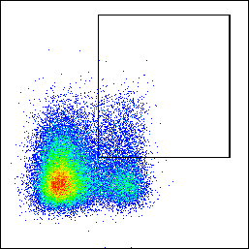
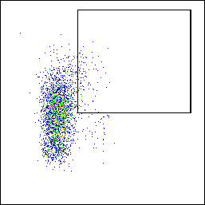
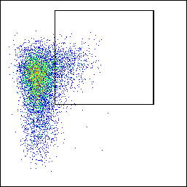
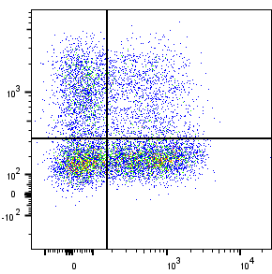
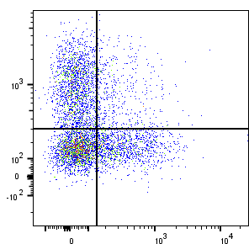
SUPPLEMENTAL FIGURE 2
A
PBMC T cells
1
2
Naïve
Central memory
Effector memory
Effector
Treg
FSC-H
SSC
CD3
CD8
CD27
4
3
FSC-A
FSC-A
Live/dead
CD4
CD45RO
5
CD25
FOXP3
B
LNMC Tfh cells
HC
Pre-ART
Post-ART
0.48
3.40
13.7
PD-1
CXCR5
C
PBMC cTfh cells
HC
Pre-ART
Post-ART
4.61
3.38
12.6
PD-1
CXCR5
D
PBMC cTfh cells subsets
HC
Post-ART
20.8
15.9
33.2
8.92
HC
CXCR3
27.1
36.2
36.8
21.1
CCR6

Slide 3
SUPPLEMENTAL FIGURE 3
A
B

Slide 4
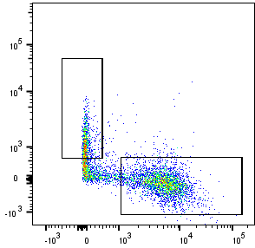
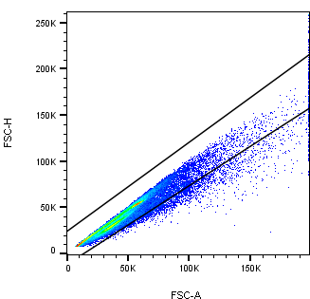
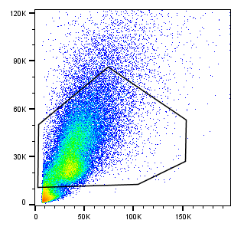
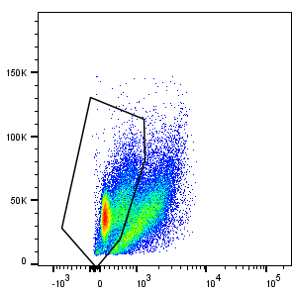
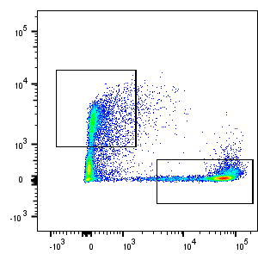
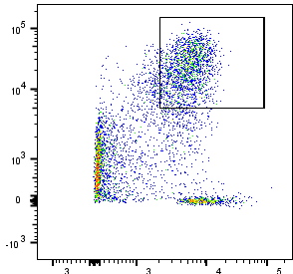
SUPPLEMENTAL FIGURE 4
A
Co-culture B cells
IgD
FSC-H
SSC-A
FSC-A
CD19
CD19⁺
CD27
FSC-A
FSC-A
L/D
CD3
CD38
CD27
B
C
D
E

Slide 5
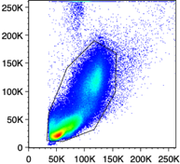
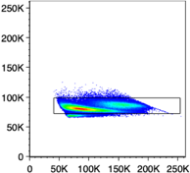
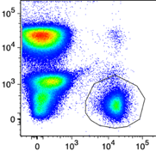
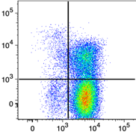
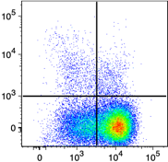
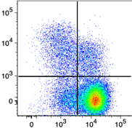
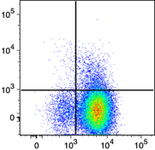
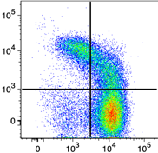
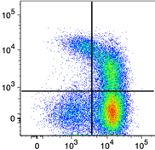
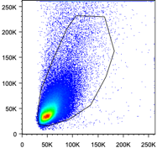
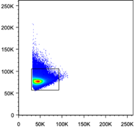
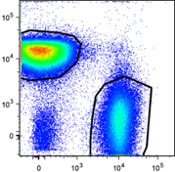
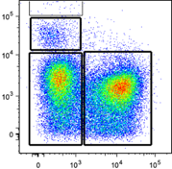
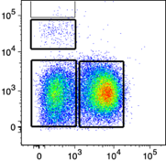
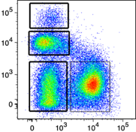
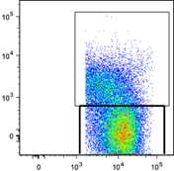
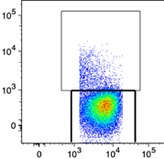
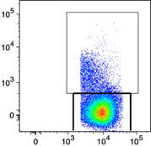
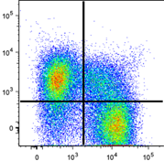
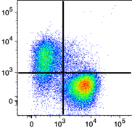
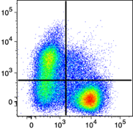
SUPPLEMENTAL FIGURE 5
A
PBMC B cells
HC
Pre-ART
Post-ART
1
3
CD19⁺
2
SSC-A
FSC-W
CD3
CD27
4
5
FSC-A
FSC-H
CD19
CD21
ASC
Activated memory
Resting memory
Tissue-like memory
Naïve
Transitional/immature T1, T2, T3
6
T1
T2
CD10
T3
CD21
B
LNMC B Cells
HC
Pre-ART
Post-ART
1
2
SSC-A
FSC-W
CD3
CD19⁺
CD38
3
4
FSC-A
FSC-H
CD19
IgD
ASC
Germinal center
IgD⁻ memory
Naïve and IgD⁺ memory
IgD⁺ memory
Naïve
IgD/CD27 double negative
5
6
CD27
7
IgD
C
D

Slide 6
SUPPLEMENTARY FIGURE 6
A
B

Slide 7
SUPPLEMENTAL FIGURE 7
A

Slide 8
SUPPLEMENTAL FIGURE 7
B
Pre-ART
Cell subset | IL-18 | IL-27 | MIP3 | CXCL13 | CXCL9 | TGFβ1 | IgA | IgG | IgM | sCD25
GCBC | r= 0.244 | r= 0.023 | r= 0.320 | r= 0.365 | r= -0.0838 | r= -0.109 | r= 0.306 | r= 0.4455 * | r= 0.450 | r= 0.5039 *
DNBC | r= 0.328 | r= -0.050 | r= 0.5622 | r= 0.609 * | r= -0.0912 | r= 0.155 | r= 0.406 | r= 0.484 | r= 0.430 | r= 0.428
Tfh | r= 0.302 | r= 0.191 | r= 0.323 | r=0.540 * | r= -0.113 | r= 0.156 | r= 0.2941 | r= 0.680 *** | r= 0.713 *** | r= 0.415
Cell subset | IL-8 | TNFα | MCP-1 | IL-6R | sCD14 | D-dimer | MPO | IFNϒ | IL-10 | sPD-1 | IL-6
GCBC | r= 0.169 | r = 0.614 ** | r = 0.5324 * | r = 0.131 | r = 0.668 * | r = 0.047 | r = 0.281 | r = 0.196 | r = -0.092 | r = -0.231 | r = -0.007
DNBC | r = 0.446 | r = 0.727 * | r = 0.636 * | r = -0.182 | r = 0.709 * | r = 0.255 | r = 0.355 | r = -0.0727 | r = -0.3 | r = -0.418 | r = 0.2
Tfh | r = 0.082 | r = 0.564 * | r = 0.364 | r = 0.45 | r = 0.489 | r = 0.082 | r = 0.371 | r = 0.111 | r = -0.075 | r = -0.414 | r = 0.018
Post-ART
Cell subset | IL-18 | IL-27 | MIP3 | CXCL13 | CXCL9 | TGFβ1 | IgA | IgG | IgM | sCD25
GCBC | r = 0.0841 | r = -0.0254 | r = -0.140 | r = 0.0252 | r = 0.0792 | r = -0.162 | r = 0.312 | r = 0.181 | r = 0.195 | r = -0.00282
DNBC | r = -0.0547 | r = -0.0753 | r = -0.133 | r = 0.0175 | r = 0.00980 | r = -0.-506 | r = 0.4337 | r = 0.461 | r = 0.274 | r = -0.195
Tfh | r = -0.118 | r = 0.1304 | r = -0.078 | r = -0.027 | r = -0.091 | r = -0.268 | r = 0.5088 * | r = 0.441 * | r = 0.236 | r = -0.136
Cell subset | IL-8 | TNFα | MCP-1 | IL-6R | sCD14 | D-dimer | MPO | IFNϒ | IL-10 | sPD-1 | IL-6
GCBC | r = -0.0857 | r = 0.0571 | r = -0.379 | r = -0.025 | r = -0.207 | r = -0.196 | r = 0.189 | r = -0.243 | r = -0.443 | r = 0.318 | r = -0.196
DNBC | r = 0.0220 | r = -0.121 | r = 0.0220 | r = -0.253 | r = -0.0275 | r = -0.264 | r = 0.225 | r = -0.137 | r = -0.126 | r = -0.0385 | r = -0.258
Tfh | r = 0.026 | r = 0.05 | r = -0.109 | r = 0.235 | r = -0.4 | r = -0.356 | r = 0.038 | r = -0.332 | r = -0.162 | r = 0.0765 | r = -0.620 *
Bold indicates significance
*P < 0.05, **P < 0.01, ***P < 0.001

Slide 9
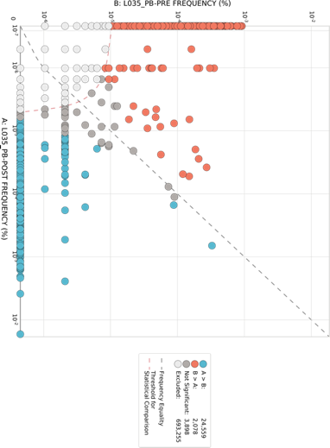
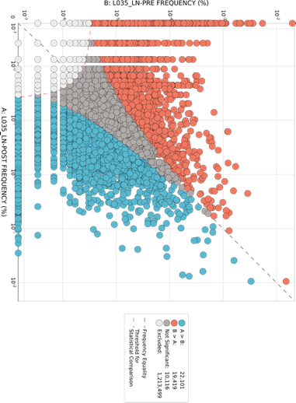
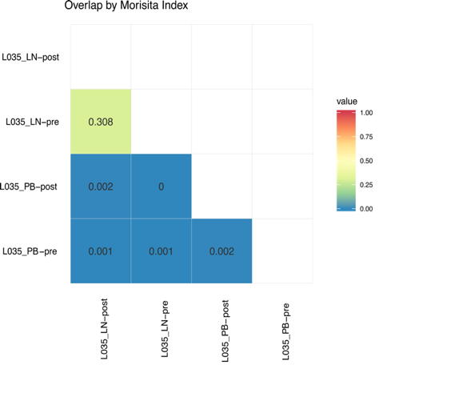
SUPPLEMENTAL FIGURE 8
A
B
C
D
PB
LN
L035 LN Post-ART
L035 LN Pre-ART
B: L035 LN Pre-ART Frequency (%)
L035 PB Post-ART
B: L035 PB Pre-ART Frequency (%)
L035 PB Pre-ART
L035 LN Post-ART
L035 LN Pre-ART
L035 PB Post-ART
L035 PB Pre-ART
A: L035 PB Post-ART Frequency (%)
A: L035 LN Post-ART Frequency (%)
E
F

