Slide 1
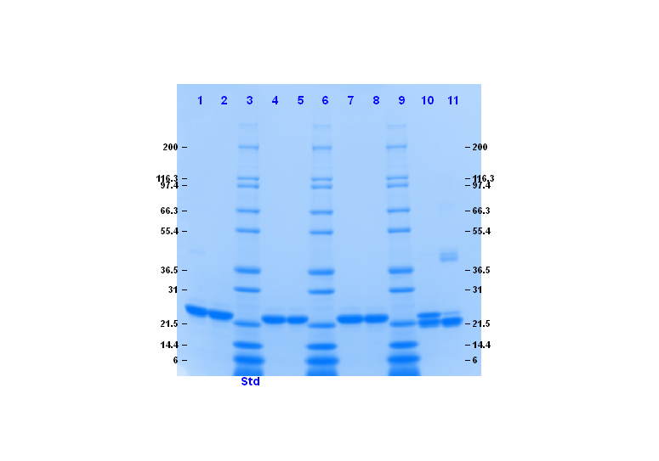
Additional file 2: Figure S2
A.
(a) PBS
(b) IMDM
Incubation
time (h)
0 18
0 18
0 18
0 18
Non-
Reducing
Reduced
with DTT
Reduced
with DTT
Non-
Reducing
B.
(a) PBS
t = 0h
(b) PBS
t = 18h
(c) IMDM
t = 18h

