Slide 1
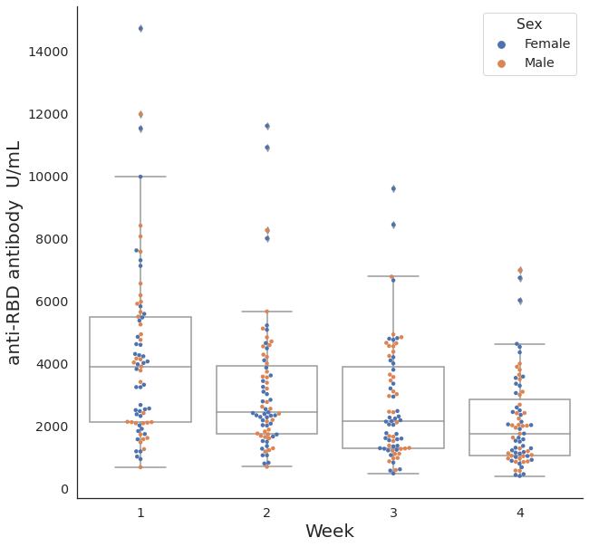
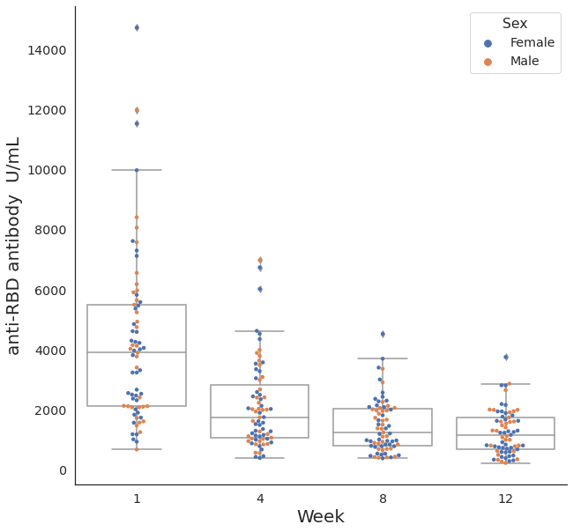
Supplementary Figure 1. SARS-CoV-2 anti-RBD antibody responses for (1A) weekly change for 4 weeks (1B) monthly change for 12 weeks.
A
B
P < 0.01
P < 0.01
P < 0.01
P = 0.11
P < 0.01
P < 0.01
SARS-CoV-2, severe acute respiratory syndrome coronavirus 2; RBD, receptor binding domain of viral spike protein.

Slide 2
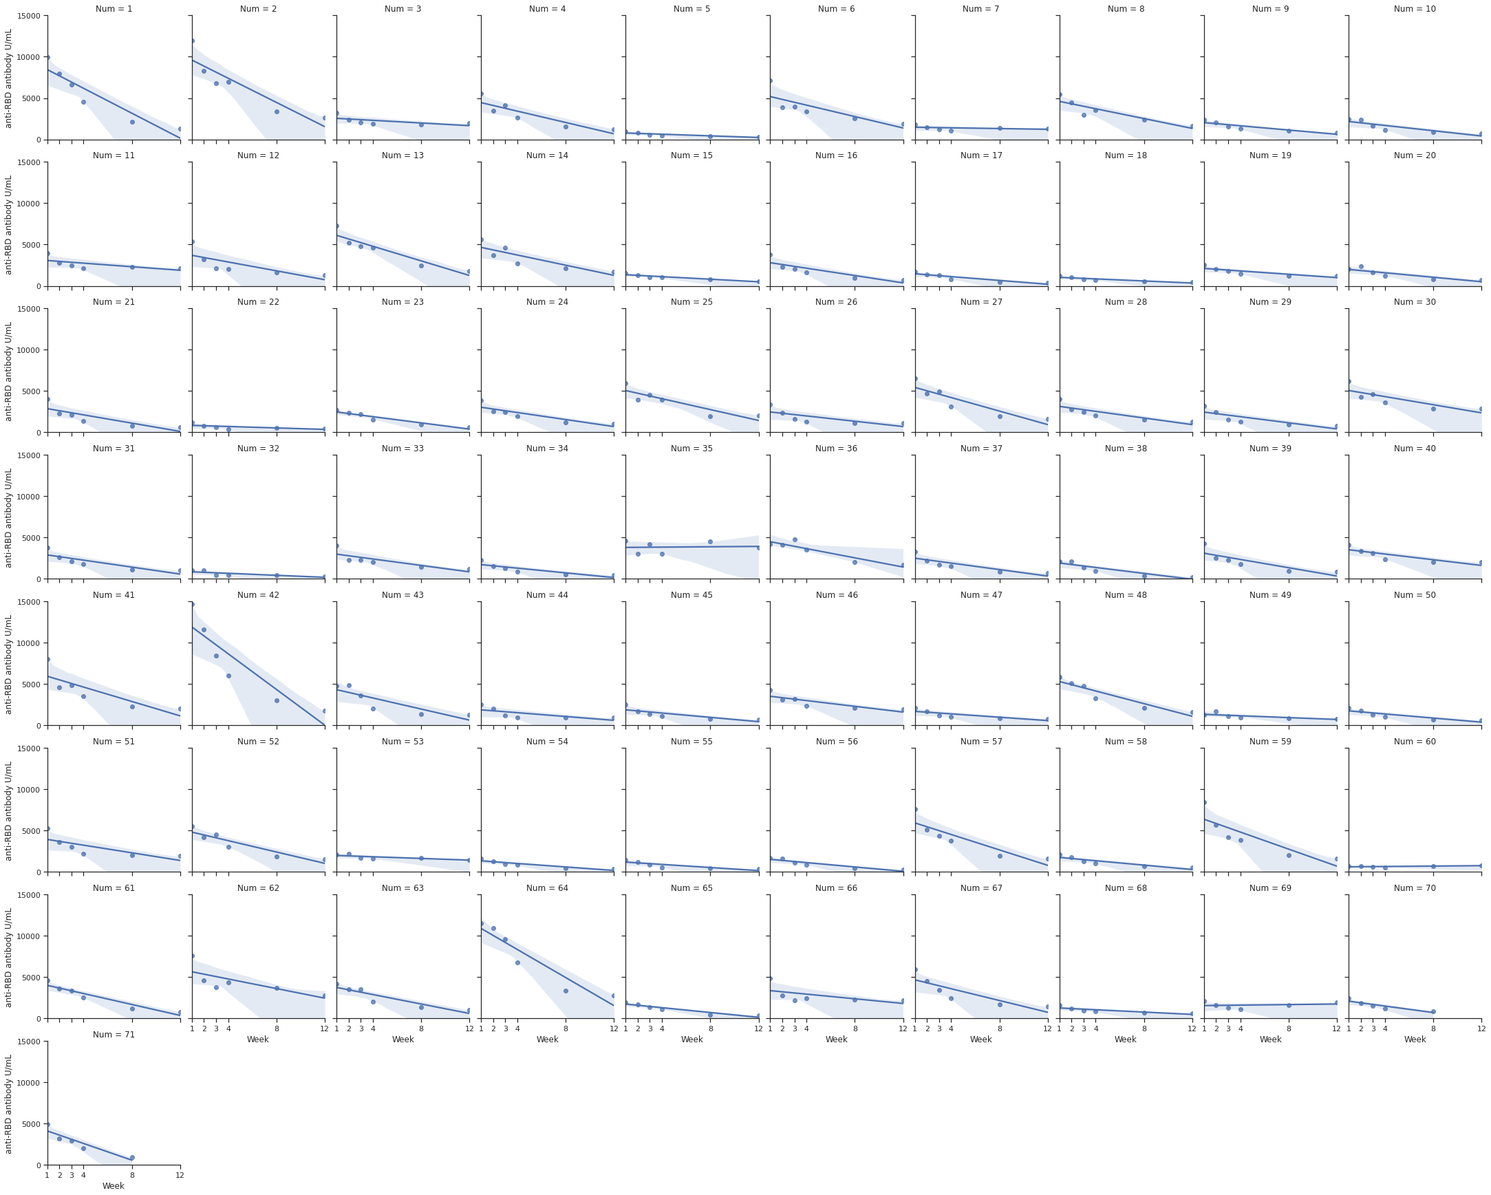
Supplementary Figure 2. Regression analysis graph of (2A) SARS-CoV-2 anti-RBD antibody (2B) SARS-CoV-2 anti-RBD antibody log10 for individuals.
A

Slide 3
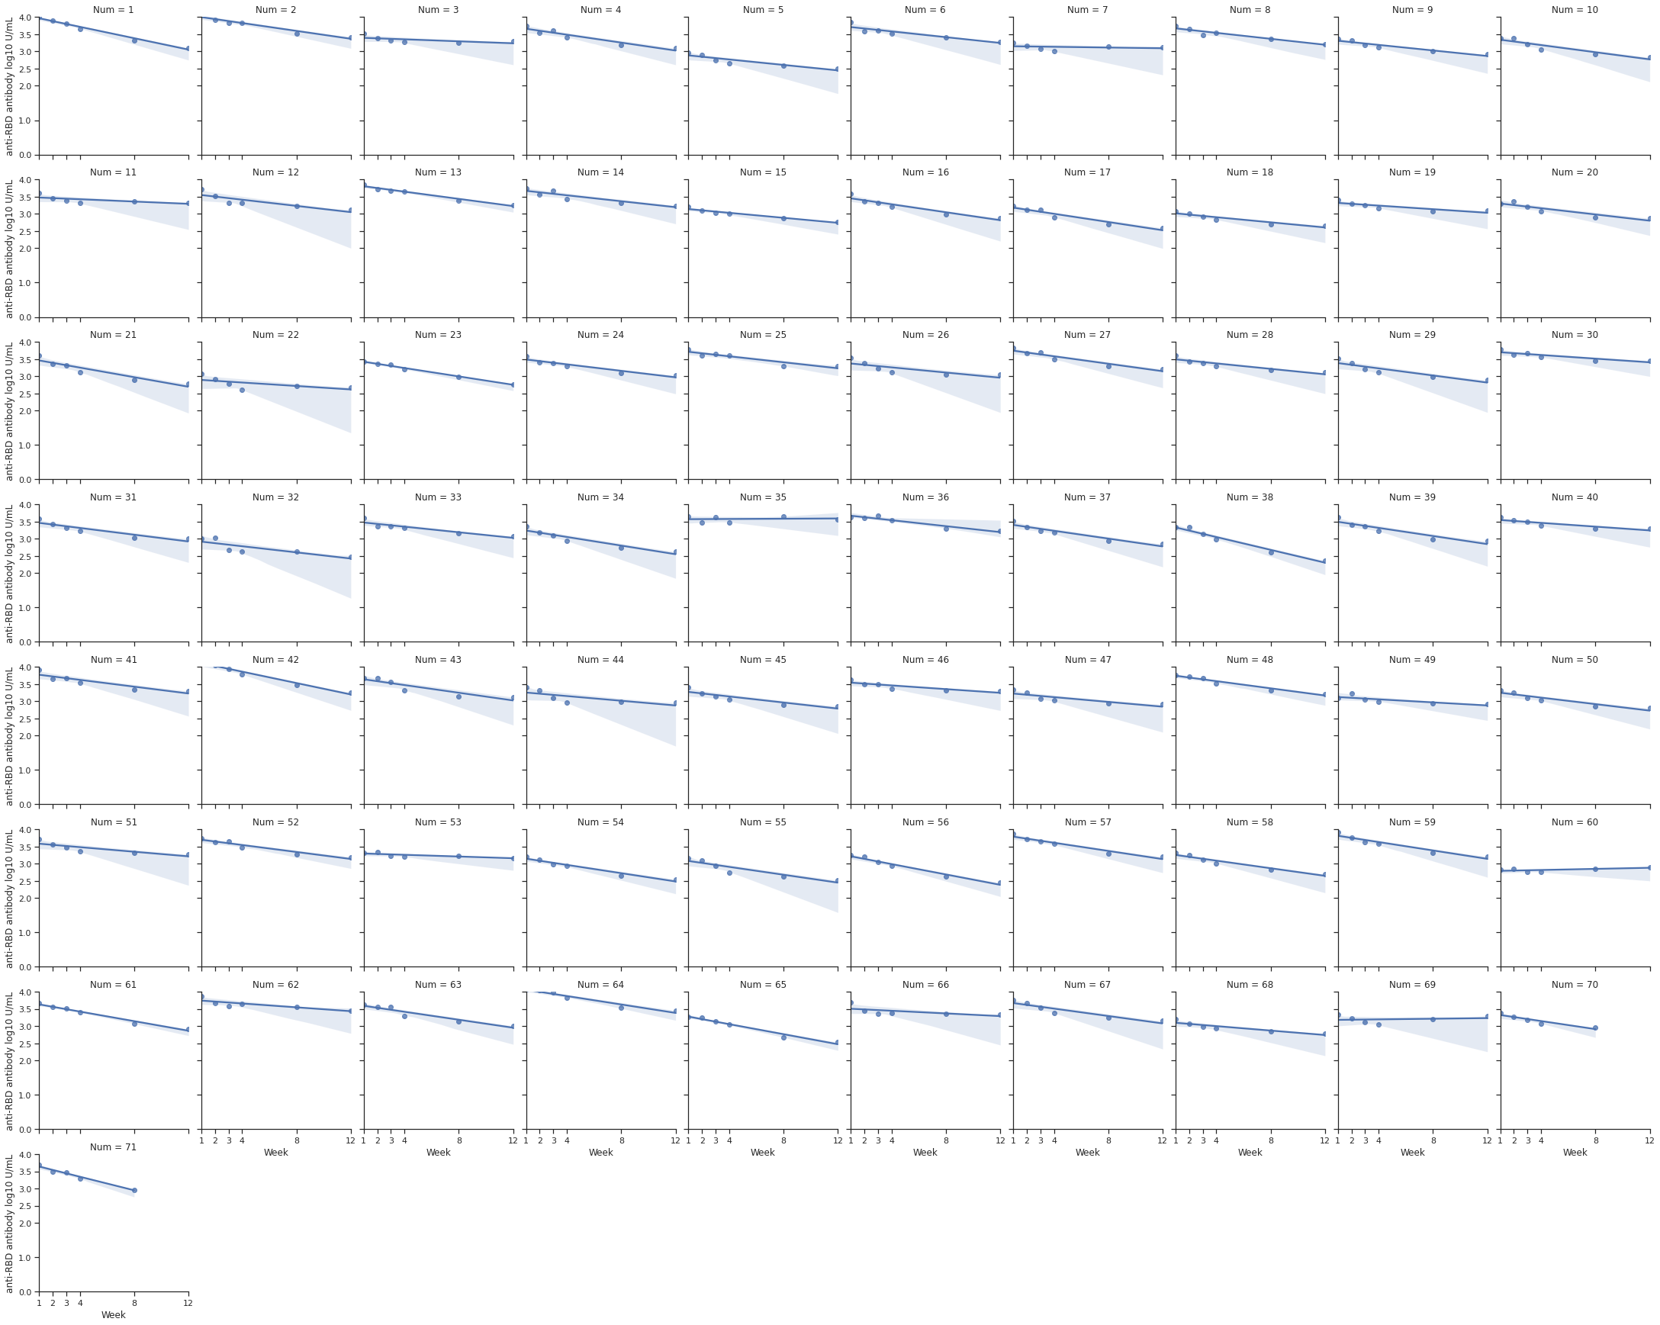
B
SARS-CoV-2, severe acute respiratory syndrome coronavirus 2; RBD, receptor binding domain of viral spike protein.

Slide 4
Supplementary Figure 3. SARS-CoV-2 neutralising antibody % change according to weeks after 2nd dose vaccination.
SARS-CoV-2, severe acute respiratory syndrome coronavirus 2 viral spike protein.

