Slide 1

Identification of the first cases of complete CD16A deficiency: Association with persistent EBV infection
A. Pérez-Portilla, BSc, PhD, M. Moraru, MD, PhD, Alfonso Blázquez-Moreno, BSc, PhD, Philipp Kolb, PhD, María Bravo García-Morato, BSc, PhD, Thanmayi Ranganath, BSc, MSc, Gloria Esteso, BSc, PhD, Carla Gianelli, MD, Rebeca Rodríguez-Pena, MD, PhD, Roberto Lozano-Rodríguez, BSc, Juan Manuel Torres-Canizales, MD, Catherine A. Blish, MD, PhD, Mar Vales-Gomez, BSc, PhD, Hartmut Hengel, PhD, Carlos Vilches, MD, PhD, Eduardo López-Granados, MD, PhD, Hugh T. Reyburn, BVMS, MRCVS, PhD
Journal of Allergy and Clinical Immunology
Volume 145 Issue 4 Pages 1288-1292 (April 2020)
DOI: 10.1016/j.jaci.2019.11.049
Copyright © 2020 American Academy of Allergy, Asthma & Immunology Terms and Conditions

Slide 2
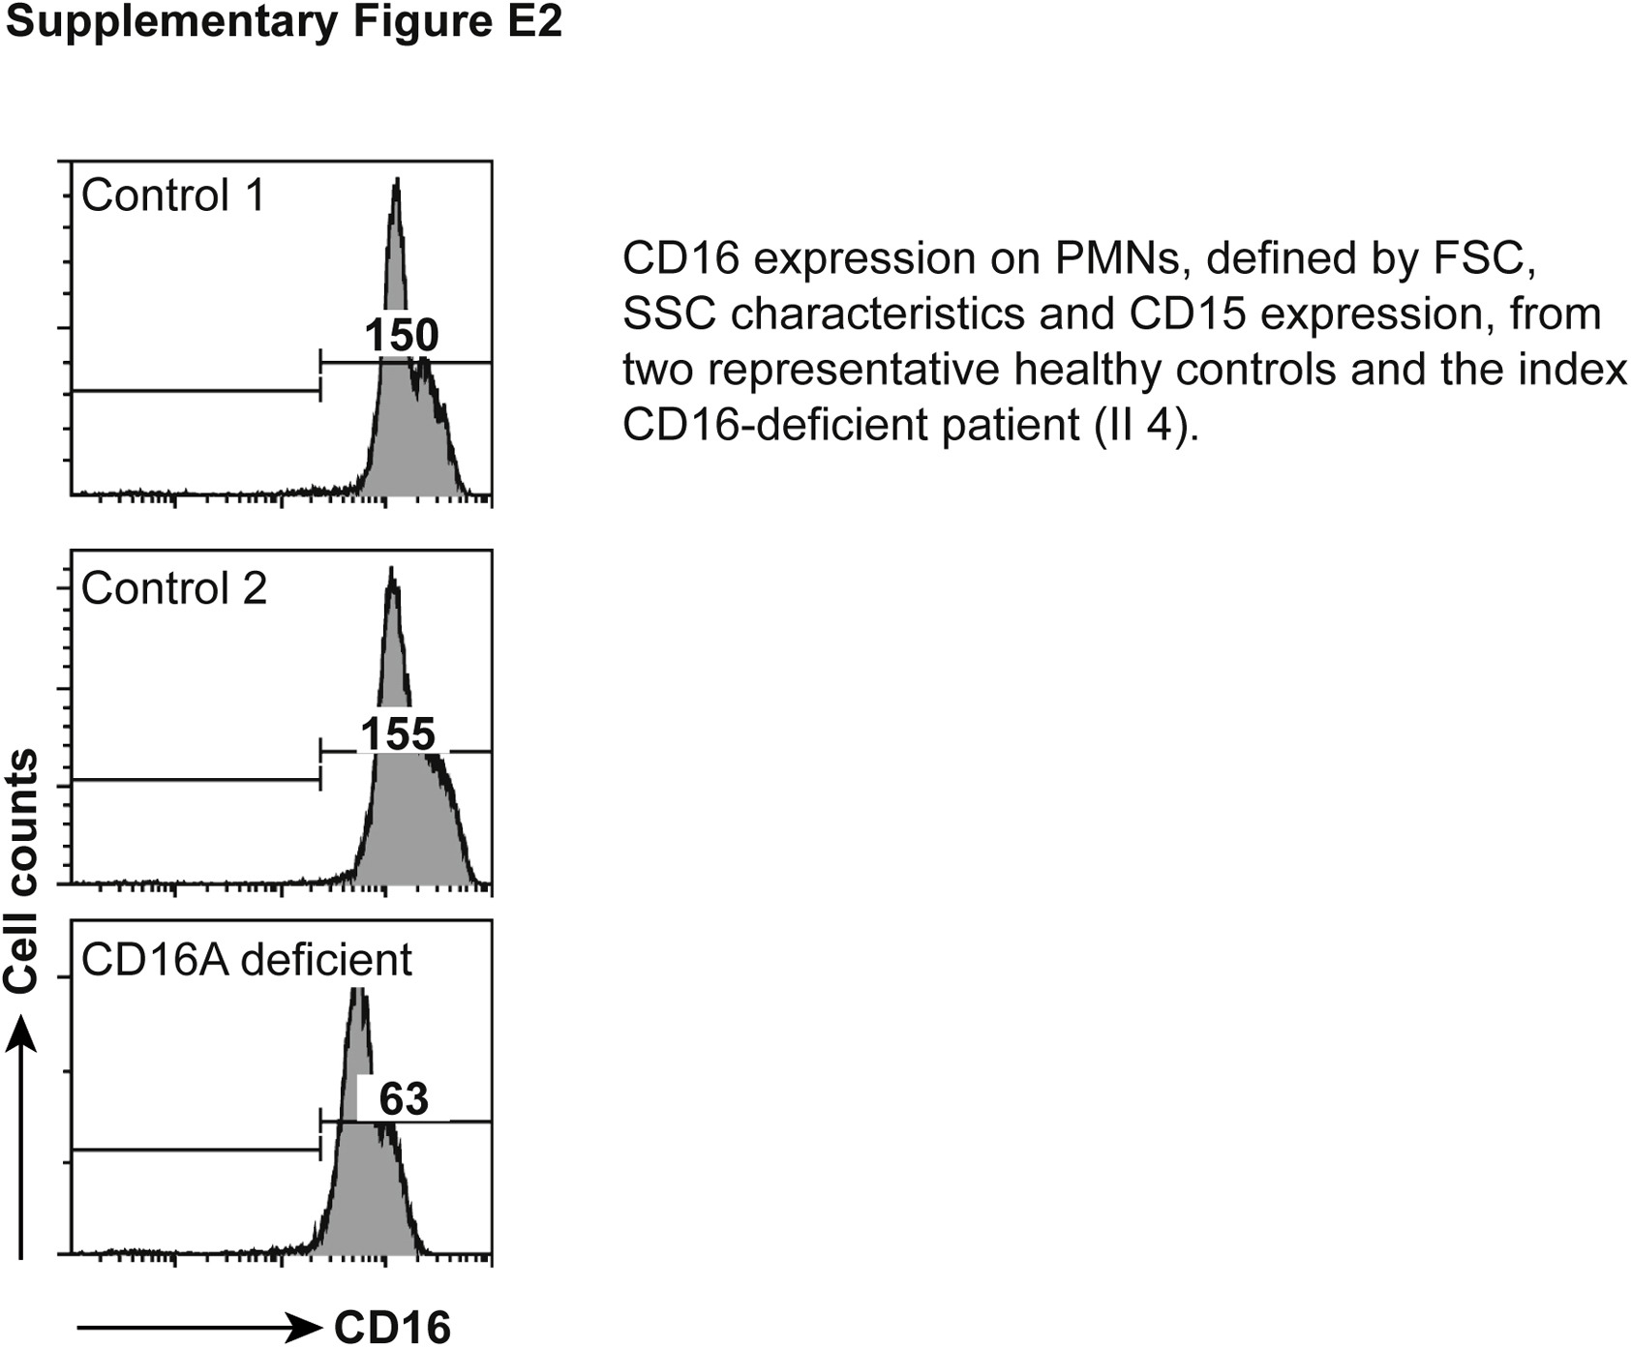
Fig E2
Journal of Allergy and Clinical Immunology 2020 1451288-1292DOI: (10.1016/j.jaci.2019.11.049)
Copyright © 2020 American Academy of Allergy, Asthma & Immunology Terms and Conditions

