Slide 1
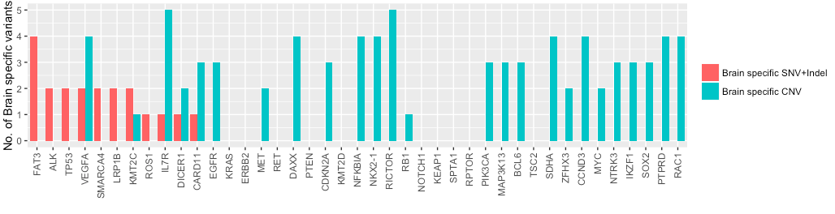
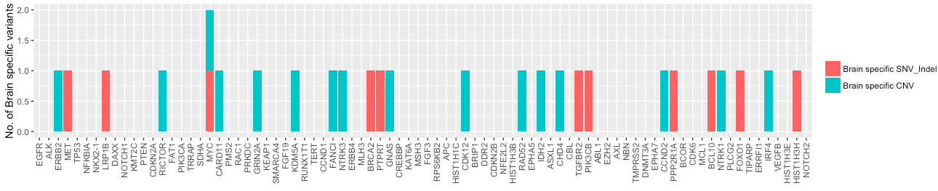
A
B
Figure S1. To identify brain-specific mutations, comparative analyses were performed on somatic mutation profiles of primary lung tumor tissue and (A) brain metastatic tissue sample from patients with brain metastasis (BM) (n=18) or (B) cerebrospinal fluid (CSF) sample from patients with leptomeningeal metastasis (LM) (n=11). Red color represents single nucleotide variations (SNV) and small insertion-deletion variations (indel). Green color denotes copy number variations (CNV).

