Slide 1
A
B
Color Key for image A-B
BGB283
VEM
CAPE
Wi-A
Wi-N
Supplementary Figure 1

Slide 2
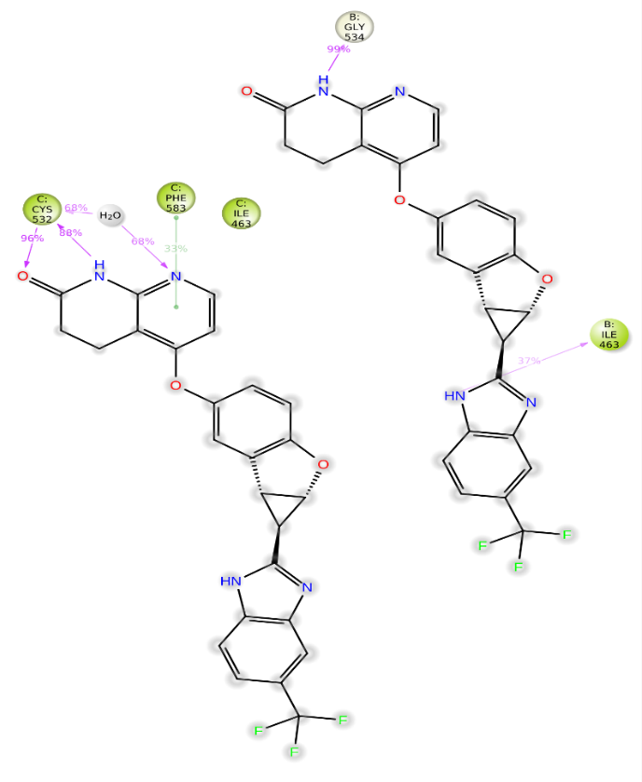
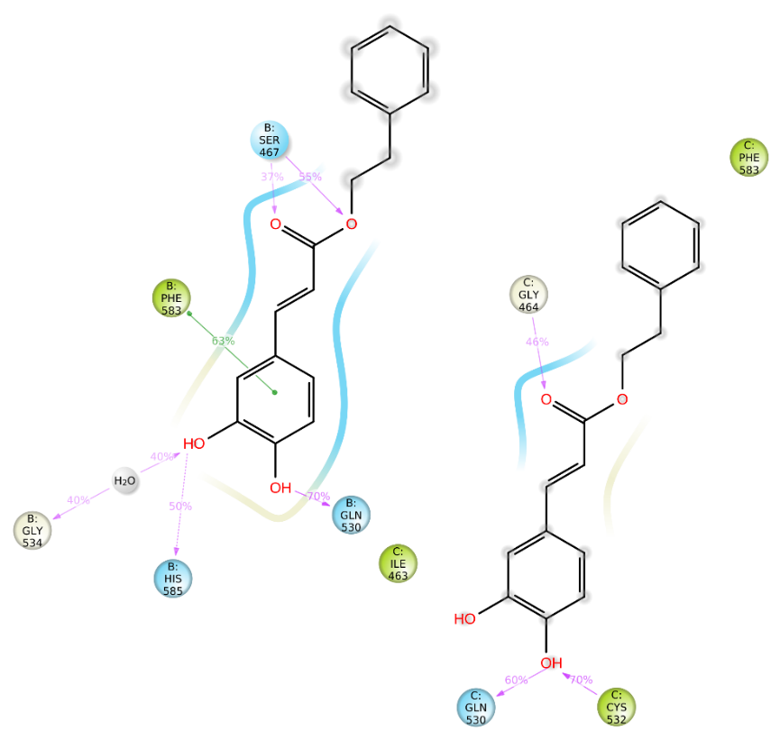
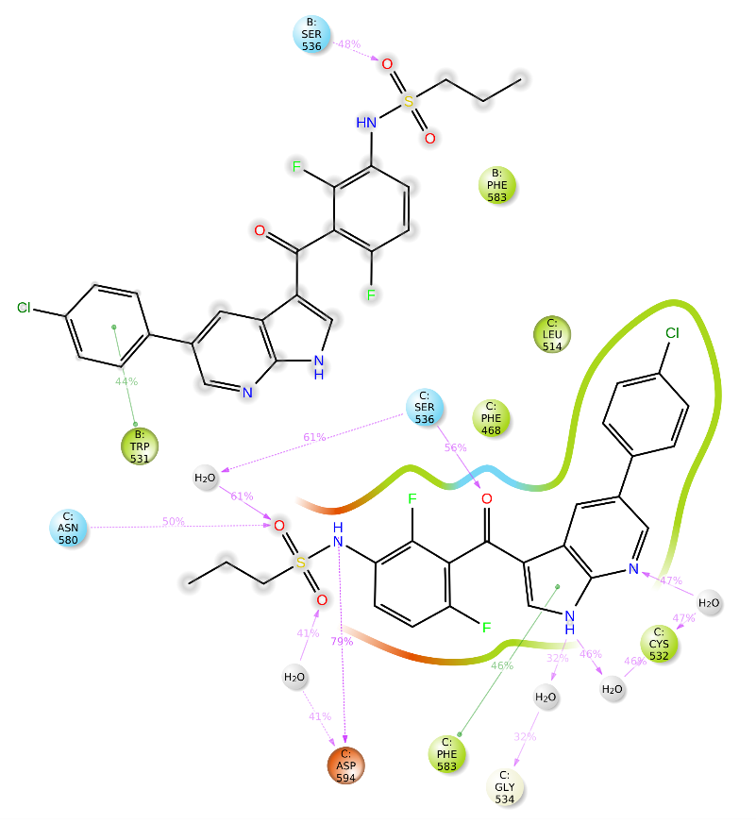
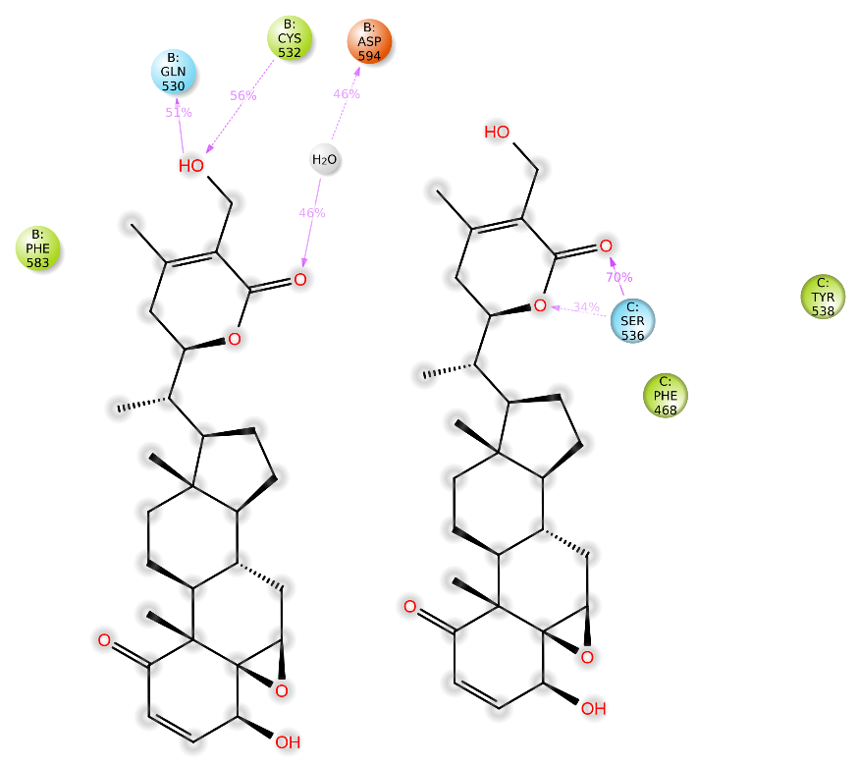
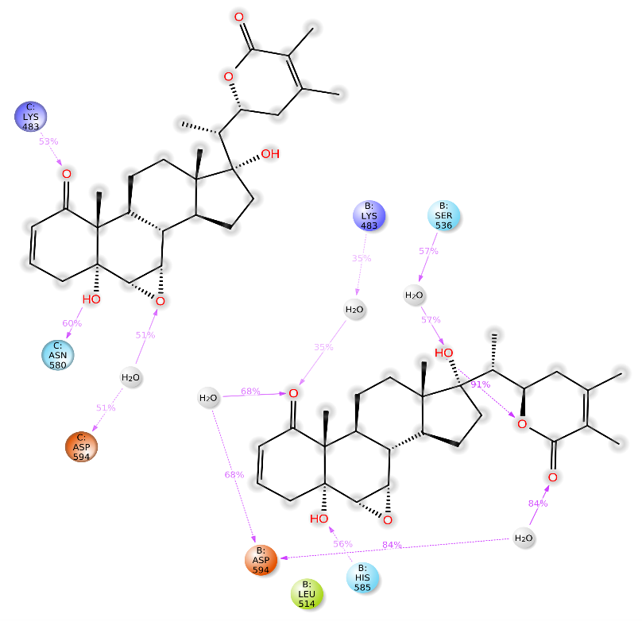
A
B
C
D
E
Supplementary Figure 2

Slide 3
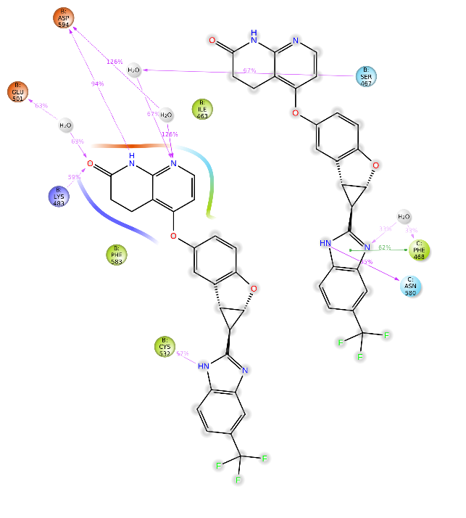
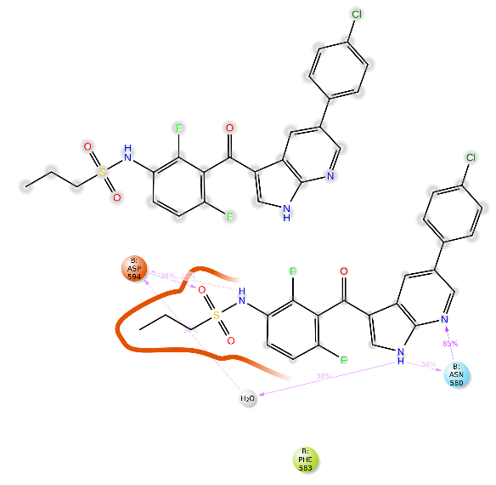
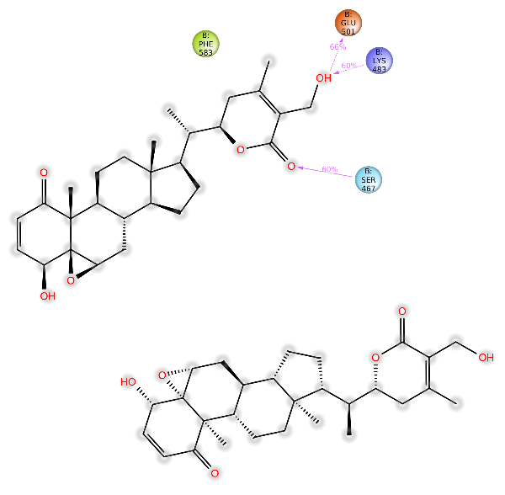
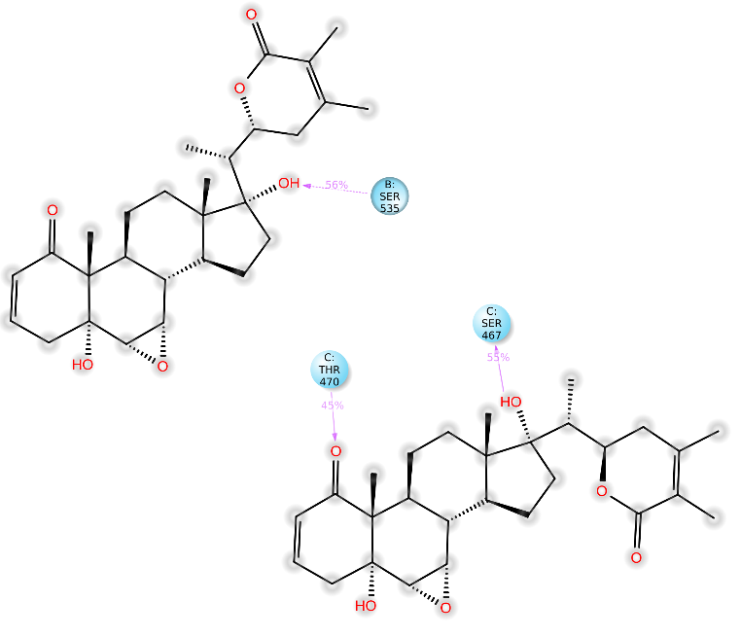
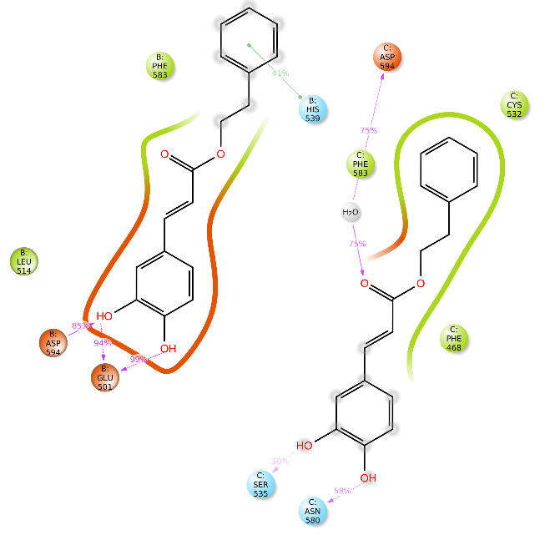
A
B
C
D
E
Supplementary Figure 3

Slide 4
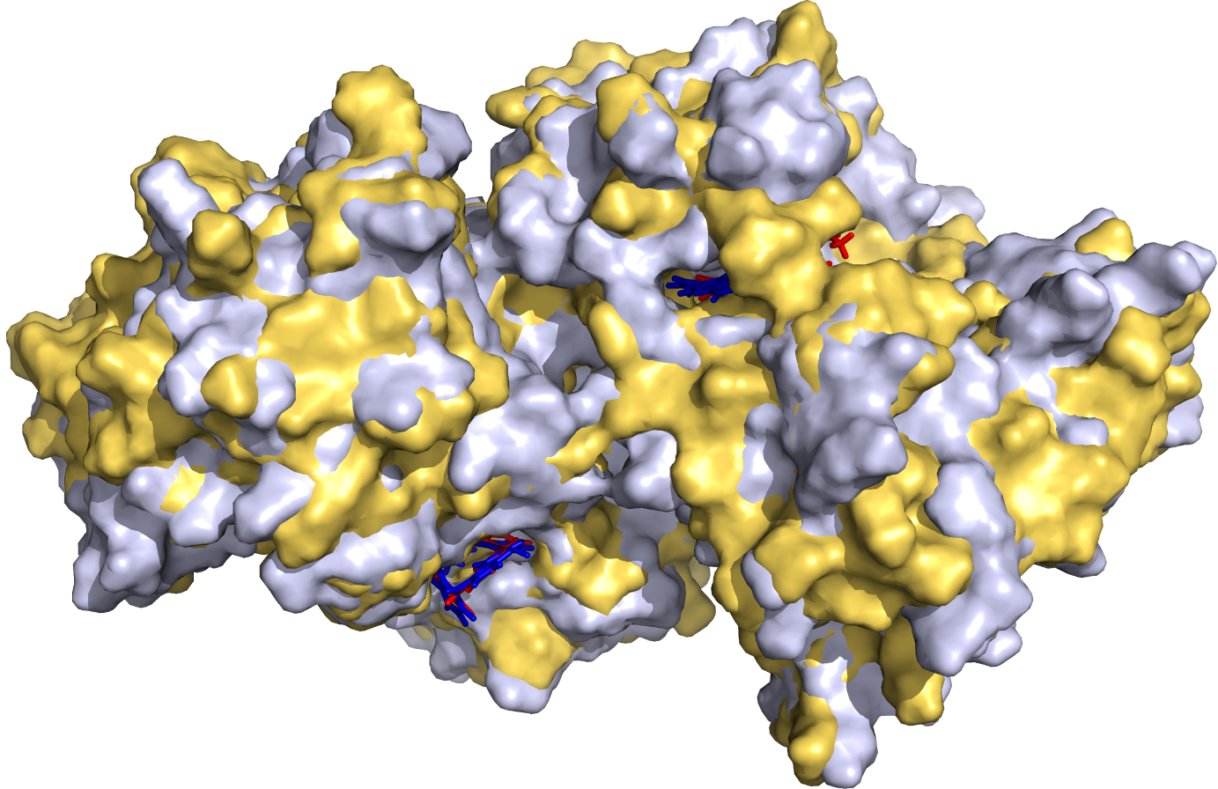
A
B
VEM
VEM
Chain B
Chain C
BRAF^{WT}-VEM complex (50 ns) BRAF^{WT}-VEM complex (500 ns)
Supplementary Figure 4

