Slide 1
Successful ablation of bifocal PVCs from both left bundle branches triggering polymorphic VT in LQTS 2
September 2021
Martinek M, Kollias G, Derndorfer M, Pürerfellner H. EHJ CR 2021.

Slide 2
Introduction
Torsade de pointes triggered by ventricular premature beats (VPB) with electric storm.
Refractory to drug treatment.
Refractory to sympathectomy.
Strategy:
Ablation of the triggering VPB.

Slide 3
Case Presentation
History and Examination Findings
19-year-old female with long QT syndrome 2 (LQTS 2) with aborted sudden cardiac death and KCNH2 mutation.
First presentation with syncopal polymorphic ventricular tachycardia.
Normal echocardiography, stress test, and cardiac MRI.
ECG suspicious of LQTS 2, proven by genetic testing.
Subcutaneous ICD (Implantable cardioverter-defibrillator) implanted.
Torsades de pointes triggered by VPB with electric storm.
Refractory to drug treatment.
Refractory to sympathectomy.

Slide 4
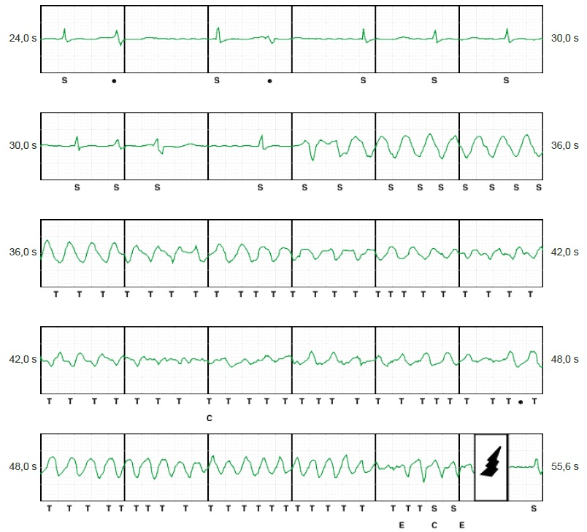
Case Presentation
Investigations
VPB in the S-ICD triggering VF

Slide 5
Case Presentation
Management
Ablation procedure – four years after initial presentation
Strategy:
Ablation of the triggering VPB from the anterolateral and postero-septal fascicular exit sites as identified and marked during LV mapping.

Slide 6
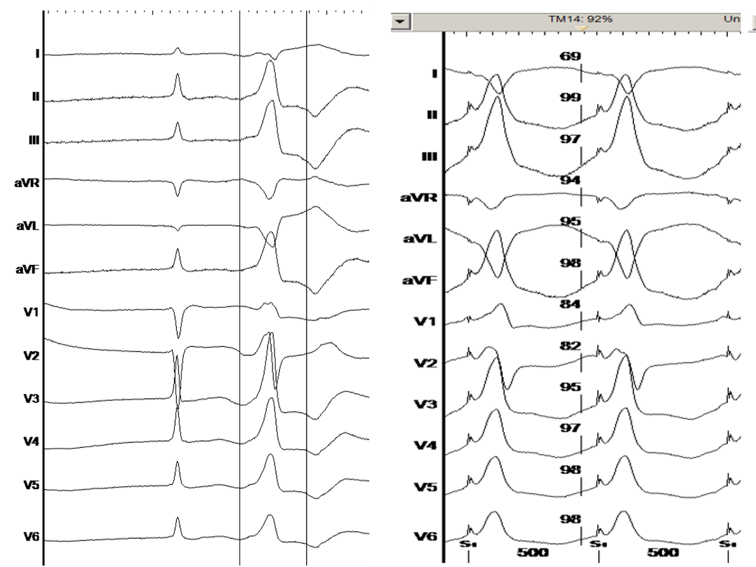
Case Presentation
Management
VPB morphology from left anterior fascicle and corresponding pace match (ECG morphology obtained by pacing from thesuspected exit site of the VPB).

Slide 7
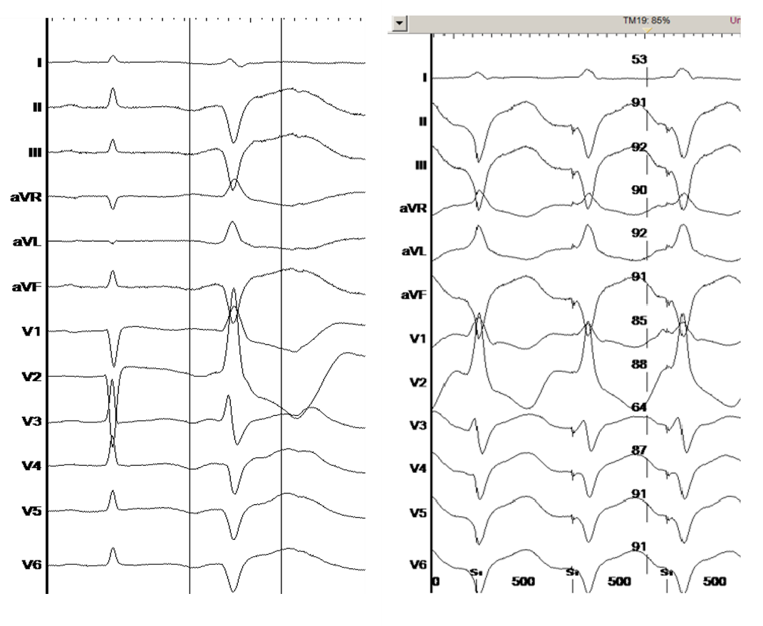
Case Presentation
Management
VPB morphology from left posterior fascicle and corresponding pace match.

Slide 8
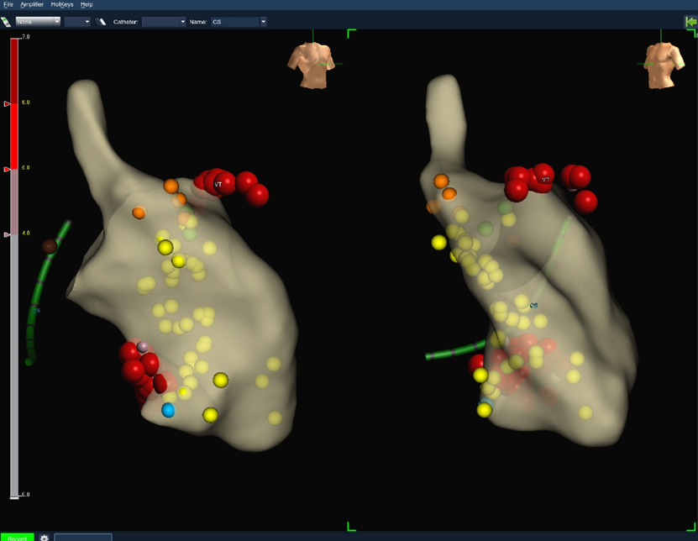
Case Presentation
Management
Electroanatomical map of left ventricle
Orange dots – His potential
Yellow dots – Purkinje potentials
Red dots – ablation points at distal ends of the left anterior and posterior fascicles
Blue dot – good pace match for left posterior fascicle morphology
Green dots – reasonable pace match for left anterior fascicle morphology

Slide 9
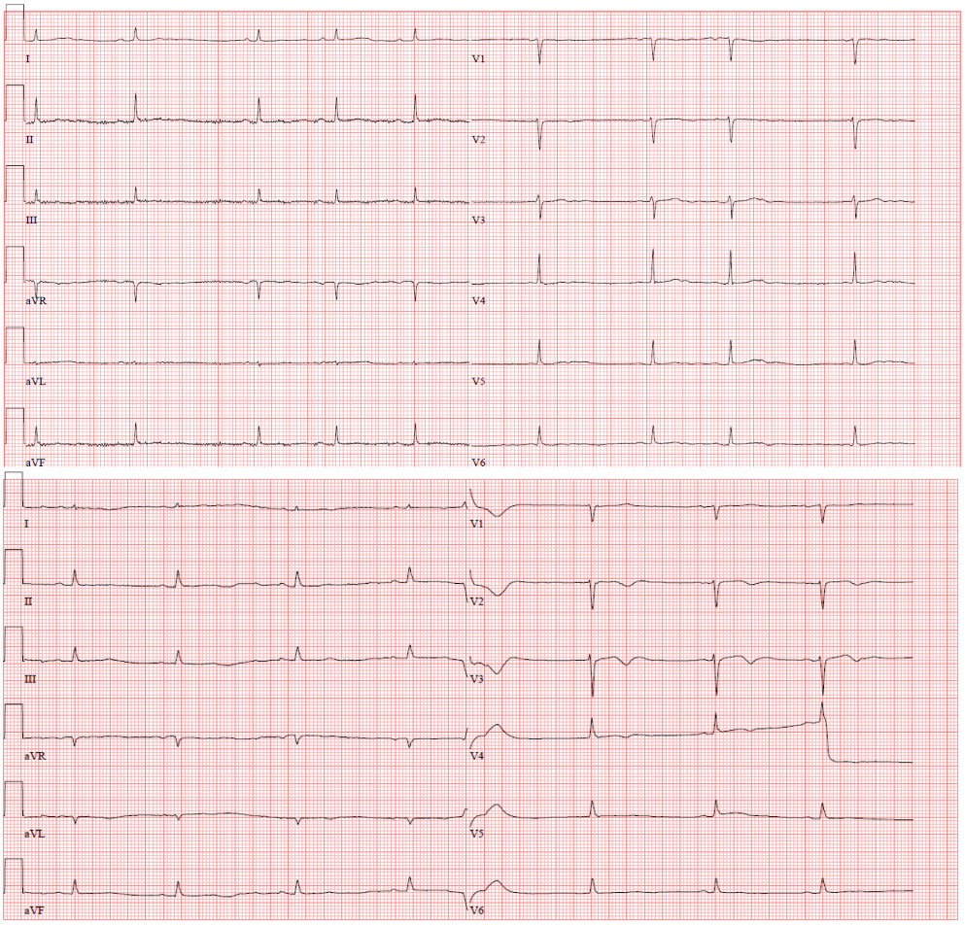
Case Presentation
Management
12-lead ECG pre and post ablation

Slide 10
Case Presentation
Follow-up
VPB burden was reduced from 4% in 24 hours to 0.08% after ablation.
Patient suffered from only one single episode of VT with appropriate shock shortly after ablation.
No ICD-therapies were necessary in a 24-months follow-up thereafter.

Slide 11
Discussion
This case presents following interesting insights:
Firstly, the consistent VPB pattern triggering the torsade de pointes. These were retrieved from the device interrogation, holter ECG and correlated with the pattern that was seen at the time of the procedure.
Secondly, VPB morphologies suggested an origin from both the left ventricular (posterior and anterior) fascicles, which has not been described so far. This was confirmed by the preceding Purkinje potentials seen at the successful ablation sites in sinus rhythm and during VPB.

Slide 12
Learning points
1) VPB arising from the distal conduction system can trigger ventricular fibrillation in LQTS.
2) Ablation of triggering VPBs is feasible and effective over a mid-term follow up in LQTS 2.

Slide 13
References
1. Haïssaguerre M, Extramiana F, Hocini M, Cauchemez B, Jaïs P, Cabrera JA, et al. Mapping and ablation of ventricular fibrillation associated with long-QT and Brugada syndromes. Circulation 2003:108, 925–928.
2. Haïssaguerre M, Shoda M, Jaïs P, Nogami A, Shah DC, Kautzner J, et al. Mapping and ablation of idiopathic ventricular fibrillation. Circulation 2002:106, 962–967.
3. Haïssaguerre M, Shah DC, Jaïs P, Shoda M, Kautzner J, Arentz T, et al. Role of Purkinje conducting system in triggering of idiopathic ventricular fibrillation. Lancet 2002:359, 677–678.
4. Migdalovich D, Moss AJ, Lopes CM, Costa J, Ouellet G, Barsheshet A, et al. Mutation and gender-specific risk in type 2 long QT syndrome: Implications for risk stratification for life-threatening cardiac events in patients with long QT syndrome. Hear. Rhythm 2011:8, 1537–1543.

