Slide 1
Figure S1. The distribution of baseline EGFR mutations of all 104 patients.

Slide 2
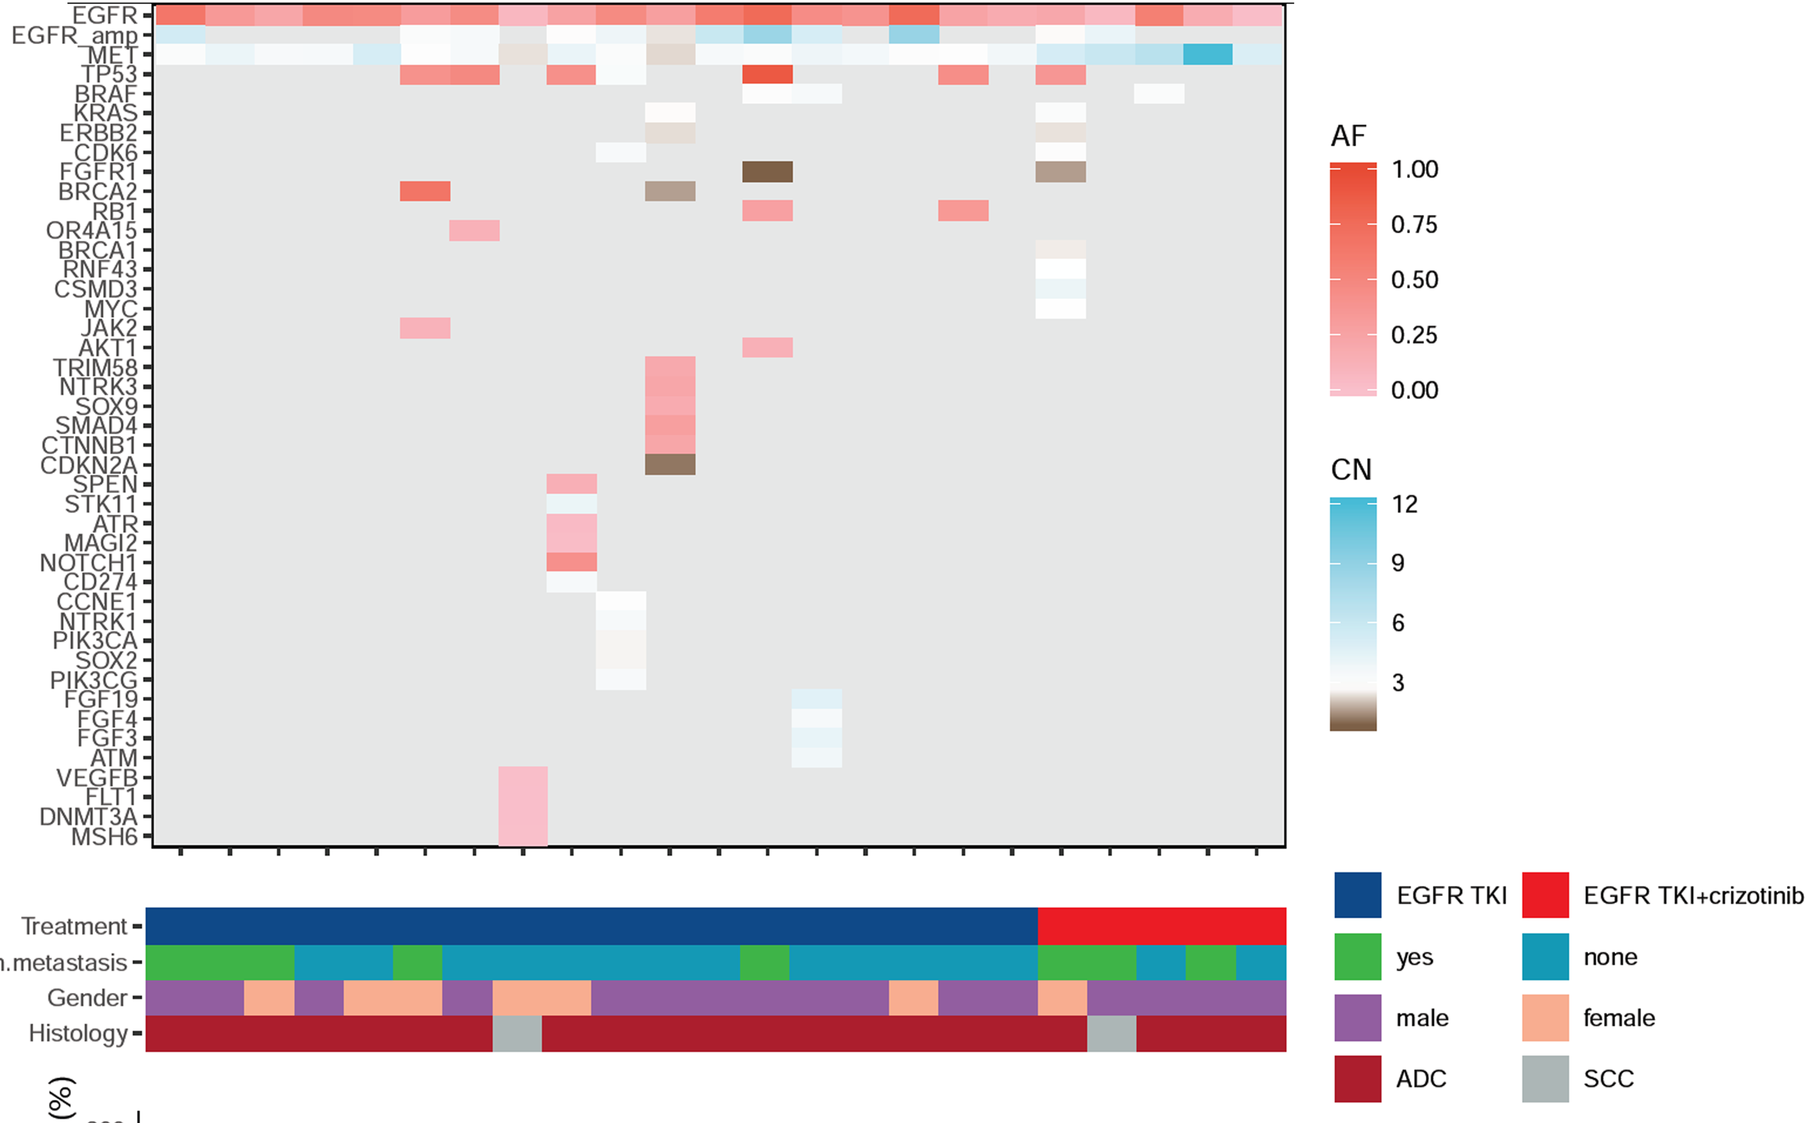
Figure S2. NGS-based mutational landscape of 28 patients. ADC: adenocarcinoma; SCC: Squamous cell carcinoma.

Slide 3
Figure S3. Waterfall plot summarizing the objective responses to EGFR-TKI monotherapy (n=19) or EGFR-TKI plus crizotinib (n=9) of the 28 patients who submitted samples for NGS. RECIST, Response Evaluation Criteria in Solid Tumors; PR, partial response; SD, stable disease; PD, progressive disease.

Slide 4
Figure S4. Swimmers plot of the progression-free survival of the 28 patients who submitted samples for NGS and received EGFR-TKI monotherapy (n=19) or EGFR-TKI plus crizotinib (n=9).

