Slide 1
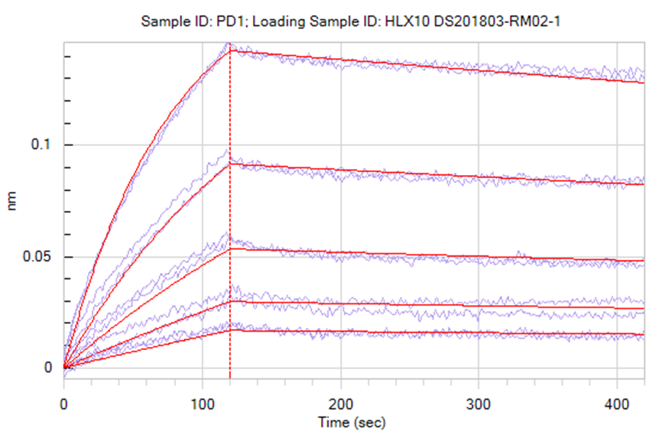
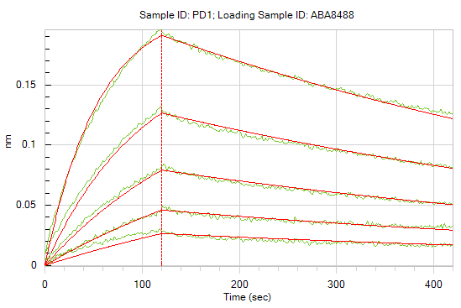
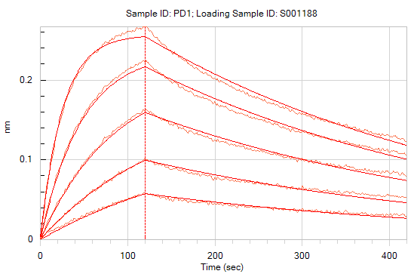
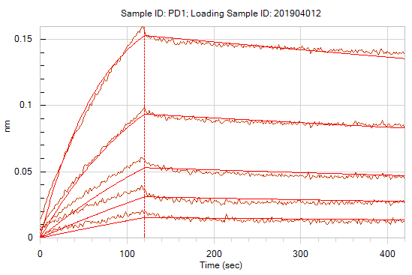
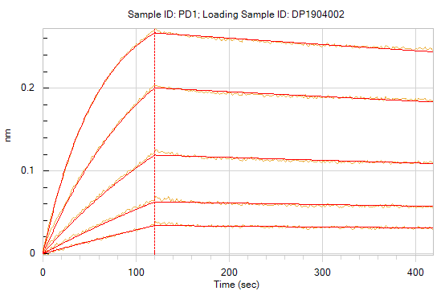
Supp Figure 1a
HLX10
Nivolumab
Pembrolizumab
58.8 nM
19 nM
6.5 nM
2.1 nM
0.72 nM
58.8 nM
19 nM
6.5 nM
2.1 nM
0.72 nM
58.8 nM
19 nM
6.5 nM
2.1 nM
0.72 nM
Toripalimab
Sintilimab
58.8 nM
19 nM
6.5 nM
2.1 nM
0.72 nM
58.8 nM
19 nM
6.5 nM
2.1 nM
0.72 nM

Slide 2
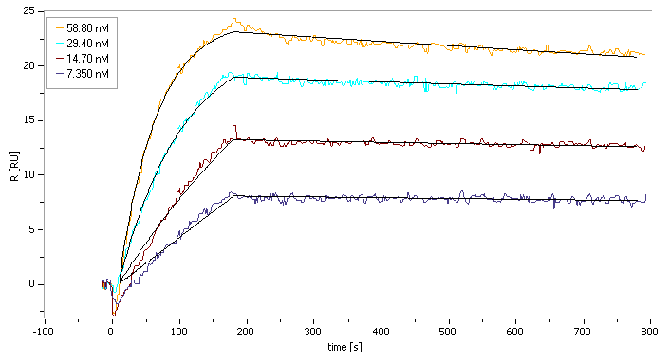
Supp Figure 1b
HLX10

Slide 3
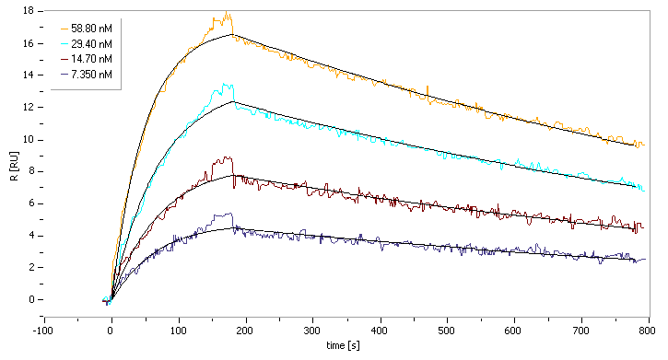
Supp Figure 1c
Nivo

