Slide 1
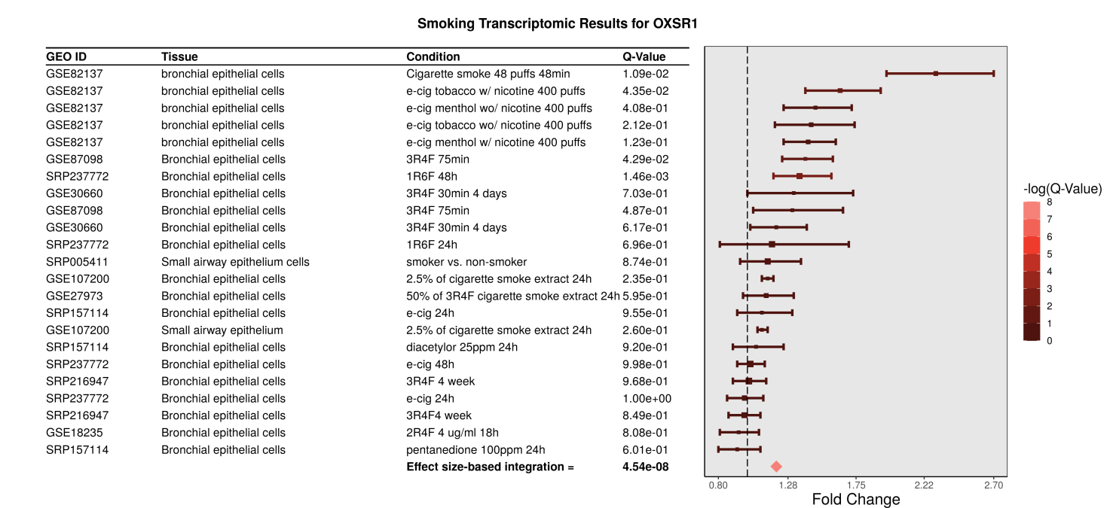
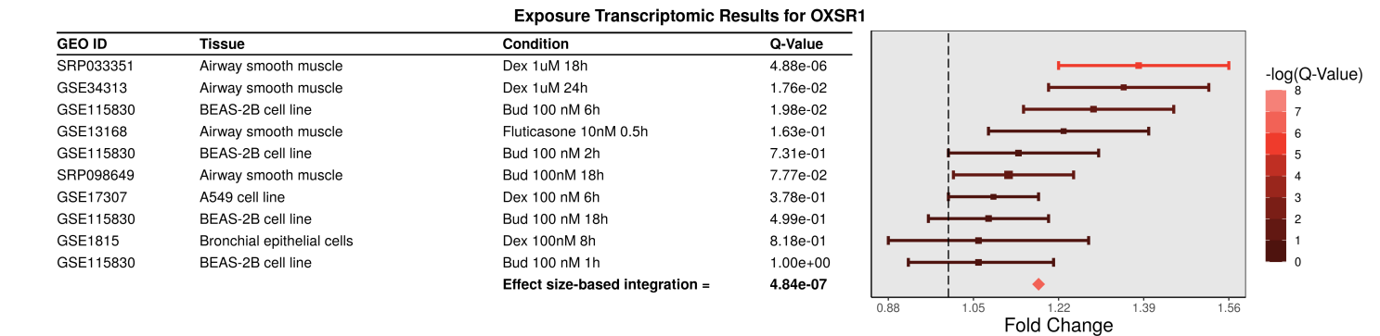
A
B
Supplementary Figure S1. The expression of the OXSR1 gene in various cells by smoking (A) and glucocorticoid (B) according to cell-based transcriptome studies in REALGAR database (https://realgar.org/).

Slide 2
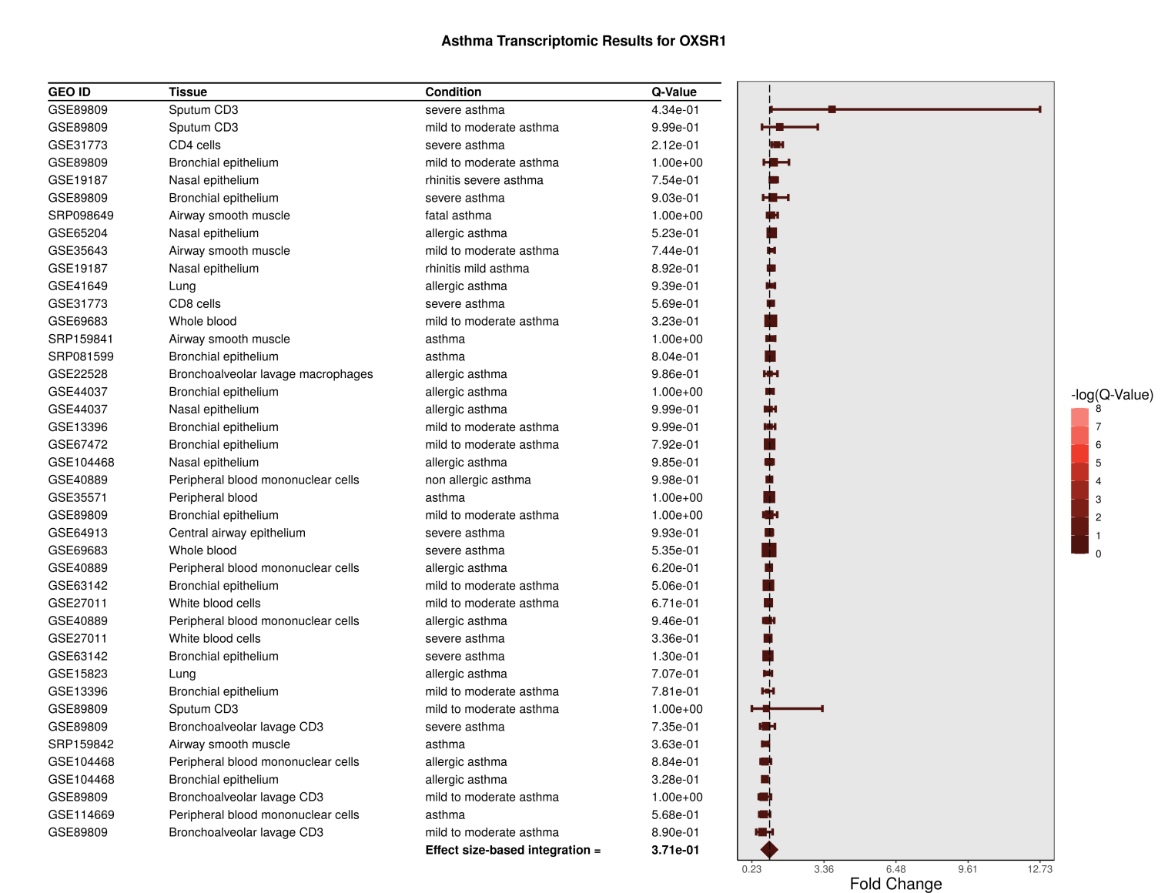
Supplementary Figure S2. The expression of the OXSR1 gene in various subtypes of asthma according to cell-based transcriptome studies in REALGAR database (https://realgar.org/).

