Slide 1
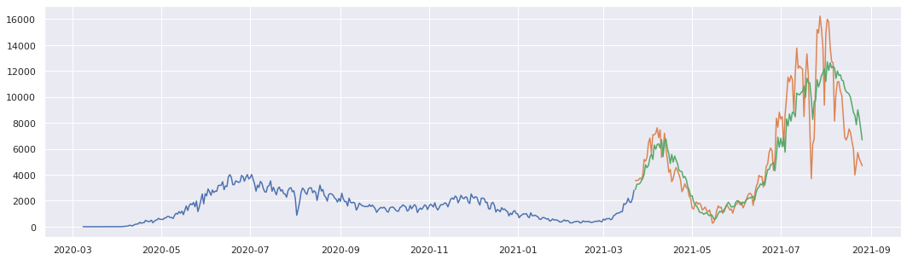
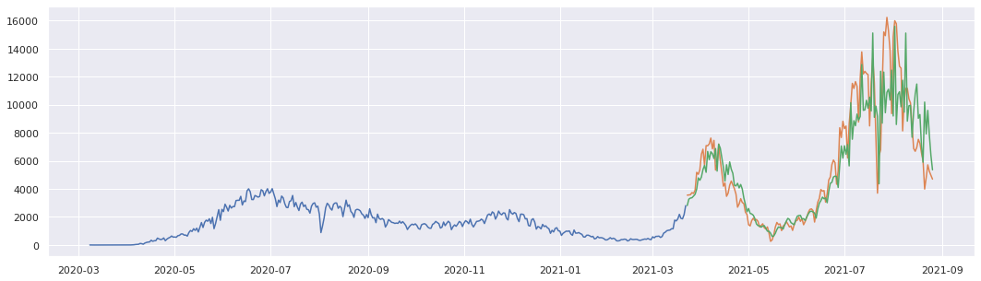
Epoch-80
Official data: (Blue and Orange colour)
Prediction data: Green colour
Prediction of Confirmed Cases (Fig. S1)
Epoch-100

Slide 2
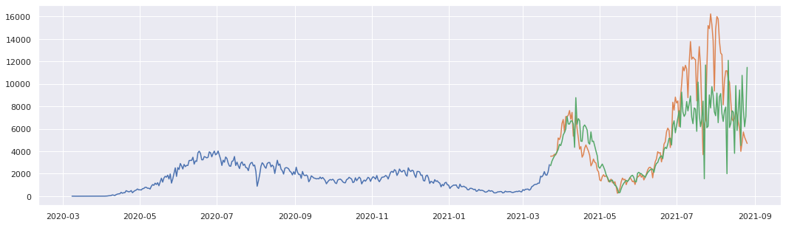
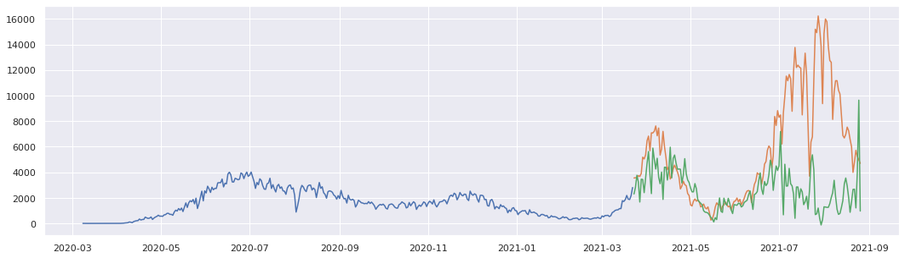
Epoch-120
Official data: (Blue and Orange colour)
Prediction data: Green colour
Prediction of Confirmed Cases (Fig. S1)
Epoch-150

Slide 3
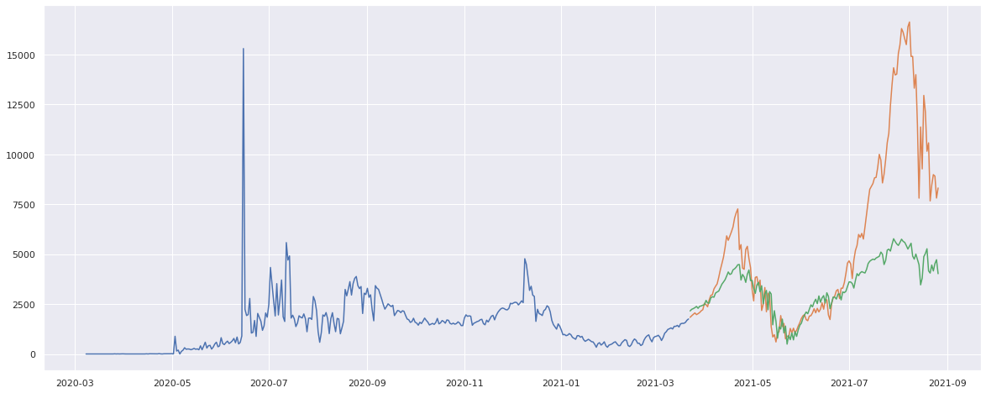
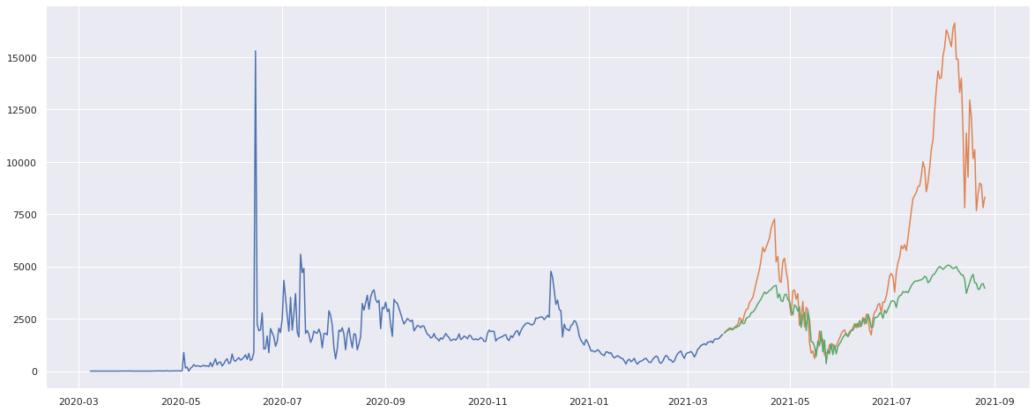
Epoch-80
Official data: (Blue and Orange colour)
Prediction data: Green colour
Prediction of Recovered Cases (Fig. S2)
Epoch-100

Slide 4

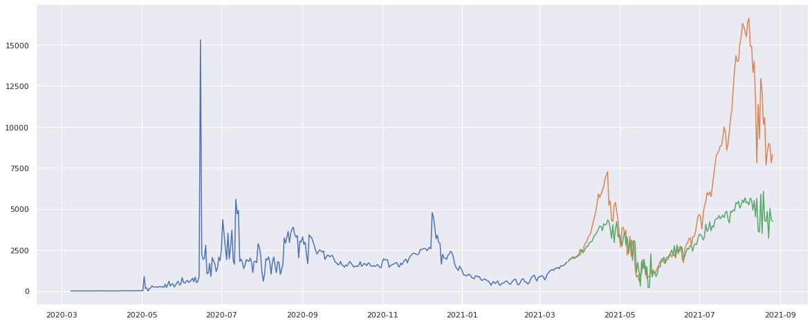
Epoch-120
Prediction of Recovered Cases (Fig. S2)
Epoch-150

Slide 5
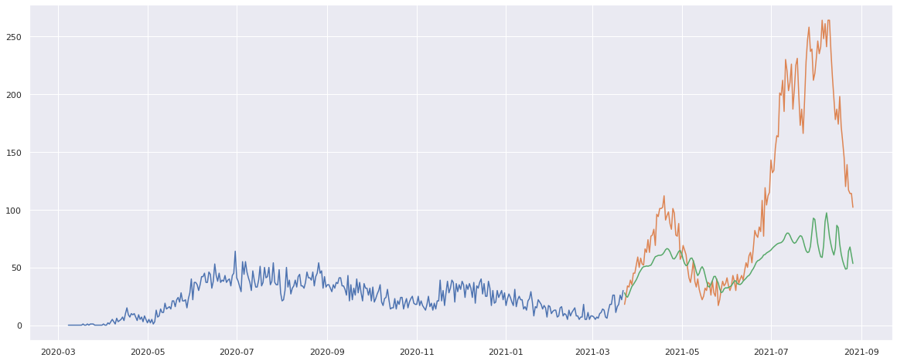
Epoch-80
Official data: (Blue and Orange colour)
Prediction data: Green colour
Prediction of Death Cases (Fig. S3)
Epoch-100

Slide 6

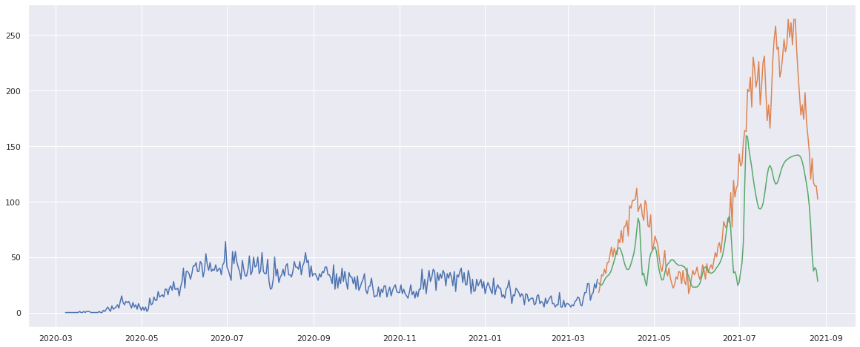
Epoch-120
Prediction of Death Cases (Fig. S3)
Epoch-150

Slide 7
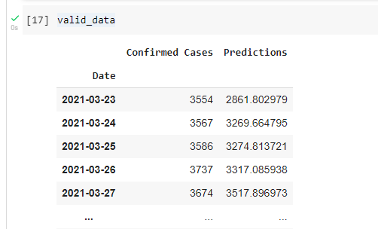
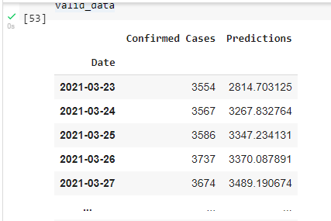
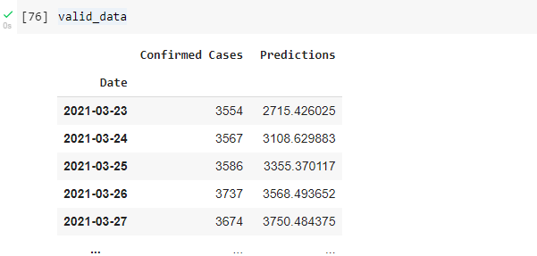
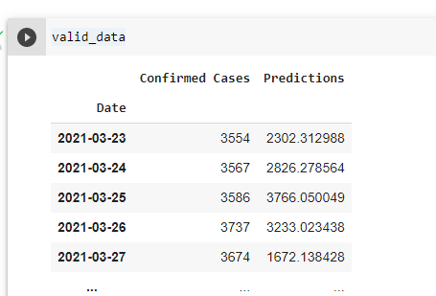
Epoch-80
Epoch-100
Prediction of Confirmed Cases
Epoch-120
Epoch-150

Slide 8
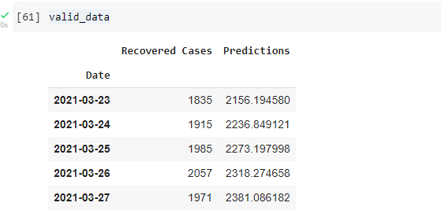
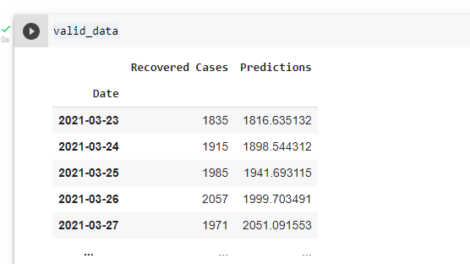
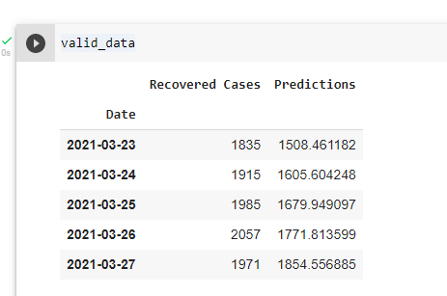
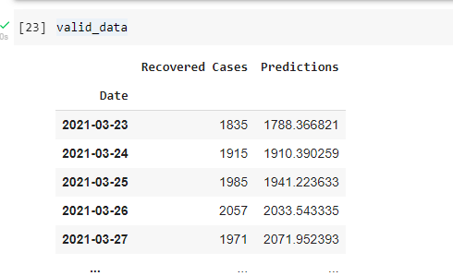
Epoch-100
Epoch-80
Prediction of Recovered Cases
Epoch-120
Epoch-150

Slide 9
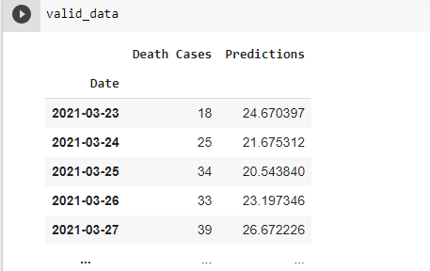
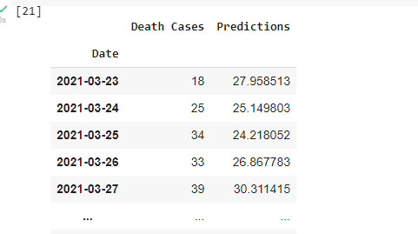
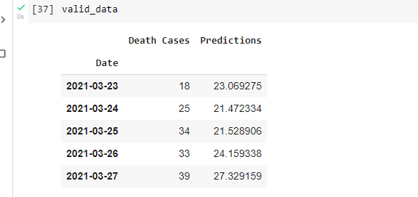
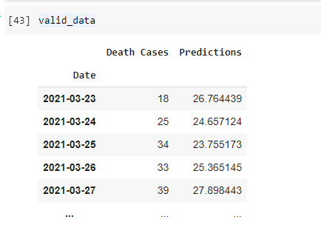
Epoch-80
Epoch-100
Prediction of Death Cases
Epoch-150
Epoch-120

