Slide 1
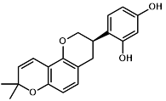
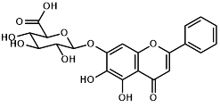
Supplementary Fig. 1. Structure of Baicalin and Glabridin
Baicalin
Glabridin

