Slide 1
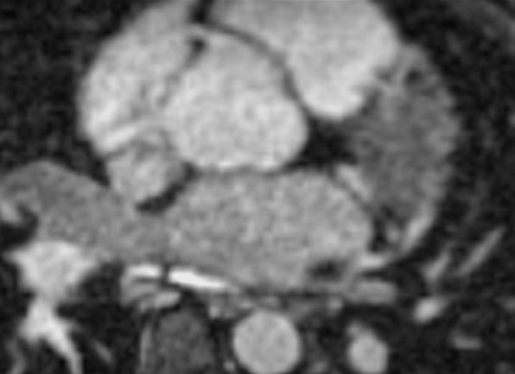
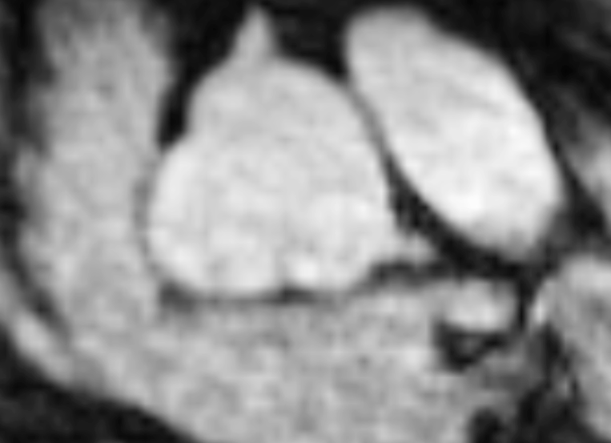
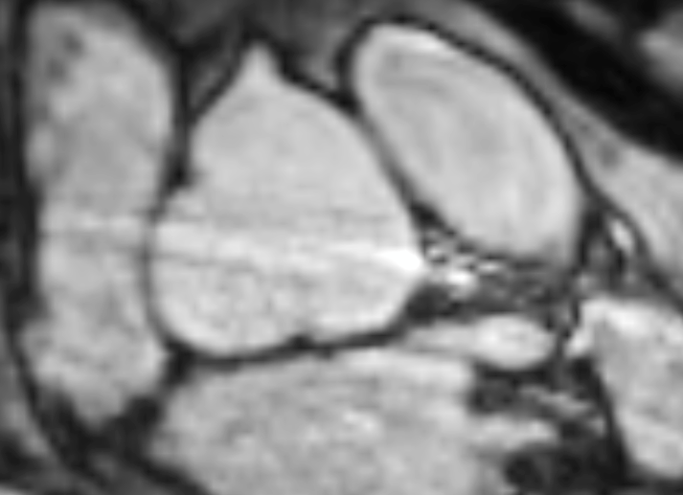
A
B
C
D
E
iNAV T2-prep bSSFP
F
G
H
I
J
dNAV T2-prep bSSFP
Patient 24
Patient 27
Patient 29
Patient 30
Patient 32

