Slide 1
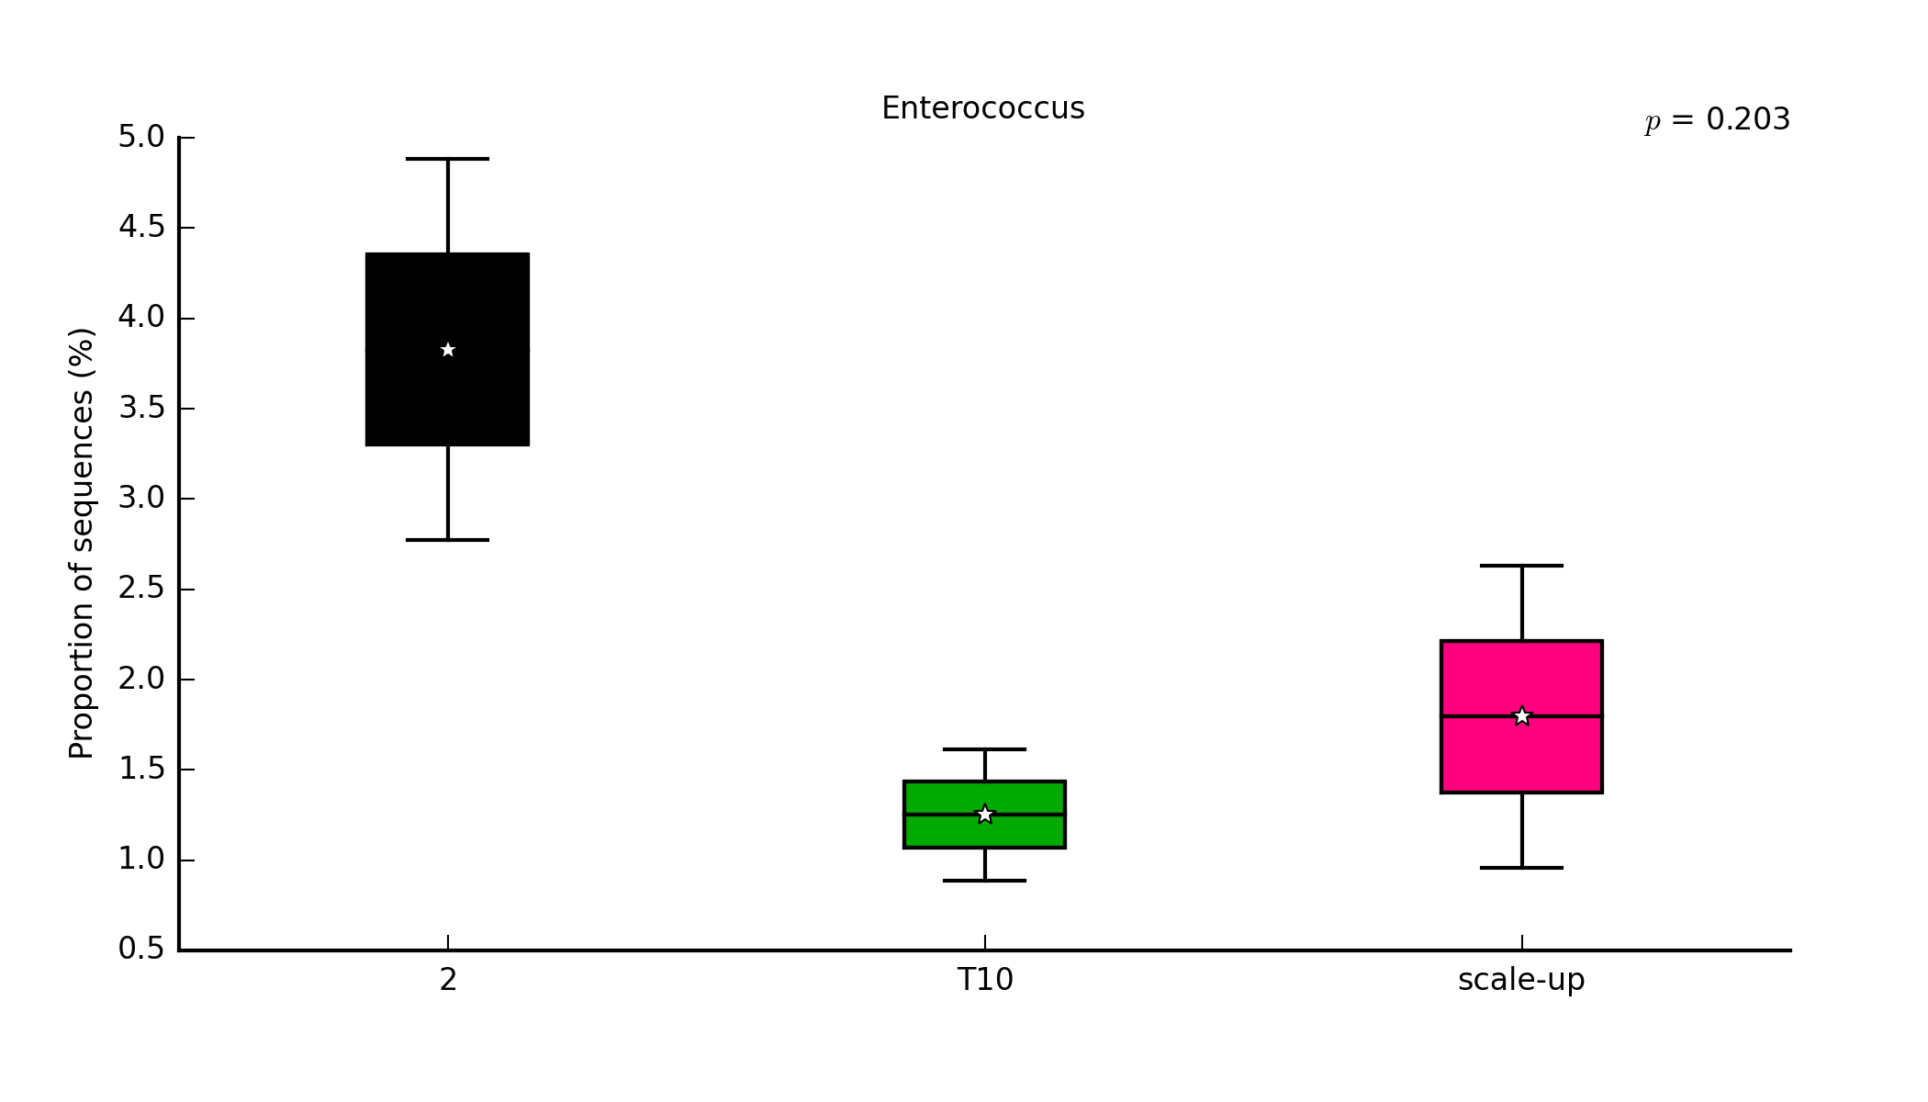
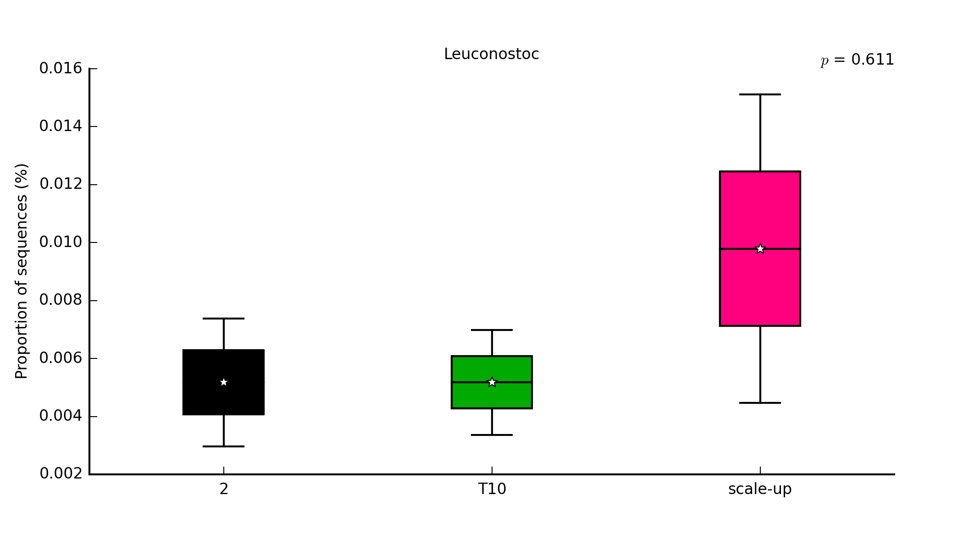
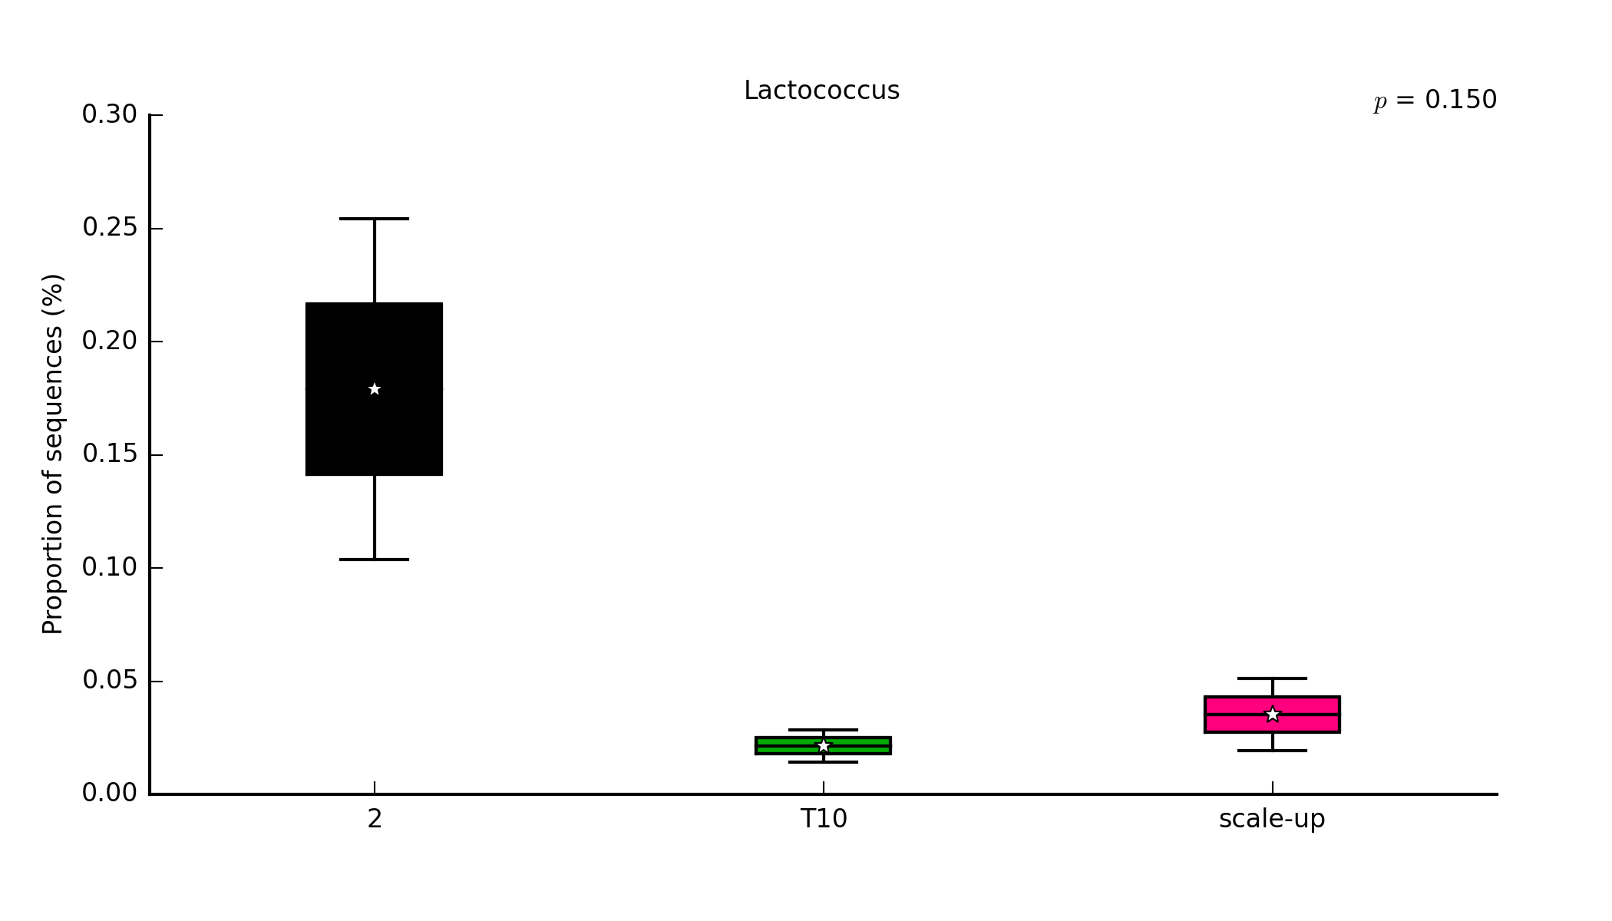
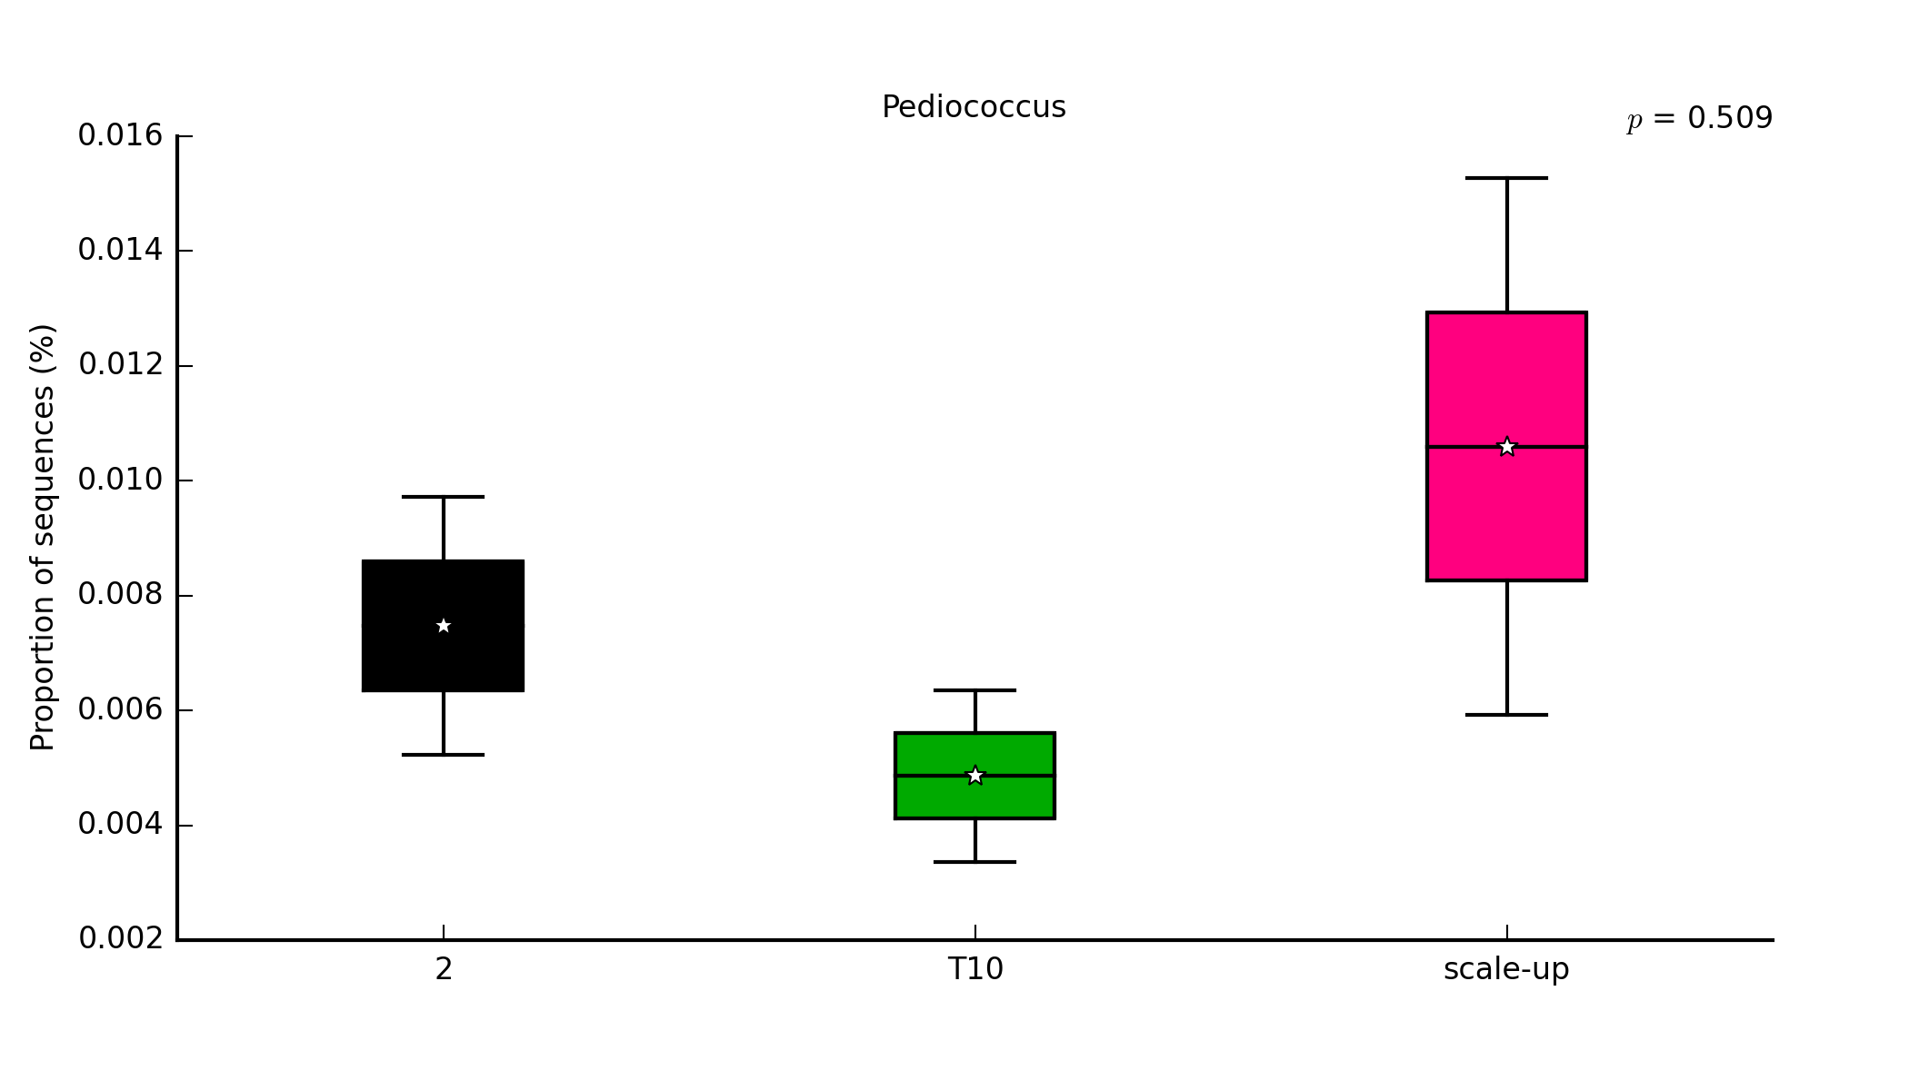
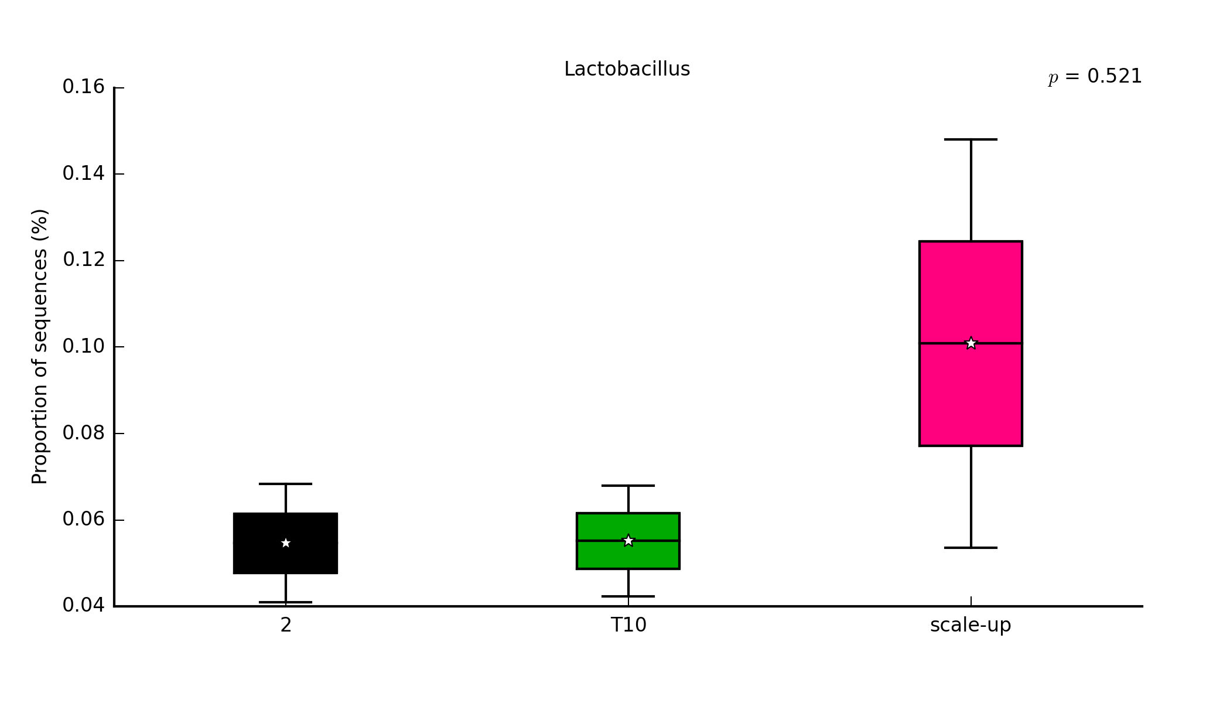
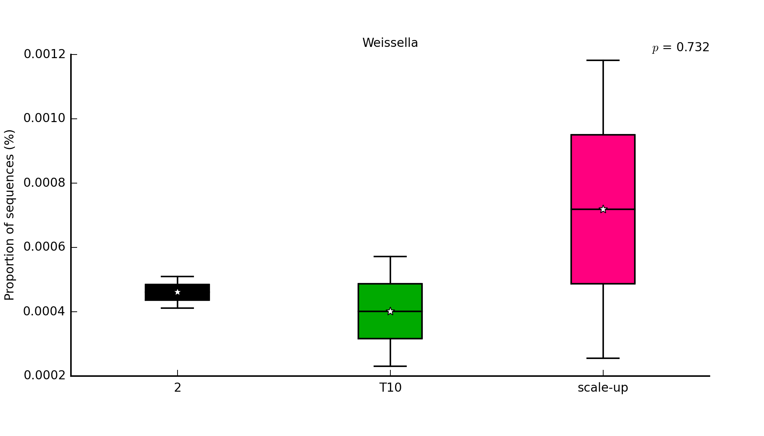
4.5
Enterococcus sp.
0.014
Leuconostoc sp.
p=0.20
p=0.61
3.5
0.010
2.5
1.5
0.006
0.25
Lactococcus sp.
0.014
Pediococcus sp.
p=0.15
p=0.50
0.010
0.15
Relative abundance (%)
0.006
0.05
0.14
Lactobacillus sp.
Weissella sp.
p=0.52
0.010
p=0.73
0.10
0.006
0.06
0.002
T2
T10
S
T2
T10
S

Slide 2
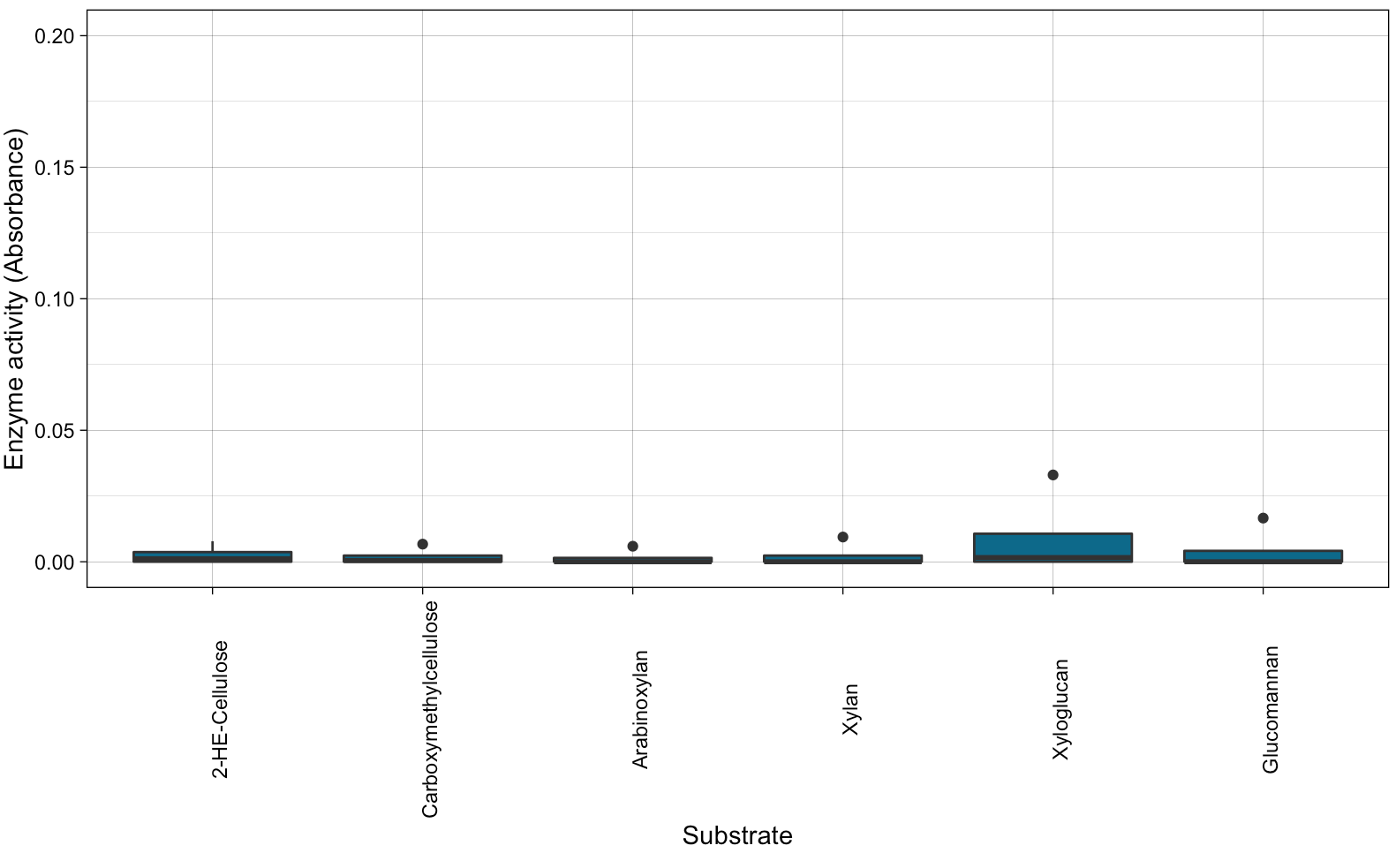
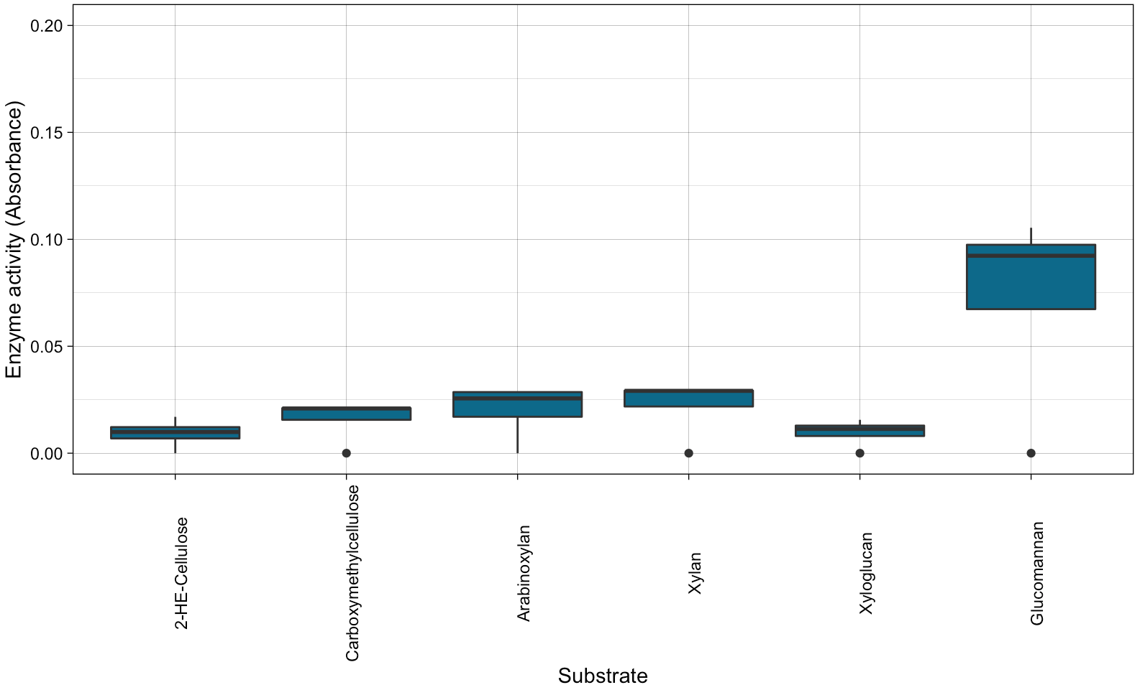
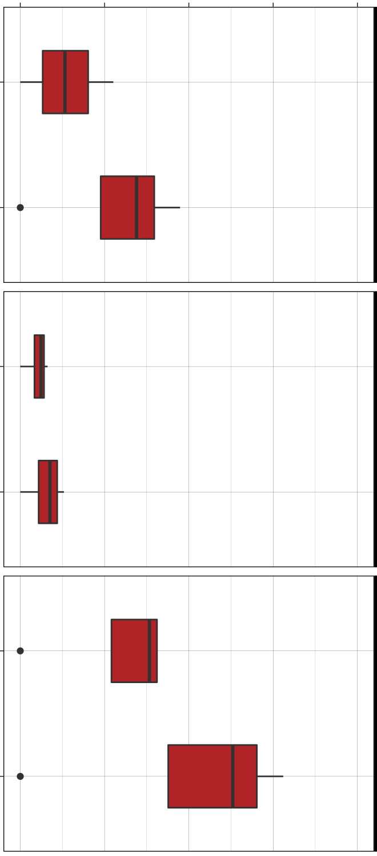
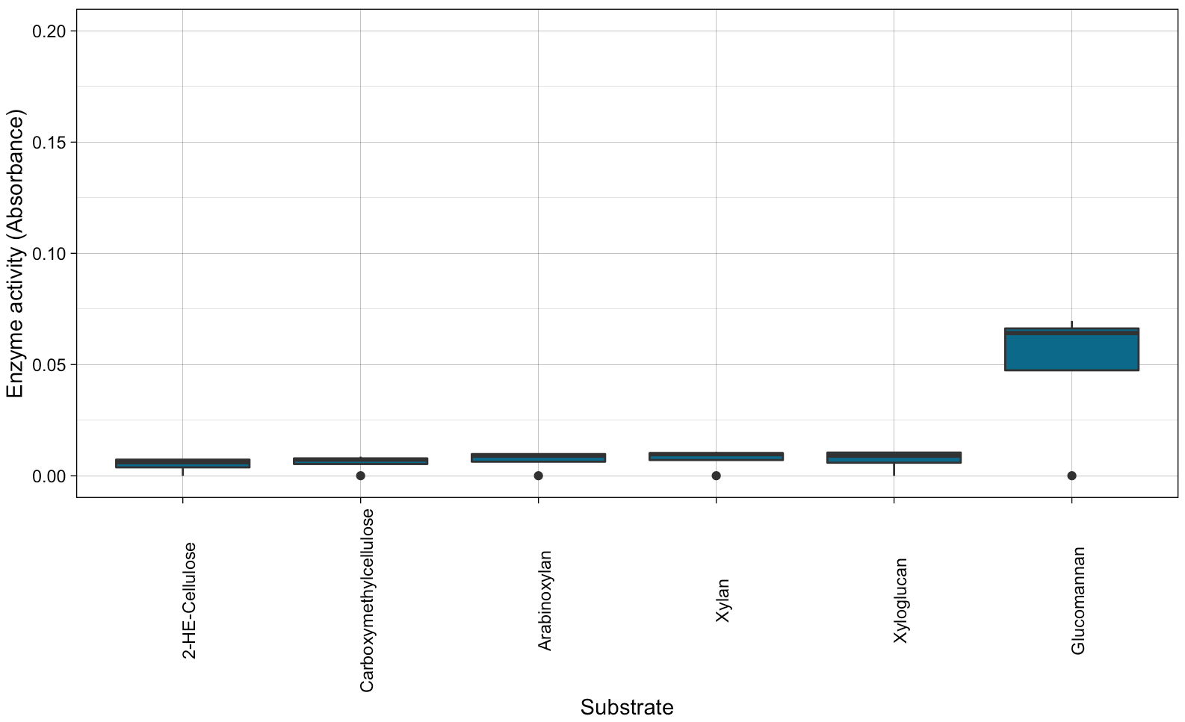
A)
B)
Enzymatic activity (OD values)
0.20
0
0.10
0.20
Unmodified
Wheat
straw
0.10
Sugarcane
bagasse
0
0.20
pH 5
Unmodified
0.10
Wheat
straw
Enzymatic activity (OD values)
0
0.20
pH 4
Sugarcane
bagasse
pH 4
0.10
Wheat
straw
0
Arabinoxylan
Xylan
Xyloglucan
2-HE-Cellulose
Glucomannan
Sugarcane
bagasse
Carboxymethylcellulose
CPH
ICB
pH 5

Slide 3
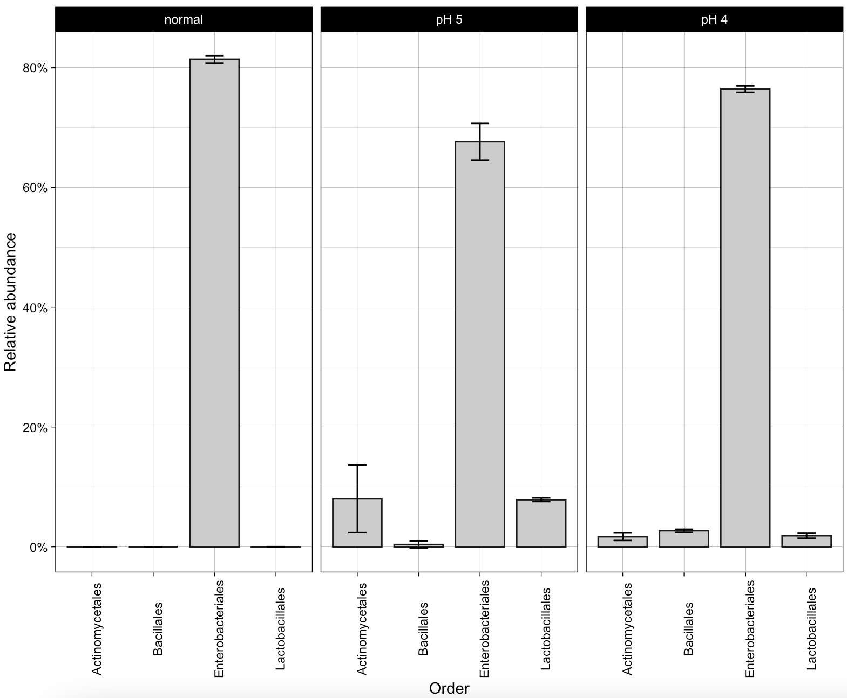
Unmodified
pH 5
pH 4
80
60
Relative abundance (%)
40
20
0
Actinomycetales
Bacillales
Lactobacillales
Actinomycetales
Bacillales
Lactobacillales
Actinomycetales
Bacillales
Lactobacillales
Enterobacteriales
Enterobacteriales
Enterobacteriales

