Slide 1
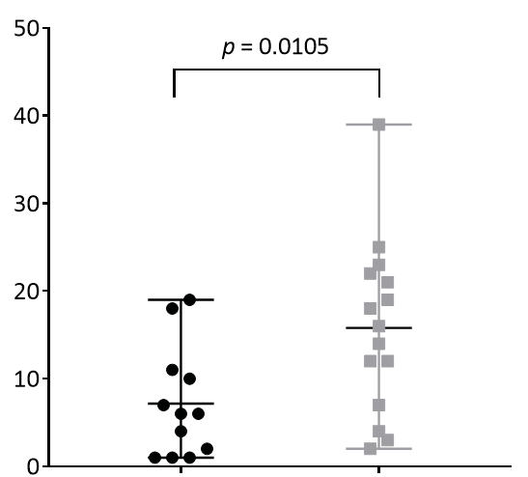
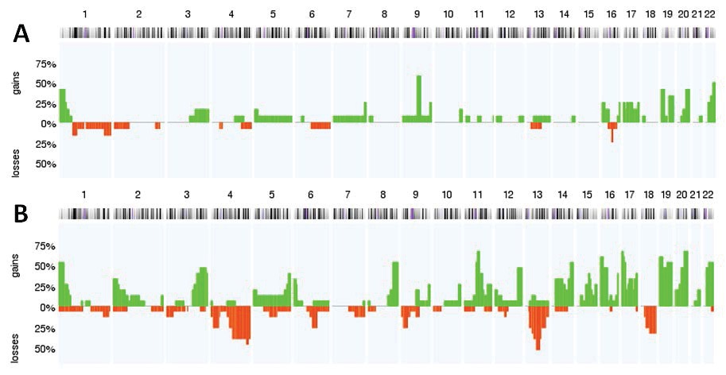

Mann-Whitney-U-Test p = 0.0105
a
number of aberrations
b
A
B
LN-derived cells
BM-derived cells

