Slide 1
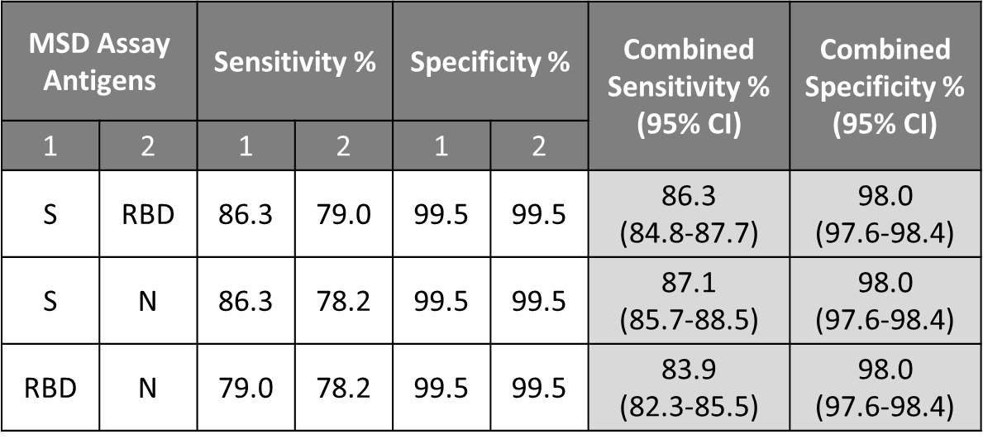
Supplemental Table 1. Parallel assessment of IgG antibodies to SARS-CoV-2 antigens.
Sensitivity and specificity of the multiplex MSD assay for parallel assessment of antibodies to two antigens at a time.

Slide 2
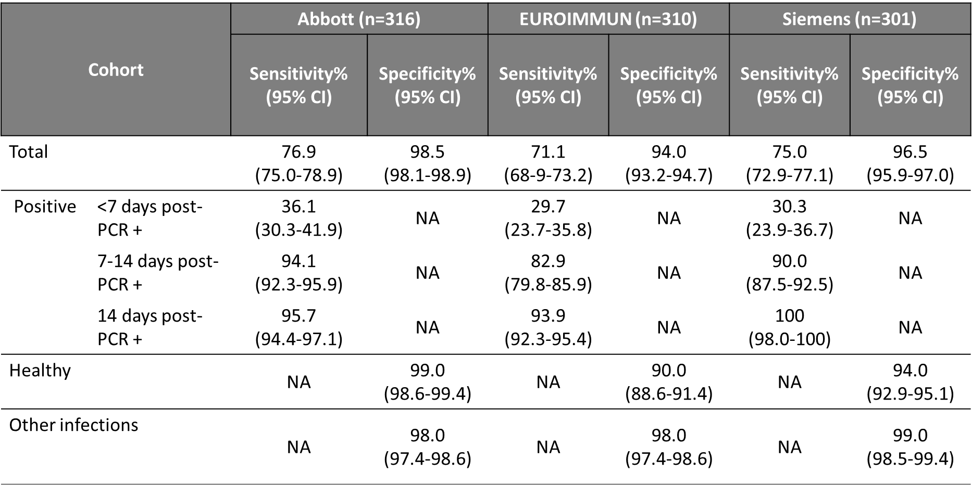
Supplemental Table 2. Agreement between IgG antibodies to individual antigens on MSD platform and commercial IgG serology assays.
The overall agreement is the proportion of concordant results, positive percent agreement is the proportion of positive results and negative percent agreement is the proportion of negative results between the MSD and commercial IgG serology assays.

Slide 3
Supplemental Table 3. Comparison of assay sensitivity and specificity using MSD- established and ARUP- established cut-points.
Sensitivity and specificity of the multiplex MSD assay at the MSD- recommended (top panel) and ARUP- established (bottom panel) cut-points in the 324 samples studied. S: Spike, RBD: Receptor binding domain, N: Nucleocapsid.

