Slide 1
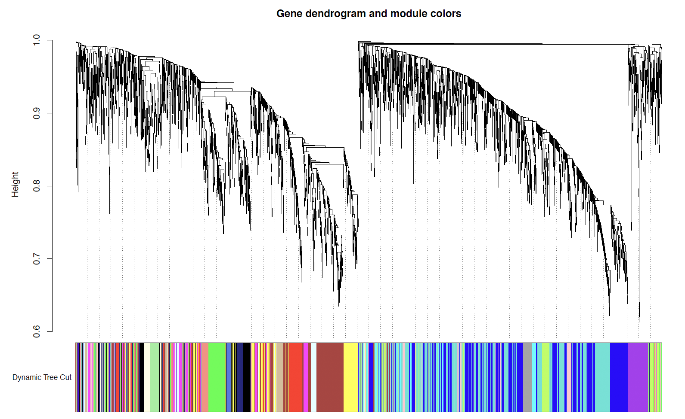
Supplementary Figure 1. WCGNA gene dendrogram and module colors.
Notes:
Supplementary Figure 1. WCGNA gene dendrogram and module colors.

Slide 2
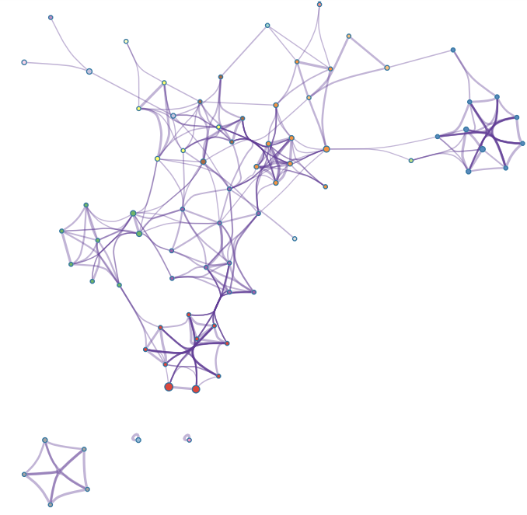
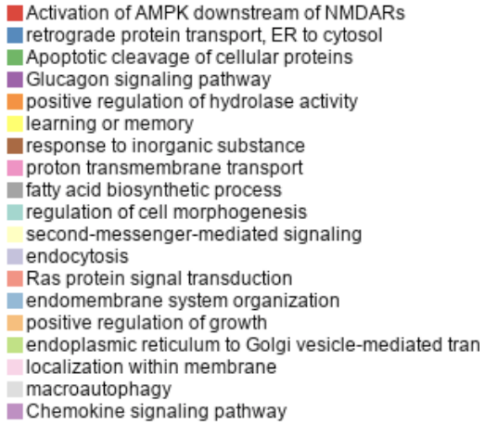
Supplementary Figure 2. Cyan gene network identified by WGCNA.
Notes:
Supplementary Figure 2. Cyan gene network identified by WGCNA.

Slide 3
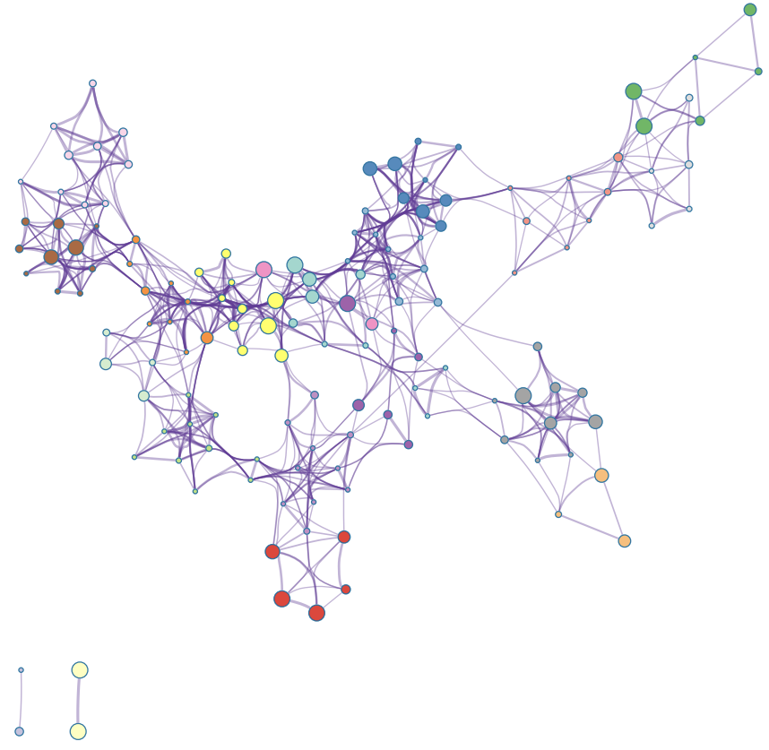
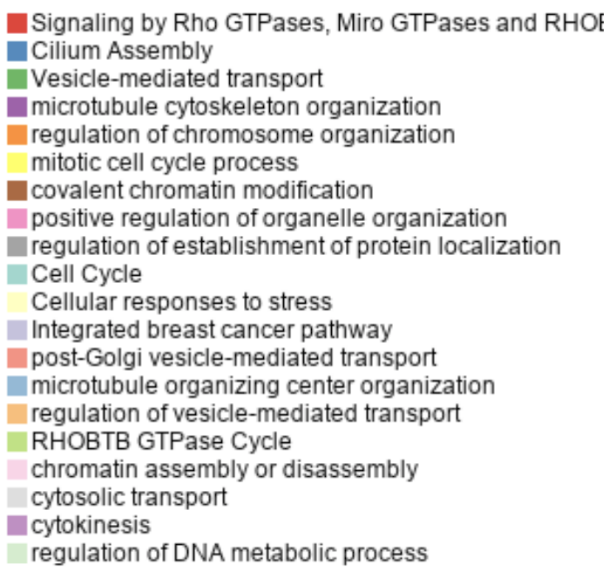
Supplementary Figure 3. Brown gene network identified by WGCNA.
Notes:
Supplementary Figure 3. Brown gene network identified by WGCNA.

Slide 4
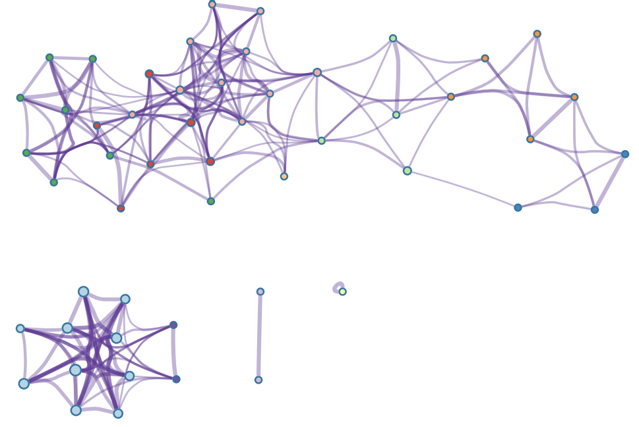
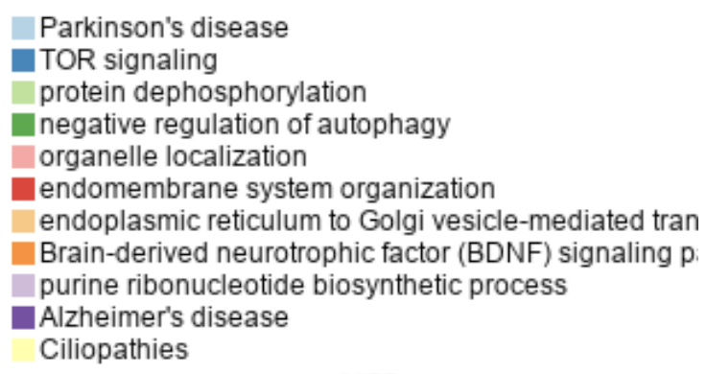
Supplementary Figure 4. Light cyan gene network identified by WGCNA.
Notes:
Supplementary Figure 4. Light cyan gene network identified by WGCNA.

Slide 5
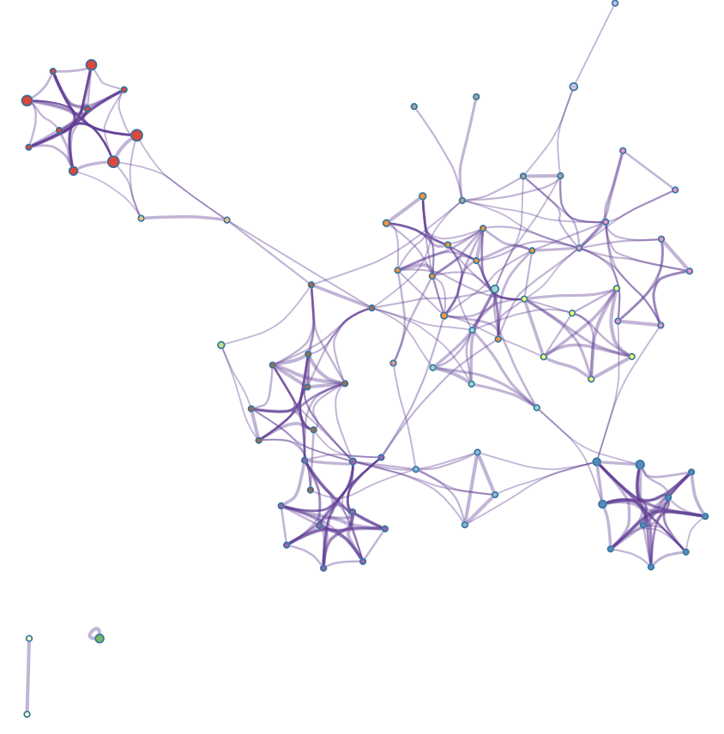
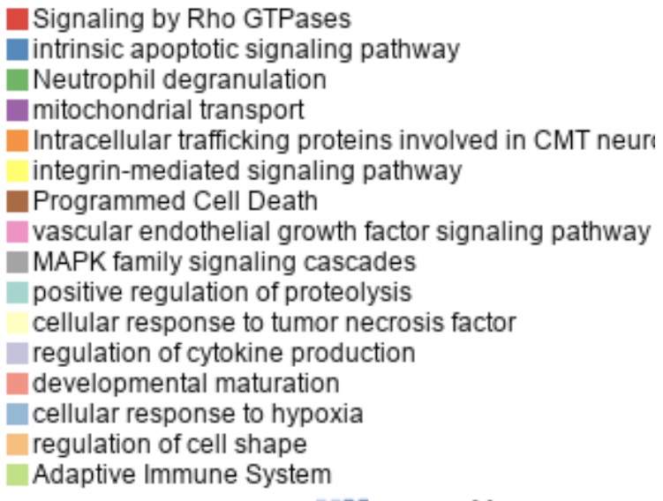
Supplementary Figure 5. Midnight blue gene network found by WGCNA.
Notes:
Supplementary Figure 5. Midnight blue gene network found by WGCNA.

Slide 6
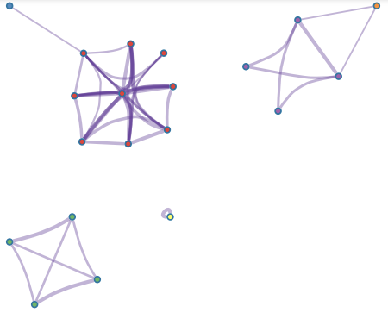
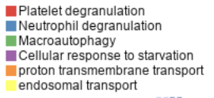
Supplementary Figure 6. Royal blue gene network found by WGCNA analysis.
Notes:
Supplementary Figure 6. Royal blue gene network found by WGCNA analysis.

Slide 7
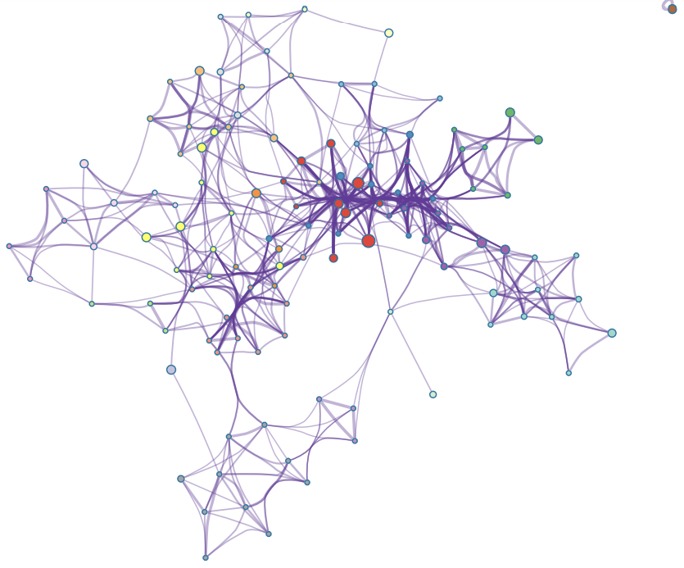
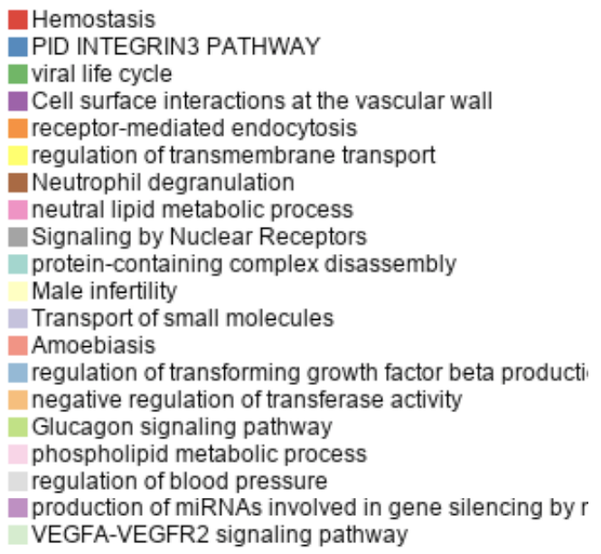
Supplementary Figure 7. Pink gene network found by WGCNA analysis.
Notes:
Supplementary Figure 7. Pink gene network found by WGCNA analysis.

Slide 8
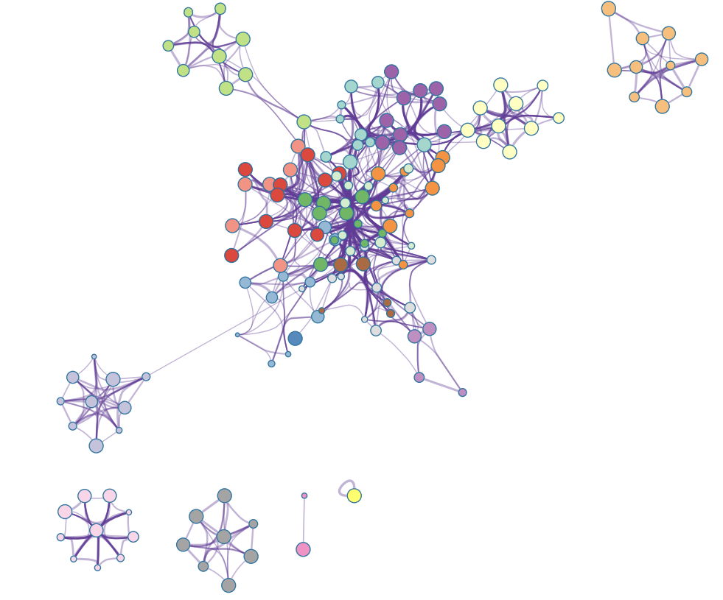
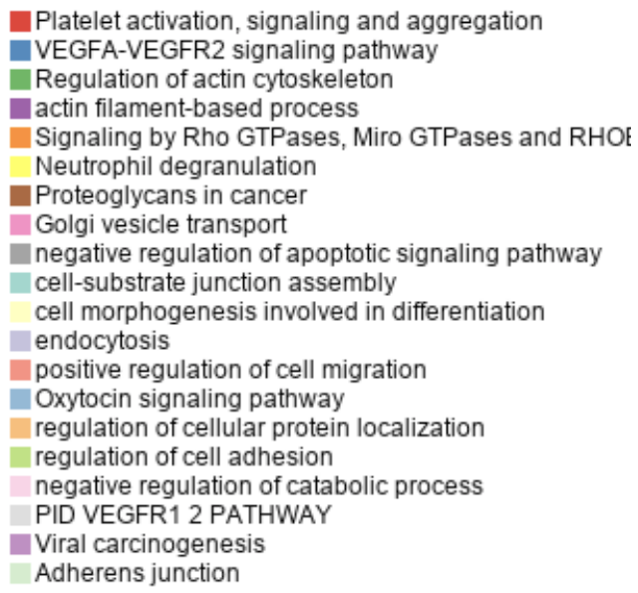
Supplementary Figure 8. Blue gene module found by WGCNA analysis.
Notes:
Supplementary Figure 8. Blue gene module found by WGCNA analysis.

Slide 9
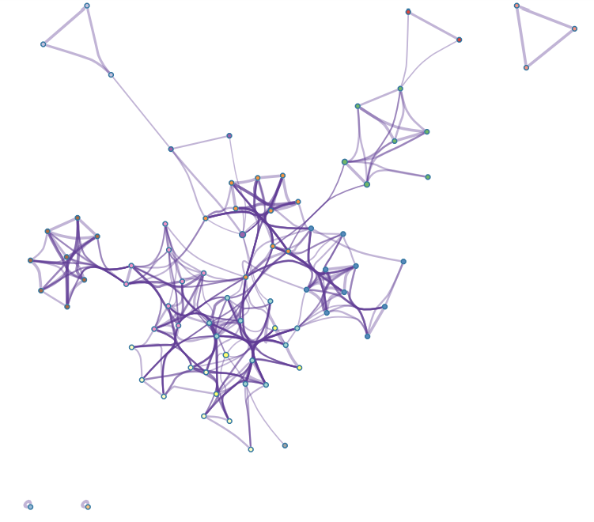
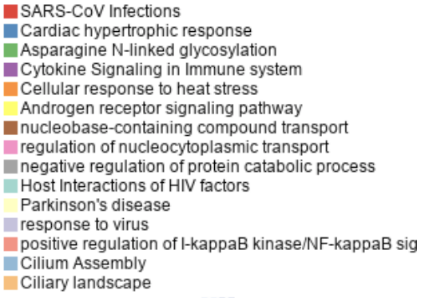
Supplementary Figure 9. Light yellow gene module found by WGCNA analysis.
Notes:
Supplementary Figure 9. Light yellow gene module found by WGCNA analysis.

Slide 10
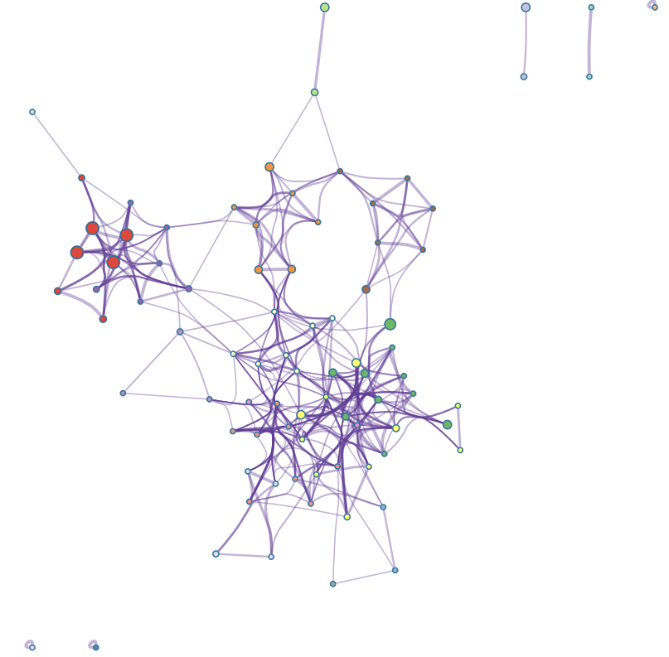
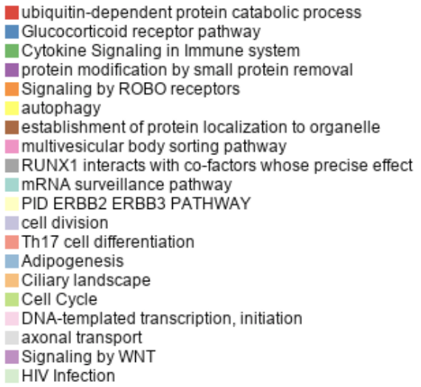
Supplementary Figure 10. Red gene module found by WGCNA analysis.
Notes:
Supplementary Figure 10. Red gene module found by WGCNA analysis.

Slide 11
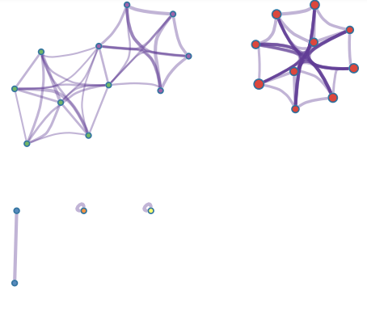
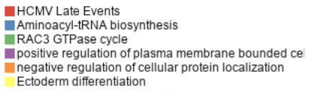
Supplementary Figure 11. Light green gene network found by WGCNA analysis.
Notes:
Supplementary Figure 11. Light green gene network found by WGCNA analysis.

Slide 12
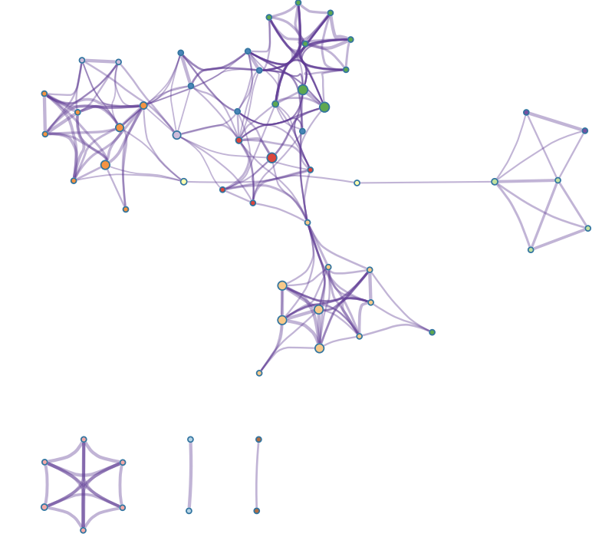
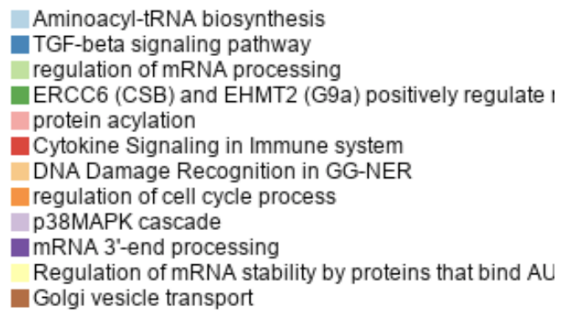
Supplementary Figure 12. Black gene module found by WGCNA analysis.
Notes:
Supplementary Figure 12. Black gene module found by WGCNA analysis.

Slide 13
Supplementary Figure 13. K-means clustering of differential alternative splicing of platelet RNA groups patients similarly to principal component analysis.
Notes:
Supplementary Figure 13. K-means clustering of differential alternative splicing of platelet RNA groups patients similarly to principal component analysis.

