Slide 1
Case report of acute myocarditis after administration of COVID-19 vaccine in Japan
August, 2021
EHJ-CR-D-21-00531

Slide 2
Introduction
✓The worldwide spread of Coronavirus disease 2019 (COVID-19) is still
not under control and vaccination in Japan started in February 2021,
albeit later than in Europe and the United States of America.
✓The COVID-19 vaccination frequently leads to minor adverse
reactions, that may be more intense after the second dose [1].
✓ Few cases of myocarditis following COVID-19 vaccination have been
recently reported.

Slide 3
Case Presentation
History and Examination Findings
✓A 26-year-old man with no previous medical history came to our hospital
complaining of acute substernal chest pain on May 21 2021, 4 days after
his second dose of BNT162b2 vaccine.
✓ECG (electrocardiogram) on arrival showed
small Q wave in II, III, aVF,
ST elevation in I, II, aVL, aVF, V4-6,
ST depression and deep negative T wave in aVR. (Figure 1)

Slide 4
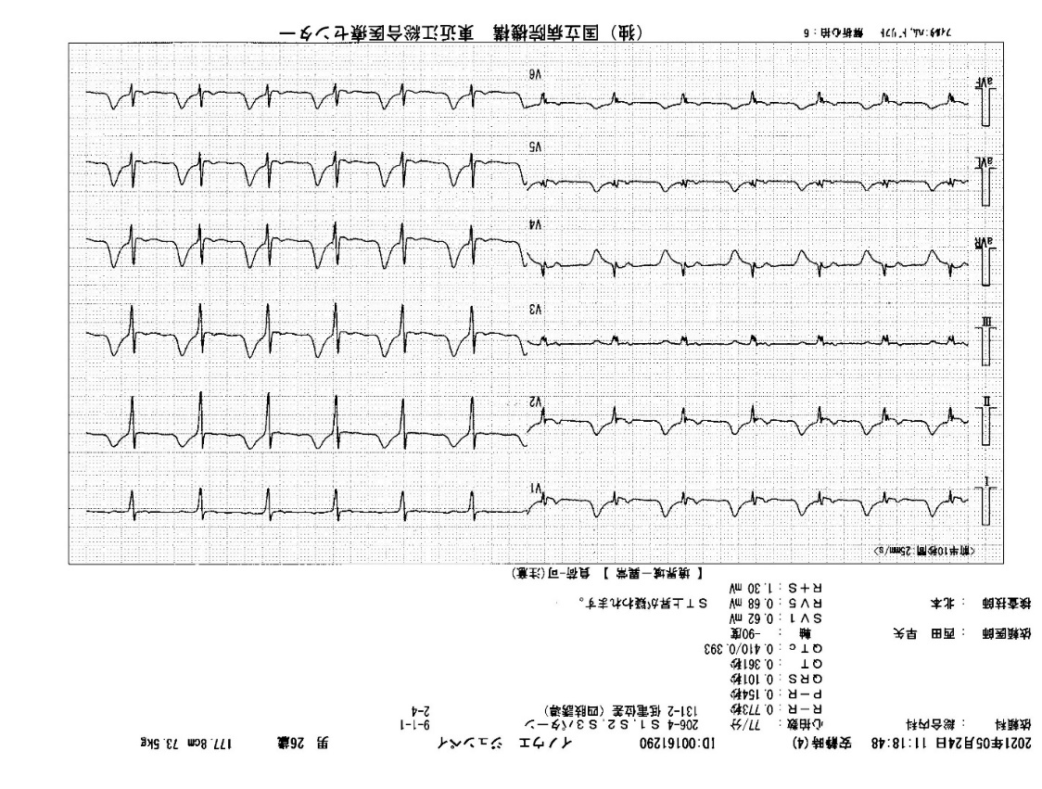
Case Presentation
Figure 1: 12 Lead ECG on presentation.

Slide 5
Case Presentation
Investigations
✓Laboratory studies revealed elevated markers of myocardial damage such as
high-sensitivity troponin I (5362.4pg/mL, referential range (RR) 0-26.2pg/mL),
Creatine Kinase (332U/L, RR 59-248U/L ), C-reactive protein (7.57mg/dL, RR 0
-0.14mg/dL ), and a negative PCR(Polymerase Chain Reaction) test for COVID-19.
✓ The plasma electrolytes and autoimmune studies were within normal
limits. Viral studies including coxsackie group B viruses and
echoviruses were all negative.
✓There were no significant findings in echocardiography, contrast-enhanced
CT(Computed Tomography) and coronary angiography.

Slide 6
Case Presentation
Examination Findings
✓Cardiac MRI (Magnetic Resonance Imaging) with gadolinium 6 days after second dose of vaccination
Short T1 inversion recovery axis image acquired along the basal short-axis view demonstrates increased subepicardial and mesocardial signal intensity (yellow arrows) of the antero-septal myocardial segments (A).
Dynamic contrast-enhanced sequence demonstrates slight elevated signals (yellow arrows) of the antero-septal myocardial segments (B).
(A)
(B)

Slide 7
Case Presentation
Examination Findings
✓Cardiac MRI with gadolinium 6 days after second dose of vaccination
Fast imaging employing steady state acquisition (FIESTA)
sequences acquired along the basal short-axis view (C)
and four-chamber view (D) demonstrate myocardial
late gadolinium enhancement (yellow arrows)
with epicardial predominance in the antero-septal,
inferior and lateral walls of the basal segment and apex.
(C)
(D)

Slide 8
Case Presentation
Management
✓The patient was given acetaminophen (400mg/day) and no steroids.
✓The patient was discharged after 4 days with resolution of symptoms and
improvement in inflammatory response and myocardial injury markers.
✓ ECGs showed partial resolution of the ST changes and a trend towards
improvement. (Figure 2)

Slide 9
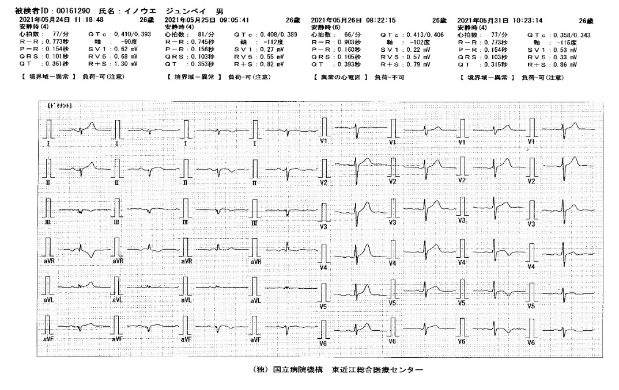
Case Presentation
Figure 2: 12 Lead ECG series.
Day1 Day2 Day3 Day8 Day1 Day2 Day3 Day8

Slide 10
Discussion
✓ The diagnosis of acute myocarditis after COVID-19 vaccination was confirmed by cardiac MRI, although no endocardial biopsy was performed. Non-invasive tests such as MRI, CT, and echocardiogram are useful for diagnosis and are of benefit to patients.
✓ The number of reports vaccine-associated myocarditis has been increasing not only in caucasian European and American populations [2] but also in Asians of Mongoloid heritage.
✓ There is a significantly higher risk of cardiac involvement from COVID-19 infection compared to COVID-19 vaccination [3].
✓ We therefore believe that COVID-19 vaccination plays an important role in herd immunity and overall provide more benefit than harm.

Slide 11
Learning Points
As COVID-19 vaccination has increased, reports of adverse reactions have also increased.
We should be aware that acute myocarditis after administration of COVID-19 vaccine may also occur even in healthy young men without immune abnormalities.
Cardiac magnetic resonance imaging is useful in the diagnosis of acute myocarditis.

Slide 12
References
1. Center for Disease Control and Prevention. Possible Side Effects After
Getting a COVID-19 Vaccine.
https://www.cdc.gov/coronavirus/2019-ncov/vaccines/expect/after.html
2. Center for Disease Control and Prevention. Myocarditis and Pericarditis
Following mRNA COVID-19 Vaccination. https://www.cdc.gov/coronavirus
/2019-ncov/vaccines/safety/myocarditis.html
3. Polack FP, Thomas SJ, Kitchin N, et al. Safety and Efficacy of the BNT162b2
mRNA Covid-19 Vaccine. N Engl J Med 2020; 383:2603-2615.
doi: 10.1056/NEJMoa2034577

