Slide 1
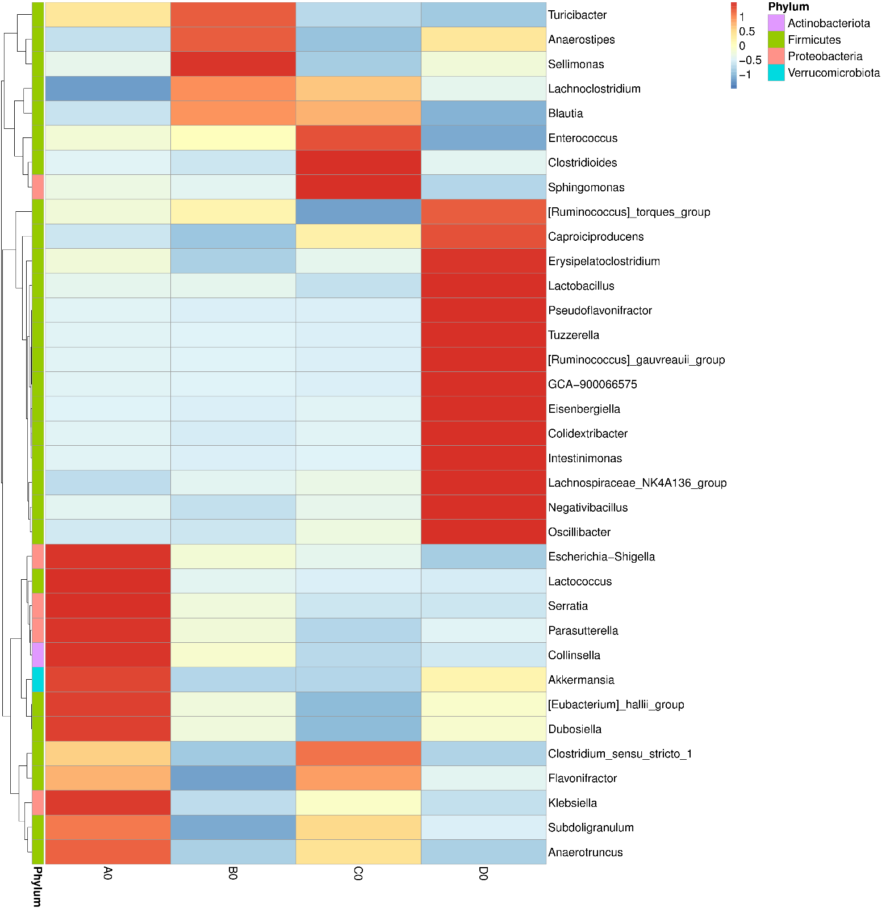
SP Control Phage SP+Phage
Figure S1. Huang, et al.

